Slide 1
Prospectus on the APPLICATION OF SPECTRAL SHAPING FOR SIMULATING NUCLEAR WEAPON ENVIRONMENTS
Lt Nick Quartemont
MS Nuclear Engineering 19M
Air Force Institute of Technology
5 September 2018

Slide 2
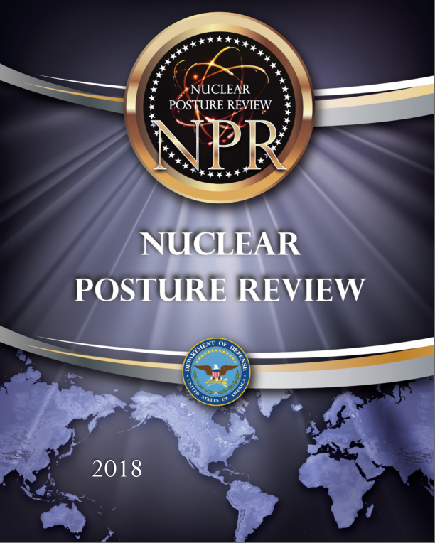
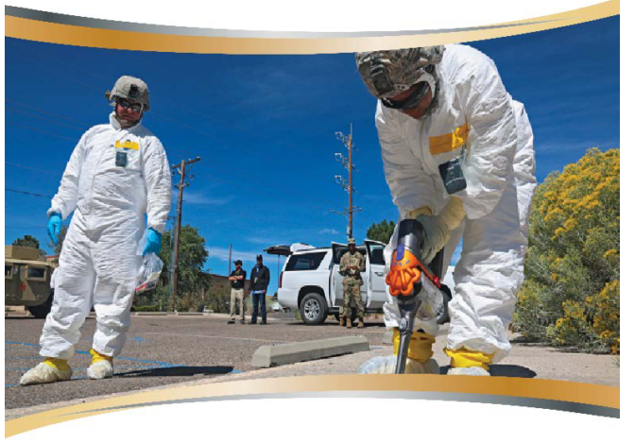
Motivation
Create spectrally accurate neutron energy flux environment for nuclear weapon testing
Nuclear weapons effects (Deterrence – Surety)
Technical Nuclear Forensics (Deterrence – Attribution)
2018 Nuclear Posture Review key efforts in countering nuclear terrorism - “deterring state support for nuclear terrorism through advanced forensics and attribution capabilities.”
Notes:
The technical nuclear forensics (TNF) community requires the ability to general representative post-detonation debris samples for training and development of attribution techniques. The generation of accurate fission product inventories in the representative debris is both extremely important for the attribution of the origin of a nuclear device and very difficult to do with existing facilities.
Additionally, an important nuclear weapon testing related mission is radiation effects on electronics in nuclear systems. The current neutron sources do not have an accurate energy or temporal distribution for the nuclear environment that nuclear systems are required to survive in certification testing. This problem is complicated further as the transmitted neutron flux through the physical environment and to the target varies significantly in energy and temporal distribution depending on the scenario and system being considered. To address this capability gap, it would be beneficial to have a testing capability with an accurate temporal profile.

Slide 3
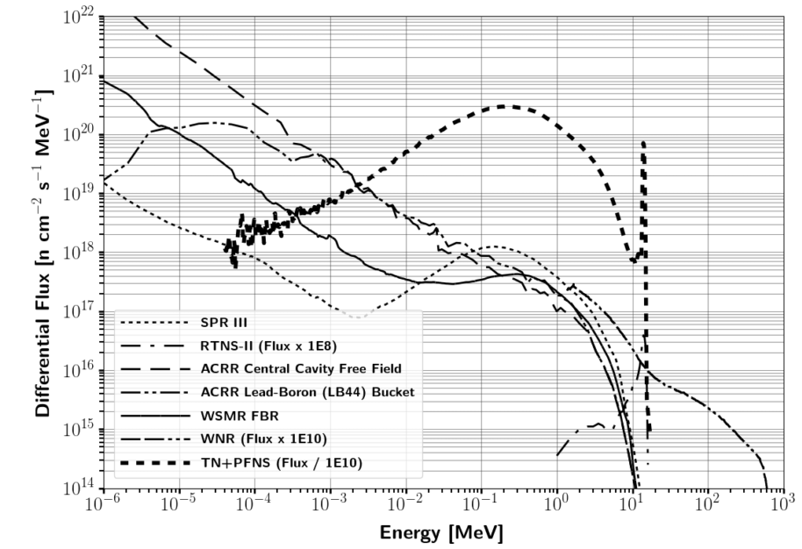
Capability gap in reproducing nuclear weapon environments
Notes:
A key consideration for testing is the neutron energy spectrum in comparison with the environment that a nuclear weapon would see or produce.
A particular spectrum of interest is the combination of a thermonuclear (TN) and prompt fission neutron spectrum (PFNS) as the present testing does not address this region to a large extent.
The vast majority of testing facilities are focused on the Watt-fission spectrum, while a few are capable of producing the 14.1 MeV TN component from the deuterium-tritium (DT) fusion process\cite{Bridgman}.
The current prompt neutron facilities available are not well suited for the TN+PFNS application testing because of the lack of high energy neutrons, or there is not a large enough flux of neutrons on target.
Several examples of testing facilities for prompt neutrons outlined in Table \ref{tab:NWECap} are the Sandia Pulsed Reactor III (SPR), Sandia Annual Core Research Reactor (ACCR), White Sands Missile Range (WSMR) Fast Burst Reactor (FBR), and the Los Alamos National Laboratory (LANL) Rotating Target Neutron Source (RTNS).
The differential spectral profile of these sources compared to a notional TN+PFNS is shown in Figure \ref{fig:CompSource}. the LANL Weapons Neutron Research facility (WNR).

Slide 4
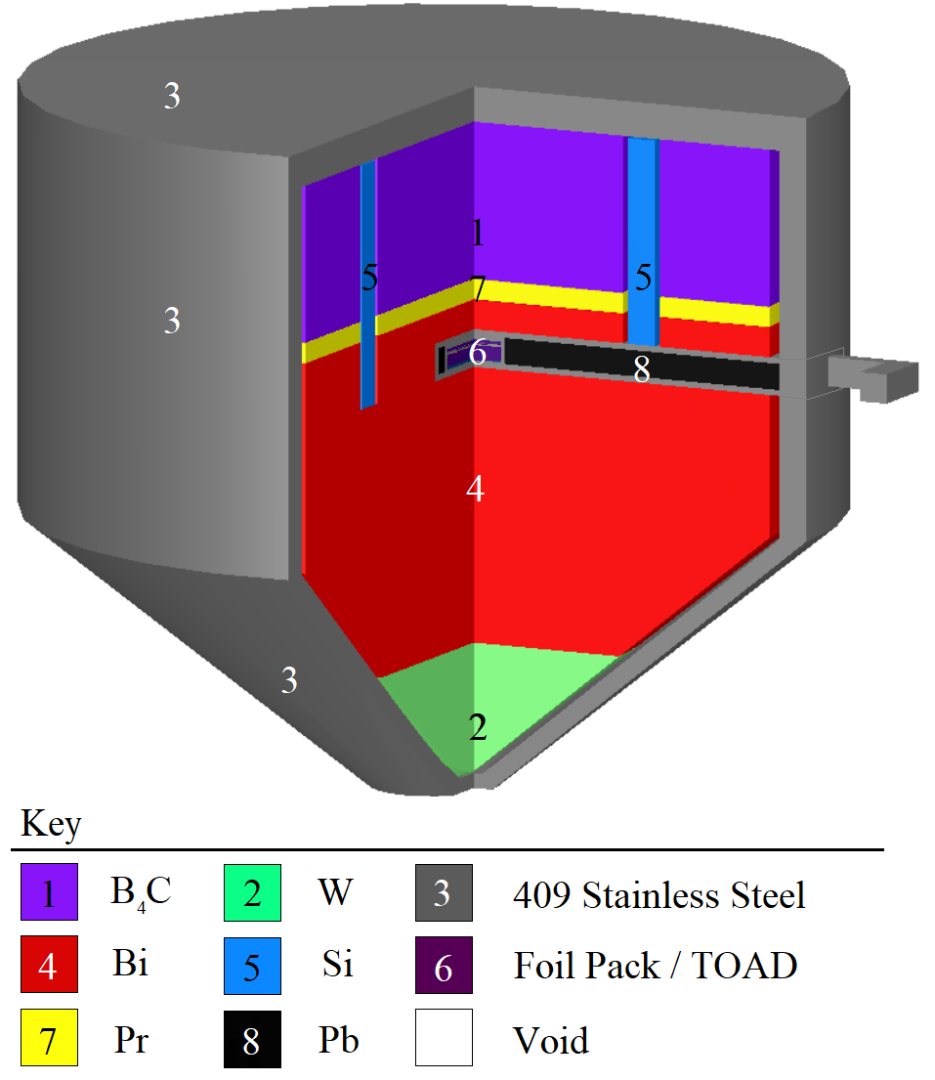
Previous Work
UC – Berkeley and LLNL developed energy tuning assembly (ETA).
Coeus metaheuristic optimization software package
Validation test at LBNL 88-Inch Cyclotron

Slide 5
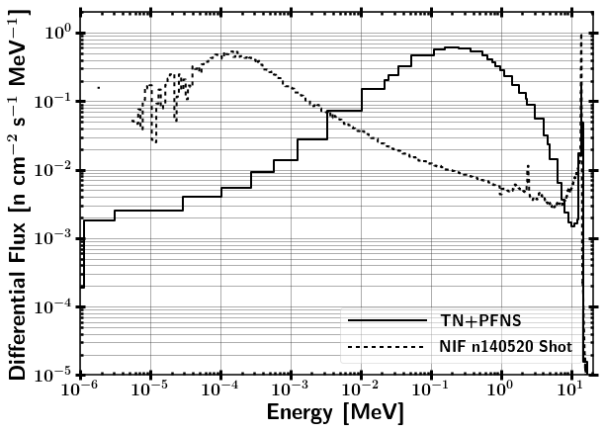
Research Objective
Can an accurate neutron energy distribution expected from a "typical" thermonuclear or boosted nuclear weapon detonation be produced using spectral modification at the NIF?

Slide 6
Research Problem (ETA)
FY2019 NIF Shot (ETA)
Quantify the impact of nuclear data covariances of the simulated results for the neutron energy spectrum, foil activation rates, and fission product production rates
Design a foil activation diagnostic pack to provide better resolution in the epithermal neutron energy range
Prioritize and estimate production of fission products for radio-chemical analysis using recently published data

Slide 7
Questions and Hypothesis (ETA)
2019 ETA Fission Product Experiment
What is the impact of nuclear data covariance on the simulated results?
Does the activation foil pack have sufficient coverage of the neutron spectrum to be used for unfolding?

Slide 8
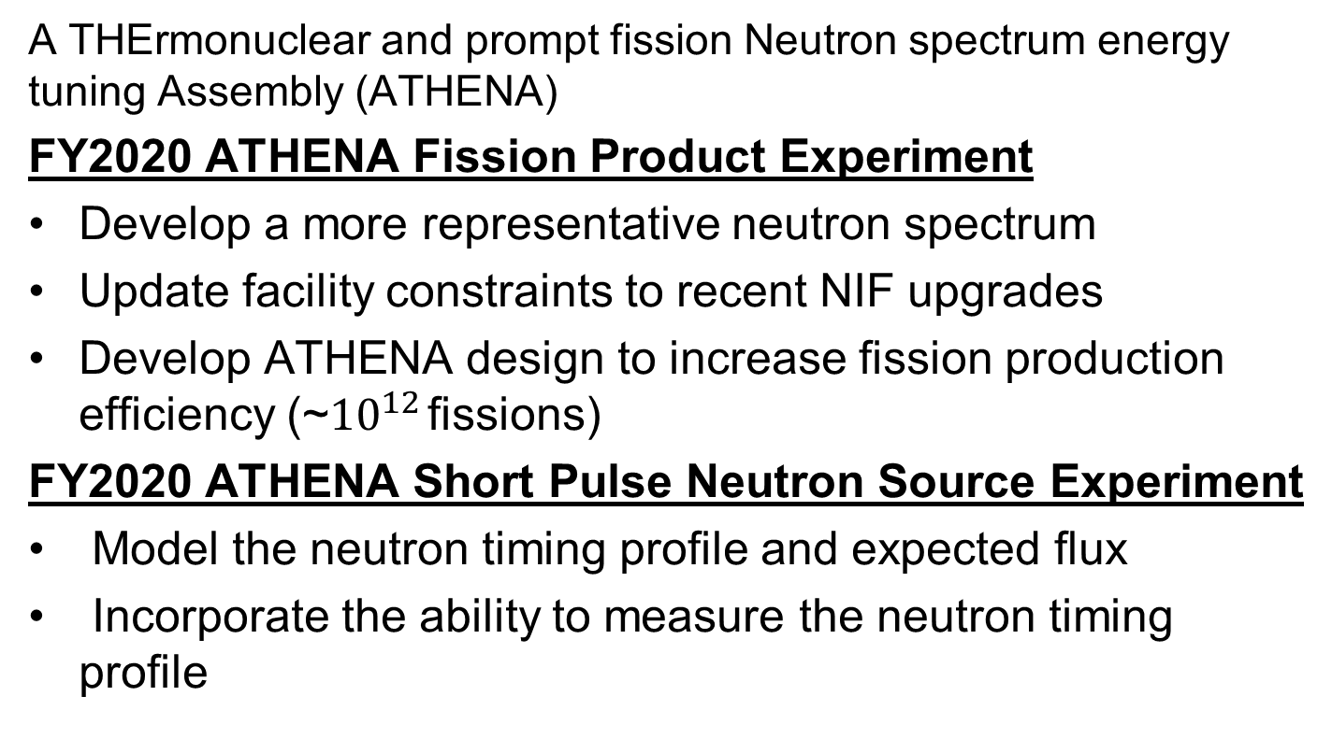
Research Problem (ATHENA)
A THErmonuclear and prompt fission Neutron spectrum energy tuning Assembly (ATHENA)
FY2020 ATHENA Fission Product Experiment
Develop a more representative neutron spectrum
Update facility constraints to recent NIF upgrades
Develop ATHENA design to increase fission production efficiency (~${10}^{12}$ fissions)
FY2020 ATHENA Short Pulse Neutron Source Experiment
Model the neutron timing profile and expected flux
Incorporate the ability to measure the neutron timing profile

Slide 9
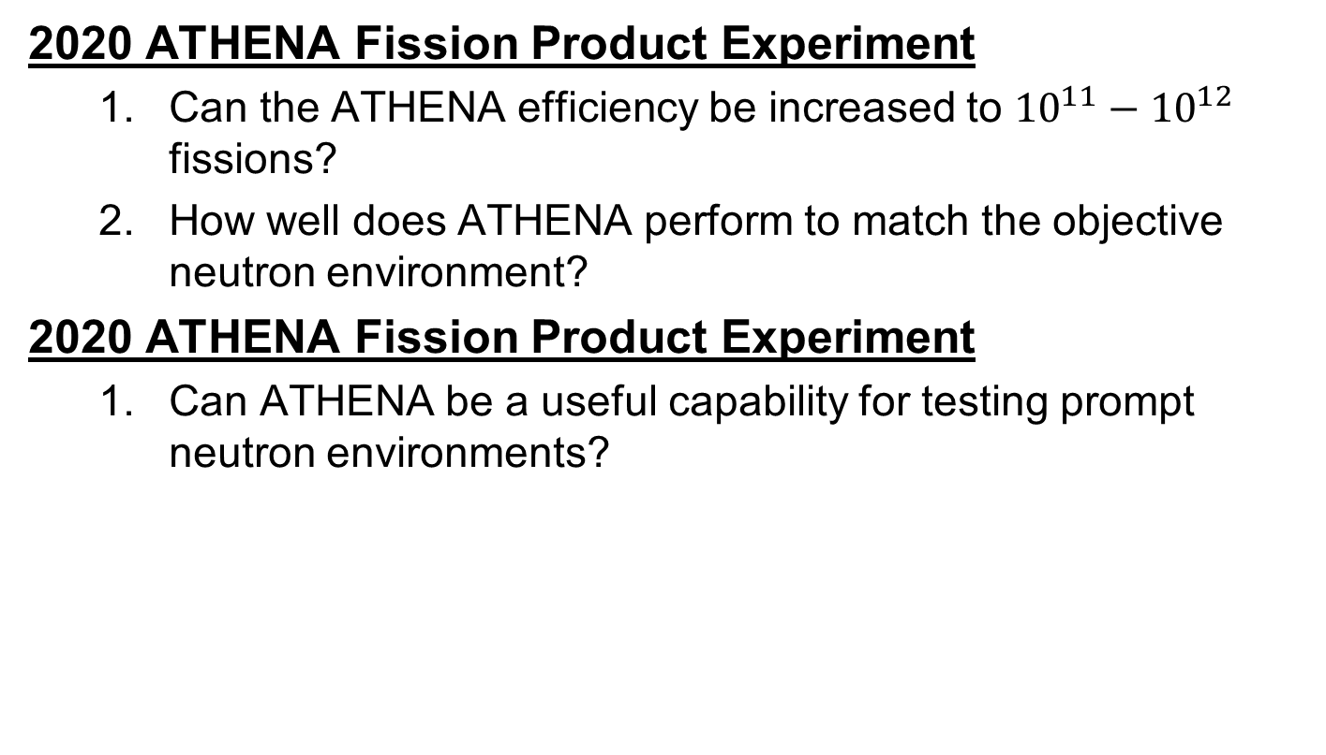
Questions and Hypothesis (ATHENA)
2020 ATHENA Fission Product Experiment
Can the ATHENA efficiency be increased to ${10}^{11}−{10}^{12}$ fissions?
How well does ATHENA perform to match the objective neutron environment?
2020 ATHENA Fission Product Experiment
Can ATHENA be a useful capability for testing prompt neutron environments?

Slide 10
Assumptions and Limitations
Nuclear data
Unclassified nuclear weapon spectrum
NIF neutron source
TN+PFNS
Nuclear weapon environment
Not analyzed at weapon temperatures
No temporal dependence
No fractionation

Slide 11
Theory
Neutron Interactions with Matter
Fission Theory / Fission Products
Monte Carlo Neutron Transport
Foil Activation
Neutron Energy Spectrum Unfolding
Optimization
Nuclear Data Covariance
* Bold indicates that it is included in this brief

Slide 12
Fission Process
Fission fragments (prompt decay) → Fission Products

Slide 13


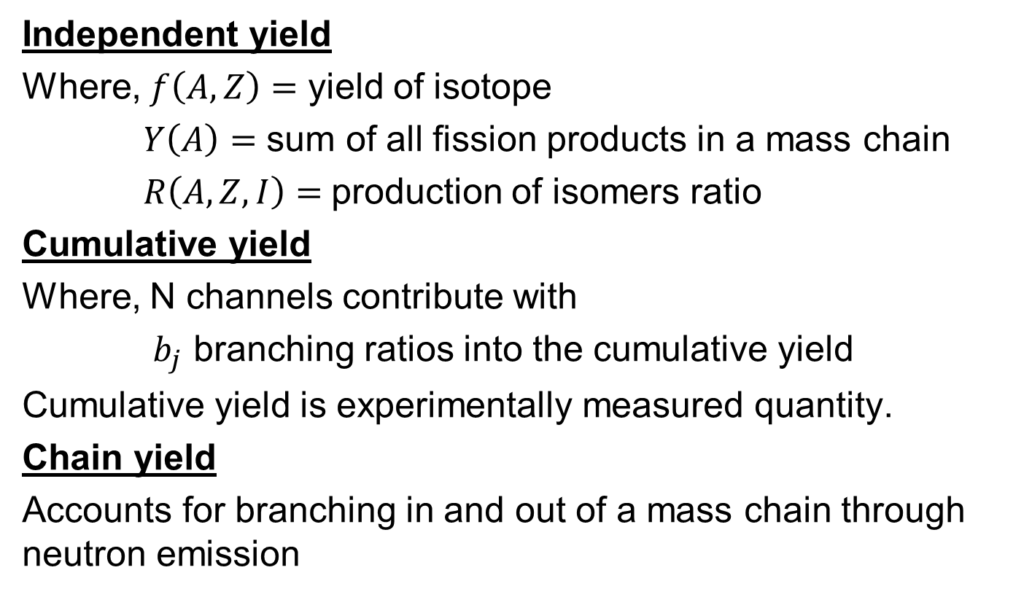
Fission Yields
Independent yield
Where, $f\left(A,Z\right)=$ yield of isotope
$Y\left(A\right)=$ sum of all fission products in a mass chain
$R\left(A,Z,I\right)=$production of isomers ratio
Cumulative yield
Where, N channels contribute with
$b_{j}$ branching ratios into the cumulative yield
Cumulative yield is experimentally measured quantity.
Chain yield
Accounts for branching in and out of a mass chain through neutron emission

Slide 14
Fission Yields
U-235 thermal (n,f)

Slide 15
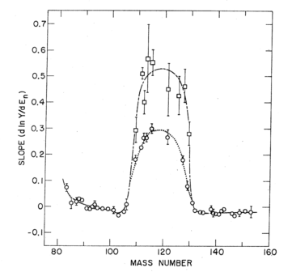
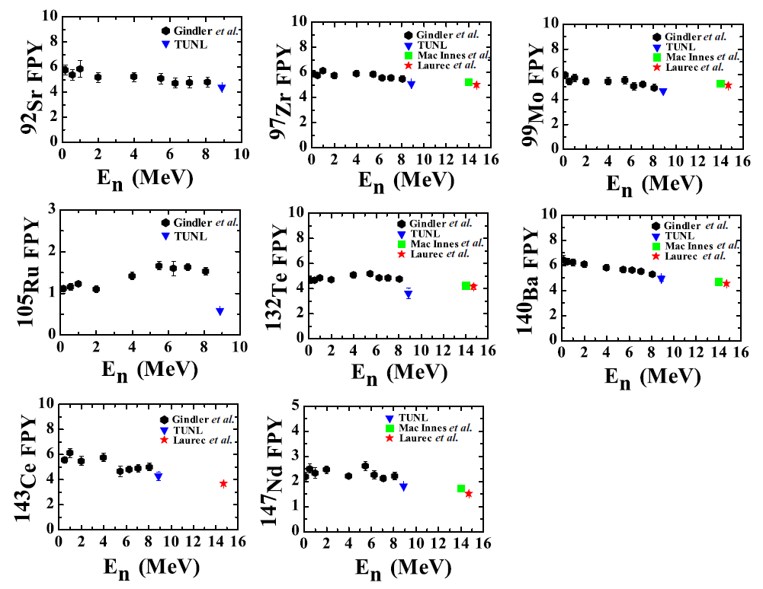
Fission Product Estimation
General Observables of Fission (GEF)
Fit to model (Nagy fits)

Slide 16


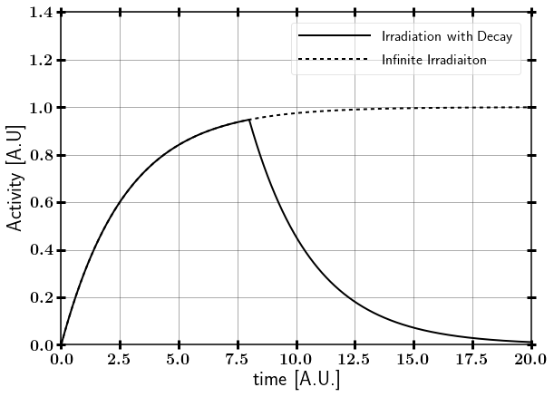


Foil Activation
Saturation Activity
Activity Post Irradiation
$t_{i} −$ irradiation time
Short pulse approximation
(Applicable to NIF)

Slide 17


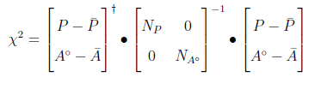
Unfolding Solution Methods
Matrix inversion
Least-square spectral adjustment (ex. PNNL STAYSL)
Incorporates uncertainty and an can incorporate covariance
Requires guess spectrum
Stochastic methods
P = Neutron flux and nuclear data
A = Activity
N =Covariance

Slide 18
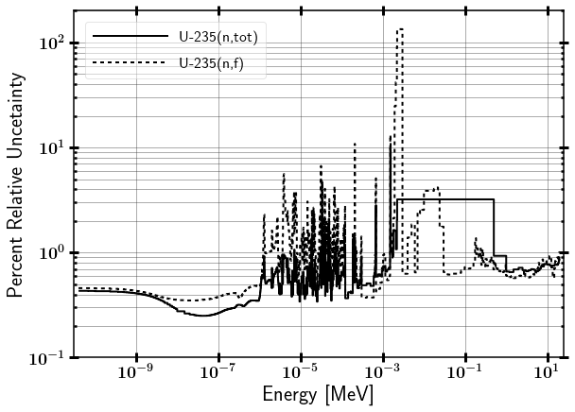
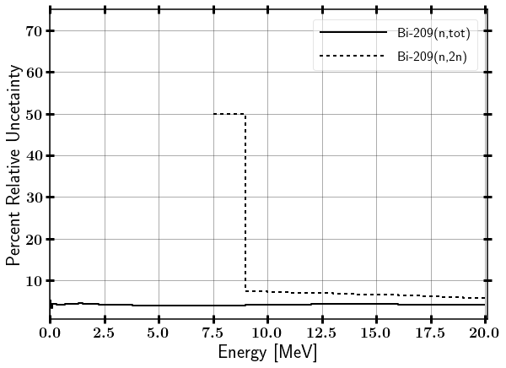
Nuclear Data Uncertainty

Slide 19
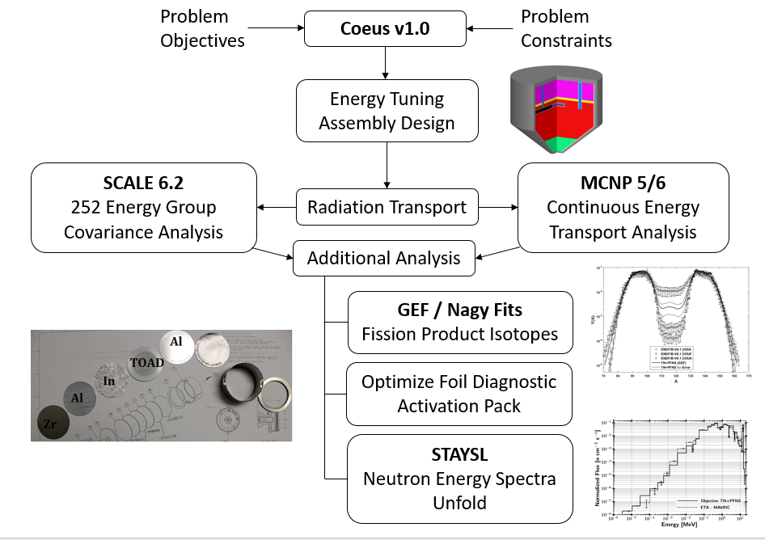
Methodology

Slide 20
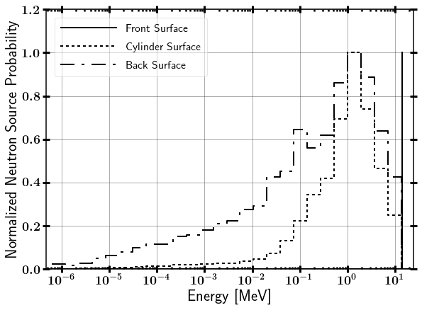
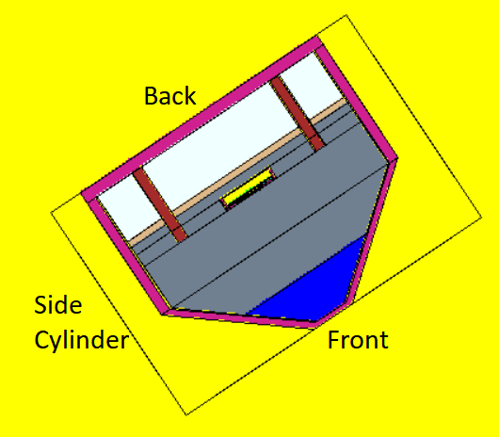
SCALE source from MCNP SSR

Slide 21
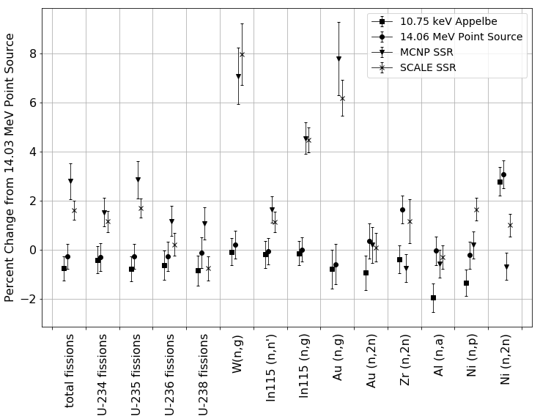
Importance of source characterization

Slide 22
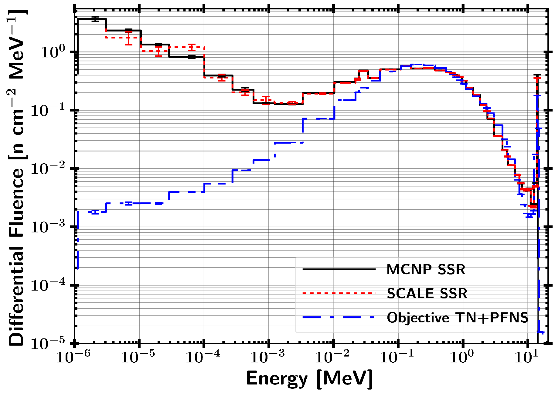
Importance of source characterization

Slide 23
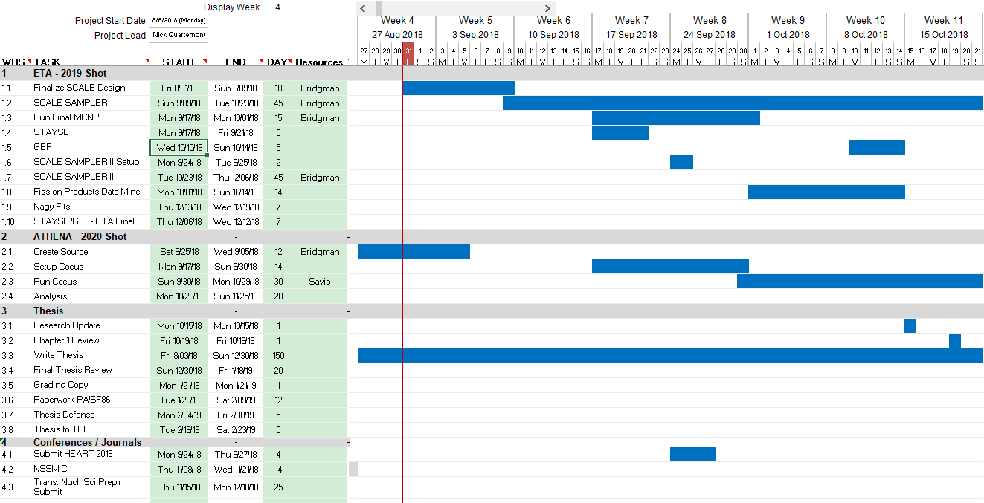
Research Schedule
Schedule risk: Computational resources and changing model

Slide 24
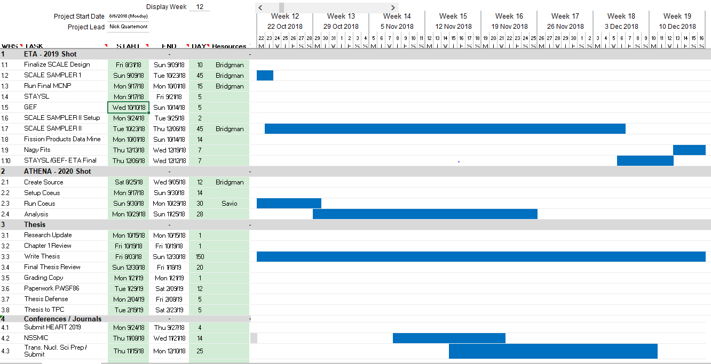
Research Schedule

Slide 25
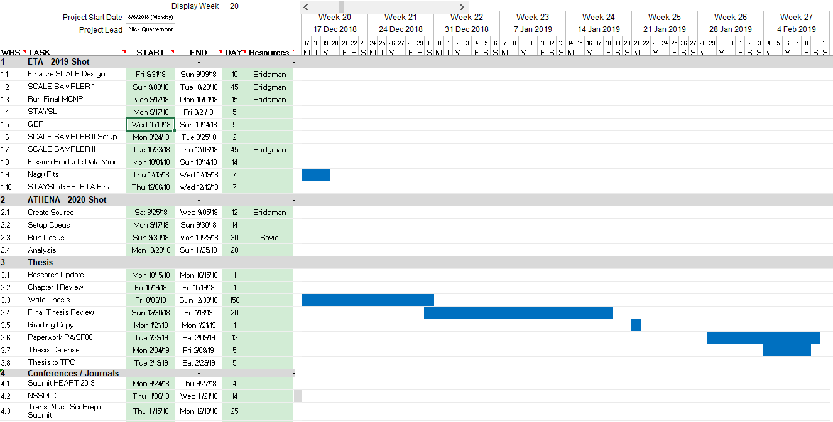
Research Schedule

Slide 26
Possible PHD follow on research areas
Analyze the actual ETA Experiment results (2019)
Incorporate fractionation of fission debris, work into ATHENA (2020 experiment).
Neutron flux unfolding technique using pre-built SCALE libraries

Slide 27
BACKUPS

Slide 28
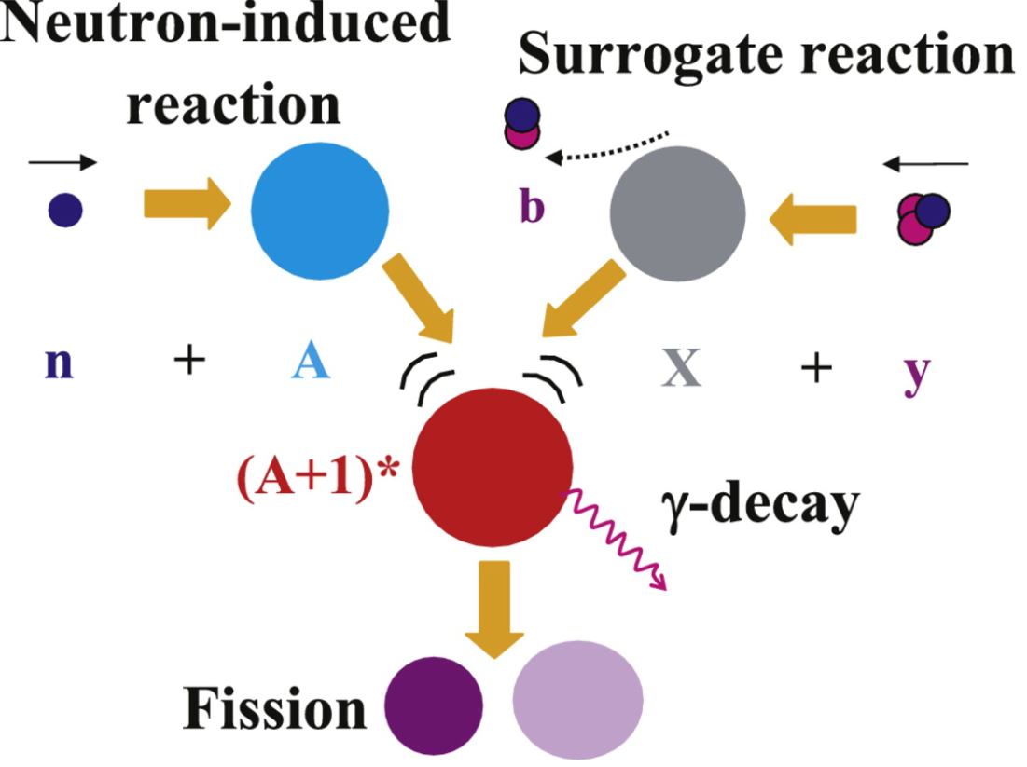
Options to Generate Representative Nuclear Weapon Environments
Synthetic Fission Debris
Sample doping
Direct production using fission converters
Surrogate methods
Spectral modification
Neutron Effects on Electronics
Utilize existing sources
Models
Surrogate charged particle reactions

Slide 29
Overview
Introduction and Background
Theory
Methodology
Research Schedule
Future work

Slide 30
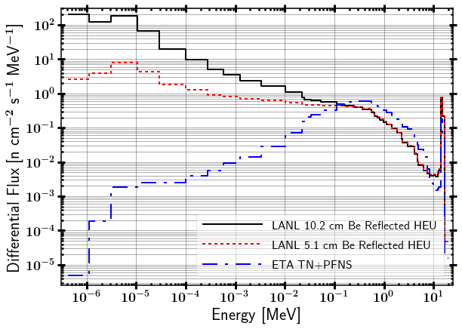
ATHENA Spectrum

Slide 31
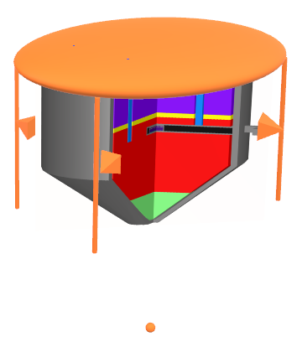
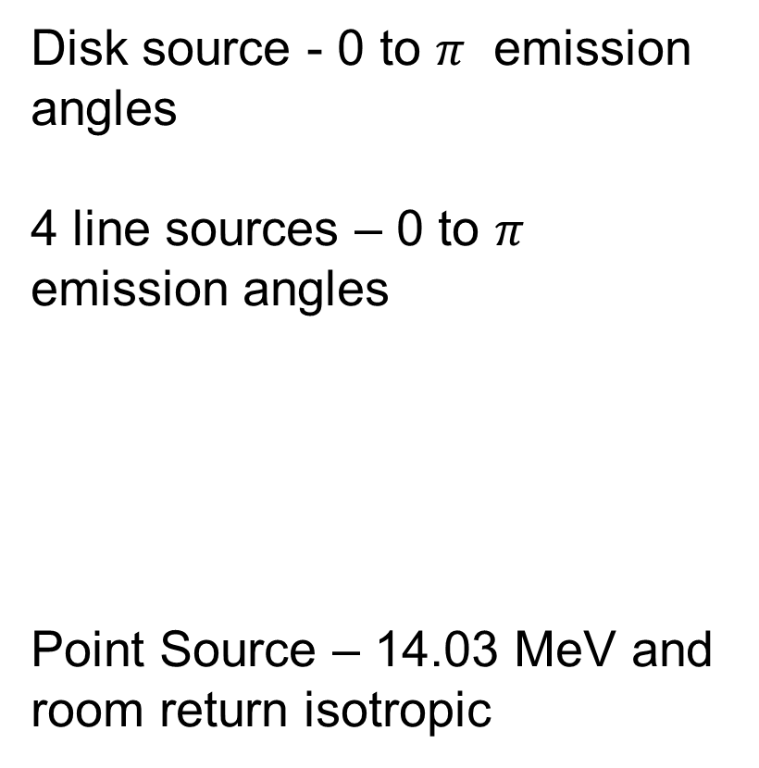
SCALE source from MCNP SSR
Disk source - 0 to $π$ emission angles
4 line sources – 0 to $π$ emission angles
Point Source – 14.03 MeV and room return isotropic

Slide 32
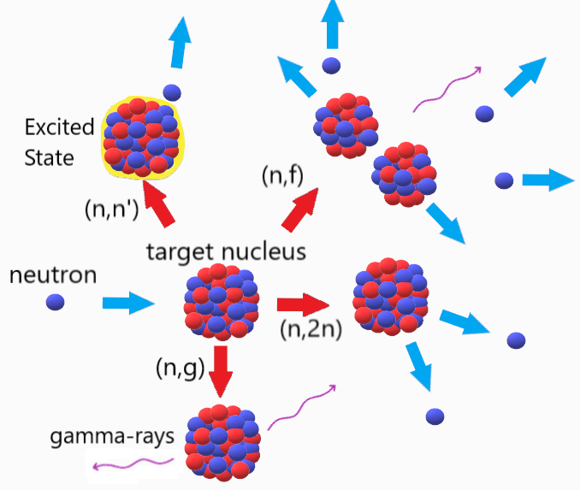
Neutron interactions relevant to ETA design

Slide 33
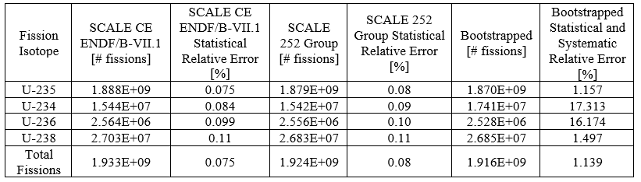
HEU Foil Fissions

Slide 34
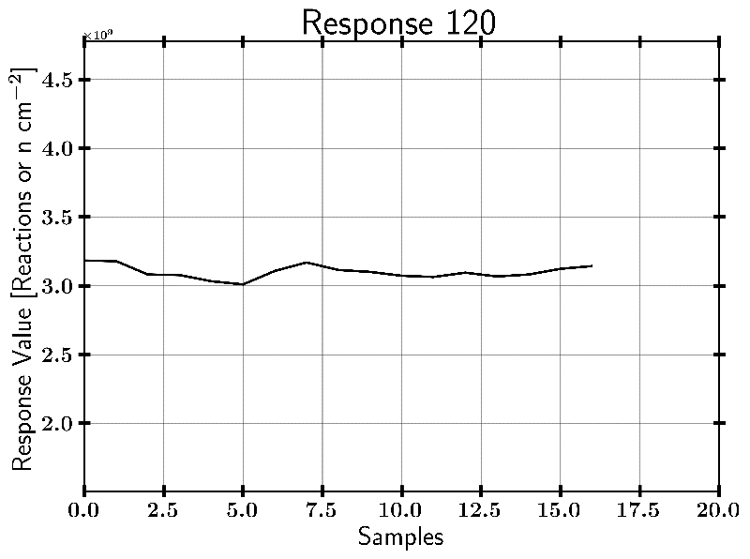
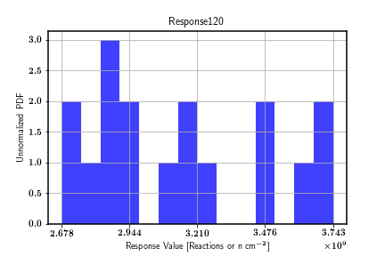
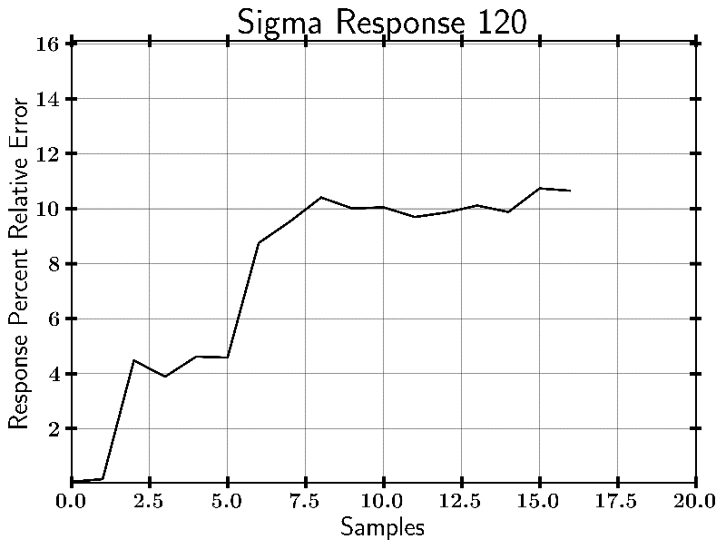
In-115 (n,g) Example Case
Output from SAMPLER
OLD RESULTS: NOT USING SSR
***16 SAMPLER Cases, results not converged

Slide 35
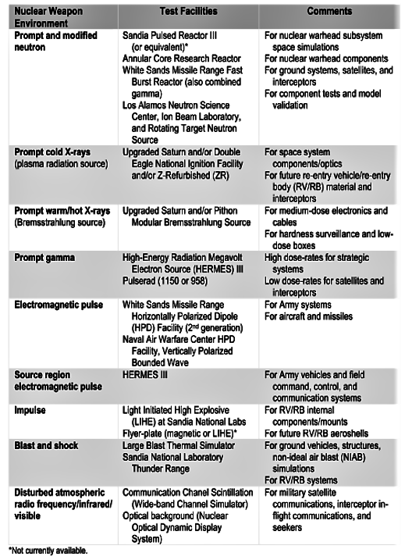
Scope of Nuclear Weapons Effects Testing Simulators
Notes:
\ Representative nuclear weapons system and effects testing is carried out through various organizations in the Department of Energy (DOE), Department of Defense (DOD), and supporting organizations. The scope of the testing sites is incredibly wide, ranging from radio frequency communications to the prompt gamma and neutron emissions following a nuclear event. A summary of some of the nuclear weapons effects testing simulation and facility capabilities is shown in Table \ref{tab:NWECap}.

Slide 36
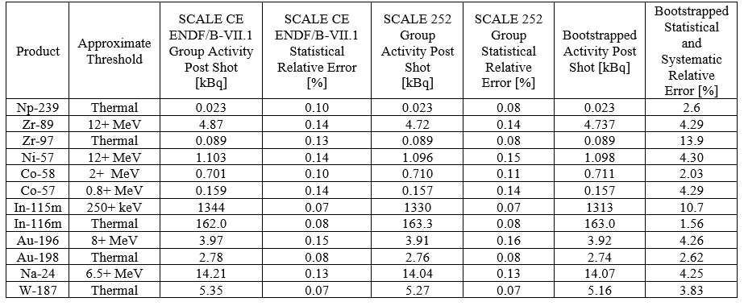
Foil Diagnostic Activation Pack
Nuclear data covariance increases the uncertainty in the results!
Notes:
Activities are on the order of what is needed for counting experiments
Foils can be counted in a High Purity Germanium Detector (HPGe)
Large increase in uncertainty based on reaction data uncertainty.

Slide 37
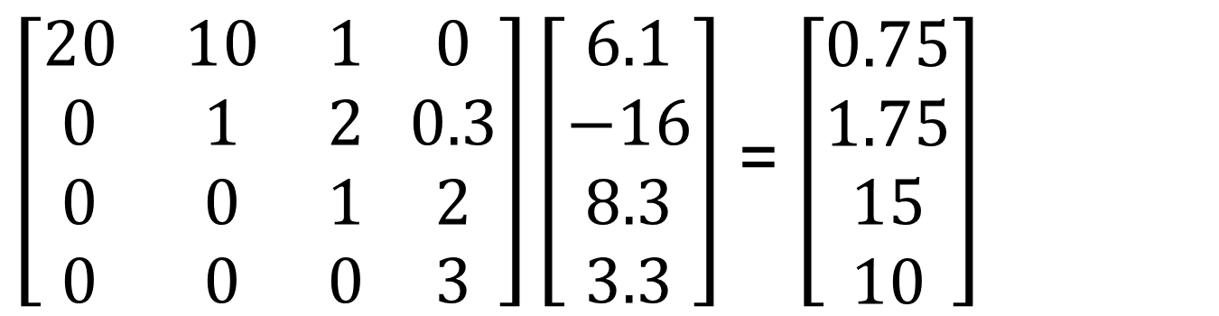
Neutron Flux Unfolding
If you knew everything… it is just doing a matrix inversion of the reaction group averaged cross-section.
Reaction Matrix [cm^2] Flux [n/cm^2-s] Reaction Rate [1/s]
(n,g)
(n,n’)
(n,2n)
(n,2n)
$\left[\begin{matrix}20 & 10 & 1 \\ 0 & 1 & 2 \\ 0 & 0 & 1 \\ 0 & 0 & 0\end{matrix} \begin{matrix}0 \\ 0.3 \\ 2 \\ 3\end{matrix}\right]\left[\begin{matrix}6.1 \\ −16 \\ 8.3 \\ 3.3\end{matrix}\right]$ = $\left[\begin{matrix}0.75 \\ 1.75 \\ 15 \\ 10\end{matrix}\right]$
Does not work because:
Measurement Error
Too broad of bin structure
Not enough reactions
Adding too many foils to create a large bin structure is counter to being optically thin

