Slide 1
DEVELOPMENT OF SURROGATE NUCLEAR WEAPON ENVIRONMENTS CAPABILITIES AT THE NIF
Capt Nick Quartemont
MS Nuclear Engineering 19M
Air Force Institute of Technology
January 15th, 2019

Slide 2
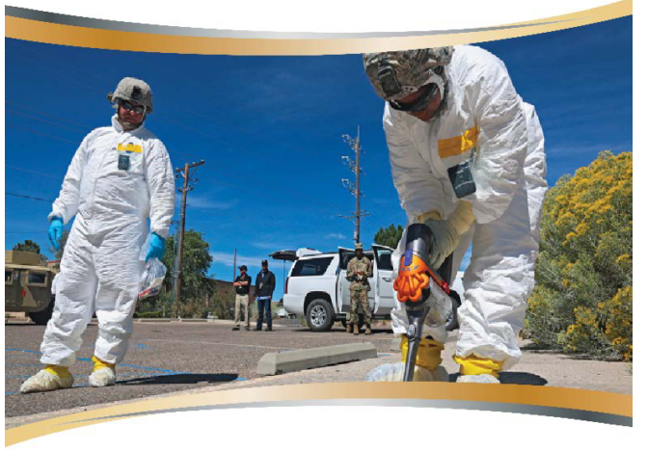
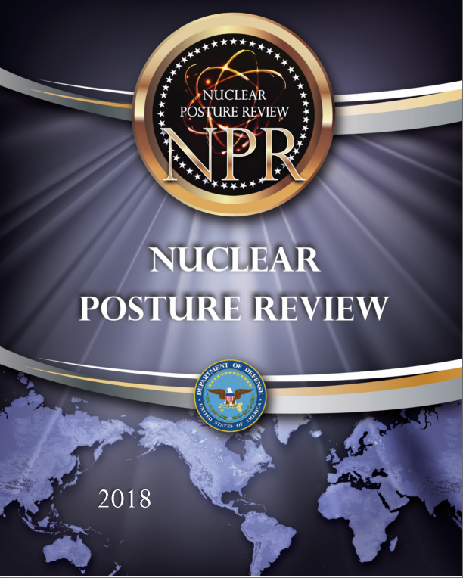
Motivation
Create accurate surrogate nuclear weapon neutron environment
Addresses deterrence and non-proliferation capability gaps:
Attribution
Certification and testing
2018 Nuclear Posture Review key efforts in countering nuclear terrorism - “deterring state support for nuclear terrorism through advanced forensics and attribution capabilities.”
Notes:
The technical nuclear forensics (TNF) community requires the ability to general representative post-detonation debris samples for training and development of attribution techniques. The generation of accurate fission product inventories in the representative debris is both extremely important for the attribution of the origin of a nuclear device and very difficult to do with existing facilities.
Additionally, an important nuclear weapon testing related mission is radiation effects on electronics in nuclear systems. The current neutron sources do not have an accurate energy or temporal distribution for the nuclear environment that nuclear systems are required to survive in certification testing. This problem is complicated further as the transmitted neutron flux through the physical environment and to the target varies significantly in energy and temporal distribution depending on the scenario and system being considered. To address this capability gap, it would be beneficial to have a testing capability with an accurate temporal profile.

Slide 3
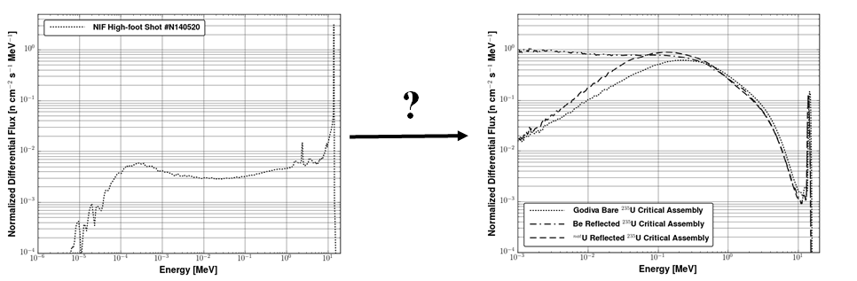
Research Objectives and Capability Development
Problem: U.S. lacks broad spectrum neutron source capable of reproducing full range of nuclear weapons environments
Solution: Develop a capability to modify existing facilities for cost-effective, repeatable solution
?
Future Work: Accepted 2020 shot at NIF to improve objective spectrum, increase number of fissions, and move towards operational capability
BLUF: ▪ Removed 40-60% error intrinsic to current methods
▪ Significantly expanded synthetic debris production range

Slide 4
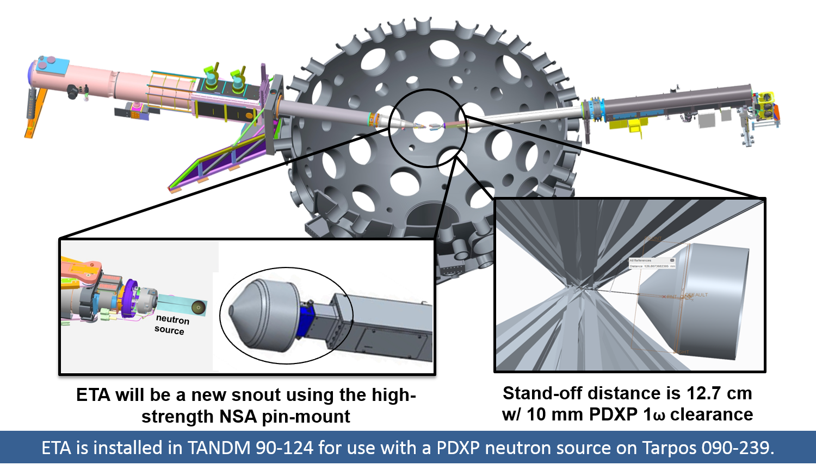
Experimental Overview
Q4 FY2019 Experiment
Highly enriched uranium foil – Fission product production
Activation foil set – Infer neutron flux with reaction unfolding techniques

Slide 5
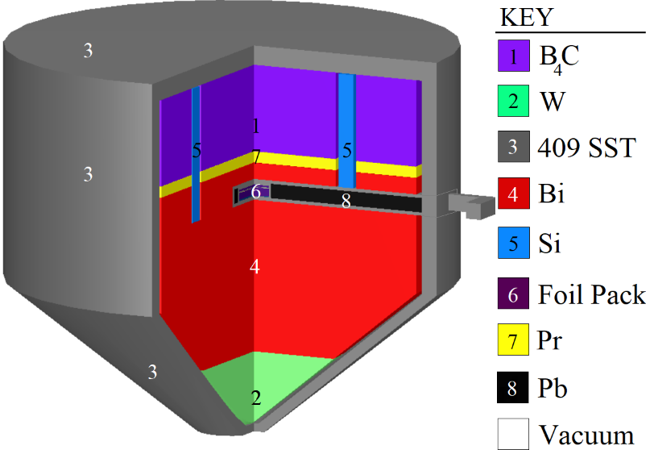
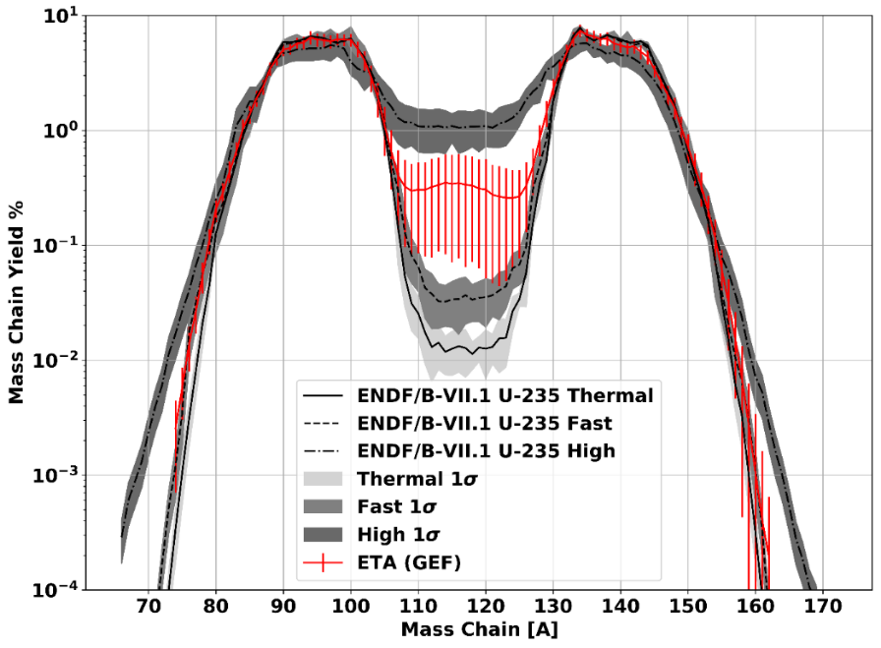
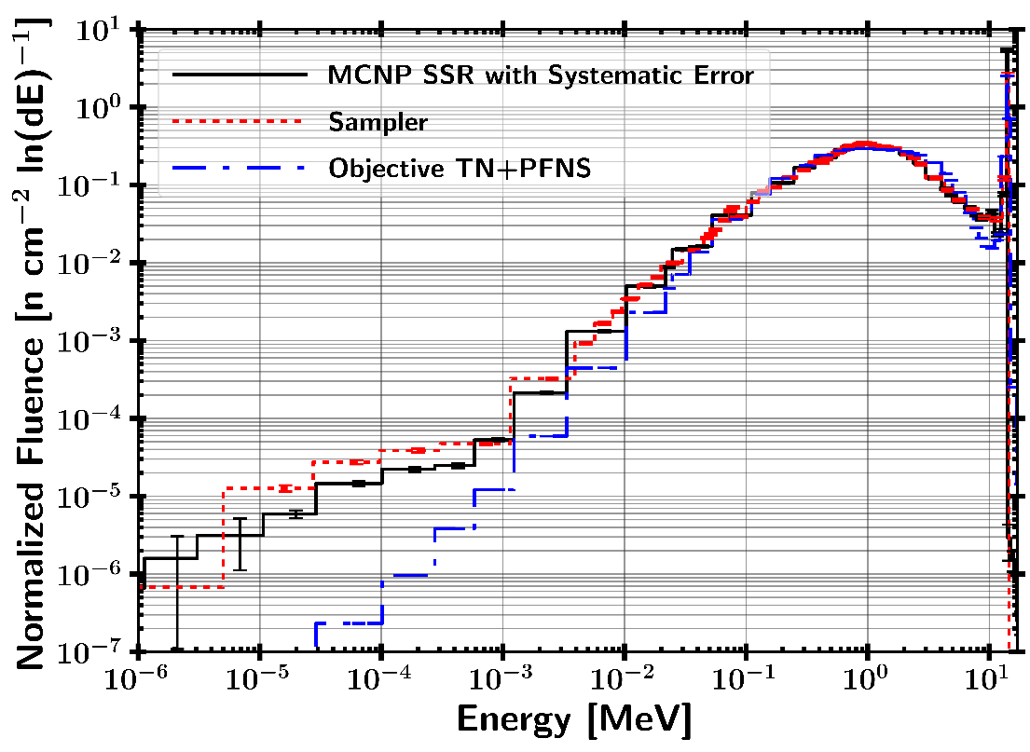
ETA Modeled Performance
Notes:
ETA created with the Coeus v1.0 metaheuristic optimization software package
Objective thermonuclear and prompt fission neutron spectrum (TN+PFNS).
Input spectrum NIF D-T fusion
Optimize flux in highly enriched uranium (HEU) foil adjacent to Target Option Activation Device (TOAD)
Base of cone originally 6 cm from neutron source (moved to 15 cm)

Slide 6
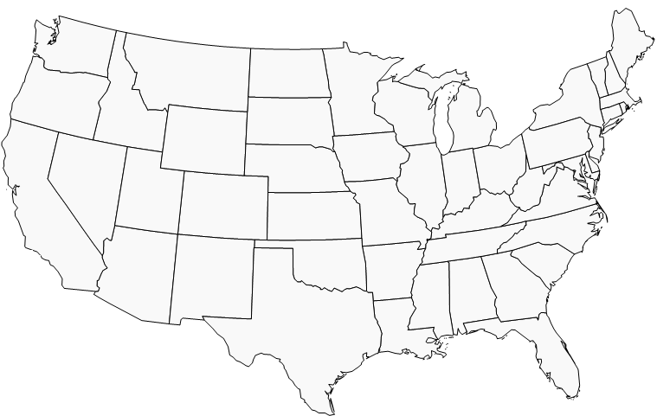








Collaboration / Resources
Nuclear Weapons Courses (NENG 605, 631, 635)
Nuclear Forensics Courses (NENG 680, 880)
HPC (DSRC + Bridgman)
ETA Design and Analysis
Custom ETA Optimization Tools (COEUS)
88” Cyclotron
NIF
Radio-chemistry
Mechanical Support
HPC Support (Savio)
Funding Support
Technical Guidance
Real World Application
Funding Support

Slide 7
Conclusions
ETA will provide experimental data to further enable post-detonation attribution through enhanced technical nuclear forensics
The path forward includes improved capability development leveraging DoD HPC resources, AFIT developed custom AI optimization algorithms, and cutting edge uncertainty quantification
Partnerships with national laboratories (LLNL) and universities (UC-Berkeley) allowed access to cutting edge facilities
AFIT provides a academic coursework involving nuclear weapon effects and forensics that uniquely prepares students to engage in this research across all classification levels

Slide 8

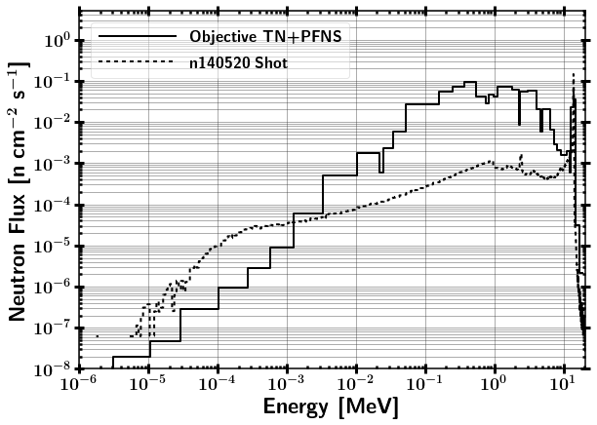
Novel Energy Tuning Assembly Design
Thermonuclear and Prompt Fission Neutron Spectrum (TN+PFNS)
NIF Source
Notes:
ETA created with the Coeus v1.0 metaheuristic optimization software package
Objective thermonuclear and prompt fission neutron spectrum (TN+PFNS).
Input spectrum NIF D-T fusion
Optimize flux in highly enriched uranium (HEU) foil adjacent to Target Option Activation Device (TOAD)
Base of cone originally 6 cm from neutron source (moved to 15 cm)

Slide 9

Energy Tuning Assembly Modeled Performance
Notes:
ETA created with the Coeus v1.0 metaheuristic optimization software package
Objective thermonuclear and prompt fission neutron spectrum (TN+PFNS).
Input spectrum NIF D-T fusion
Optimize flux in highly enriched uranium (HEU) foil adjacent to Target Option Activation Device (TOAD)
Base of cone originally 6 cm from neutron source (moved to 15 cm)

Slide 10
Collaboration / Resources
AFIT
Bridgman Cluster (MCNP / SCALE)
Nuclear Weapons Courses Sequence
Nuclear Forensics Courses
Sponsors
AFTAC
DTRA
DHS
NNSA
Partnerships
LLNL/NIF
UC-Berkeley / Savio HPC
(MCNP / SCALE / COEUS)

