Slide 1
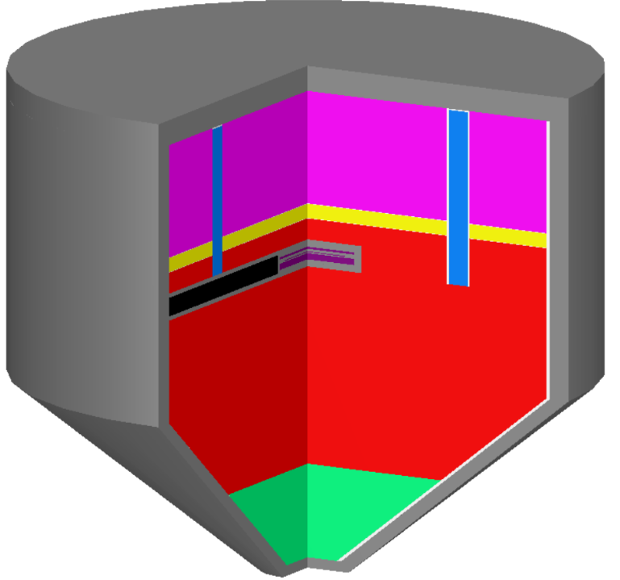
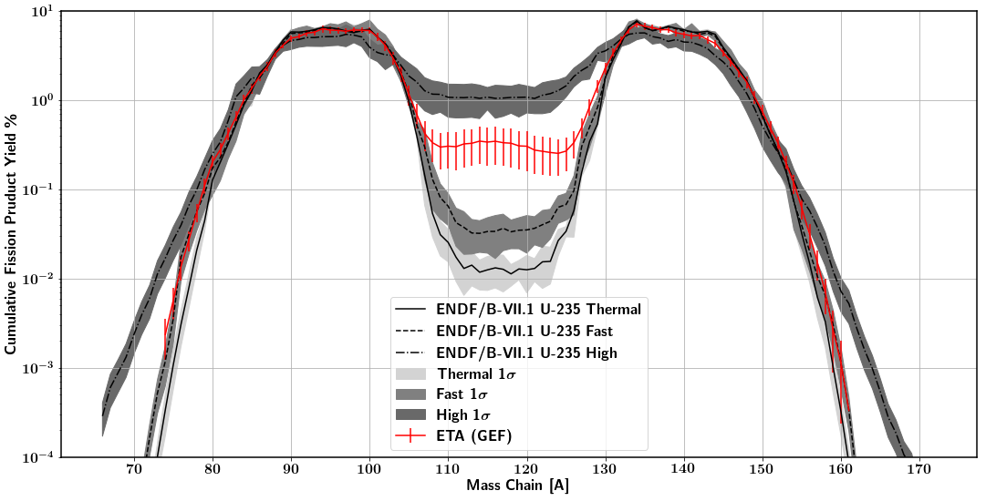
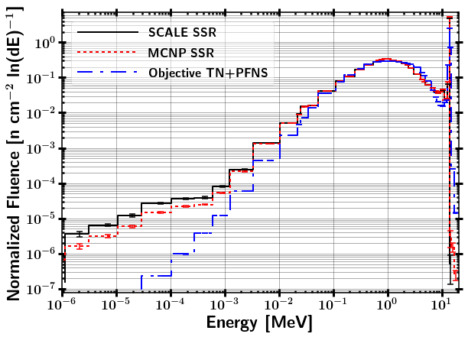
Problem Objectives
Coeus v1.0
Problem Constraints
Energy Tuning Assembly Design
SCALE 6.2
252 Energy Group Covariance Analysis
MCNP 5/6
Continuous Energy Transport Analysis
Radiation Transport
Additional Analysis
GEF / Nagy Fits
Fission Products
Optimize Foil Diagnostic Activation Pack
STAYSL
Neutron Energy Spectra Unfold

