Slide 2
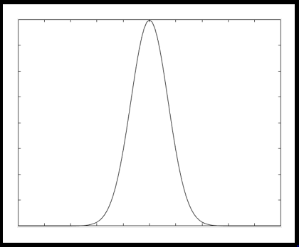
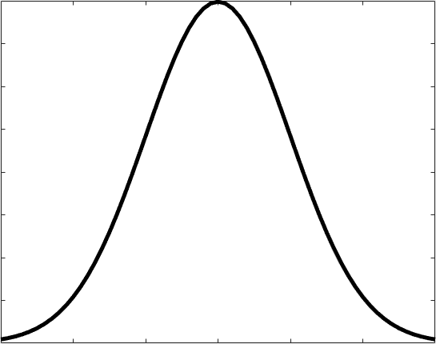
SCALE Sampler Module (Neutron Transport)
Unperturbed
Response
N Sampled Responses with Perturbed Nuclear Data
IRDFF Nuclear Data Covariance
Perturbation
Combine with Statistical Bootstrapping
Continuous Energy Statistical Uncertainty
Final response with statistical, neutron transport, and reaction cross-section uncertainties
2

