Slide 1
Things to Know
Capt Nick Quartemont
MS Nuclear Engineering 19M
Air Force Institute of Technology
29 Jan 2019

Slide 2
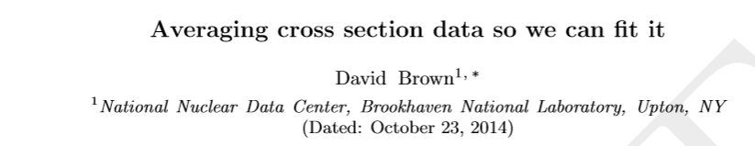
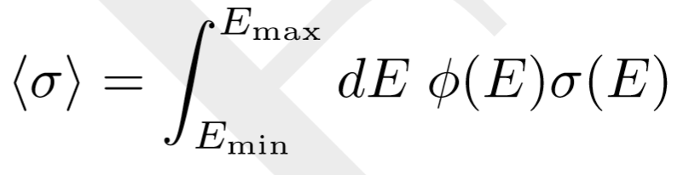
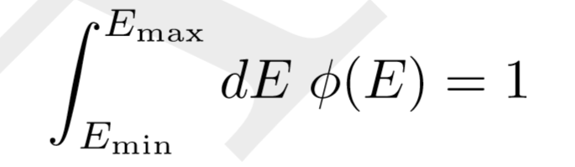
Cross-section weighting Functions
Also applies to group cross-section library creation

Slide 3
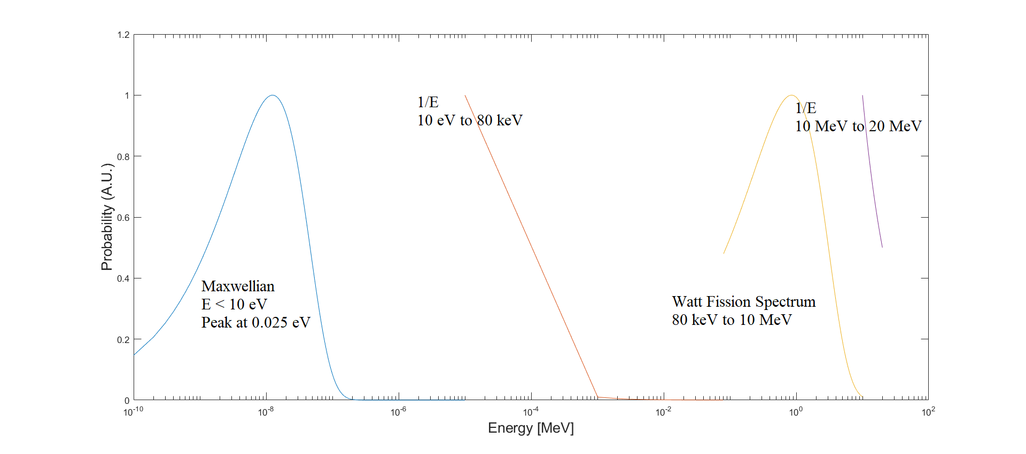
Multi-group Cross-section Libraries Weighting Functions

Slide 4
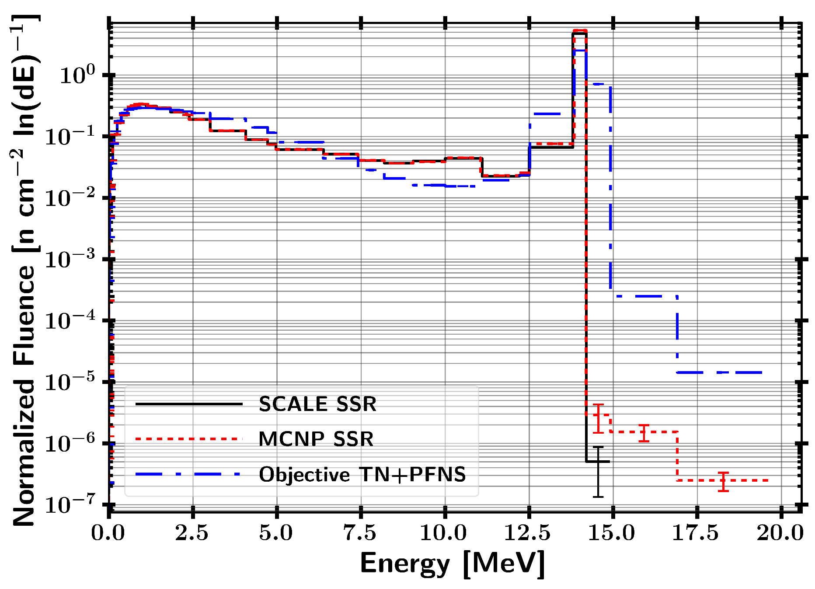
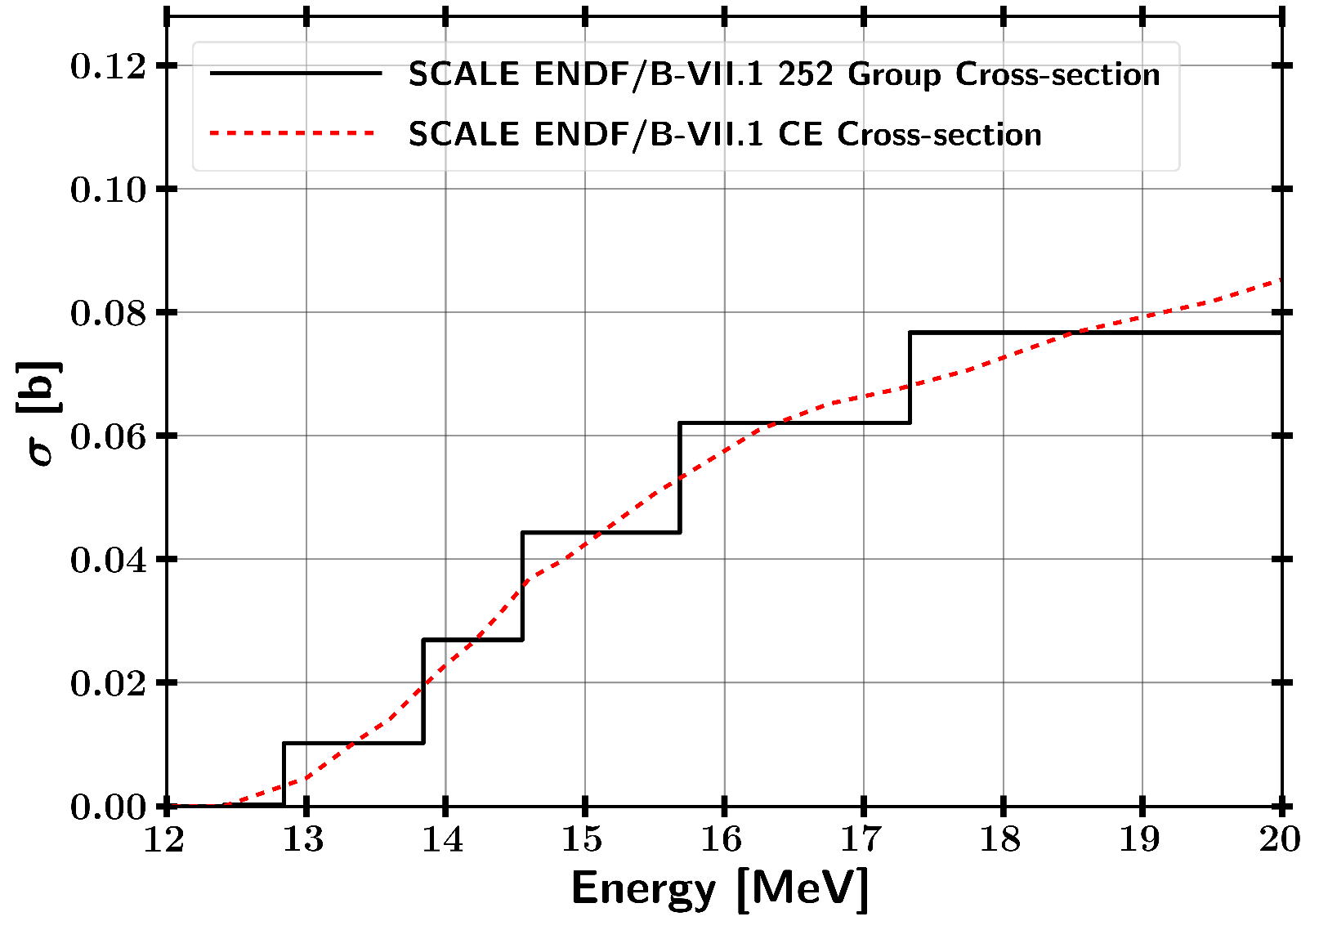
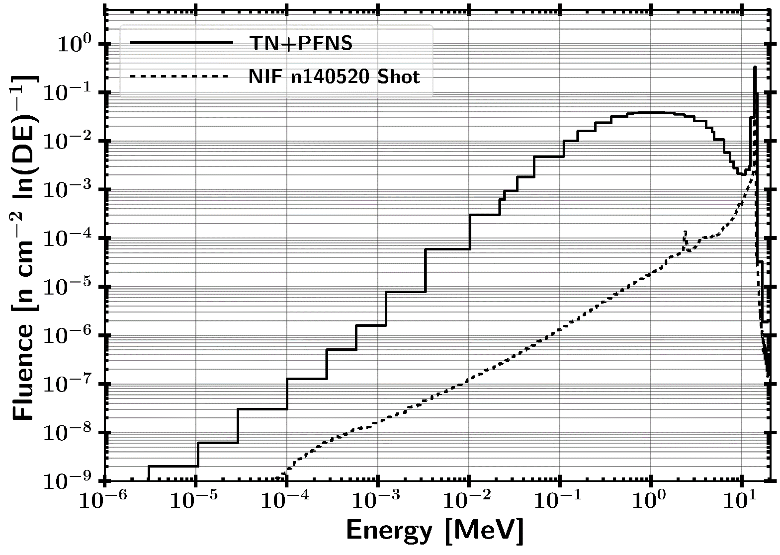
When is this an issue?
Weighting Function

Slide 5
Ways to look at impact
Look at nuclear data before using it
Do continuous energy calculation if available
Analytical solution to check if answer makes sense (this really applies to all problems)

Slide 6
Save Time Programming
Large program that takes a while to run
Output milestone results to text files (or pickle files in Python)
Easily jump back into a certain spot.
Modular coding
Do the work upfront to save time later
Read in from text files (MCNP output for example)
Read in from standardized excel format
Version Control
Documentation

Slide 7
My Research
Read in and format results (1 hr)
Stored as Pickle file
Driver Program
(~1 hr)
Output shared info
Covariance
Bootstrapping
csv
csv
Fission
Products
~ 5 min
Unfolding
~1 hr
csv
Spectra Analysis (1 min)
csv

Slide 8

Questions

