Slide 1
Nuclear Data Uncertainty
in Radiation Transport Simulations
Capt Nick Quartemont
MS Nuclear Engineering 19M
Air Force Institute of Technology
4 December 2018

Slide 2
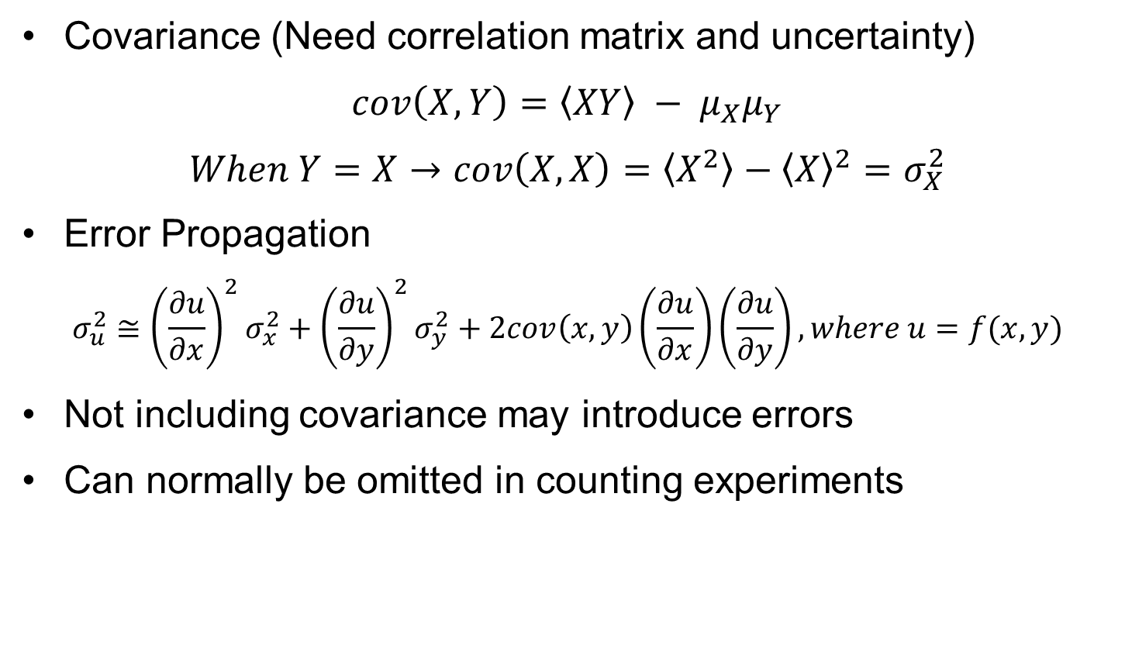
Covariance (What is it?)
Covariance (Need correlation matrix and uncertainty)
$$cov\left(X,Y\right)=\left\langle XY\right\rangle − μ_{X}μ_{Y}$$
$$When Y=X→cov\left(X,X\right)=\left\langle X^{2}\right\rangle −{\left\langle X\right\rangle }^{2}=σ_{X}^{2}$$
Error Propagation
$$σ_{u}^{2}≅{\left(\frac{∂u}{∂x}\right)}^{2}σ_{x}^{2}+{\left(\frac{∂u}{∂y}\right)}^{2}σ_{y}^{2}+2cov\left(x,y\right)\left(\frac{∂u}{∂x}\right)\left(\frac{∂u}{∂y}\right), where u=f(x,y)$$
Not including covariance may introduce errors
Can normally be omitted in counting experiments

Slide 3
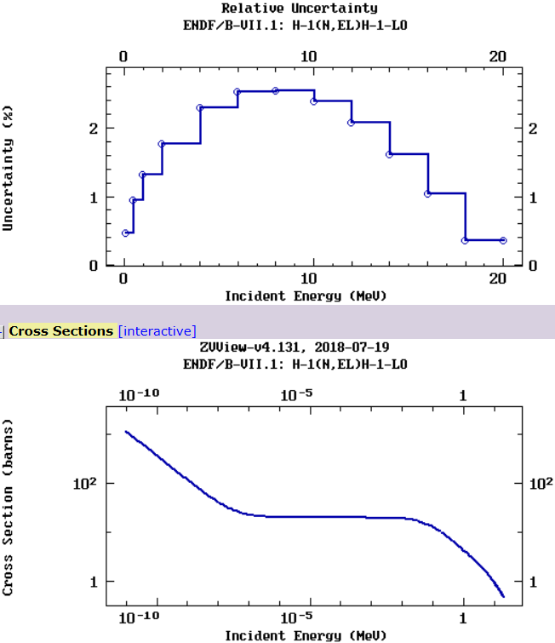
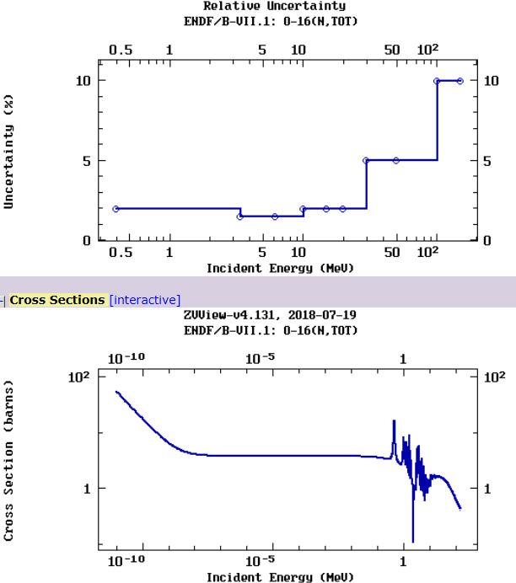
Example Data
H-1 (n,el) O-16 (n,tot)

Slide 4
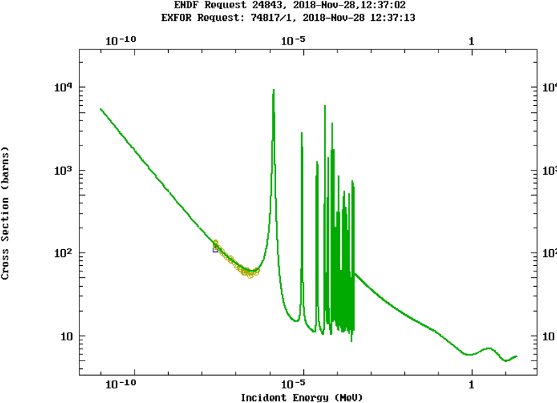
Ir-193 (n,tot) Example
Experimental Data

Slide 5
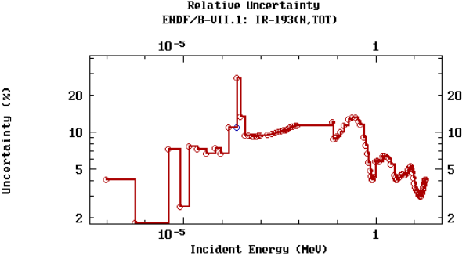
Ir-193 (n,tot) Example
Experimental Data

Slide 6
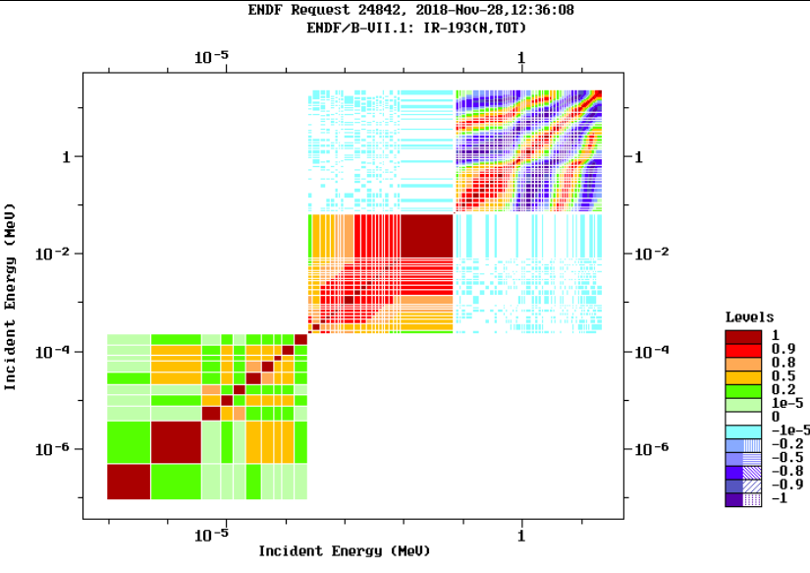
Ir-193 (n,tot) Example

Slide 7
Ir-193 (n,tot) Example

Slide 8
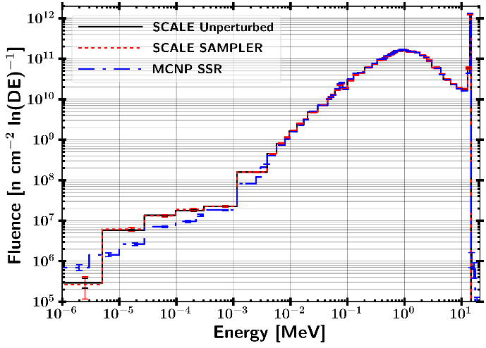
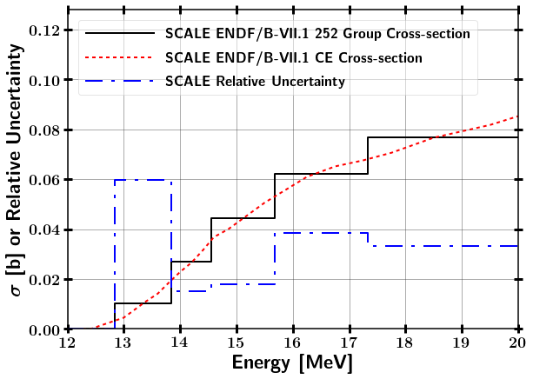
Combining Responses from Perturbed Nuclear Data
Uncertainty from
Statistical
Neutron transport
Foil activation data
Ni-58 (n,2n)
8

Slide 9
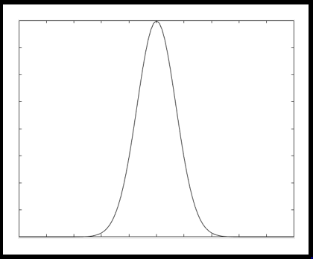
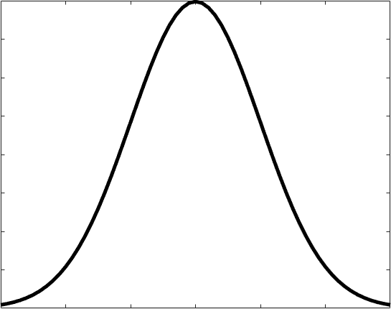
Combining Responses from Perturbed Nuclear Data
Uncertainty from
Statistical
Neutron transport
Foil activation data
SCALE Sampler Module (Neutron Transport)
Unperturbed
Response
N Sampled Responses with Perturbed Nuclear Data
Ni-58 (n,2n)
9

Slide 10
Combining Responses from Perturbed Nuclear Data
Uncertainty from
Statistical
Neutron transport
Foil activation data
SCALE Sampler Module (Neutron Transport)
Unperturbed
Response
N Sampled Responses with Perturbed Nuclear Data
IRDFF Nuclear Data Covariance
Ni-58 (n,2n)
10

Slide 11
Combining Responses from Perturbed Nuclear Data
Uncertainty from
Statistical
Neutron transport
Foil activation data
SCALE Sampler Module (Neutron Transport)
Unperturbed
Response
N Sampled Responses with Perturbed Nuclear Data
IRDFF Nuclear Data Covariance
Continuous Energy Statistical Uncertainty
Combine Data with Bootstrapping
Ni-58 (n,2n)
Final response with statistical, neutron transport, and reaction cross-section uncertainties
11

Slide 12
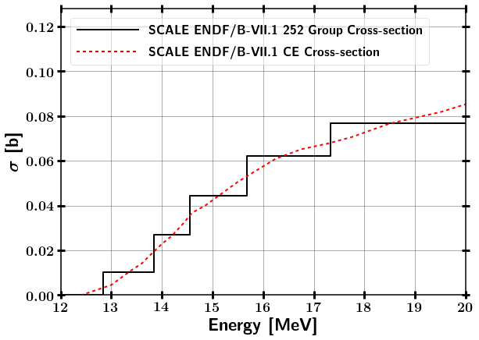
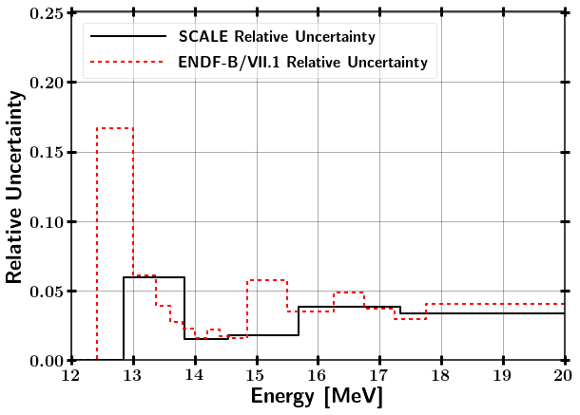
Test Case - Mapping SAMPLER Uncertainty to alternate bin structure
⁵⁸Ni(n,2n) comparison between SCALE 252 Group and CE
1 n/cm²-s flux scaled by bin width from 12.4 – 20 MeV
Notes:
Assumed pure ⁵⁸Ni, 1 cc, and N = 10²⁴ at/cc
1 n/cm²-s flux scaled by bin width from 12.4 – 14 MeV

Slide 13
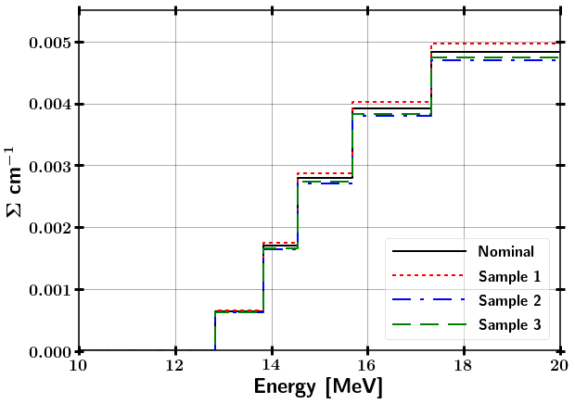
Test Case - Mapping SAMPLER Uncertainty to alternate bin structure
⁵⁸Ni(n,2n) comparison between SCALE 252 Group and CE
1 n/cm²-s flux scaled by bin width from 12.4 – 14 MeV
Ni-58 (n,2n) SAMPLER Samples
Sample Cross-section
Notes:
Assumed pure ⁵⁸Ni, 1 cc, and N = 10²⁴ at/cc
1 n/cm²-s flux scaled by bin width from 12.4 – 14 MeV

Slide 14
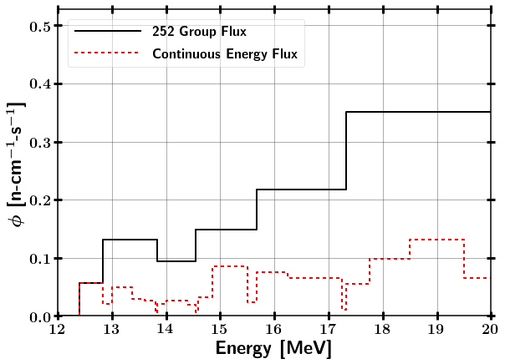
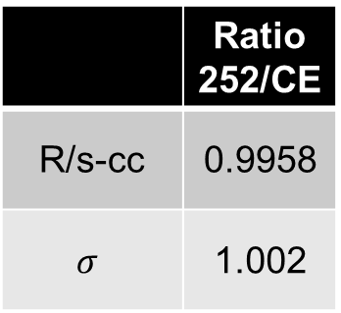
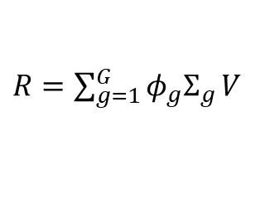
Test Case - Mapping SAMPLER Uncertainty to alternate bin structure
⁵⁸Ni(n,2n) comparison between SCALE 252 Group and CE
1 n/cm²-s flux scaled by bin width from 12.4 – 14 MeV
Ni-58 (n,2n) SAMPLER Samples
Sample Cross-section
$R=\sum_{g=1}^{G}{{φ_{g}Σ}_{g}}V$
 | Ratio 252/CE
R/s-cc | 0.9958
$$σ$$ | 1.002
Notes:
Assumed pure ⁵⁸Ni, 1 cc, and N = 10²⁴ at/cc
1 n/cm²-s flux scaled by bin width from 12.4 – 14 MeV

Slide 15
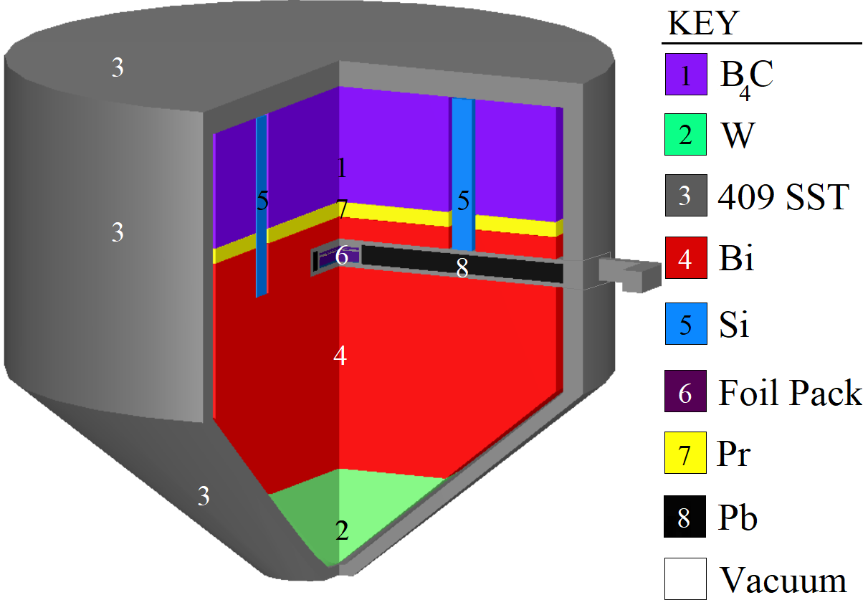
ETA Design

Slide 16
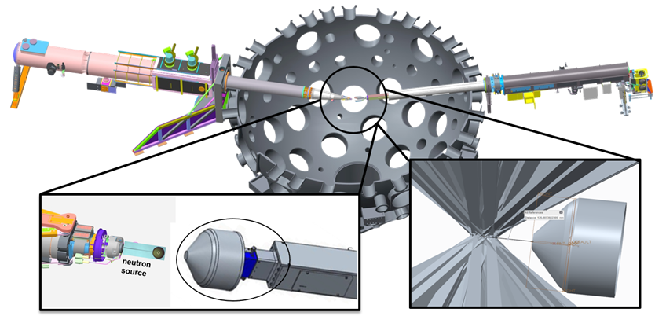
Full NIF Model Source Surface Read
Modeled Polar Drive Exploding Pusher (PDXP) Deuterium-Tritium neutron source
3.7 x 10¹⁵ 14 MeV neutron yield
Minimal downscatter compared indirect drive methods utilizing a hohlraum
NIF Neutron Source with Mounted ETA Incident Laser Exclusion Zone
Notes:
including the target positioner (TARPOS), Target and Diagnostic Manipulator (TANDM) with ETA and diagnostic snout, polar diagnostic instrument manipulator (DIM), and target chamber with first panel walls

Slide 17
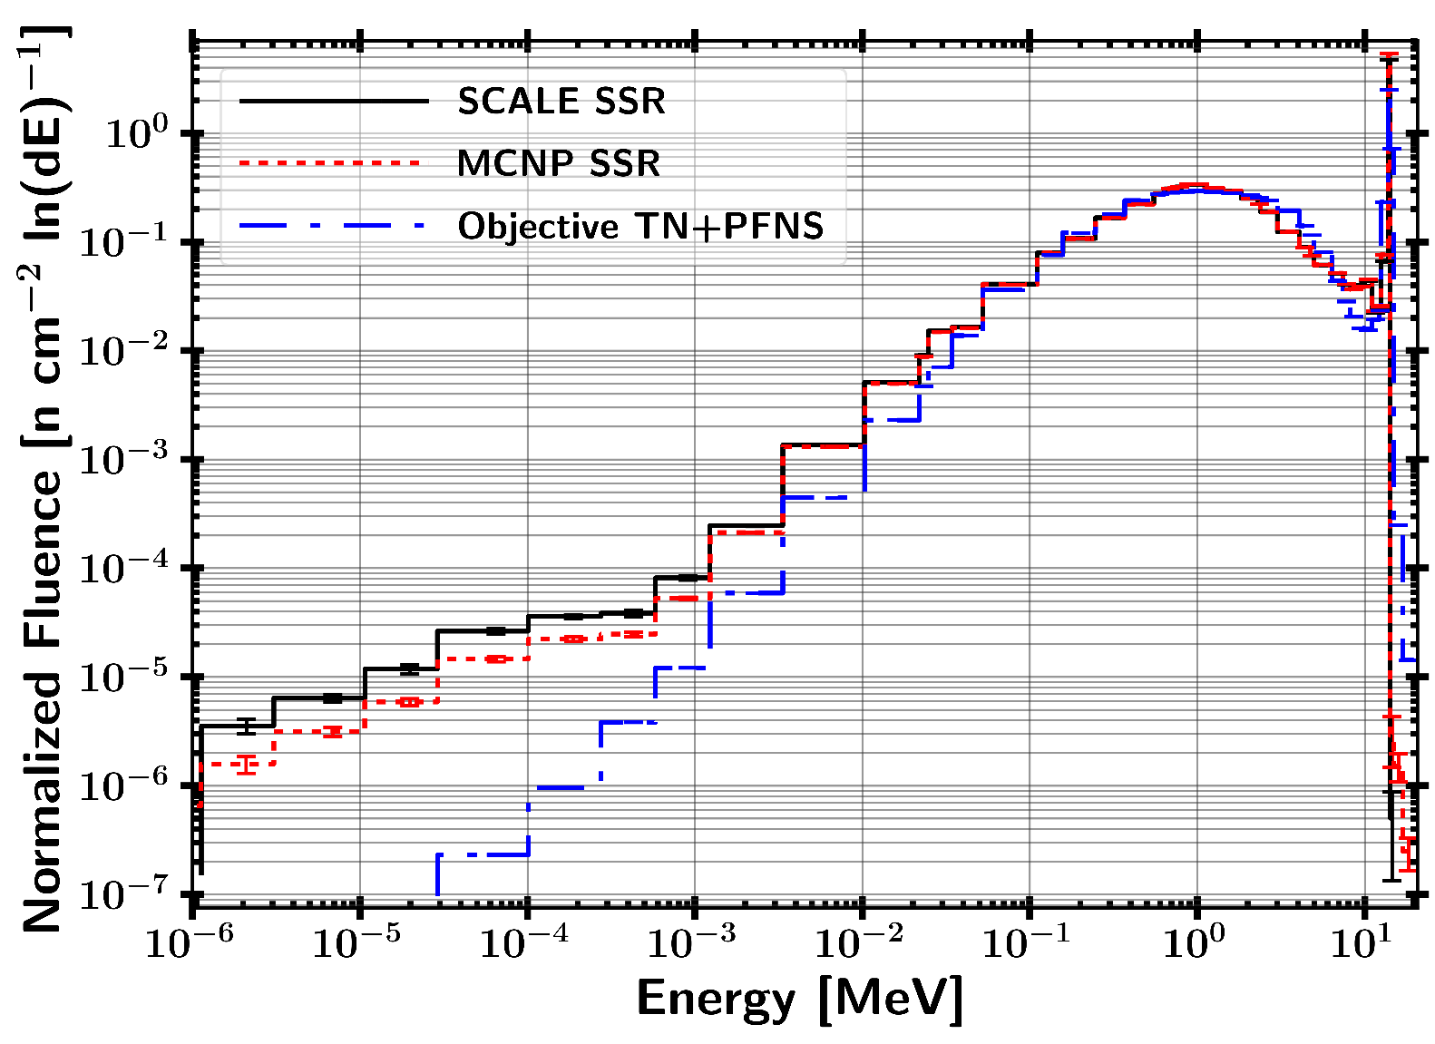

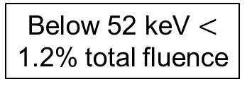
Current Results SSR Source Mapping to SCALE
Below 52 keV $<$ 1.2% total fluence
r(MCNP,Obj) = 0.90
r(MCNP,SCALE)= 0.9999
Pearson Correlation Coefficient:

Slide 18
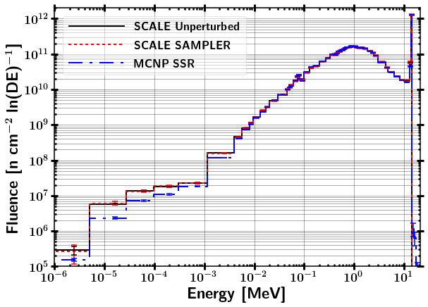
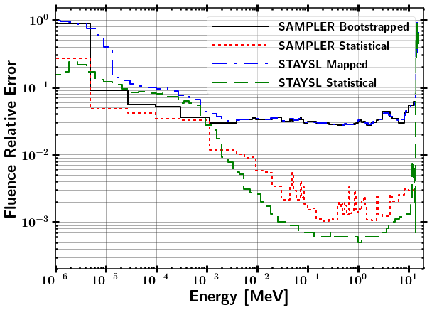
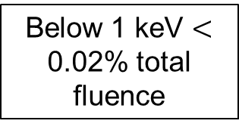
SCALE SAMPLER Fluence Results
Fluence Spectra Comparison Fluence Uncertainty
Below 1 keV $<$ 0.02% total fluence

Slide 19
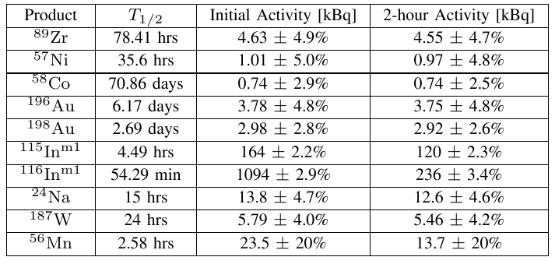
Activation Foil Pack Results

Slide 20
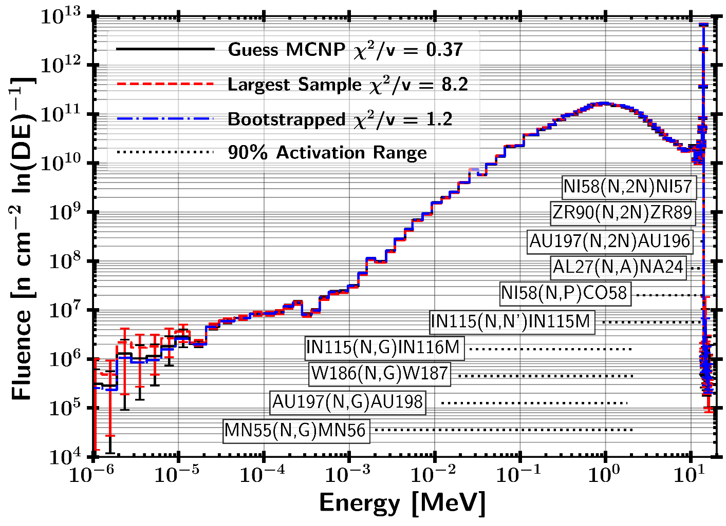
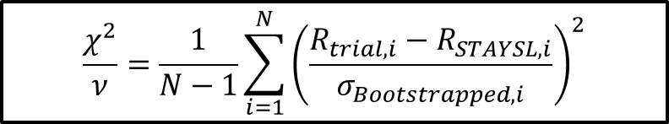
STAYSL Unfolded Spectrum
182 Sampled Activation Results
83.5% of samples were not-rejected with a p-value greater than 0.05
16.5% of samples were rejected with a p-value lower than 0.05
$$\frac{χ^{2}}{ν}=\frac{1}{N−1}\sum_{i=1}^{N}{{\left(\frac{R_{trial,i}−R_{STAYSL,i}}{σ_{Bootstrapped,i}}\right)}^{2}}$$

Slide 21
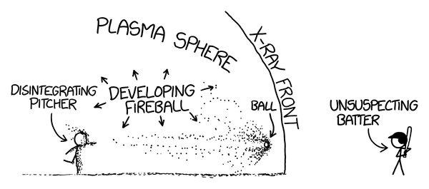
Questions?

Slide 22
BACKUPS

Slide 23
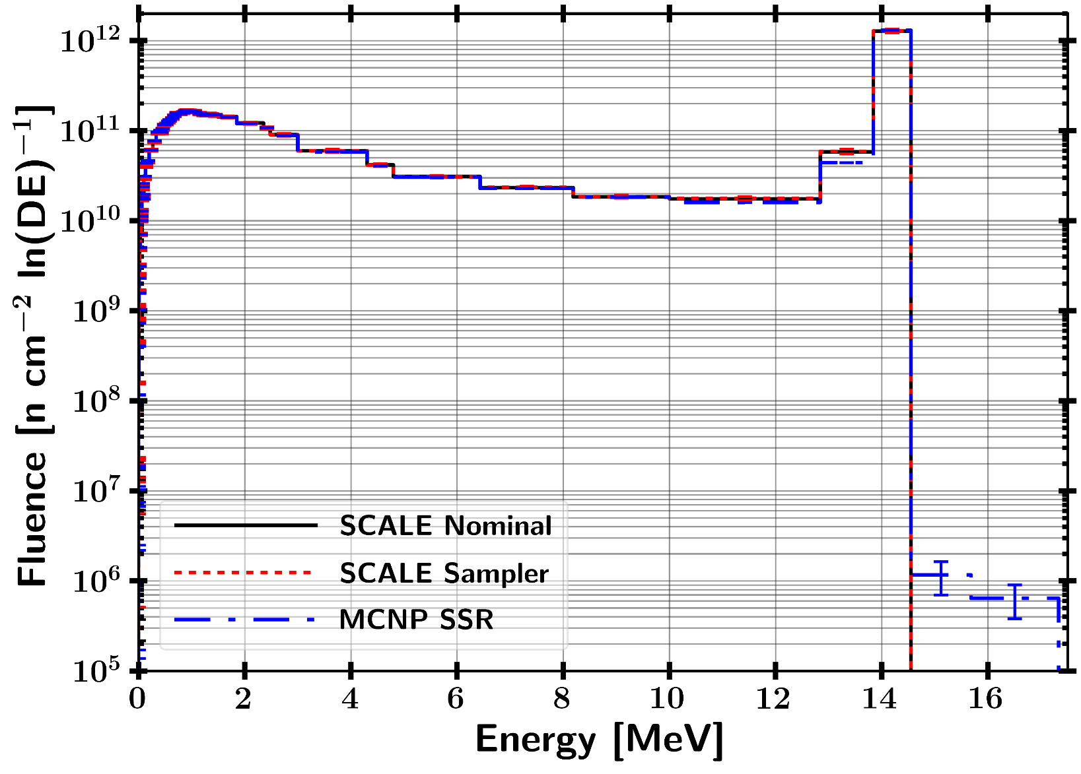
Linear

Slide 24
Combining Responses from Perturbed Nuclear Data
SCALE Sampler Module
Unperturbed
Response
N Sampled Responses with Perturbed Nuclear Data
Combine Data with Bootstrapping
Sampled with replacement from each Sampler case and Gaussian distribution based on response statistical uncertainty
Final Response with Statistical and Nuclear Data Covariance Uncertainty

Slide 25
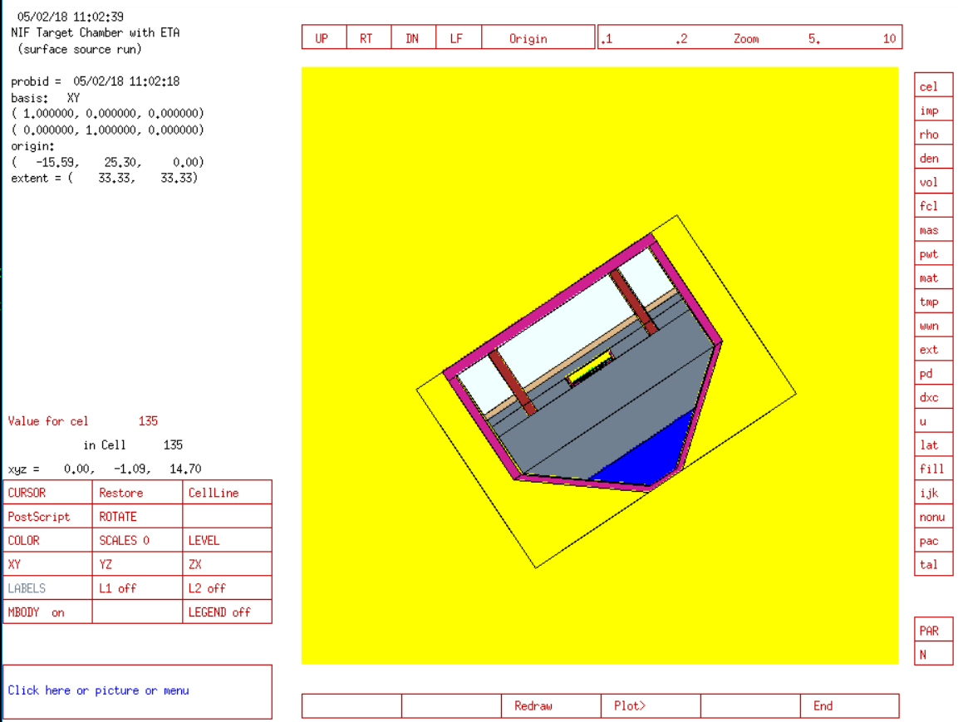
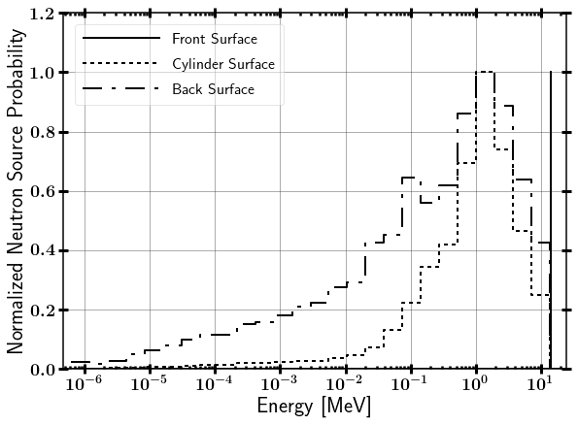
NIF Neutron Source
Surface Source Read file from LLNL
Contains NIF “room return”, which accounts for less than 1% of source.

Slide 26
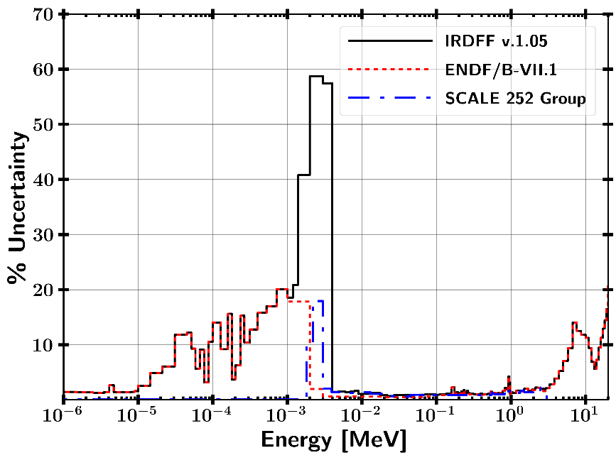
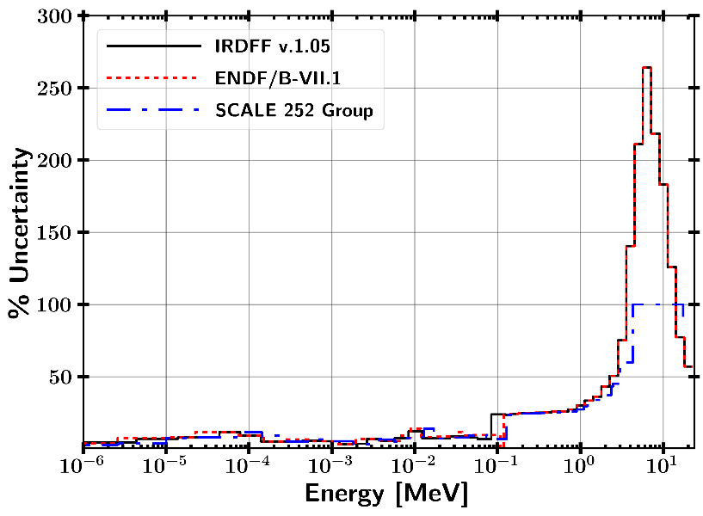
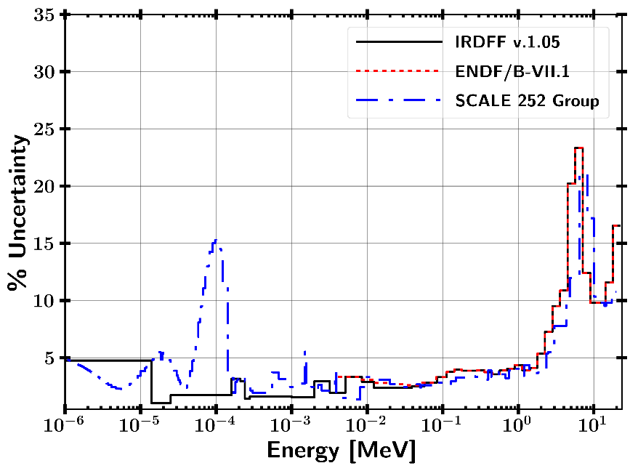
(n,g) Uncertainties (most interesting ones)
Au Mn
W

