Slide 1
Application of Spectral Shaping for Simulating Neutron Environments
Lt Nick Quartemont
MS Nuclear Engineering 19M
Air Force Institute of Technology
28 August 2018

Slide 2


Motivation
Create spectrally accurate neutron energy flux environment
Nuclear weapons effects (Deterrence)
Technical Nuclear Forensics (Deterrence – Attribution)
2018 Nuclear Posture Review key efforts in countering nuclear terrorism - “deterring state support for nuclear terrorism through advanced forensics and attribution capabilities.”

Slide 3
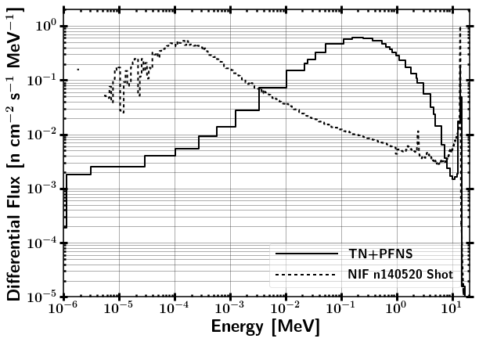
ETA Research Objectives
Research Question:
Can we produce an accurate neutron energy distribution expected from a "typical" thermonuclear or boosted nuclear weapon detonation using spectral modification at the NIF?

Slide 4
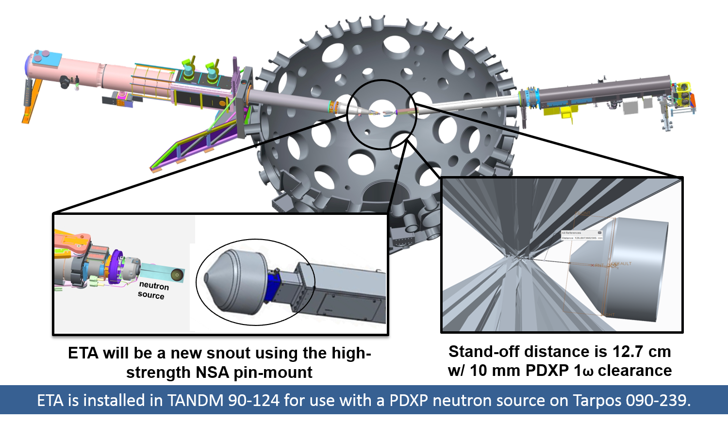
Experimental Overview

Slide 5
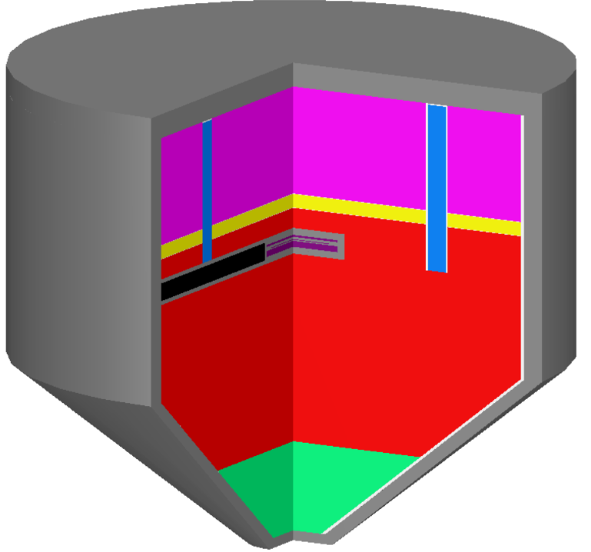
Research Objectives
Energy tuning assembly (ETA) optimized for synthetic weapons debris production
ETA 1 – 2019 proof of concept experiment at National Ignition Facility (NIF)
ETA 2 – Awarded 2020 shot at NIF
Explore ETA for ‘short pulse’ neutron source
Proposed for 2020 shot at NIF

Slide 6
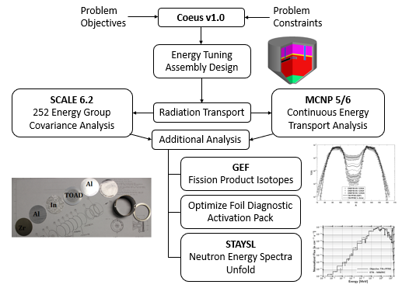
Research Plan Outline

Slide 7
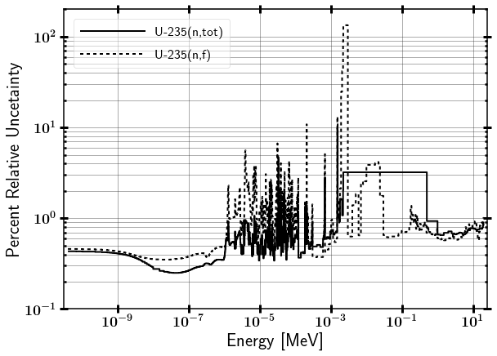
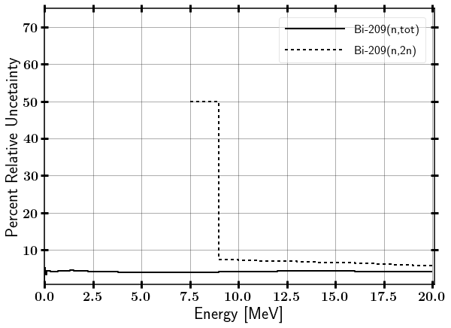
Nuclear Data Uncertainty

Slide 8
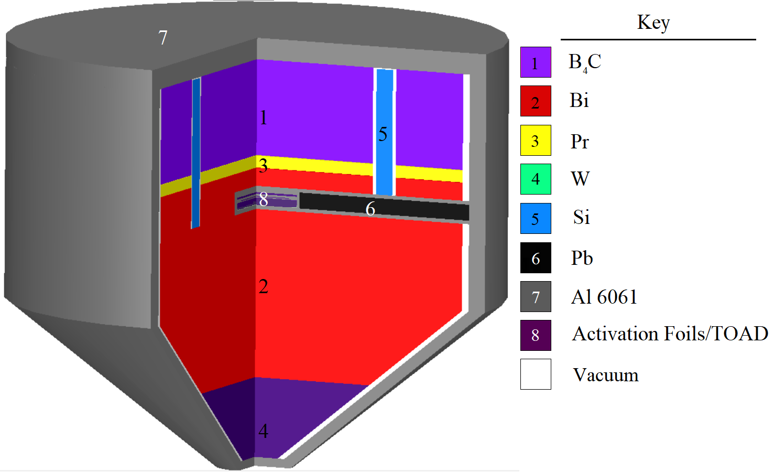
Energy Tuning Assembly Design
28 cm
~28 cm
Foil pack contains:
HEU, Al, Zr, W, In, Au, Ni
NIF Source 15 cm from cone base
Notes:
ETA created with the Coeus v1.0 metaheuristic optimization software package
Objective thermonuclear and prompt fission neutron spectrum (TN+PFNS).
Input spectrum NIF D-T fusion
Optimize flux in highly enriched uranium (HEU) foil adjacent to Target Option Activation Device (TOAD)
Base of cone originally 6 cm from neutron source (moved to 15 cm)

Slide 9
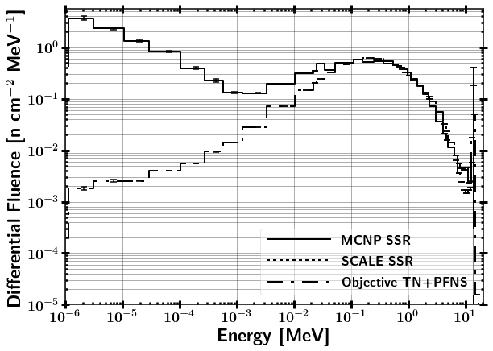
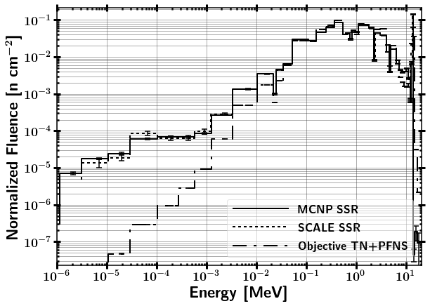
ETA HEU Foil Incident Neutron Energy Spectrum (CE)
Normalized so that integral is 1.

Slide 10
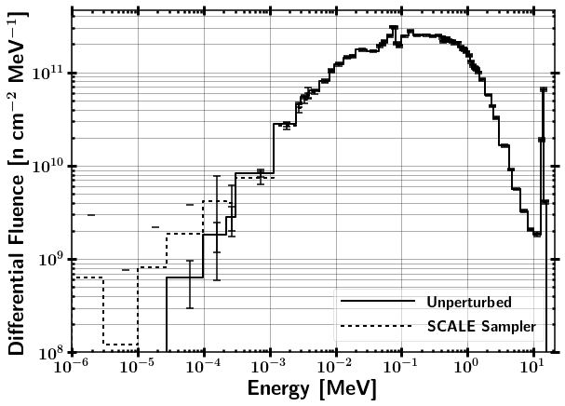
72 Group HEU Foil Incident Neutron Energy Spectrum
OLD RESULTS: NOT USING SSR

Slide 11
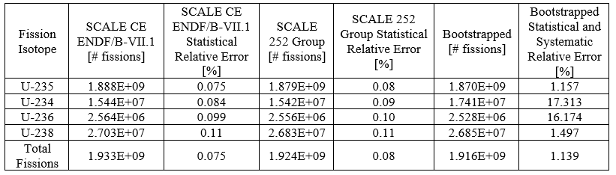
HEU Foil Fissions

Slide 12
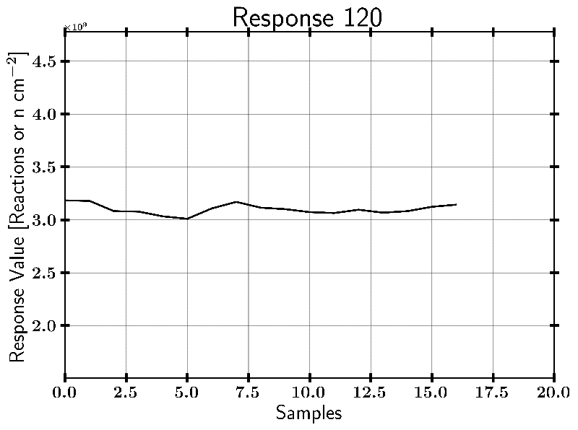
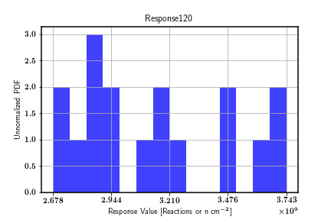
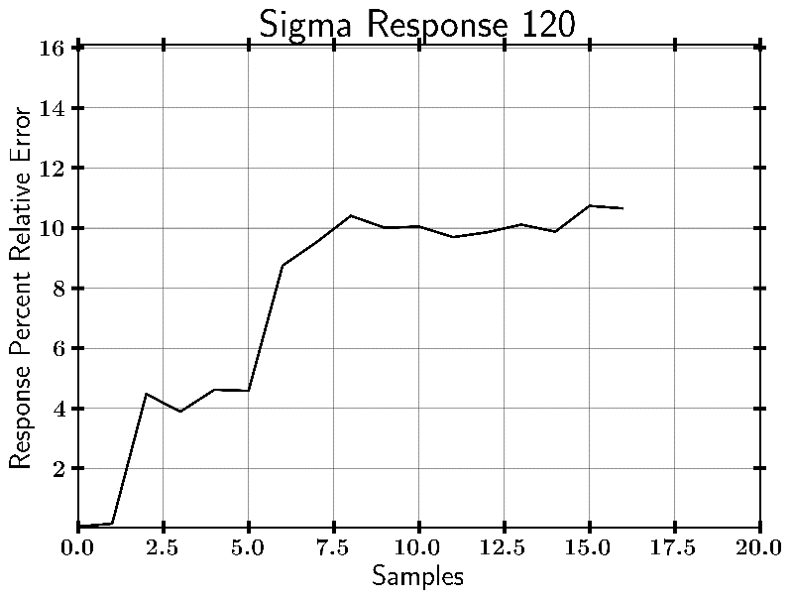
In-115 (n,g) Example Case
Output from SAMPLER
OLD RESULTS: NOT USING SSR
***16 SAMPLER Cases, results not converged

Slide 13
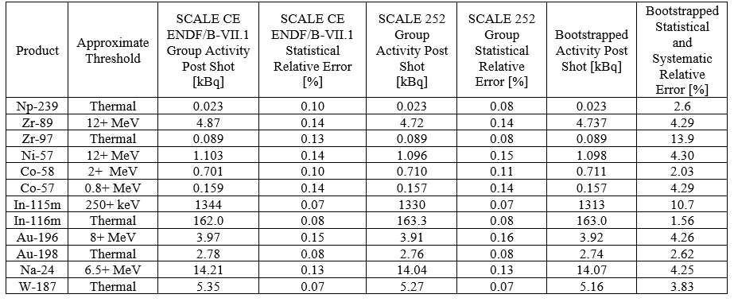
Foil Diagnostic Activation Pack
Nuclear data covariance increases the uncertainty in the results!
Notes:
Activities are on the order of what is needed for counting experiments
Foils can be counted in a High Purity Germanium Detector (HPGe)
Large increase in uncertainty based on reaction data uncertainty.

Slide 14
Summary
ETA neutron energy spectrum is consistent with a realistic boosted/thermonuclear neutron environment
Modeled ETA with nuclear data covariance indicates moderate systematic uncertainties.
Future work to add to this research:
Increase statistical significance of covariance modeling
Complete SAMPLER with SSR → currently running on Bridgman
Thesis research!

Slide 15
Questions

Slide 16
Backups

Slide 17
Summary
ETA neutron energy spectrum is consistent with a realistic boosted/thermonuclear neutron environment
FP production is within uncertainties given target objective neutron energy spectrum
Modeled ETA with nuclear data covariance indicates minimal systematic uncertainties
Future work to add to this research:
Increase statistical significance of covariance modeling
Develop FY20 ETA to increase efficiency
Incorporate realistic surrogate debris matrix – FY20 shot?
Explore fractionation methods to generate volatile and refractory samples

Slide 18
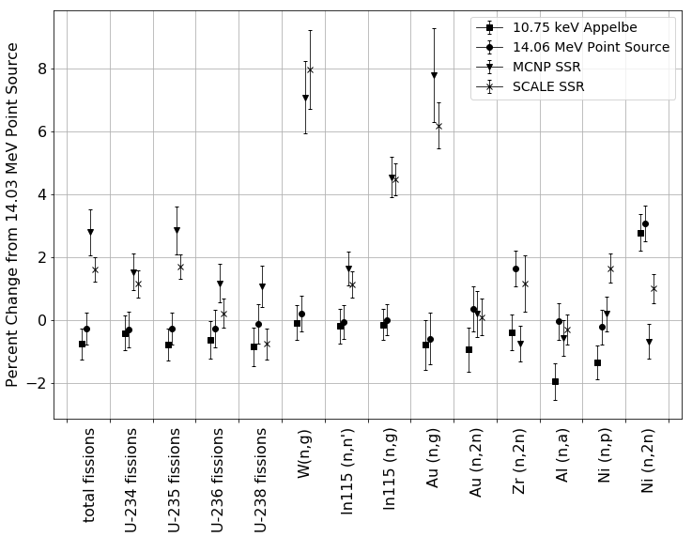
Variance based on NIF Source

Slide 19
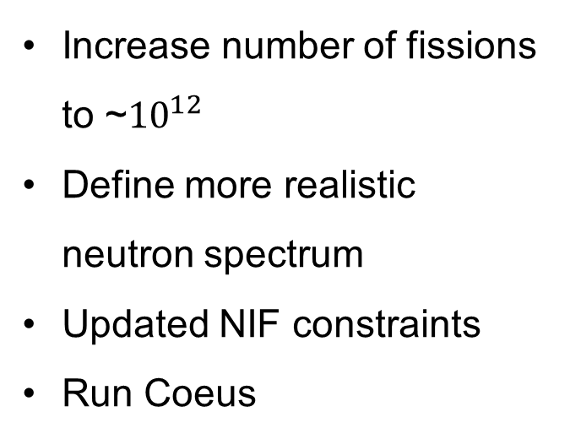
ETA2 Research Objectives
Enhanced efficiency for generating synthetic fission debris
Investigate capability for use as a short pulse neutron source
Time profile of neutron flux
Energy spectrum of incident neutron flux
Run Coeus
Increase number of fissions to ~${10}^{12}$
Define more realistic neutron spectrum
Updated NIF constraints
Run Coeus

Slide 20
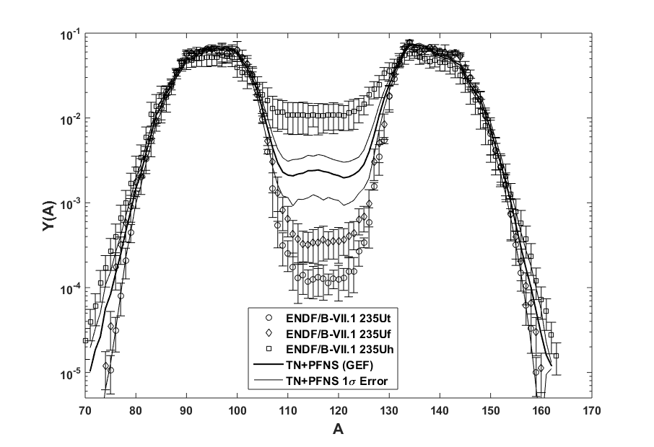
Fission Product Distribution

Slide 21
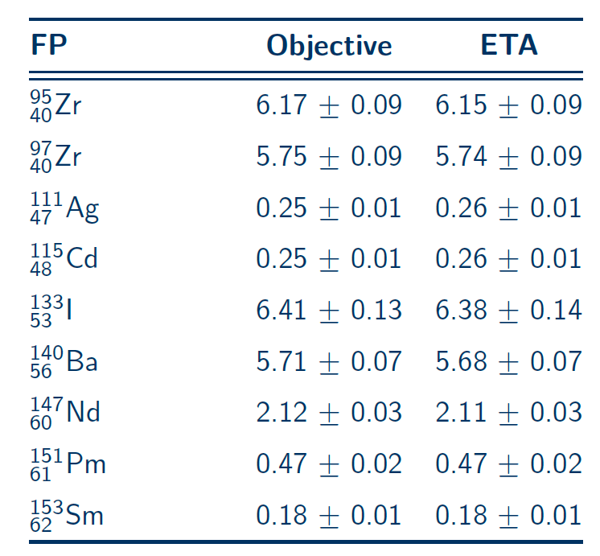
FP Production

Slide 22
SCALE Nuclear Data Covariance Libraries
Distributed with 252 and 56 energy group structure
Based on evaluated covariance data and approximate data
ENDF/B-VI,VII.1,VII.2-previously proposed
JENDL-4.0
Collaborative research with Brookhaven National Laboratory, Los Alamos National Laboratory, and Oak Ridge National Laboratory
Working Party on International Nuclear Data Evaluation Co-operation (WPEC) Subgroup-26
SCALE has corrected correlation data to meet the definition of a correlation matrix (ie. Maximum value of 1)

Slide 23
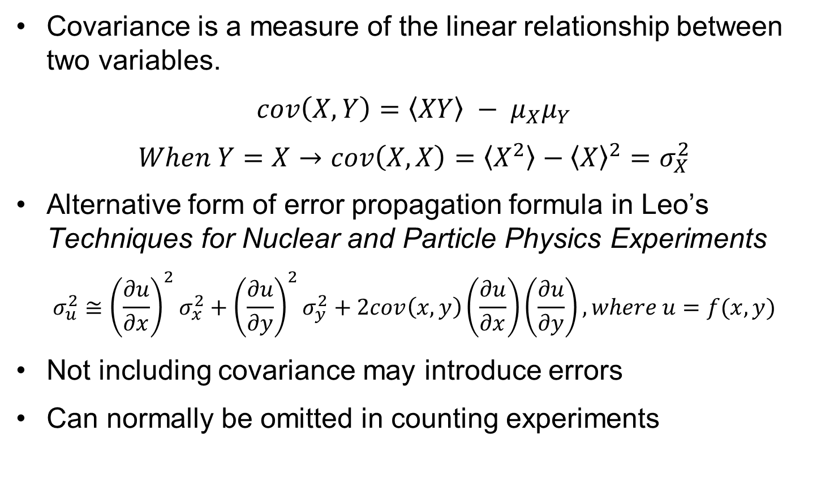
Covariance (What is it?)
Covariance is a measure of the linear relationship between two variables.
$$cov\left(X,Y\right)=\left\langle XY\right\rangle − μ_{X}μ_{Y}$$
$$When Y=X→cov\left(X,X\right)=\left\langle X^{2}\right\rangle −{\left\langle X\right\rangle }^{2}=σ_{X}^{2}$$
Alternative form of error propagation formula in Leo’s Techniques for Nuclear and Particle Physics Experiments
$$σ_{u}^{2}≅{\left(\frac{∂u}{∂x}\right)}^{2}σ_{x}^{2}+{\left(\frac{∂u}{∂y}\right)}^{2}σ_{y}^{2}+2cov\left(x,y\right)\left(\frac{∂u}{∂x}\right)\left(\frac{∂u}{∂y}\right), where u=f(x,y)$$
Not including covariance may introduce errors
Can normally be omitted in counting experiments

Slide 24
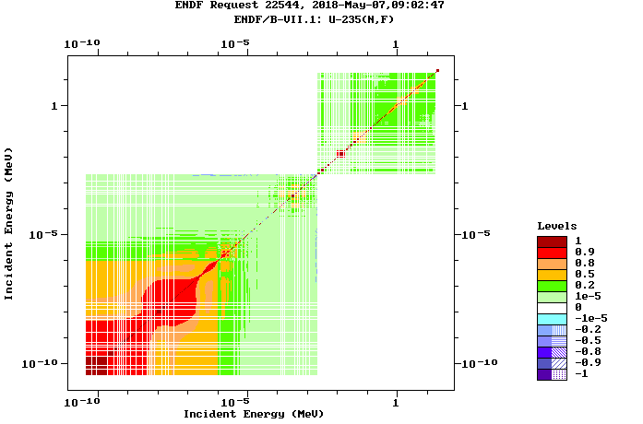
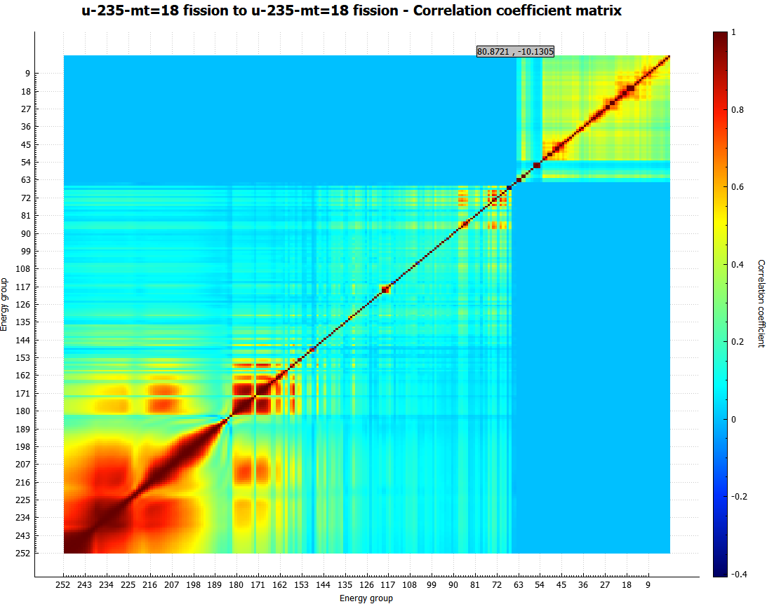
ENDF/B-VII.1 vs SCALE 252 Group Correlation Matrix
ENDF/B-VII.1 SCALE 6.2 252 Group

Slide 25
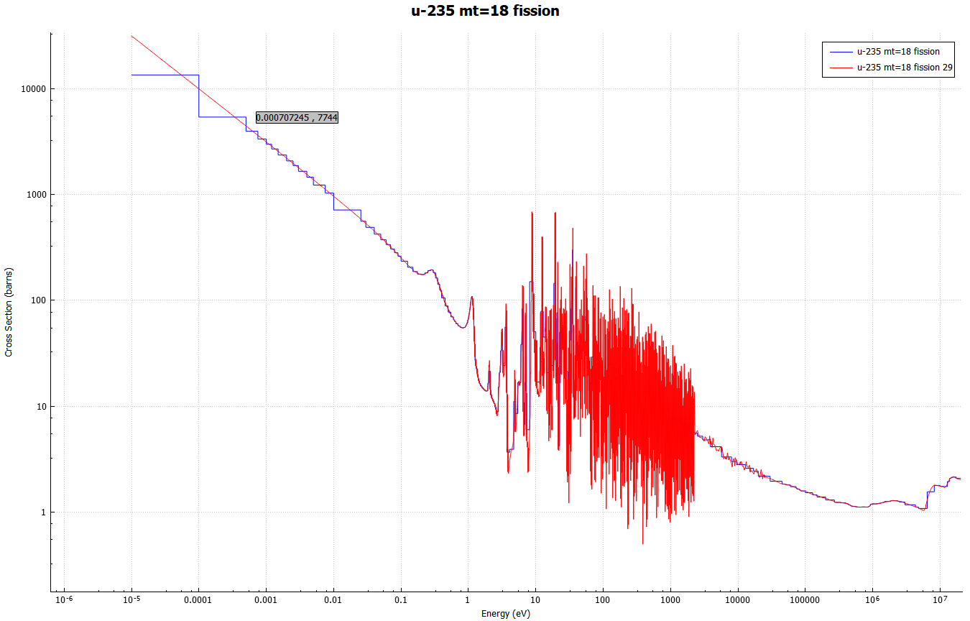
U-235 (n,f) 252 Group Structure

Slide 26
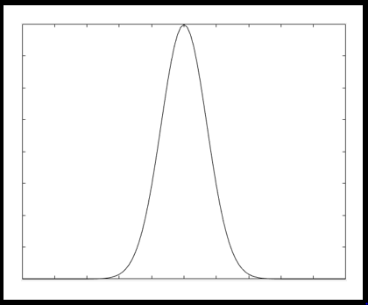
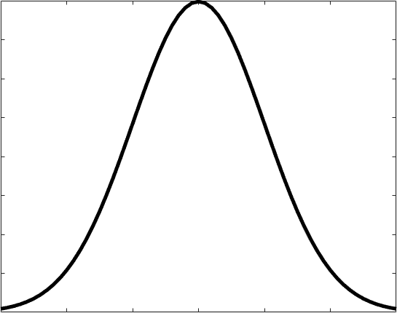
Combining Responses from Perturbed Nuclear Data
SCALE Sampler Module
Unperturbed
Response
N Sampled Responses with Perturbed Nuclear Data
Combine Data with Bootstrapping
Sampled with replacement from each Sampler case and Gaussian distribution based on response statistical uncertainty
Final Response with Statistical and Nuclear Data Covariance Uncertainty

Slide 27
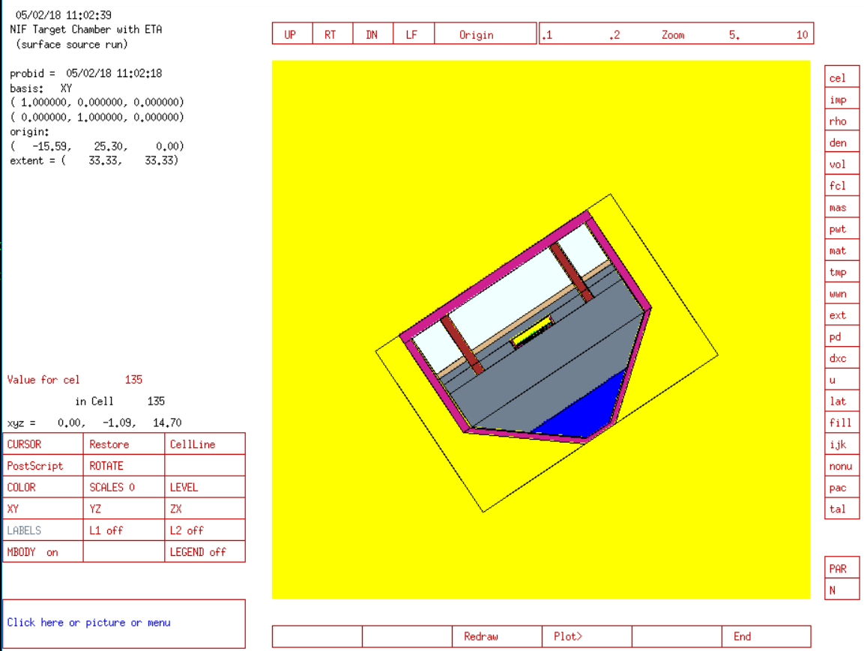
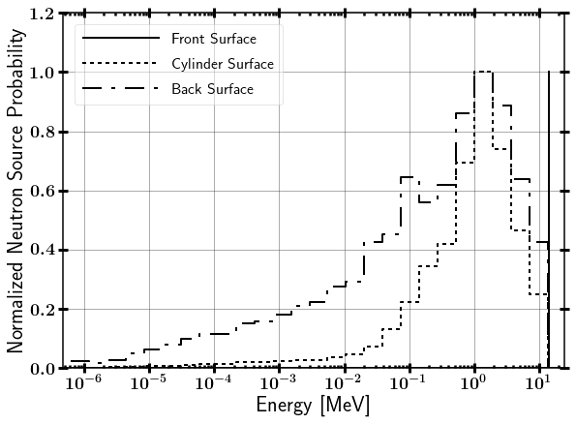
NIF Neutron Source
Surface Source Read file from LLNL
Contains NIF “room return”, which accounts for less than 1% of source.

Slide 28
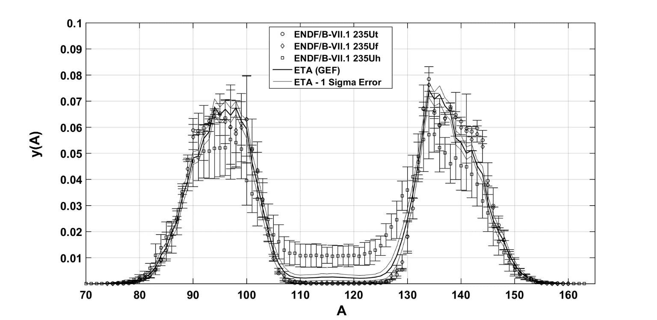
Fission Product Isotopes
ENDF uses thermal, watt fission spectrum, and fast neutron spectra to provide fission product yields.
Determining fission product yields a priori can have relative errors on the order of 10%.
Options:
Fit experimental data to phenomenological model.
Use A General Description of Fission Observables (GEF)

Slide 29
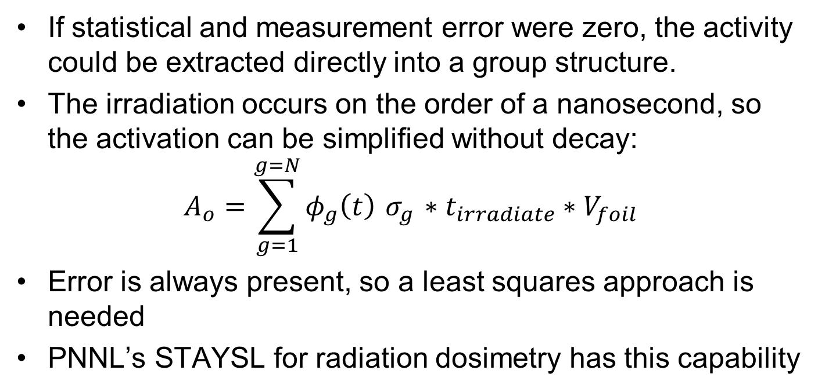
Unfolding the Neutron Spectrum From Foil Activation
If statistical and measurement error were zero, the activity could be extracted directly into a group structure.
The irradiation occurs on the order of a nanosecond, so the activation can be simplified without decay:
$$A_{o}=\sum_{g=1}^{g=N}{φ_{g}\left(t\right){ σ}_{g} ∗t_{irradiate}}∗V_{foil}$$
Error is always present, so a least squares approach is needed
PNNL’s STAYSL for radiation dosimetry has this capability

Slide 30
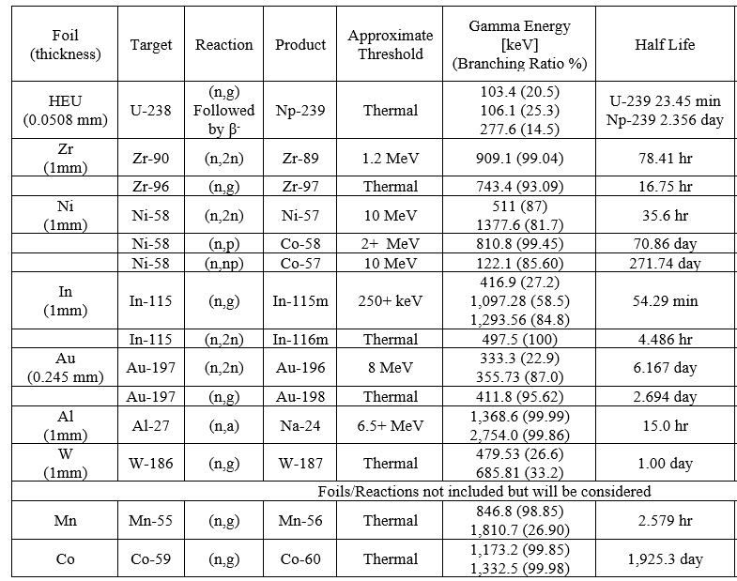
Foil Diagnostic Activation Pack

