Slide 1
Neutron Activation Spectrometer benefits to expansion
Spatial coverage: This can be deployed any/all SRC locations without interfering with SRC. Currently, there are 4 positions at 090-078 and 2-4 on PDIM.
Cost: All activation filters except Ni are reusable. Builds and installs are occurring anyway for SRC, so adding NAS positions is marginally free.
Speed: For a DT yield of 5e14, the NAS Al/Zr samples can count as a stack in 30 minutes. Results would be available an hour after sample delivery.
Operation: With additional counting hardware similar to what already exists for NAD20, this system is operable by NIF TAOs.
Cost is limited to simple new drawings: copy/paste and title/material/dim change. Filters are inexpensive and reusable.

Slide 2
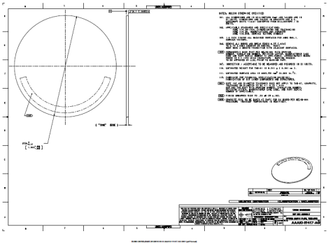
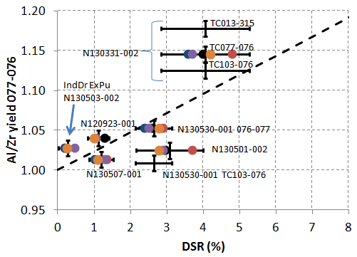
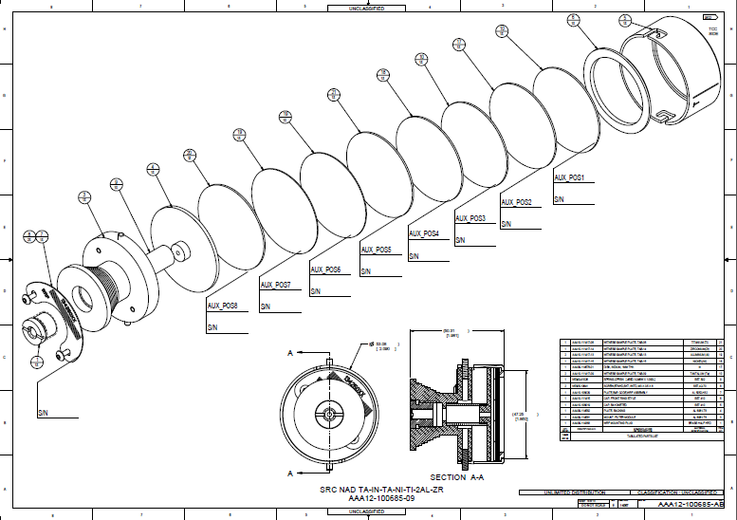

Neutron Activation Spectrometer supplies, spares, and design scope statement
Justification: The snout-mounted NAD neutron activation spectrometer (NAS) has produced TT/DT yield and other n-spectrum data for the HED Physics mix symcap campaign. It has also produced a measurable response to DSR on recent layered cryo and symcap DT shots. The current assembly drawings require the build of unnecessary filters that do not produce data on DT shots and expend SRC metal collectors.
Resources:
Design 0.25 man-months
Procurement: $35k including shared SRC/NAD spares
Part drawing: AAA09-114578 (rev to AC)
scoping results
In | 1 mm | 3mm
Zr
Al
Ni
V
Ta
soft
neutron spectrum
hard
Assembly drawing: copy AAA12-100685
C1 | C2 | C3 | C4 | C5
SRC | Zr 3
SRC | Zr 1
SRC | Al 3 | Zr 3
SRC | Al 1 | Zr 1
SRC | In 1 | Ni 1 | Al 1 | Zr 1
SRC | In 3 | Ni 3
SRC | In 1 | Ni 1
WRF | In 3 | Ni 3

Slide 3
Neutron Activation Spectrometer (NAS) extended 6-12 MeV measurement capability
Presentation to
Nuclear Diagnostics June 11, 2013
Charles Yeamans
NAD RS
Brian Daub
NAD alt-RS

Slide 4
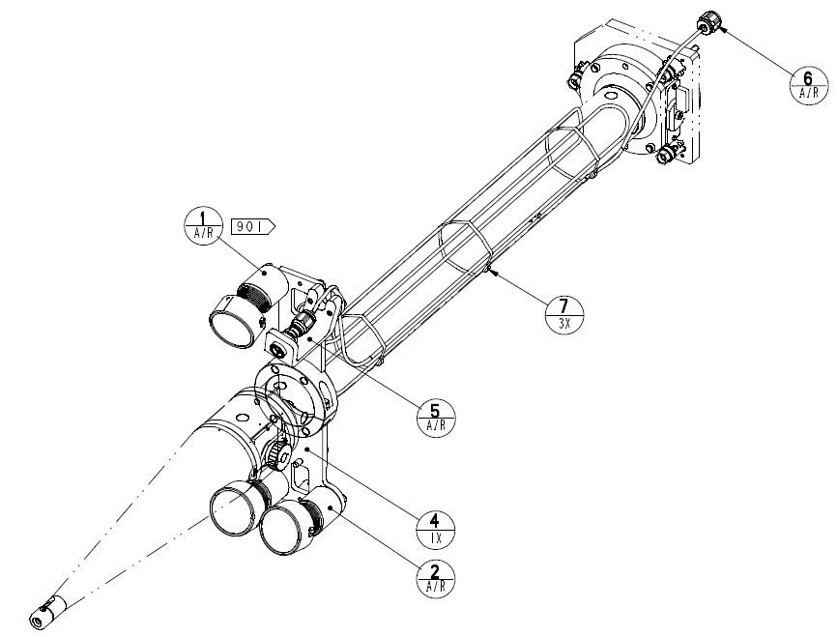
Neutron Activation Spectrometer (NAS) fielding on NIF shots
DIM 090-078 Position 1
The NAS is fielded on any one on the DIM Snout-mounted diagnostic positions. Typically, 090-078 Pos1 is used.

Slide 5
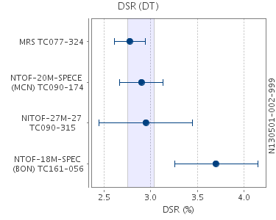
Neutron Activation Spectrometer motivation for expansion
Flange-NAD has shown unscattered primary yield can vary by as much as 20%, indicating large scattering mass anisotropy.
SpecE
SpecA
SpecSP
nTOF measured DSR has been shown to vary by 20% between any of the 3 nTOF locations on many shots.
The problem with interpreting only 3 nTOF locations is sampling a 4pi surface with three points can miss important features. Ideally, there would be 19 nTOFs just like the 19 FNADs, but the cost would be prohibitive.

Slide 6
Neutron Activation Spectrometer motivation for expansion
N130501-002
SpecE
SpecA
SpecSP
Are the existing nTOF lines of sight getting a good 4pi picture of DSR?

Slide 7
Neutron Activation Spectrometer assembly hardware and filters
A set of 50 mm diameter activation “filters” are assembled. The filters are pure metallic elements selected to have measureable neutron activation products. Up to 7 mm thickness of filter materials may be fielded per spectrometer position.

Slide 8
Neutron Activation Spectrometer MCNP 3D neutron transport model geometry: near and far field
NAS
DIM 090-078 and CryoTarPos
target chamber
TMP, hohlraum, and capsule
A detailed model of the local and target chamber geometry is necessary to properly interpret the activities measured in the foils as the product of a source spectrum.

Slide 9
Neutron Activation Spectrometer what it measures with Zr and Al filters
Difference in activation is between 6.5 and 12.1 MeV
The DSR region is effectively a single energy bin below the Zr-90(n,2n) threshold but above where Al-27(n,alpha) is significant.

Slide 10
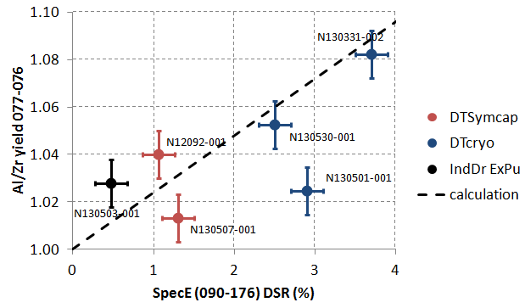
Neutron Activation Spectrometer DT shot results
(nT single scatter)
The yield calculated from “nocap” MCNP runs assumes a perfect Gaussian release at TCC and traveling through everything except the capsule, effectively the NAS IRF.

Slide 11
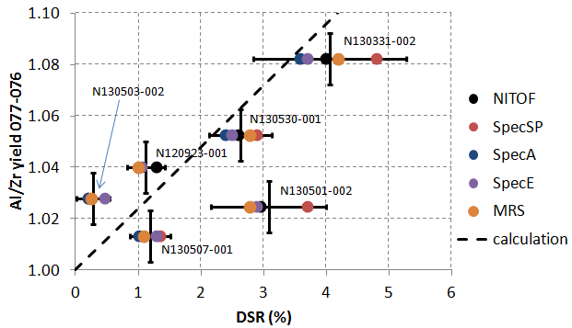
Neutron Activation Spectrometer DT shot results
(nT single scatter)
The yield calculated from “nocap” MCNP runs assumes a perfect Gaussian release at TCC and traveling through everything except the capsule, effectively the NAS IRF. The nT scattering cross section is used to predict the activity ratio as a function of DSR.

Slide 12
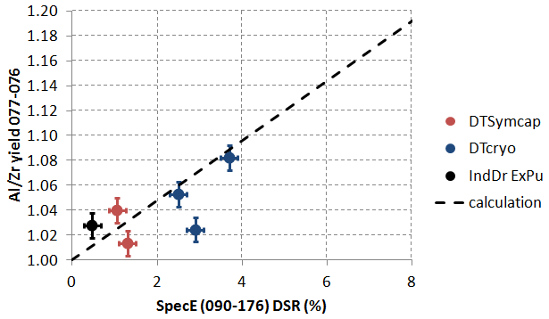
Neutron Activation Spectrometer DT shot results
(nT single scatter)
The yield calculated from “nocap” MCNP runs assumes a perfect Gaussian release at TCC and traveling through everything except the capsule, effectively the NAS IRF.

Slide 13
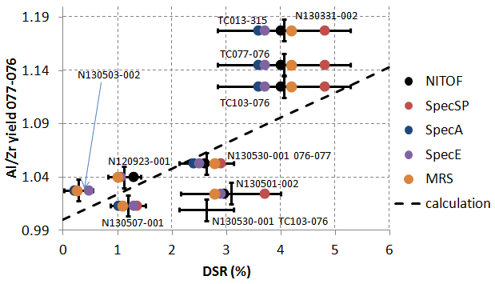
Neutron Activation Spectrometer DT shot results
(nT single scatter)
Spatial variations observed on N130331-002 and N130530-001 are indicative of DSR variations of 5% over multiple locations.

