Slide 1
Fundamentals of Engineering Thermodynamics Chapter 3 Evaluating Properties
Nick DiFilippo
5/21/2015

Slide 2
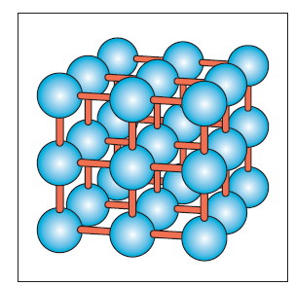
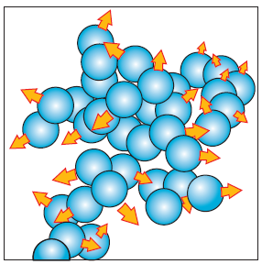
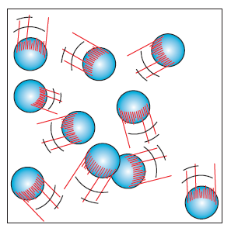
Phase and Pure Substances
3 phases (liquid, solid, vapor)
Pure substances
Phase changes
Vaporization
Melting
Sublimation
Two phases
Liquid-Vapor
Solid-Liquid
Solid-Vapor

Slide 3
State Principle
For a simple compressible system, two independent intensive thermodynamics properties will fix the values of all other intensive thermodynamics properties

Slide 4
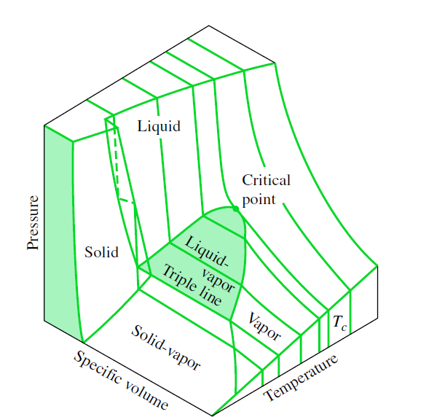
3.2 P-V-T Surface
Axes
1 phase Regions
2 phase regions
3 phase region
Saturation lines
Critical Point

Slide 5
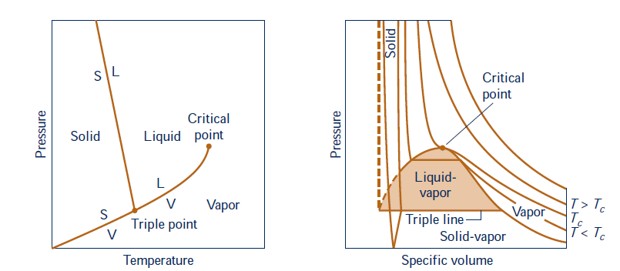
Projections of PVT surface

Slide 6
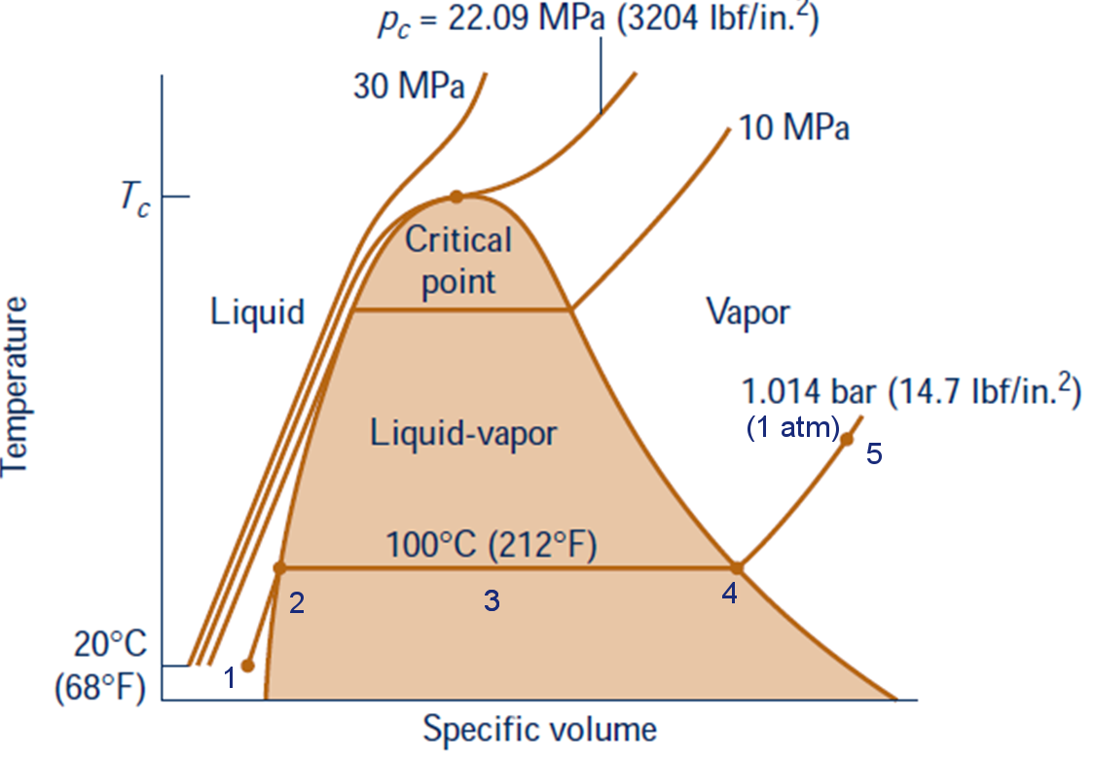

T-v Diagram
Quality x :$x=\frac{m_{vapor}}{m_{liquid} + m_{vapor}}=\frac{m_{vapor}}{m_{total}}$

Slide 7
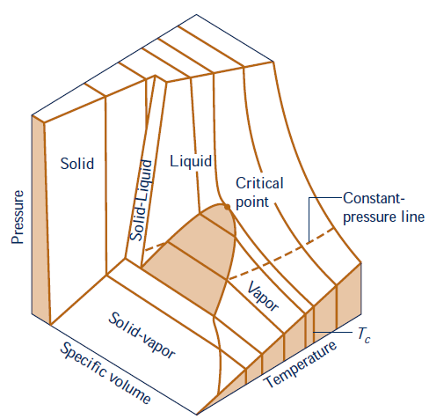
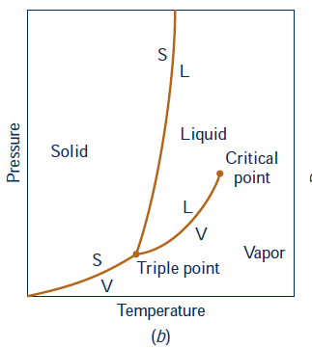

Slide 8
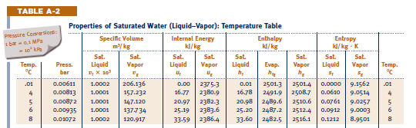
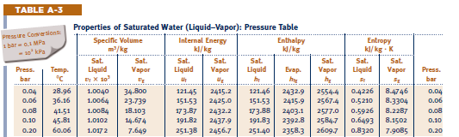
Thermodynamic Property Tables
Steam Tables (A-2) – (A-6)
Table A-2 and Table A-3 Saturation Table ( be careful with units!)

Slide 9
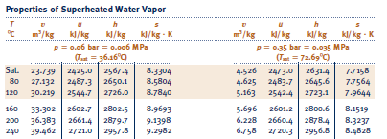
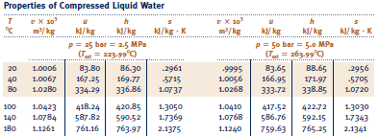
Thermodynamic Property Tables
Table A-4 Superheated Table
Table A-5 Compressed Liquid Table

Slide 10
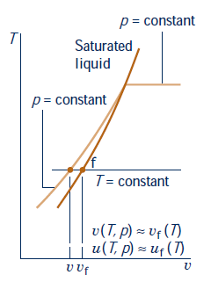
Thermodynamic Property Tables
Tables (A-7) – (A-9) Refrigerant 22
Tables (A-10) – (A-12) Refrigerant 134a
Tables (A-13) – (A-15) Ammonia
Tables (A-16) – (A-18) Propane
Need to use approximation if these are compressed liquids.

Slide 11
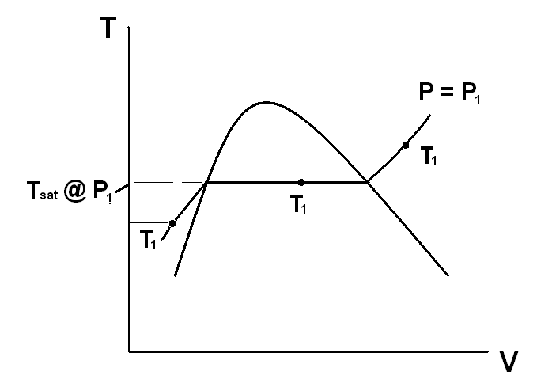
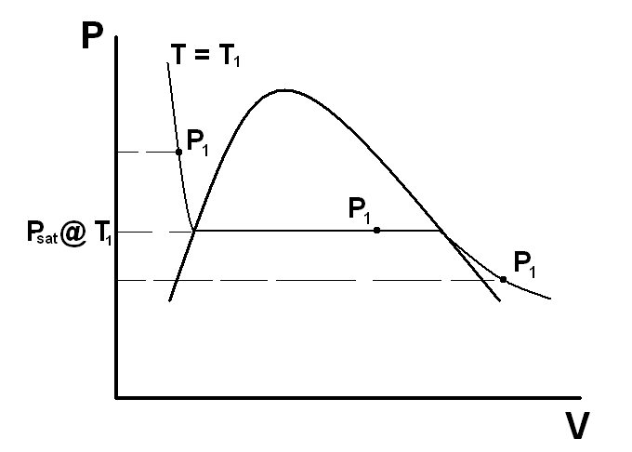
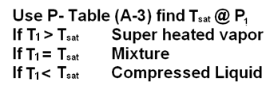
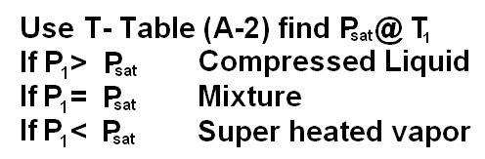

Slide 12
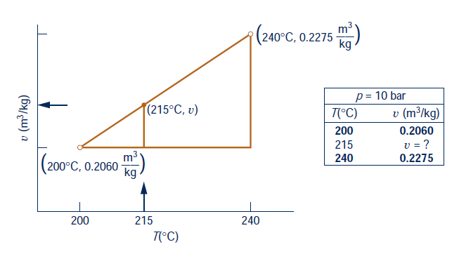
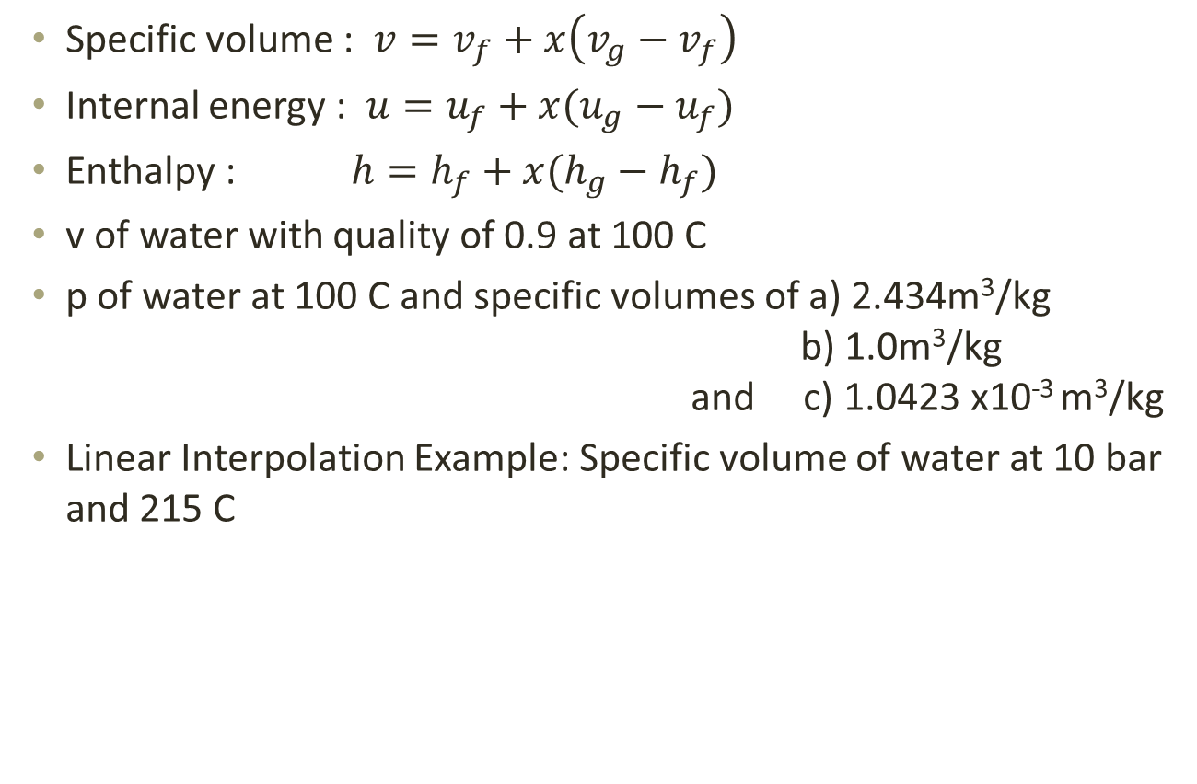
Evaluation of Properties in S-L Mixture Region
Specific volume : $v=v_{f}+x\left(v_{g}−v_{f}\right)$
Internal energy : $u=u_{f}+x(u_{g}−u_{f})$
Enthalpy : $h=h_{f}+x(h_{g}−h_{f})$
v of water with quality of 0.9 at 100 C
p of water at 100 C and specific volumes of a) 2.434m³/kg b) 1.0m³/kg and c) 1.0423 x10⁻³ m³/kg
Linear Interpolation Example: Specific volume of water at 10 bar and 215 C

Slide 13
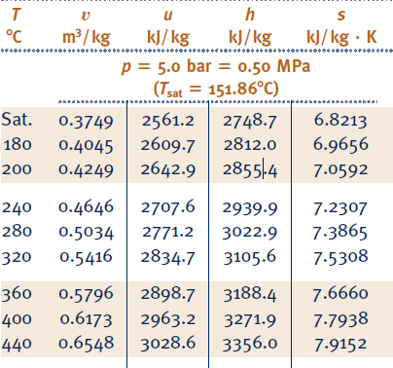
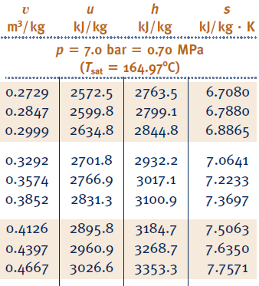
Double Interpolation Example
Find specific enthalpy (h) of a superheated steam at a temperature of 325 C and a pressure of 5.70 bar

Slide 14

Example: Complete the Table
Liquid = H₂O (water)
Temp. ( ºC) | Pressure (kPa) | u (kJ/kg) | x | Phase
120 | 198.5 | 2529.3 | 1 | Sat. vapor
50 | 80 | 209.32 | ---- | Comp. Liquid
30 | 4.246 | 1271.19 | 0.5 | mixture
240 | 300 | 2713.1 | ------- | Super. Vapor
Temp. ( ºC) | Pressure (kPa) | u (kJ/kg) | x | Phase
120 |  |  |  | Sat. vapor
50 | 80
30 |  |  | 0.5
 | 300 | 2713.1
$$u_{30}=125.78+.5(2416.6−125.78)$$

Slide 15
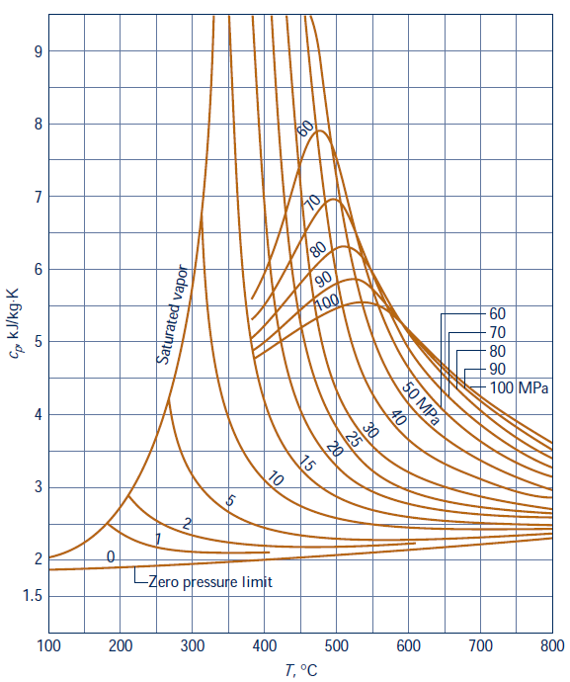
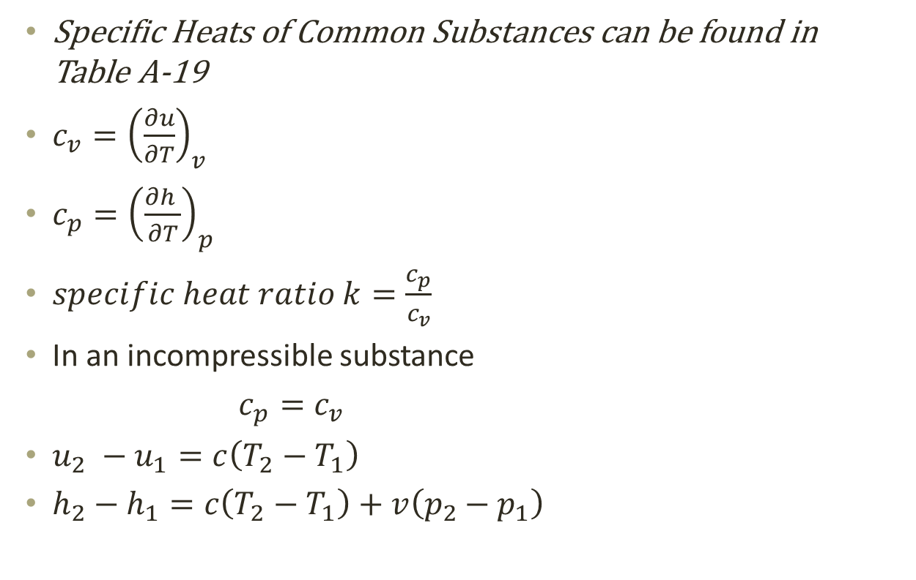
Specific Heats
Specific Heats of Common Substances can be found in Table A-19
$c_{v}={\left(\frac{∂u}{∂T}\right)}_{v}$
$c_{p}={\left(\frac{∂h }{∂T}\right)}_{p}$
$specific heat ratio k=\frac{c_{p}}{c_{v}}$
In an incompressible substance
$c_{p}=c_{v}$
$u_{2} −u_{1}=c\left(T_{2}−T_{1}\right)$
$h_{2}−h_{1}=c\left(T_{2}−T_{1}\right)+v\left(p_{2}−p_{1}\right)$

Slide 16
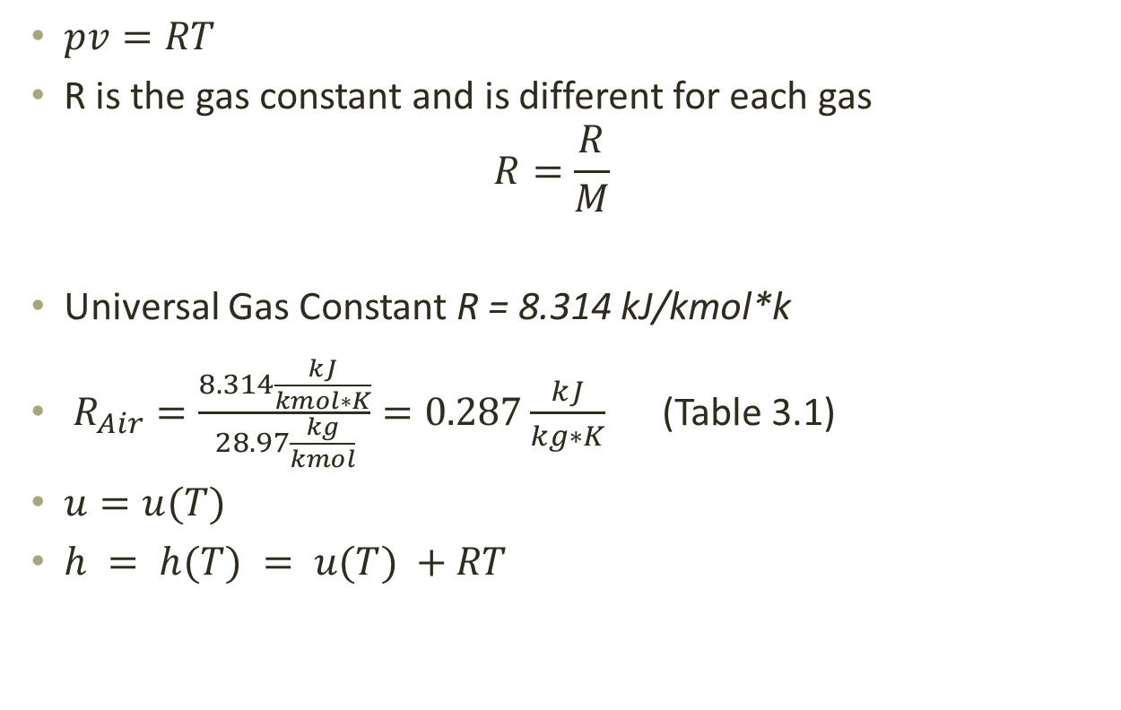
The Ideal Gas Equation of State
$pv=RT$
R is the gas constant and is different for each gas
$$R=\frac{R}{M}$$
Universal Gas Constant R = 8.314 kJ/kmol*k
$R_{Air}=\frac{8.314\frac{kJ}{kmol∗K}}{28.97\frac{kg}{kmol}}=0.287\frac{kJ}{kg∗K}$ (Table 3.1)
$u=u(T)$
$h = h(T) = u(T) +RT$

Slide 17
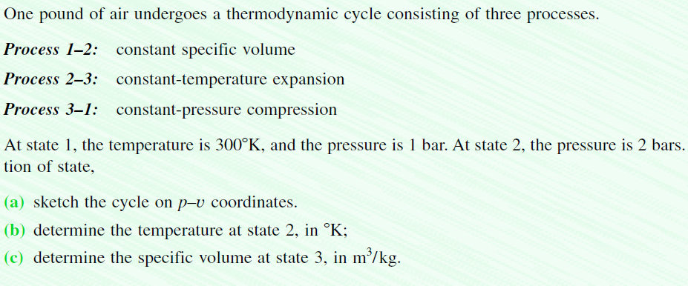
Employ the Ideal Gas Equations

Slide 18
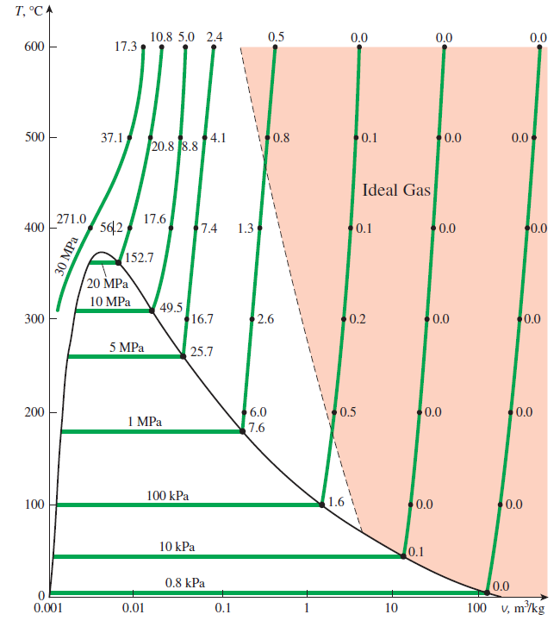
Is Water Vapor an Ideal Gas?

Slide 19
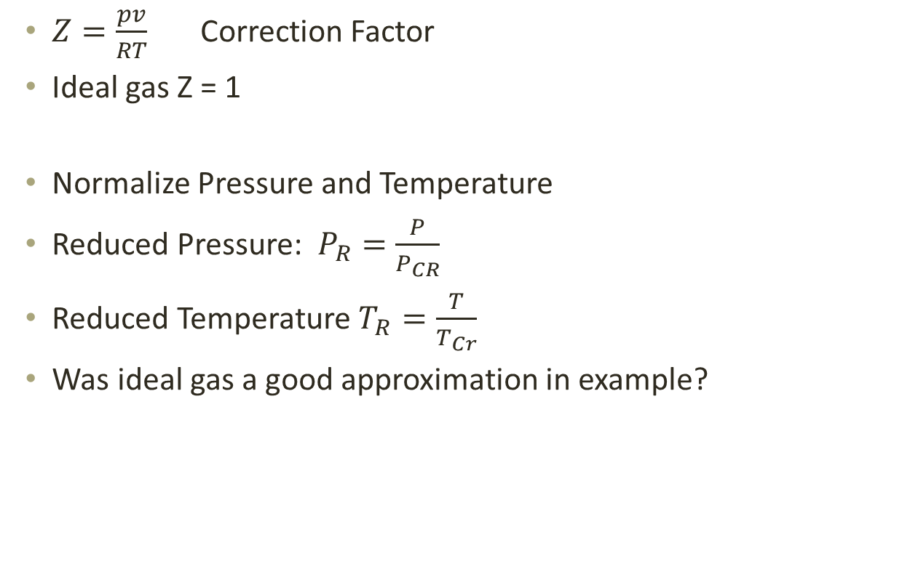
Compressibility Factor
$Z=\frac{pv}{RT}$ Correction Factor
Ideal gas Z = 1
Normalize Pressure and Temperature
Reduced Pressure: $P_{R}=\frac{P}{P_{CR}}$
Reduced Temperature $T_{R}=\frac{T}{T_{Cr}}$
Was ideal gas a good approximation in example?

Slide 20
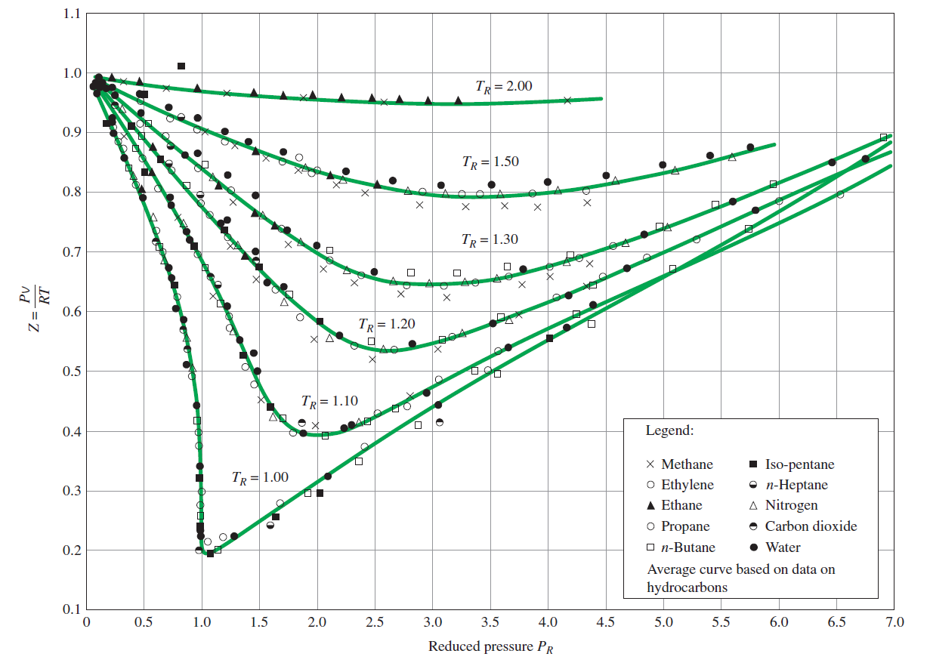
Generalized Compressibility Chart
Appendix Fig A-1 , A-2, A-3
P_{R:} 0-1 , 0,10 , 10-40

Slide 21
Example:
Given: Find the specific Volume of R-134a at 140ºC and 1.6MPa
Find: Specific volume using three methods (Ideal Gas Law, Compressibility Chart, and Z chart)
0.02103 m³/kg (10.3% error)
0.0187 m³/kg (1% error)
Z = 0.89 v = 0.0.187 m³/kg

Slide 22
A tank contains 0.05 m³ of Nitrogren at (-21ºC) and 10 Mpa. Determine the mass of nitrogen in kg using a)the ideal gas model
B) compressibility chart

Slide 23

Internal Energy Enthalpy and Specific Heat of Ideal Gases
$u\left(T_{2}\right) −u\left(T_{1}\right)= \int_{T_{1}}^{T_{2}}{c_{v}\left(T\right)dT }$
$h\left(T_{2}\right) −h\left(T_{1}\right)= \int_{T_{1}}^{T_{2}}{c_{p}\left(T\right)dT }$
$c_{p}\left(T\right)=c_{v}\left(T\right)+R$

Slide 24
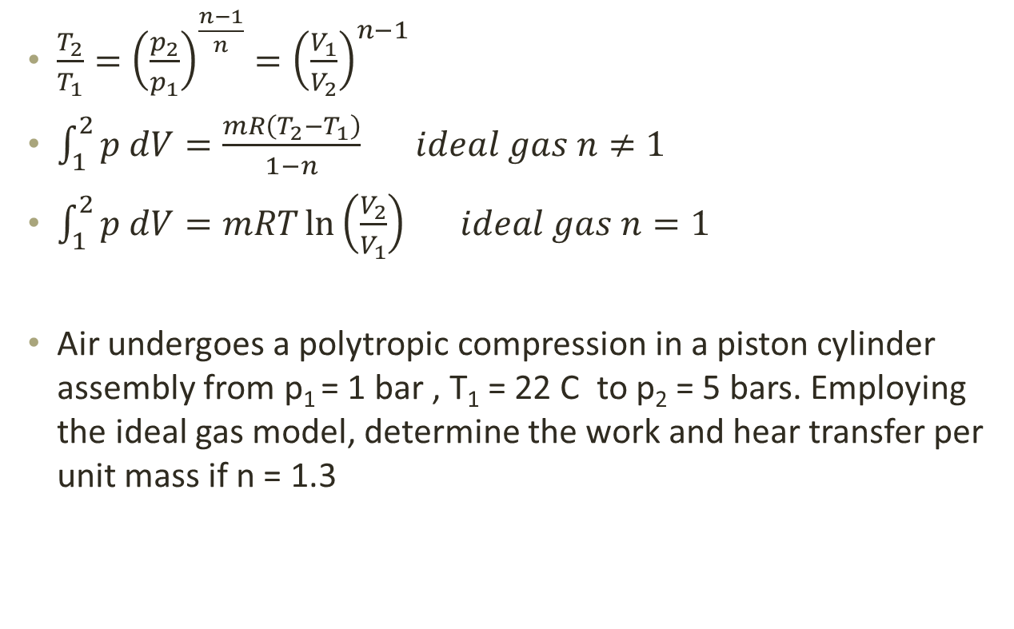
Polytropic Process of Air as an Ideal Gas
$\frac{T_{2}}{T_{1}}={\left(\frac{p_{2}}{p_{1}}\right)}^{\frac{n−1}{n}}={\left(\frac{V_{1}}{V_{2}}\right)}^{n−1}$
$\int_{1}^{2}{p dV=\frac{mR\left(T_{2}−T_{1}\right)}{1−n} ideal gas n≠1}$
$\int_{1}^{2}{p dV=mRT\ln\left(\frac{V_{2}}{V_{1}}\right) ideal gas n=1}$
Air undergoes a polytropic compression in a piston cylinder assembly from p₁ = 1 bar , T₁ = 22 C to p₂ = 5 bars. Employing the ideal gas model, determine the work and hear transfer per unit mass if n = 1.3

Slide 25
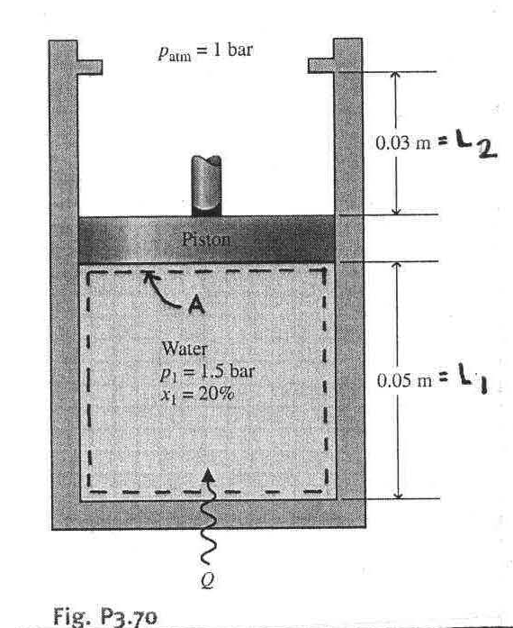
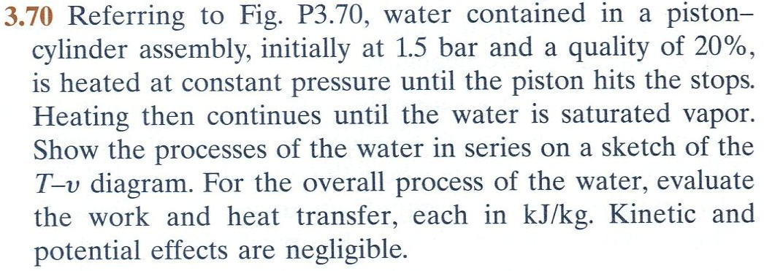
Example

Slide 26
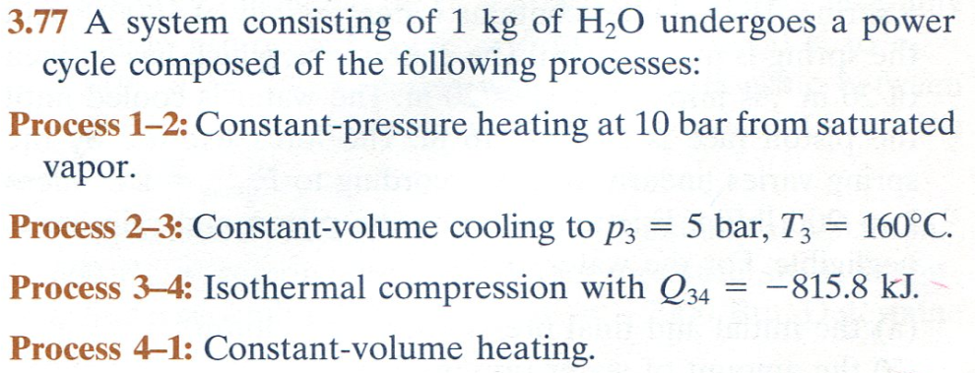
Example 2

Slide 27
Example 3
A tank fitted with an electrical resistor holds 2 kg of nitrogen initially at 27 C, 0.1 MPa. Over a period of 10 minutes, electricity is provided to the resistor at a rate of 0.12 kW. During the same time, a heat transfer of magnitude 12.59 kJ occurs from nitrogen to the ambient. Assume the idea gas behavior, determine the final temperature, in C and pressure, in MPa of the gas.

