Slide 1
Chapter 4 - Control Volumes
Nick DiFilippo

Slide 2

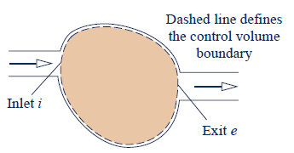

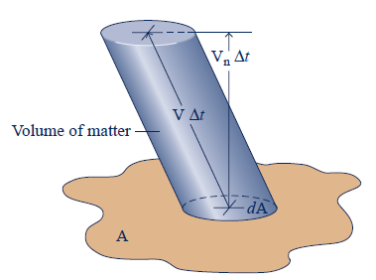
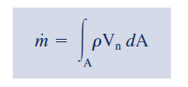
Conservation of Mass
Mass Rate Balance
Mass Flow Rate

Slide 3
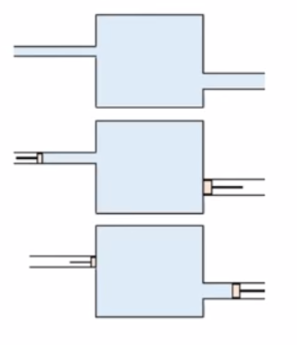
Conservation of Mass Derivation

Slide 4
Examples
Water flows at steady state in a 3cm diameter pipe at 30 m/s. If the diameter is reduced to 2cm, what is the new speed in the pipe?
A piston is fitted into a 2-cm diameter water filled pipe and moves at 1.2cm/s. What is the volumetric flow rate of the water leaving the pipe?
What is the mass flow rate of the water leaving the pipe?

Slide 5
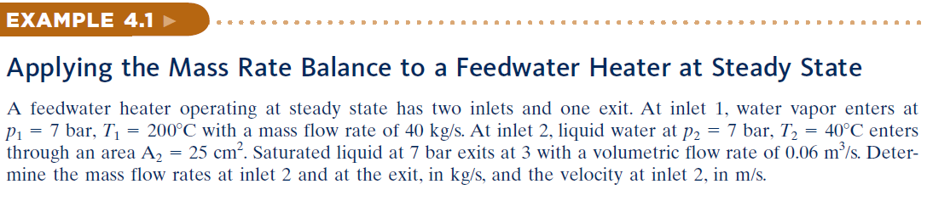
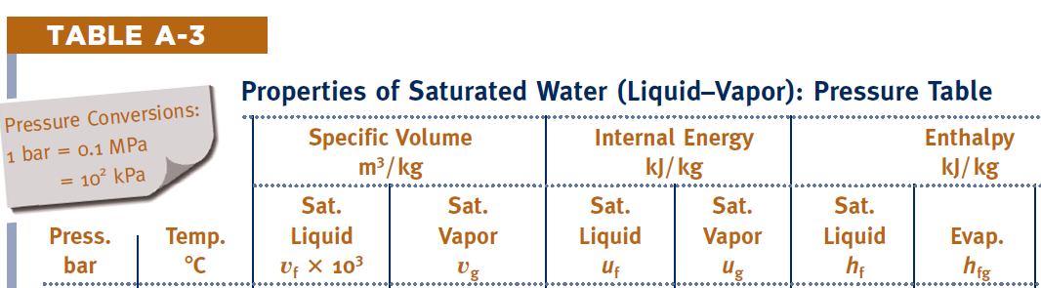
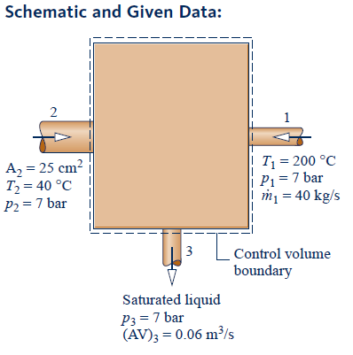
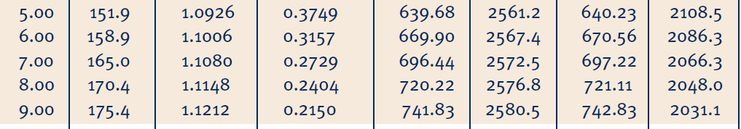
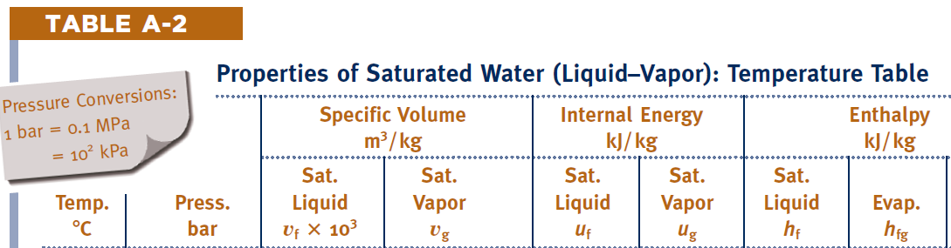
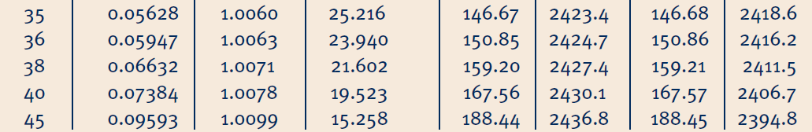

Slide 6
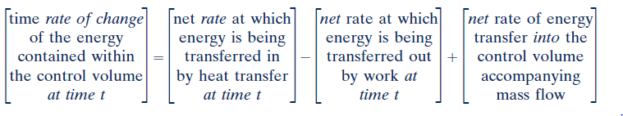
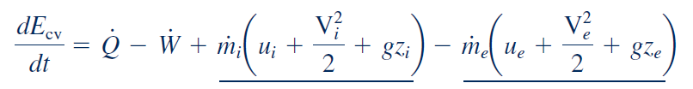
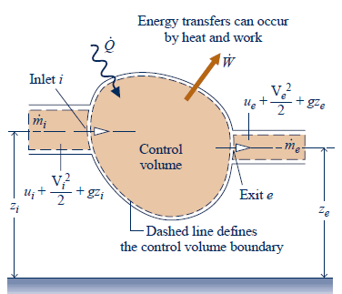
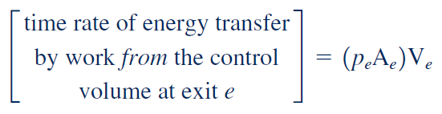
Energy Balance Derivation

Slide 7
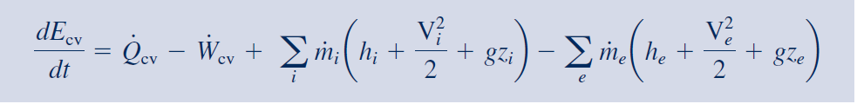
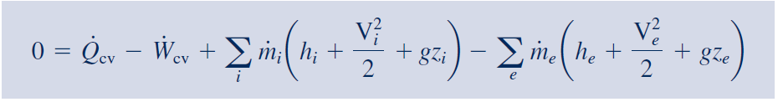
Energy Rate Balance
At Steady State

Slide 8
Steady State Applications
Nozzle and Diffuser
Turbines Compressors and Pumps
Heat Exchanger
Throttling Device

Slide 9
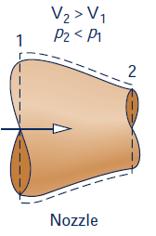
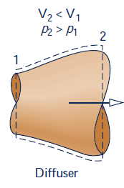

Nozzles and Diffusers
Nozzle – Velocity increases
Diffuser – Velocity decreases

Slide 10
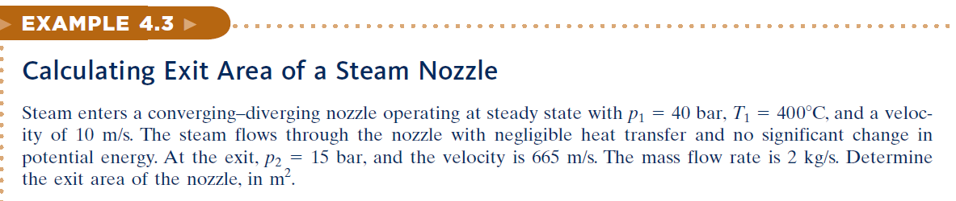
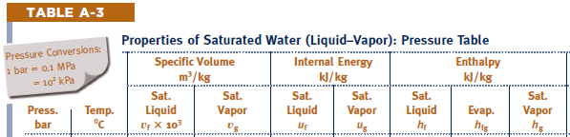
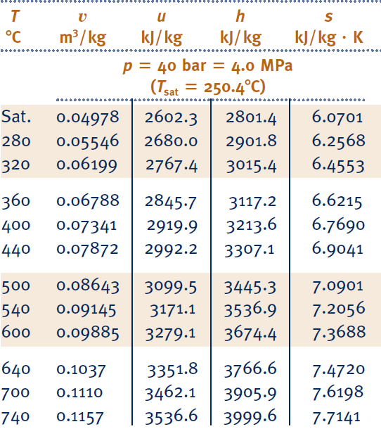


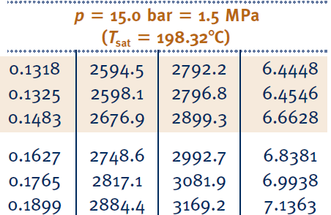


Slide 11
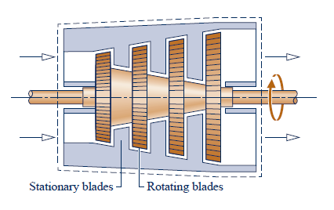
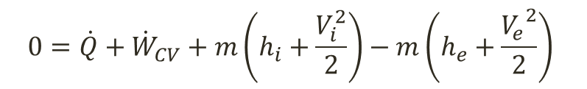
Turbines
Turbines – power is generated as a result of gas or liquid passing through a set of blades attached to a shaft free to rotate
$$0=\dot{Q}+{\dot{W}}_{CV}+m\left(h_{i}+\frac{V_{i}^{2}}{2}\right)−m\left(h_{e}+\frac{{V_{e}^{}}^{2}}{2}\right)$$

Slide 12
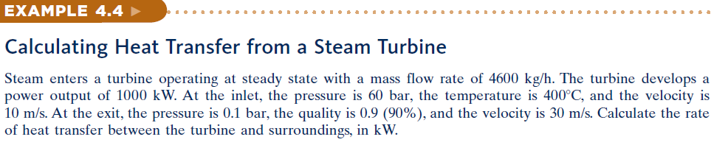
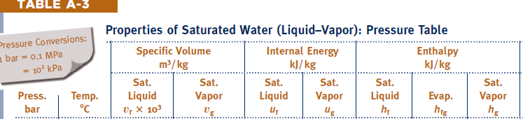

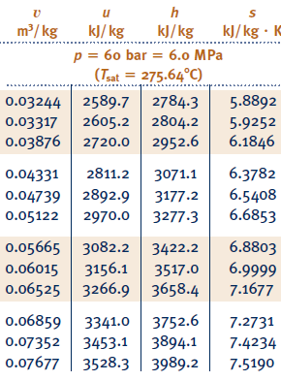

Slide 13
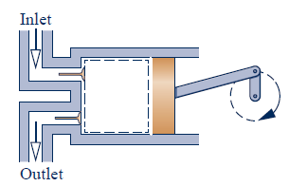
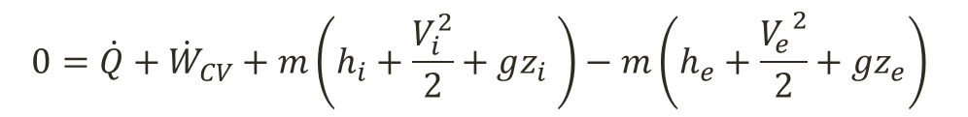
Compressor and Pumps
Compressors and pumps are devices in which work done on the substance flowing through them in order to change the state of the substance
Compressor – substance is gas
Pump – Substance is liquid
$$0=\dot{Q}+{\dot{W}}_{CV}+m\left(h_{i}+\frac{V_{i}^{2}}{2}+gz_{i} \right)−m\left(h_{e}+\frac{{V_{e}^{}}^{2}}{2}+gz_{e}\right)$$

Slide 14
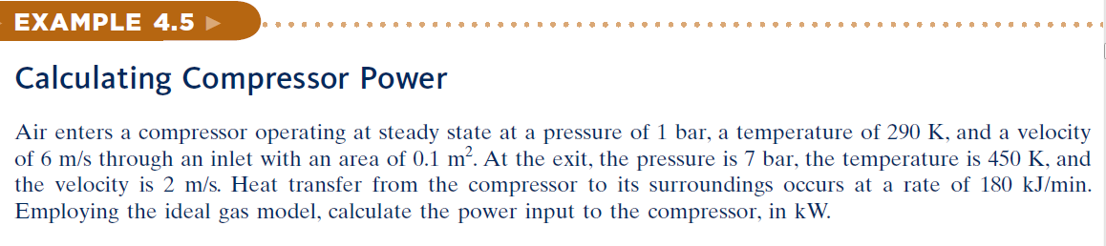
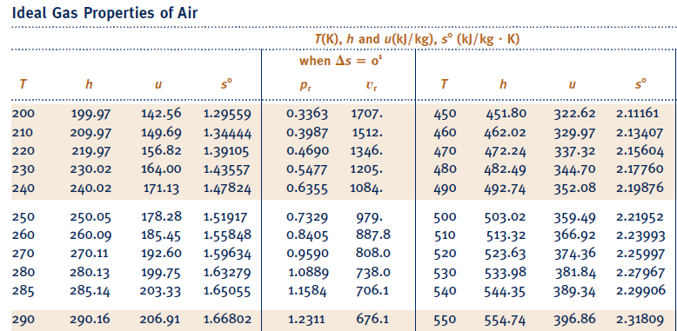

Slide 15
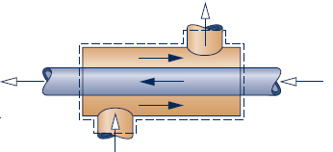

Heat exchanger
Heat exchangers are used in home heating and cooling systems

Slide 16
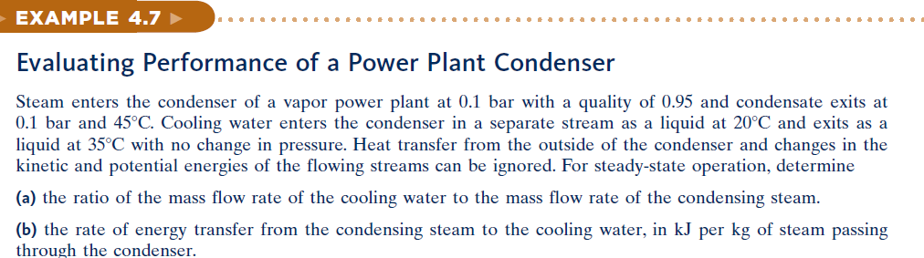
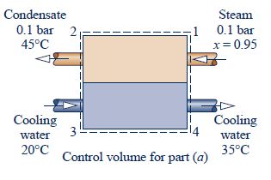
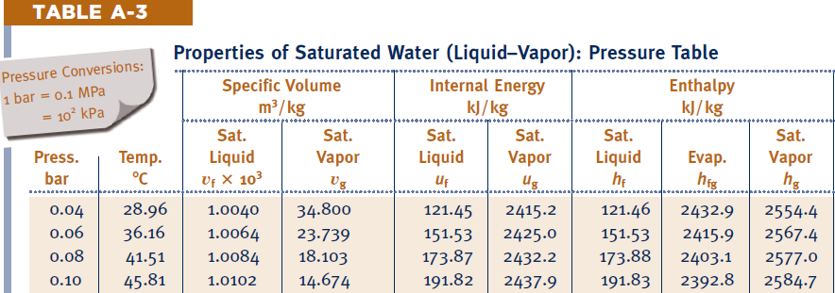

Slide 17
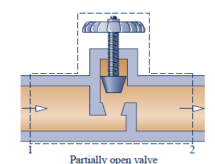
Throttling Device
Throttling Devices can reduce pressure by restricting a line which gas or liquid flows
h₂ = h₁

Slide 18
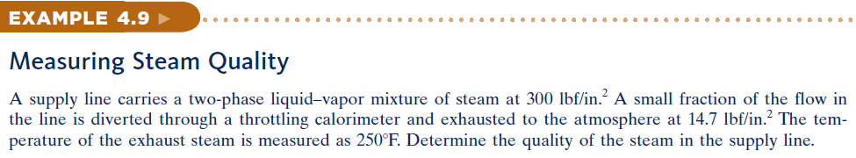
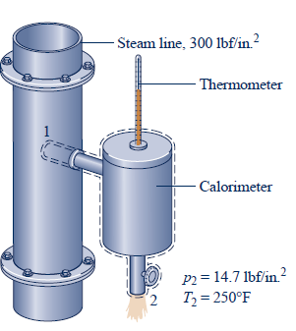
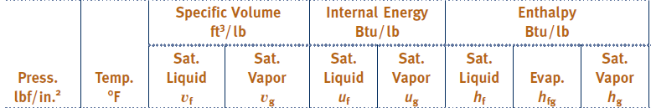
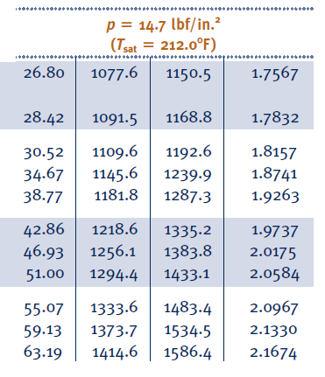


Slide 19
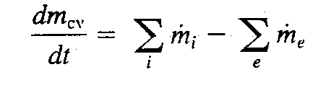
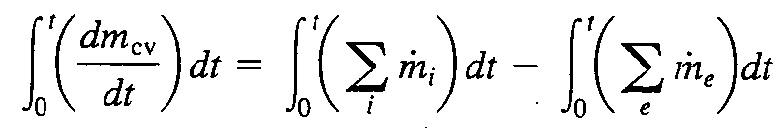
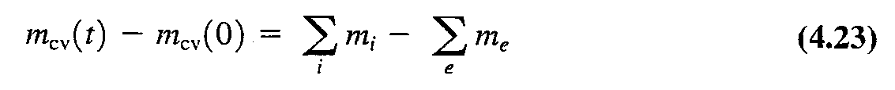
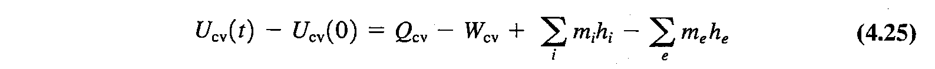
Transient Analysis

Slide 20
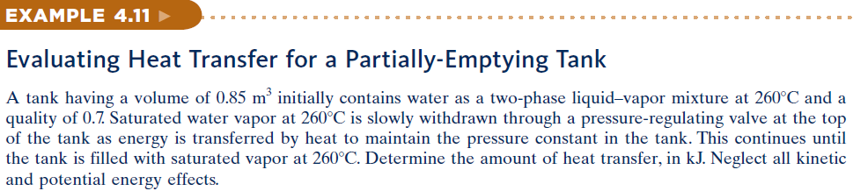
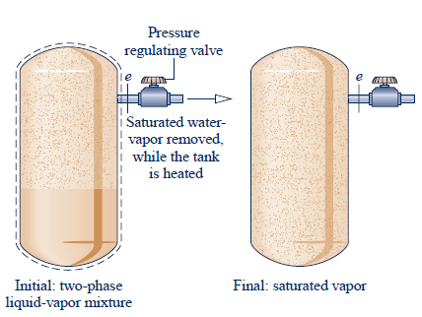

Slide 21
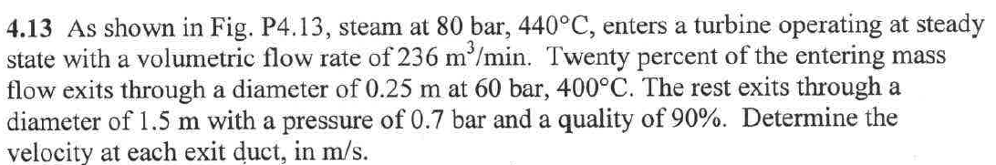
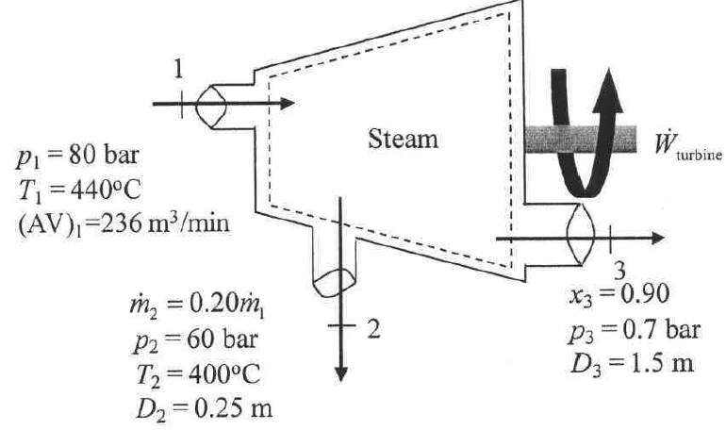

Slide 22
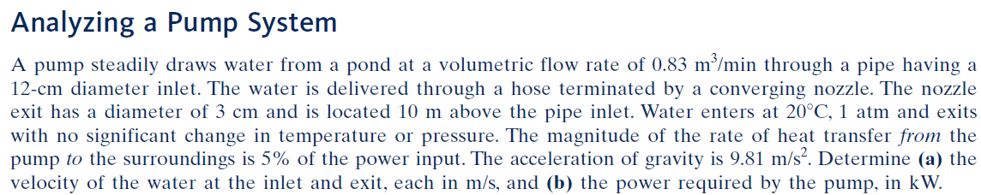
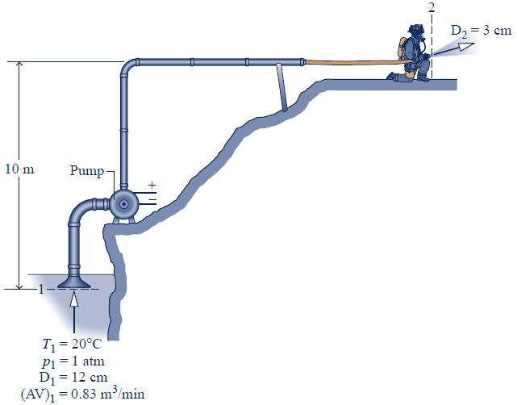


Slide 23



Slide 24



