Slide 1
Lecture 5
Nick DiFilippo
6/2/2015

Slide 2
Exam

Slide 3
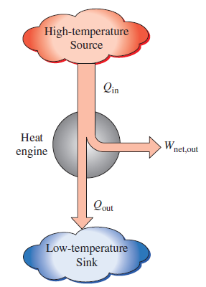
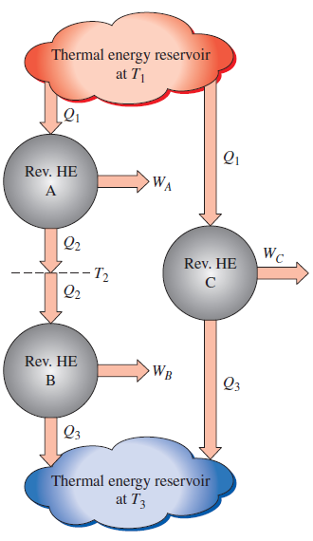
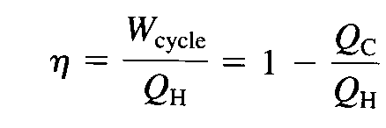
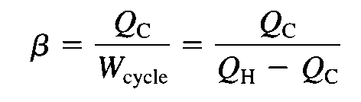
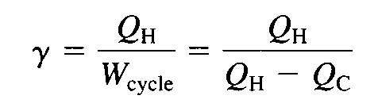
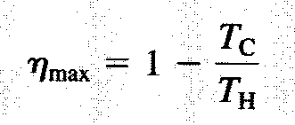
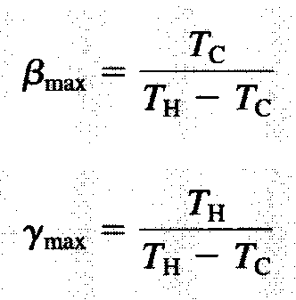
Chapter 5 Review
2nd Law of thermodynamics
Clausius Statement
Kelvin-Plank Statement
Thermodynamic Temperature Scale
Efficiencies/ Maximum Efficiencies
Power Cycle
Refrigeration Cycle
Heat Pump

Slide 4
Carnot Corollaries
The thermal efficiency of an irreversible power cycle is always less than the efficiency of a reversible power cycle when each operates between the same two thermal reservoirs
All reversible power cycles operating between the same two thermal reservoirs have the same two thermal efficiencies

Slide 5
Reversible vs Non-Reversible
Reversible : Idealized Process
A process that can be reversed without leaving any trace on the surroundings.
Internally Reversible
Irreversible Process:
The system and all parts of its surroundings cannot be restored to the initial state.

Slide 6
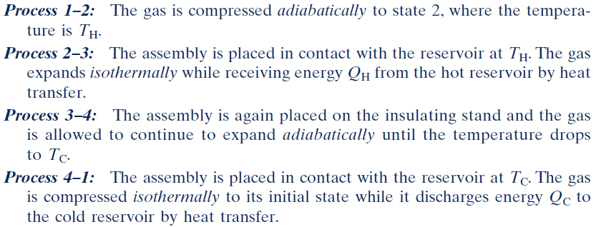
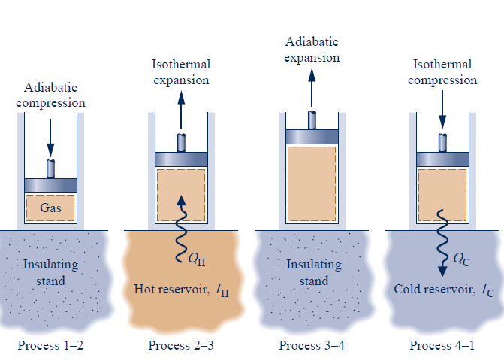
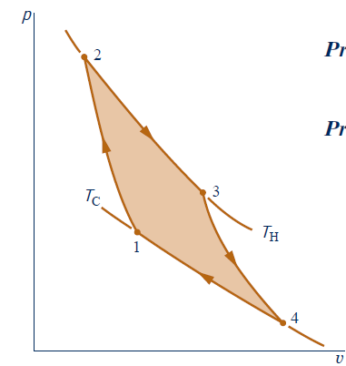
Carnot Power Cycle

Slide 7
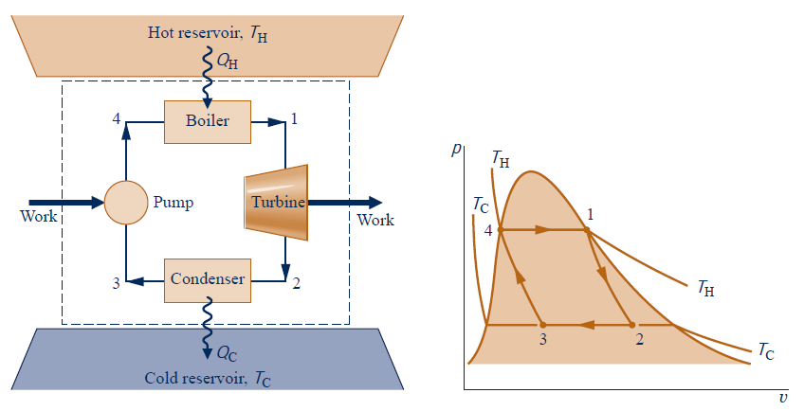

Slide 8


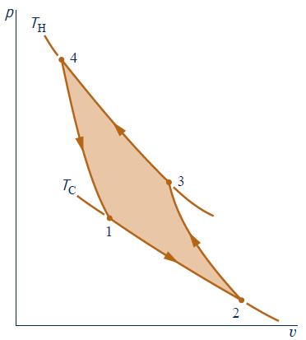
Reversed Carnot Cycle

Slide 9
Example 1
A Carnot heat engine receives 650 kJ of heat from a source of unknown temperature and rejects 250 kJ of it to a sink at 24ºC. Determine the temperature of the source and the thermal efficiency of the heat engine.

Slide 10
Example 2
When a man returns to his well-insulated/sealed house on a summer day, he finds that the house is at 35 °C. He turns on the air conditioner which cools the entire house to 20°C in 30 min. If the COP of the air conditioning system is 2.8, determine the power drawn by the air conditioner. Assume the entire mass within the house is equivalent to 800 kg of air for which Cv = 0.72 kJ/(kg C).

Slide 11
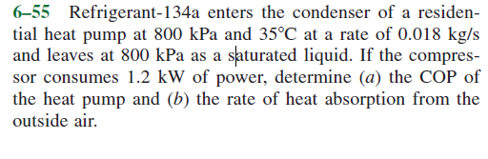
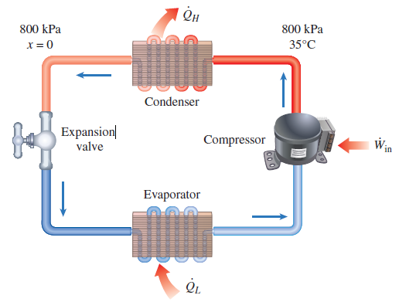
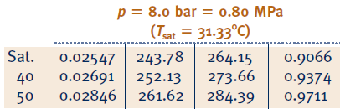

Slide 12
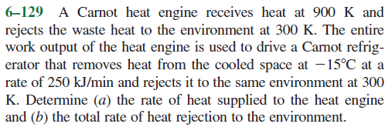

Slide 13
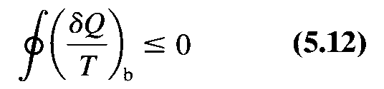
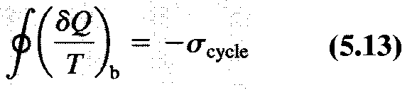
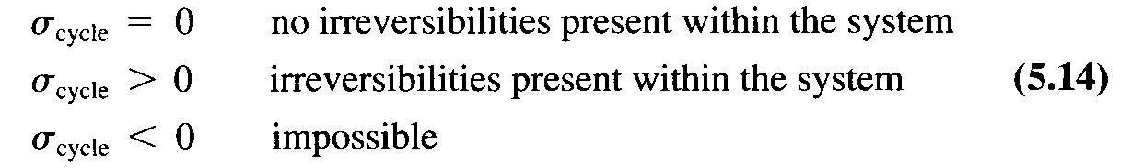

Clausius Inequality
can be regarded as the strength of the irreversibility

Slide 14
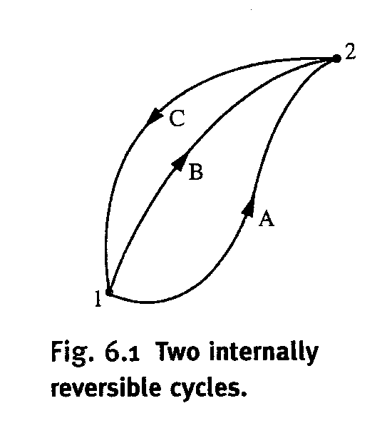
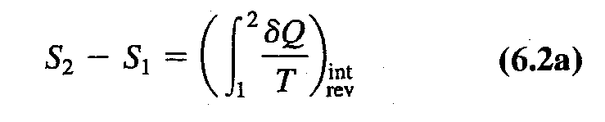
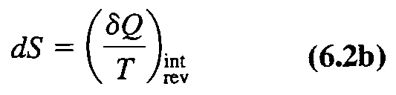
Chapter 6- Entropy
Entropy Change
Extensive Property
Units
A piston cylinder contains a liquid-vapor mixture of water at 300 K. During a constant pressure process, 750 kJ of heat is transferred to the water. As a result, part of the liquid in the cylinder vaporizes. Determine the entropy change of water.

Slide 15
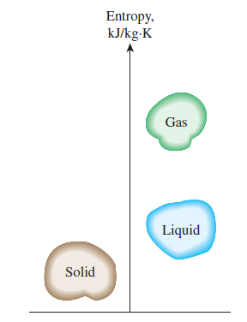
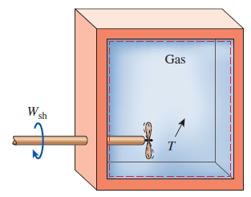
What is entropy
State of disorder
Entropy at absolute zero
Quantity of energy is preserved. Quality is bound to decrease

Slide 16


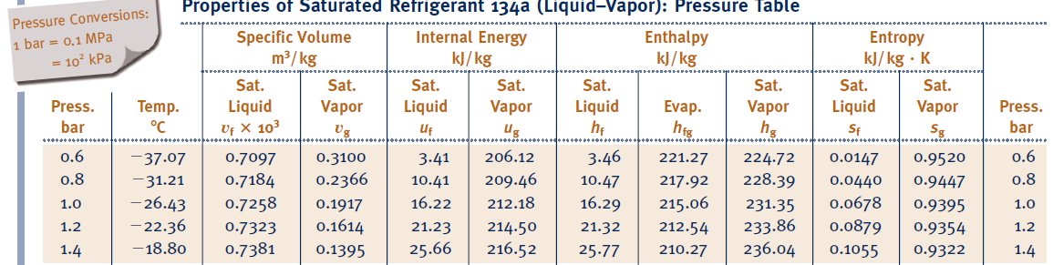
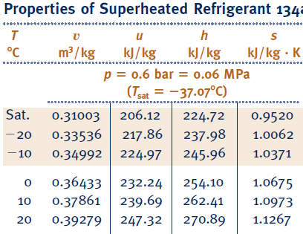
Retrieving Entropy Data
The procedures are identical to retrieve property h, u, and v
For mixture
For compressed liquid

Slide 17


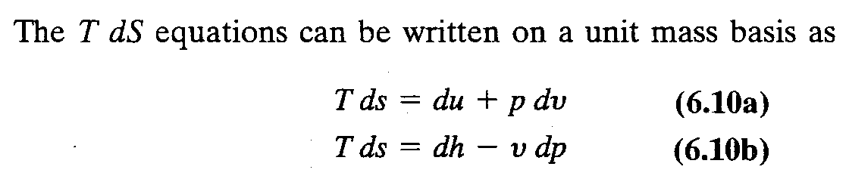
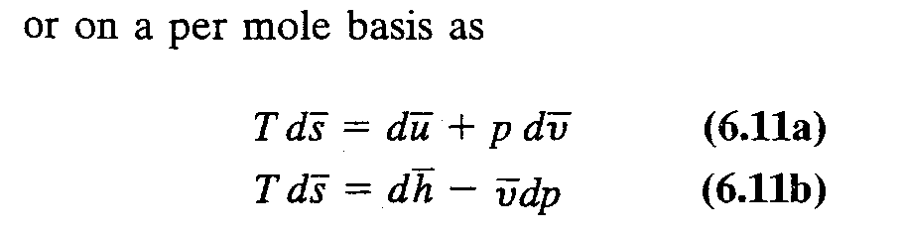
T ds Equations
1st T dS equation is:
2nd T dS equation is:

Slide 18
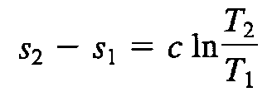
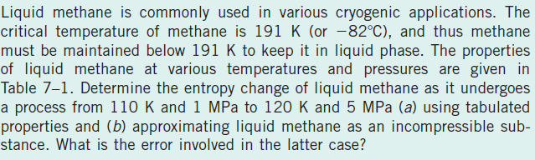
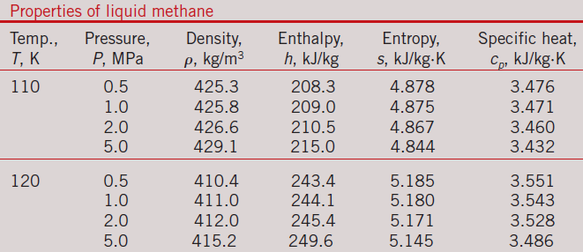
Entropy Change Incompressible

Slide 19
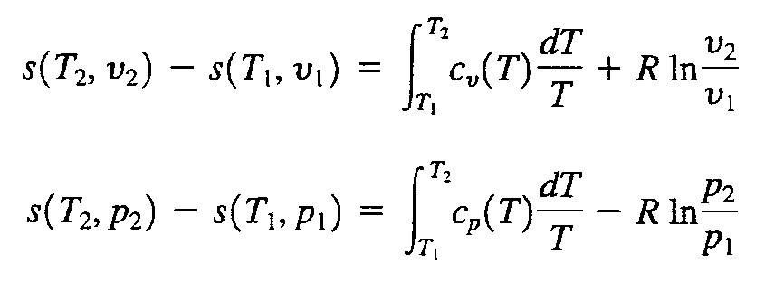
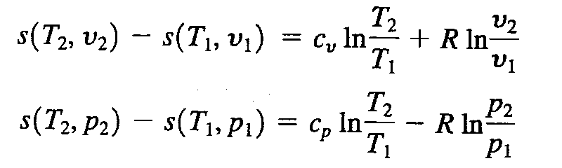
Entropy Change Ideal Gas
On integration, the change of entropy becomes
For constant specific heat

Slide 20
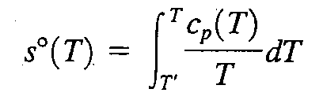
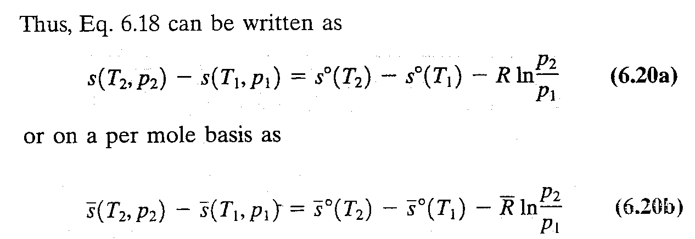
Using Ideal Gas Tables

Slide 21
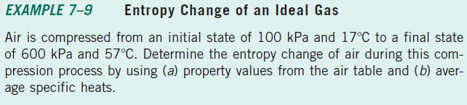
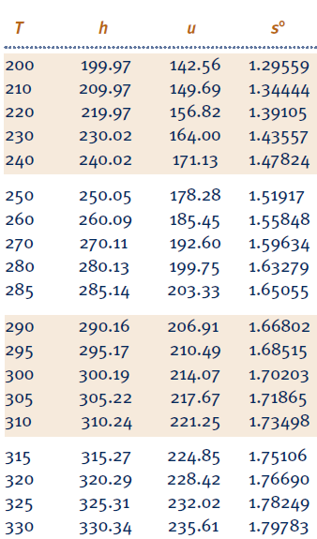
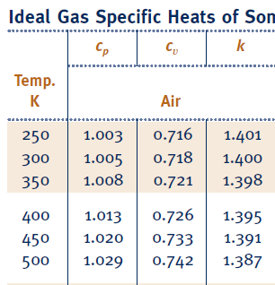

Slide 22
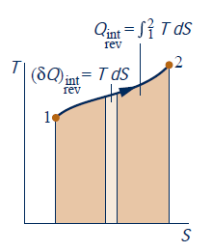
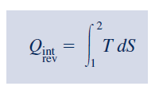
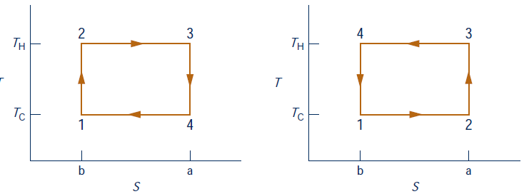
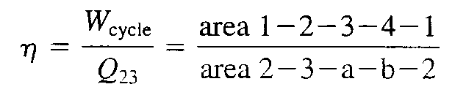
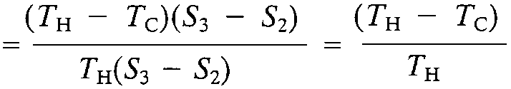
Entropy Changes of Internal Reversible Process
Carnot Cycle
Power
Refrigeration

Slide 23
