Slide 1
Lecture 6 – Entropy
Nick DiFilippo

Slide 2
Review of Last Class
Entropy
Ways to find Entropy
Entropy Change
Incompressible
Ideal Gas
Tables
Reversible Process

Slide 3

Entropy Balance Closed System

Slide 4
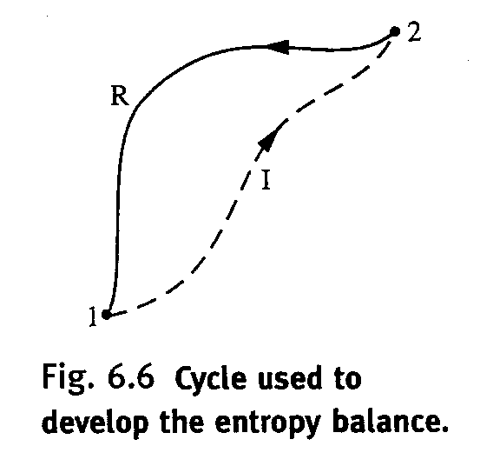
Developing Entropy balance for a Closed System

Slide 5
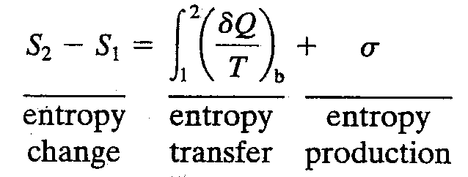
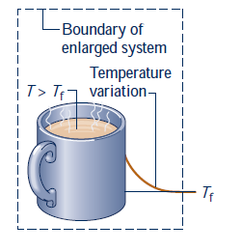
Energy Balance Interpretation
Entropy Transfer
Entropy Production

Slide 6


Example 6.2

Slide 7

Closed System Entropy Rate Balance
Closed System Entropy Rate Balance

Slide 8


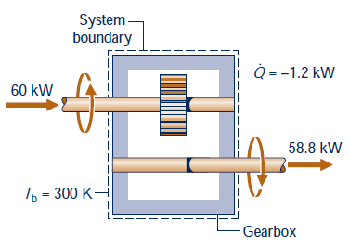
Gearbox Example

Slide 9
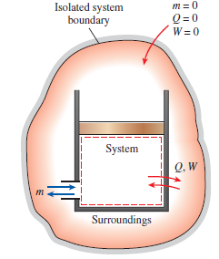
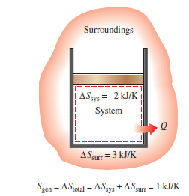
Increase of Entropy Principle
Entropy change of a system can be negative during a process, but entropy generation cannot be.
Processes occur only in such a direction that the total entropy of the system plus surroundings increases

Slide 10
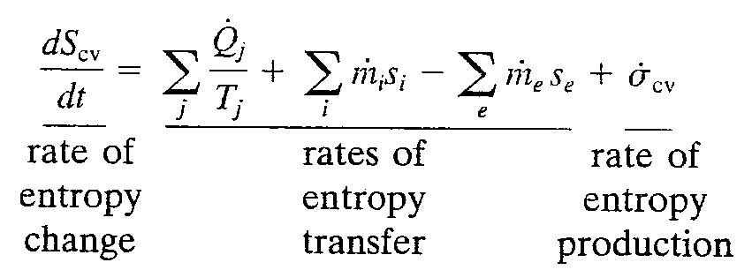



Entropy Balance for Control Volumes
Rate Balances for Control Volumes at Steady State
(4.6)
(4.18)
(6.36)

Slide 11


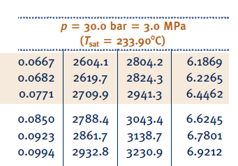


Slide 12
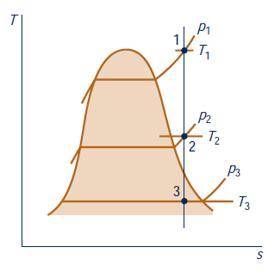

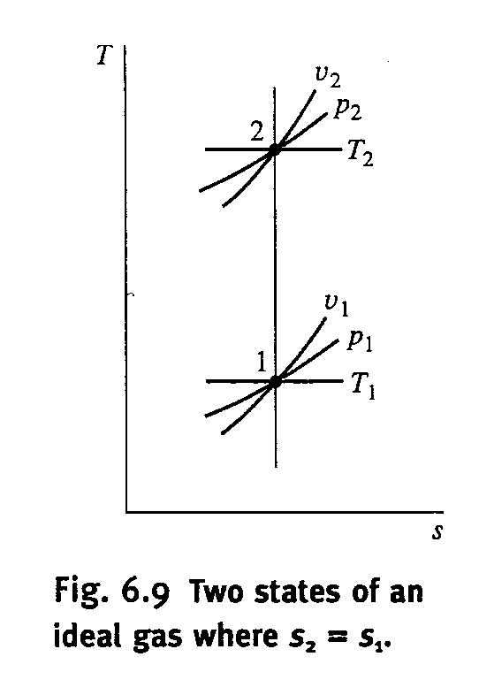



Isentropic Process
Constant Entropy
Ideal Gas Model

Slide 13
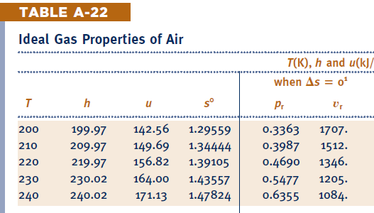

Slide 14
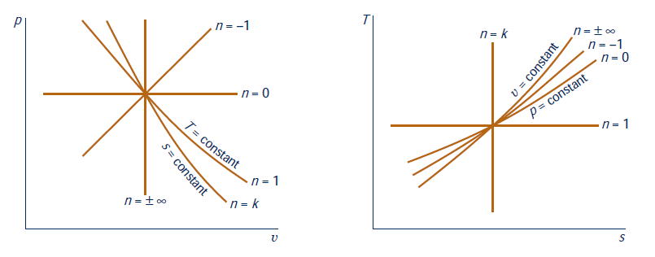
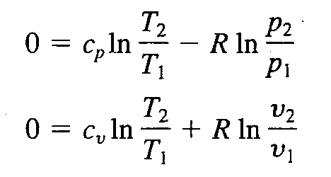
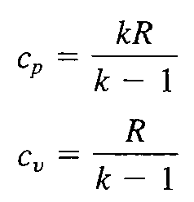
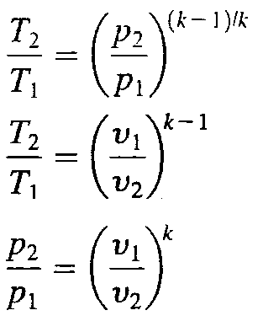

Isentropic Process Constant Specific Heat

Slide 15

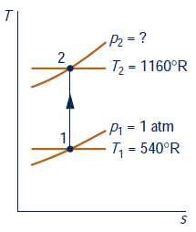
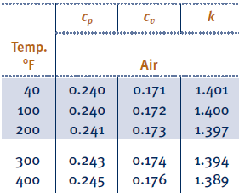
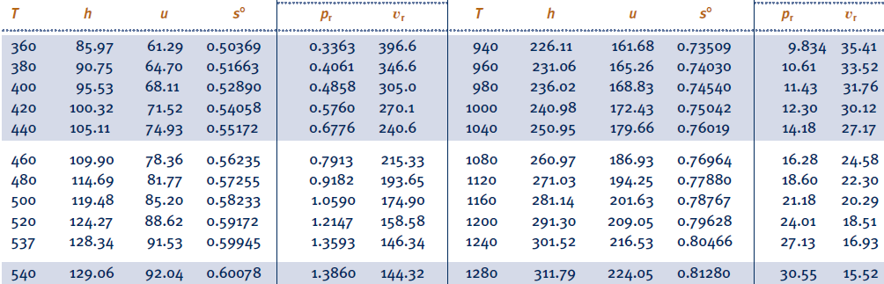

Slide 16
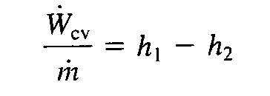
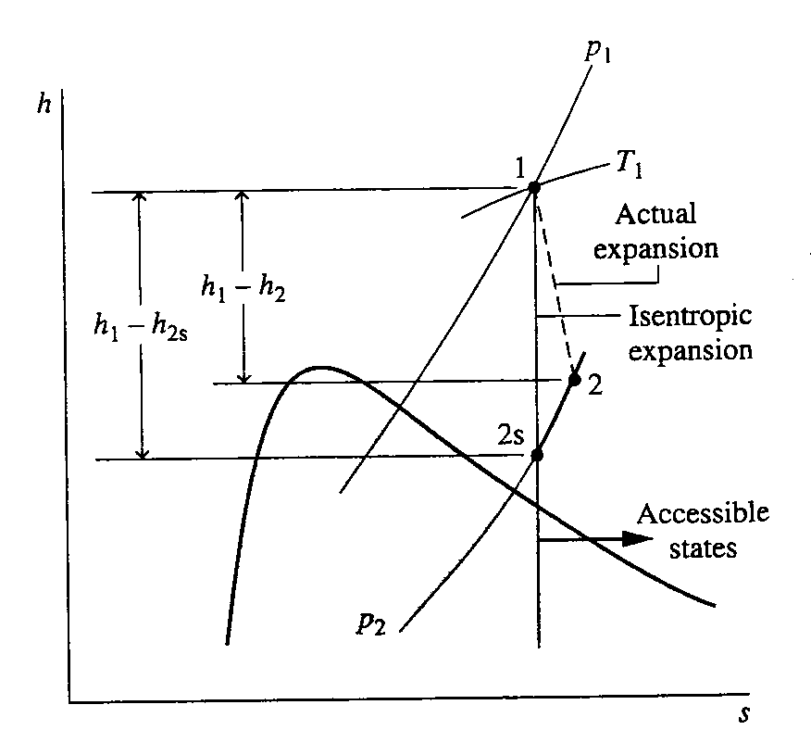
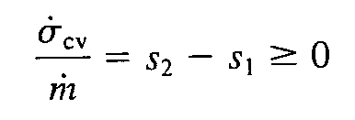
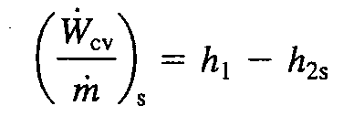

Isentropic Efficiencies of Industrial Devices
Work per unit Mass
Turbines

Slide 17
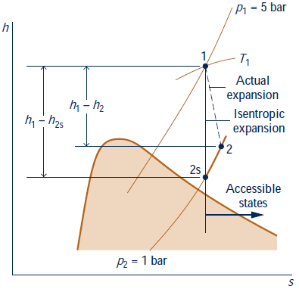
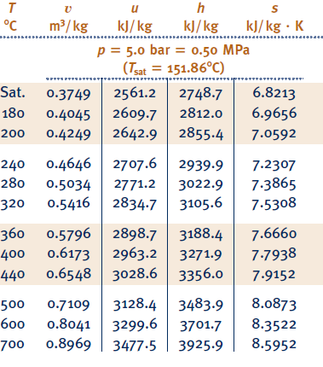
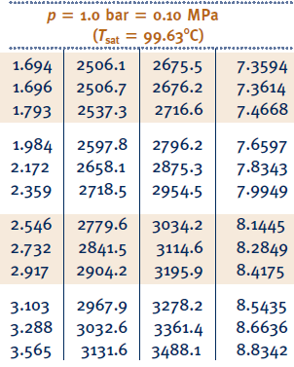


Slide 18
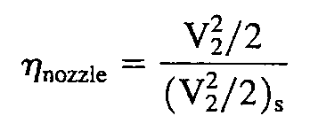
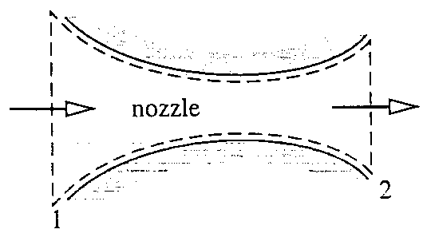


Nozzle
(neglect )

Slide 19
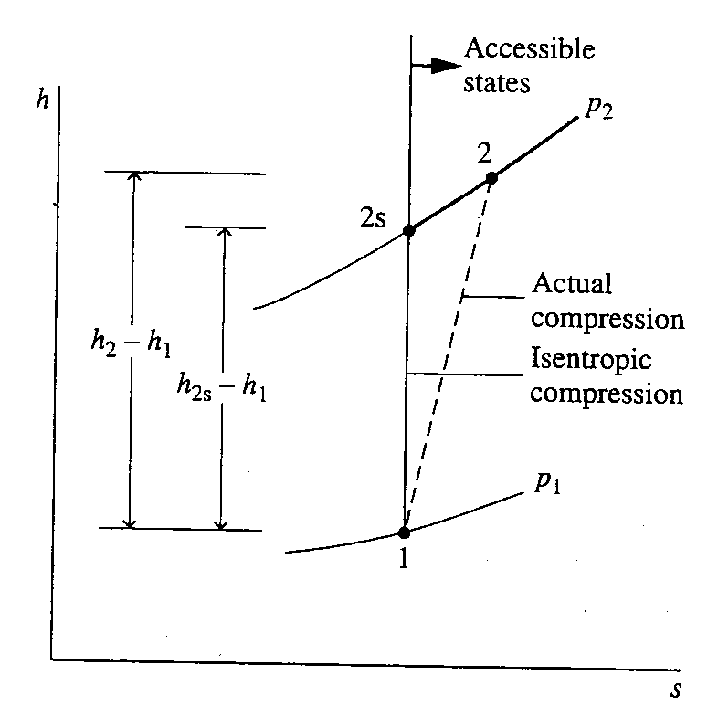
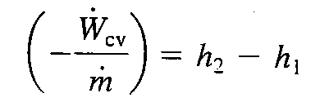
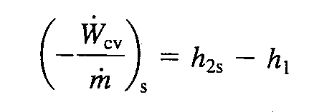

Compressors and Pumps

Slide 20
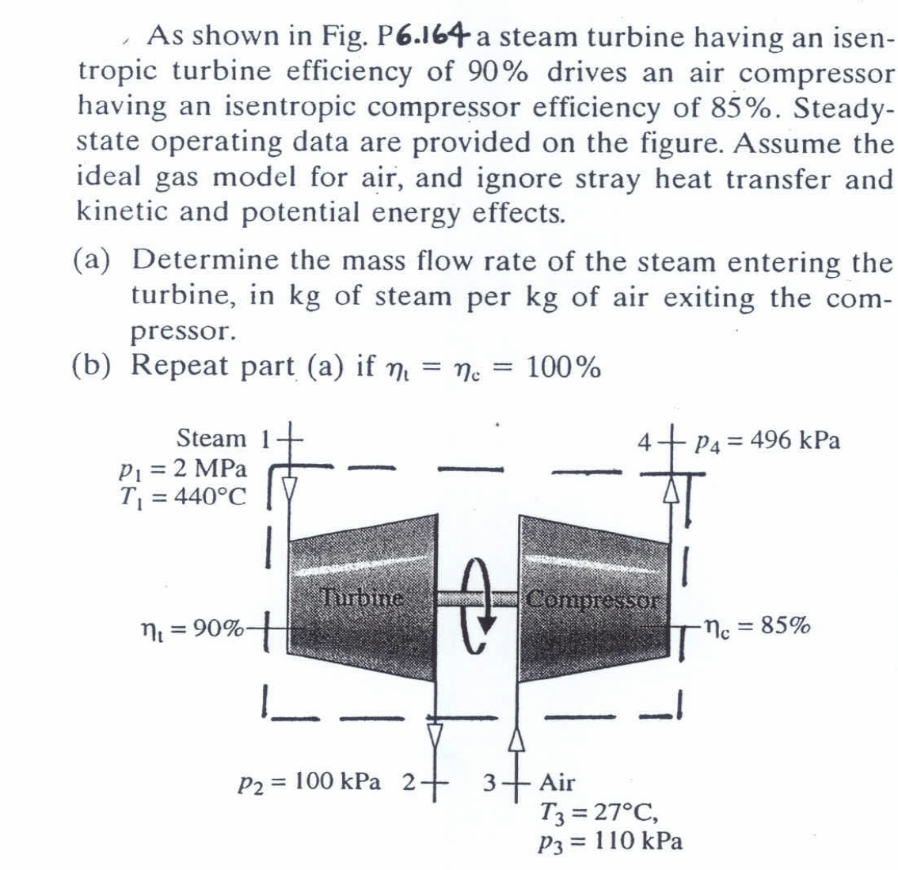
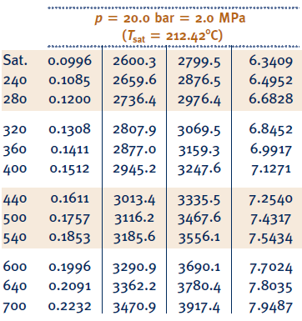


Slide 21
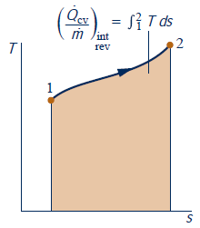



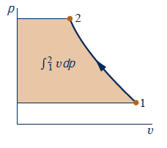


Internally Reversible, Steady State Flow Processes

Slide 22




Work in a Polytropic Process
Ideal Gas

Slide 23

