Slide 1
Chapter 8 Vapor Power System
Nick DiFilippo

Slide 2
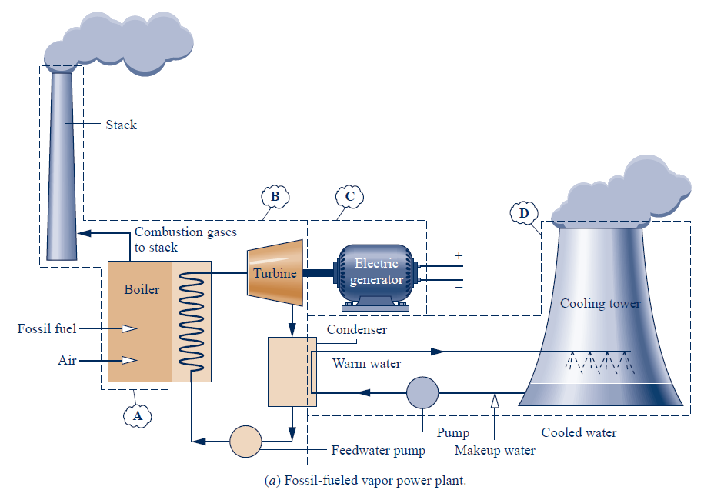

Slide 3
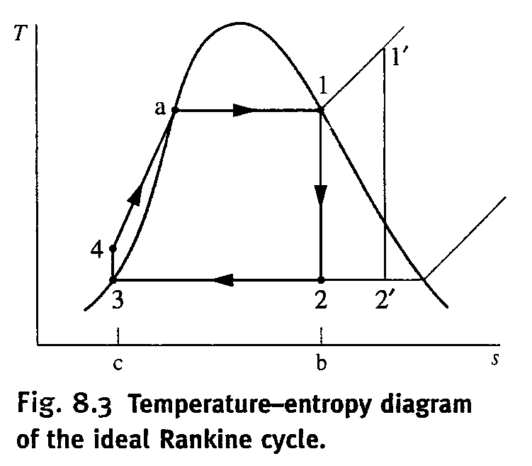
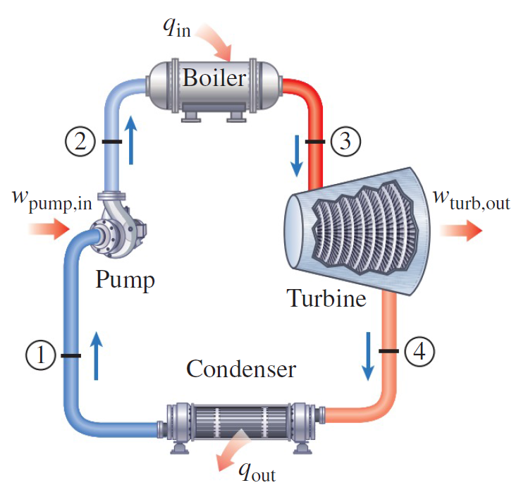
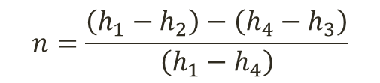
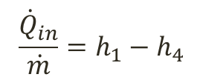
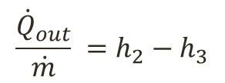
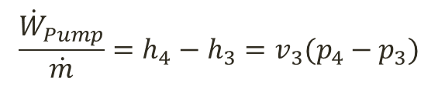

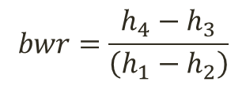
The Ideal Rakine Cycle
4
1
3
2
Turbine (Q = 0)
$\frac{{\dot{W}}_{Turbine}}{\dot{m}}=h_{1}−h_{2}$
$$n=\frac{\left(h_{1}−h_{2}\right)−\left(h_{4}−h_{3}\right)}{\left(h_{1}−h_{4}\right)}$$
Condenser(W = 0)
$$\frac{{\dot{Q}}_{out}}{\dot{m}} =h_{2}−h_{3}$$
$$bwr=\frac{h_{4}−h_{3}}{\left(h_{1}−h_{2}\right)}$$
Pump(Q = 0)
$$\frac{{\dot{W}}_{Pump}}{\dot{m}}=h_{4}−h_{3}=v_{3}(p_{4}−p_{3})$$
Boiler(W = 0)
$$\frac{{\dot{Q}}_{in}}{\dot{m}}=h_{1}−h_{4}$$

Slide 4


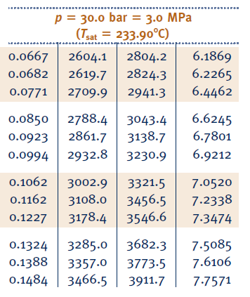
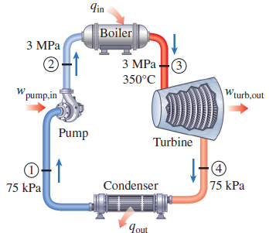

Rakine Cycle
Pressure | T_sat

Slide 5
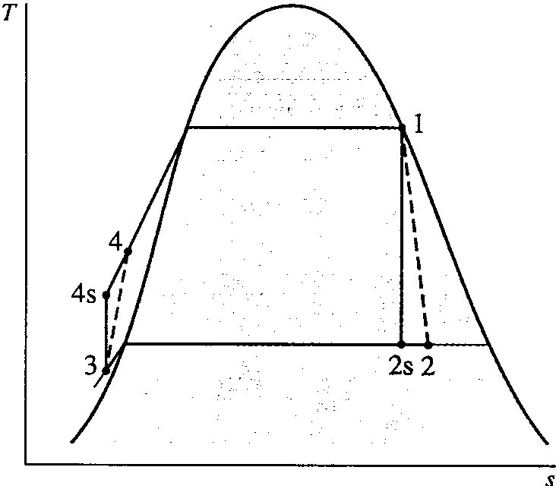
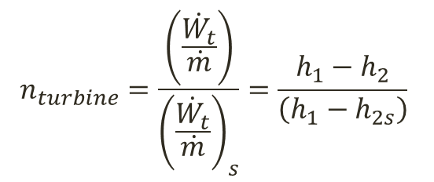
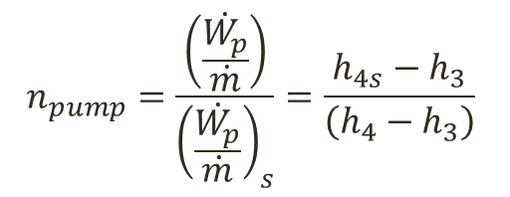
Deviations from Ideal
$$n_{turbine}=\frac{\left(\frac{\dot{W_{t}}}{\dot{m}}\right)}{{\left(\frac{\dot{W_{t}}}{\dot{m}}\right)}_{s}}=\frac{h_{1}−h_{2}}{\left(h_{1}−h_{2s}\right)}$$
$$n_{pump}=\frac{\left(\frac{\dot{W_{p}}}{\dot{m}}\right)}{{\left(\frac{\dot{W_{p}}}{\dot{m}}\right)}_{s}}=\frac{h_{4s}−h_{3}}{\left(h_{4}−h_{3}\right)}$$

Slide 6
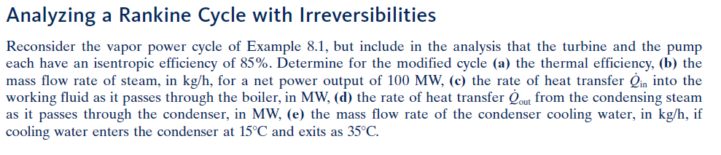
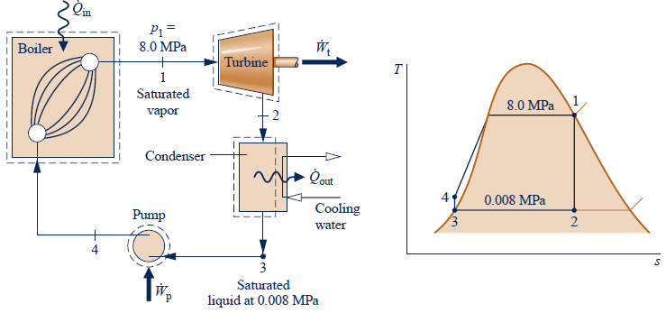

Slide 7
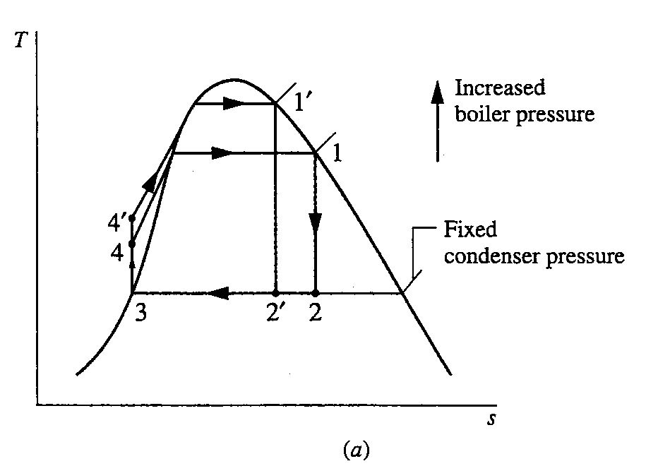
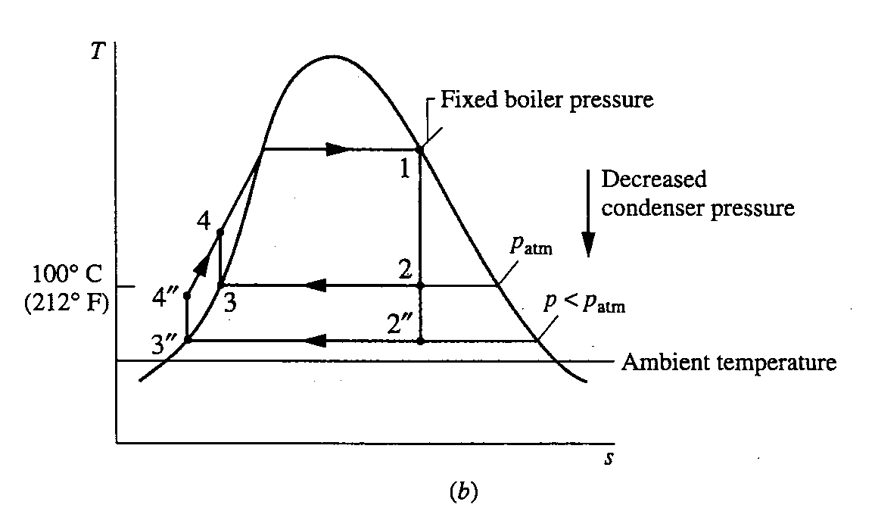
Effects of varying pressures

Slide 8
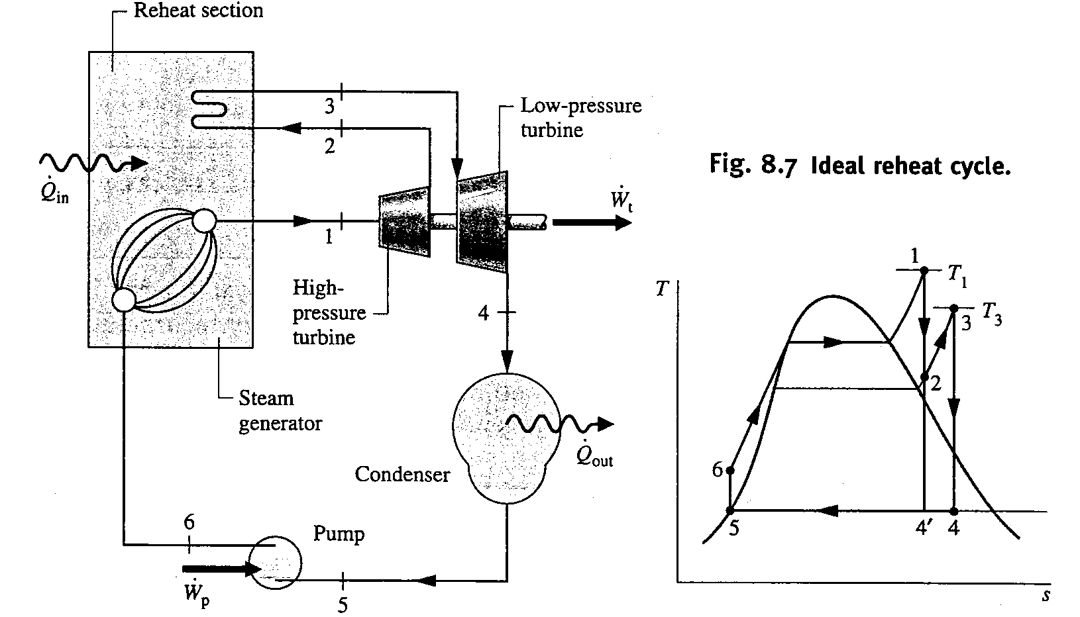
Ideal Reheat Cycle

Slide 9
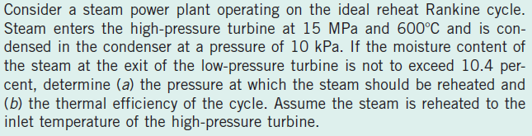
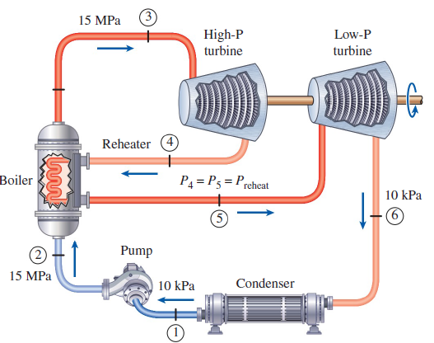
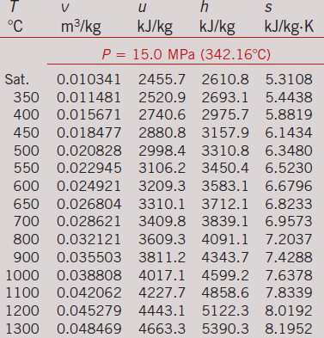
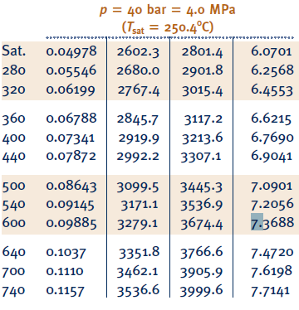
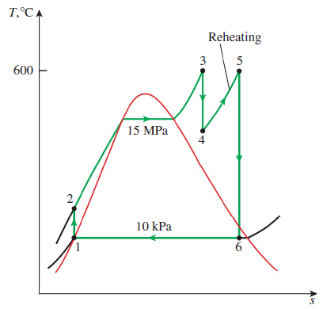

Slide 10
4
1
3
2

Slide 11
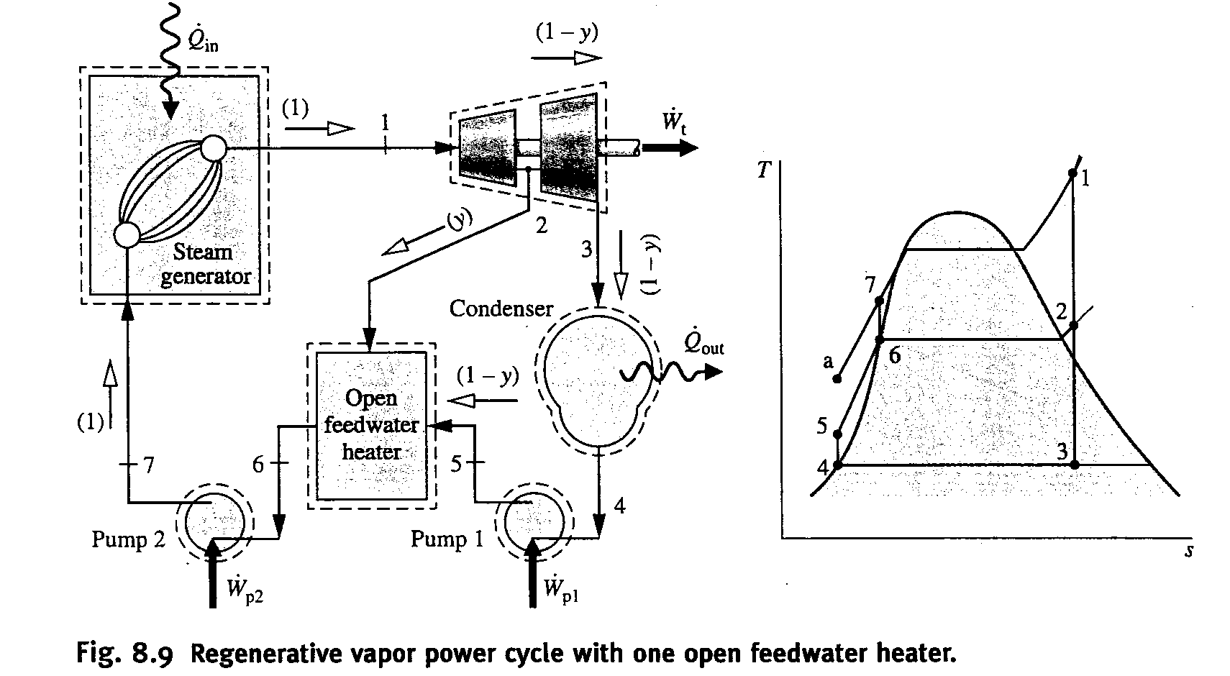

Open Feedwater Systems
$$y=\frac{h_{6}−h_{5} }{h_{2}−h_{5}}$$

Slide 12
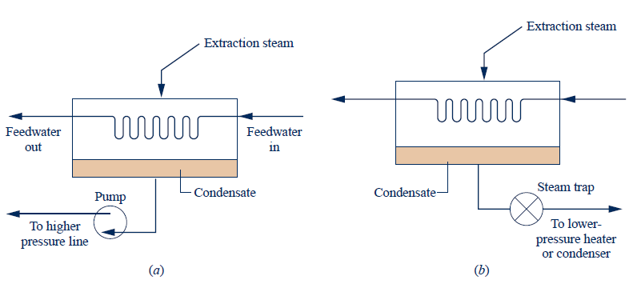
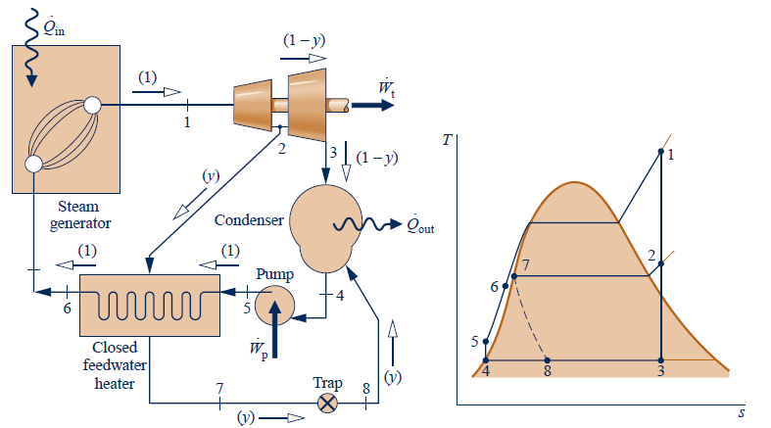
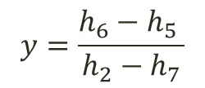
Closed Feedwater Systems
Removing condensate
$$y=\frac{h_{6}−h_{5} }{h_{2}−h_{7}}$$

