Slide 1
Gas Power Systems
Nick DiFilippo

Slide 2
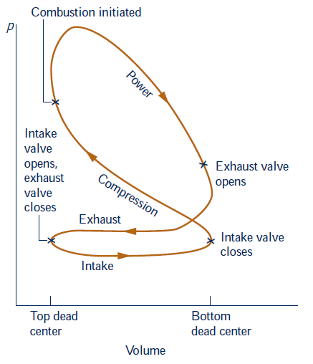
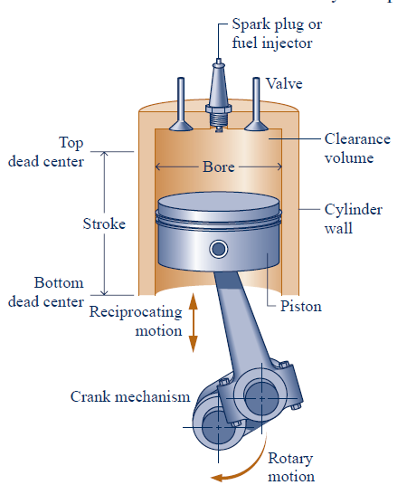
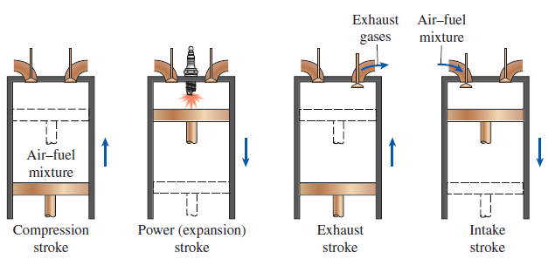
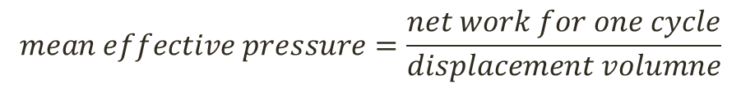
$$mean effective pressure=\frac{net work for one cycle}{displacement volumne}$$
Spark Ignition
Compression Ignition
Compression Ratio

Slide 3
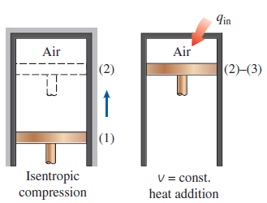
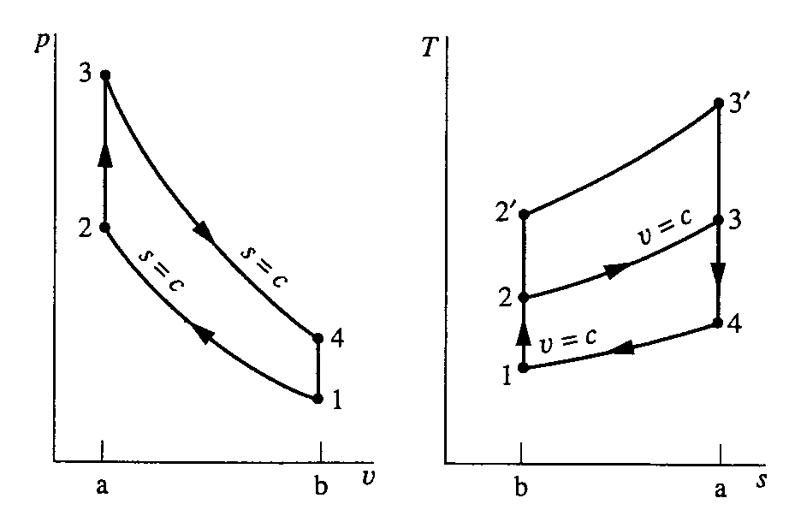
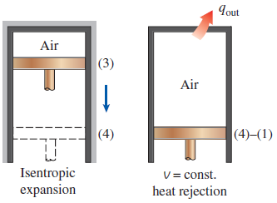
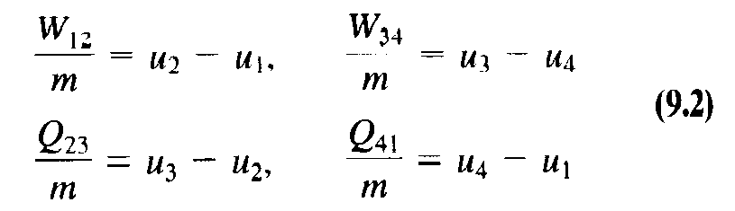
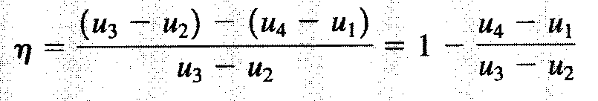
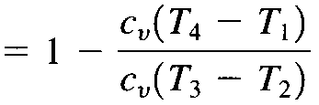

Air Standard Otto Cycle
Q
Q
Q
Q

Slide 4
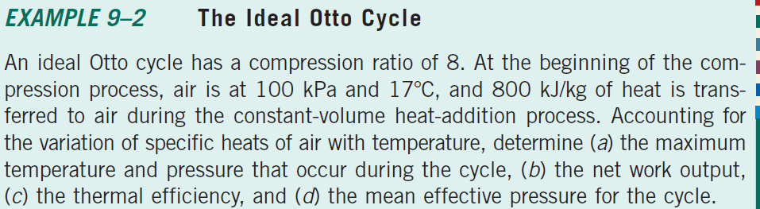


Slide 5
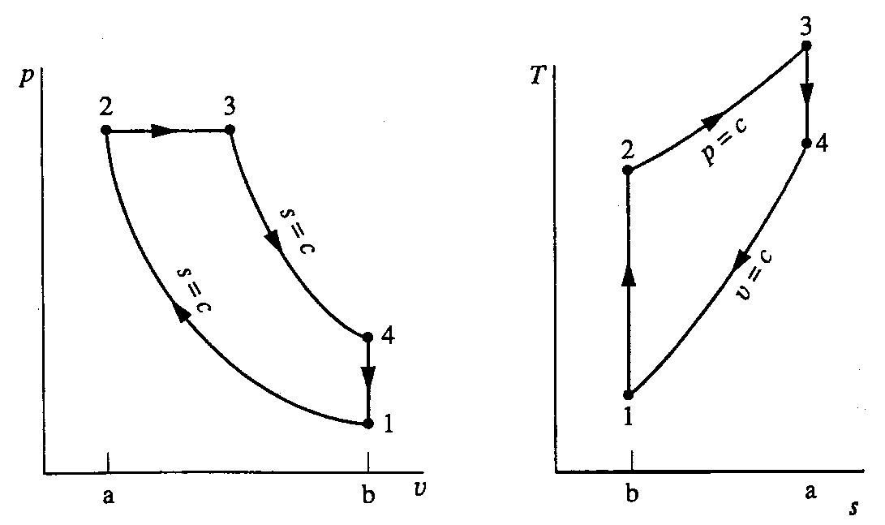
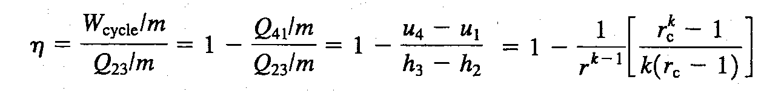
Air Standard Diesel Cycle
Q
Q
Q
Q
Air standard
Cold air standard

Slide 6
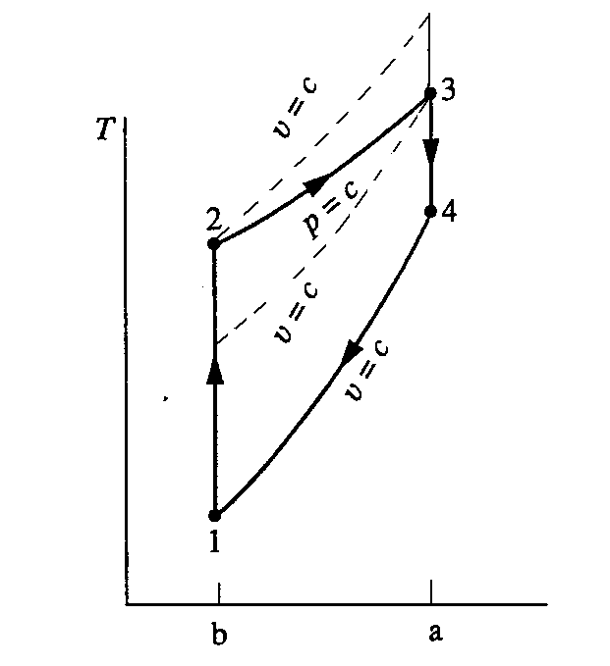
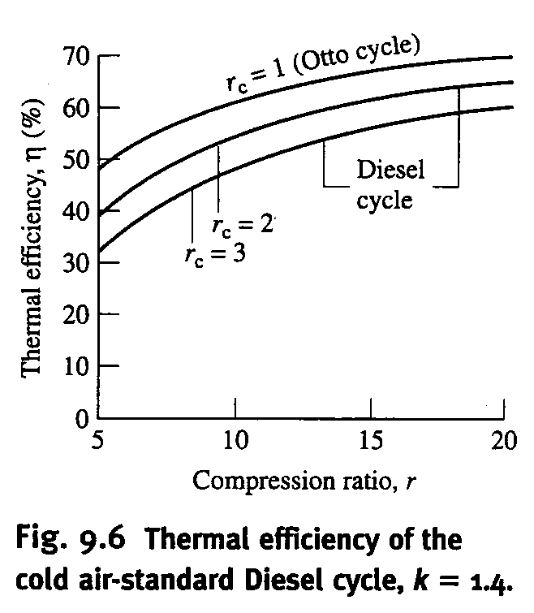
Comparison of Otto and Diesel Cycle

Slide 7
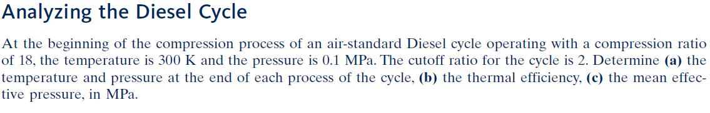



Slide 8
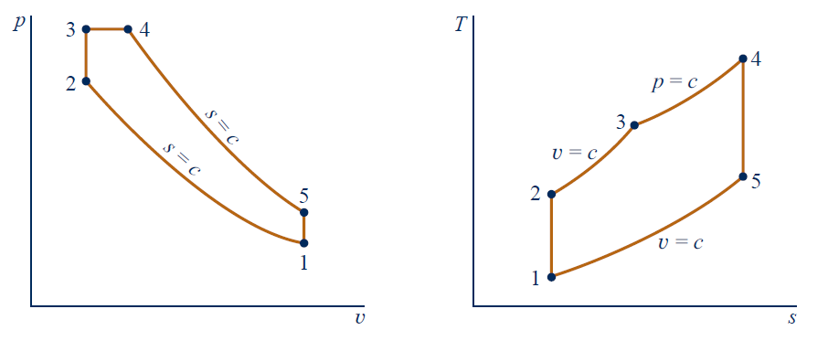
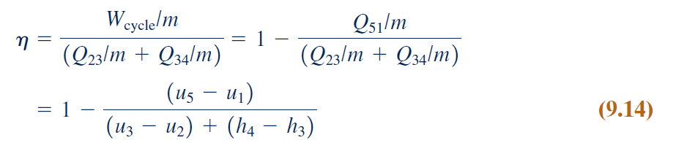
Air Standard Dual Cycle
Q
Q
Q
Q
Q
Q

Slide 9
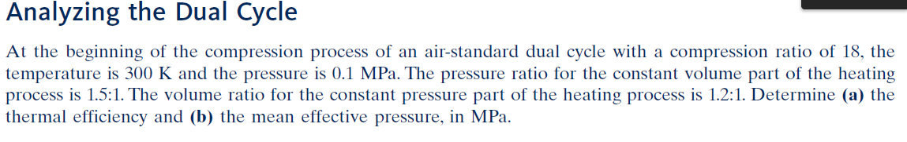
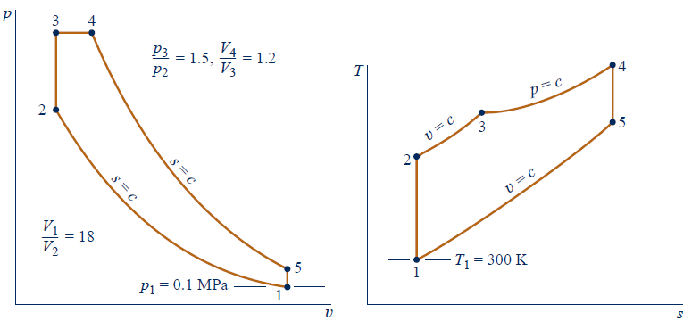

Slide 10
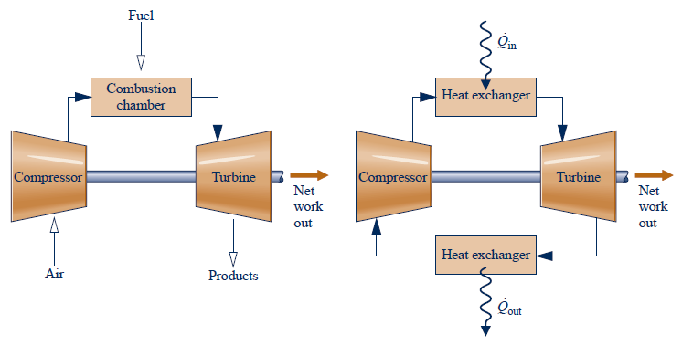
Gas Turbine Power Plants

Slide 11
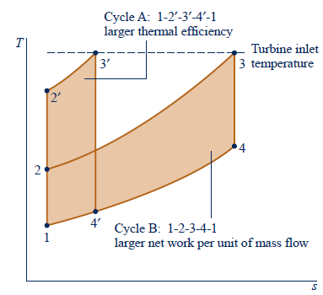
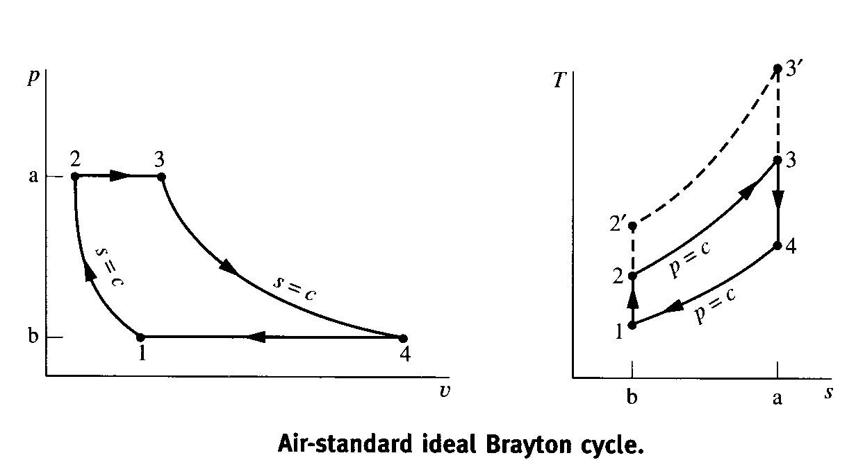







Air Standard Brayton Cycle

Slide 12
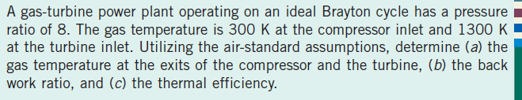
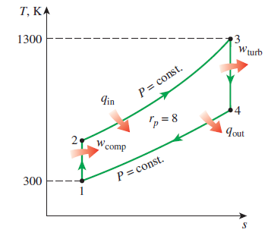


Slide 13
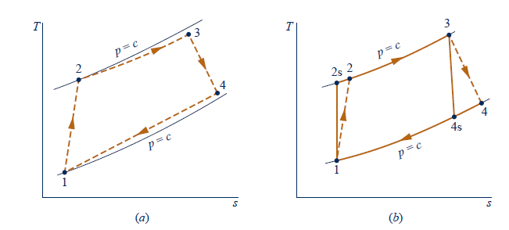
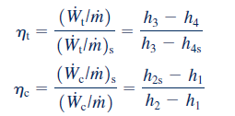
Actual Gas Turbine

Slide 14
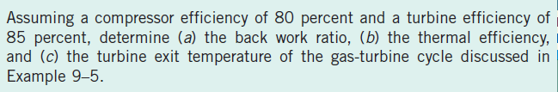
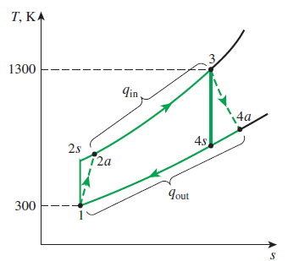


State 1
State 2s
State 3
State 4s
T1 = 300K
h1 = 300.19 kJ/kg
Pr1 = 1.3860
T2s = 540K
h2s = 544.24 kJ/kg
T3 = 1300K
h3 = 1395.97kJ/kg
Pr3 = 330.9
T4s = 720.2K
h4s = 789.37 kJ/kg

Slide 15
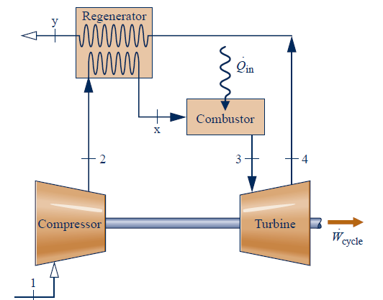
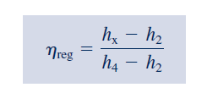

Brayton With Regeneration
T4>T2

Slide 16
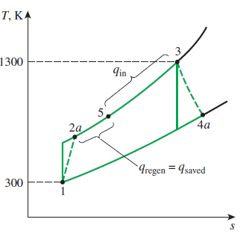
State 1
State 2s
State 3
State 4s
T1 = 300K
h1 = 300.19 kJ/kg
Pr1 = 1.3860
T2s = 540K
h2s = 544.24 kJ/kg
T3 = 1300K
h3 = 1395.97kJ/kg
Pr3 = 330.9
T4s = 720.2K
h4s = 789.37 kJ/kg
State 2
State 4
T2 = 598K
h2 = 605.39 kJ/kg
T4 = 853K
h4 = 880.36 kJ/kg

Slide 17
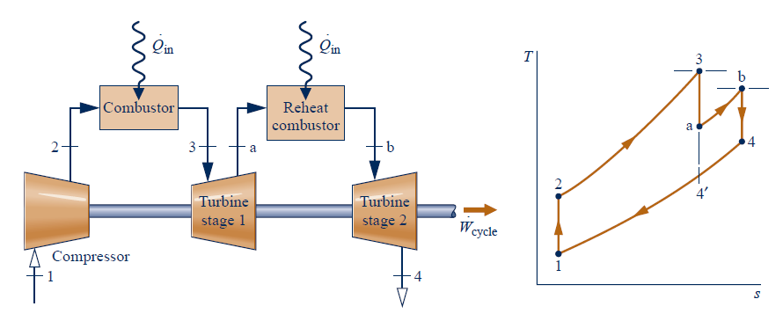
Brayton with Intercooling, Reheating and Regeneration
Reheat

Slide 18
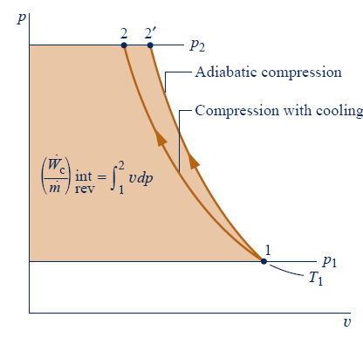
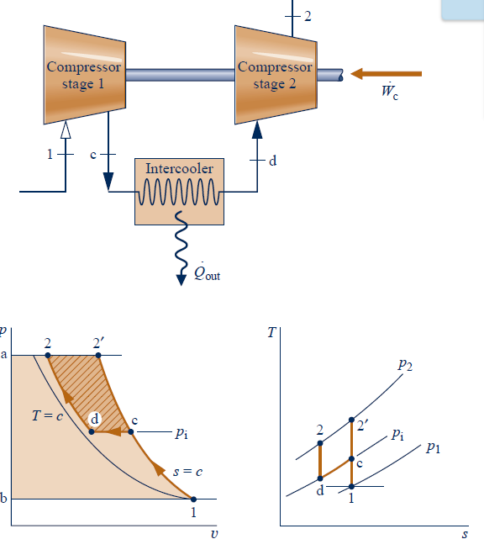

Slide 19
