Slide 1
Refrigeration and Heat Pump Systems
Nick DiFilippo 6/16/2015

Slide 2
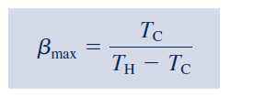
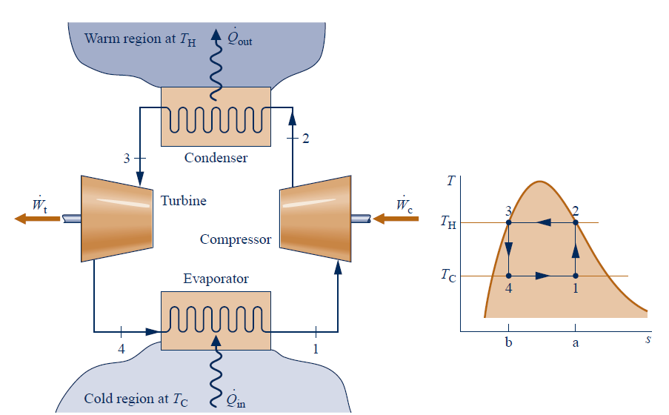
Vapor Refrigeration Systems
Carnot Refrigeration Cycle

Slide 3
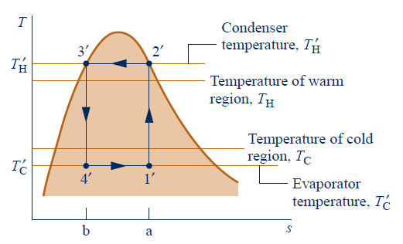
Departures from Carnot Cycle
Heat Transfers
Wet Compression vs. Dry Compression
Turbine and Throttling Valve

Slide 4
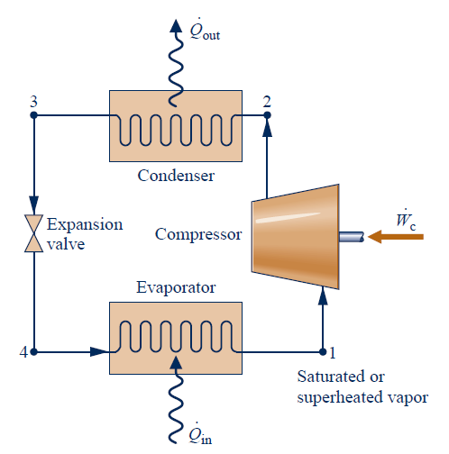
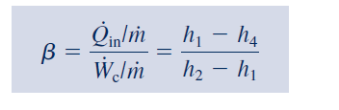
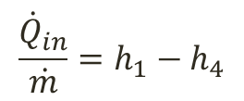

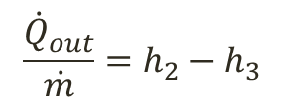
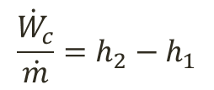
Analyzing Vapor Compression Systems
$$\frac{{\dot{Q}}_{out}}{\dot{m}}=h_{2}−h_{3}$$
$$\frac{{\dot{W}}_{c}}{\dot{m}}=h_{2}−h_{1}$$
$$h_{4}=h_{3}$$
$$\frac{{\dot{Q}}_{in}}{\dot{m}}=h_{1}−h_{4}$$

Slide 5
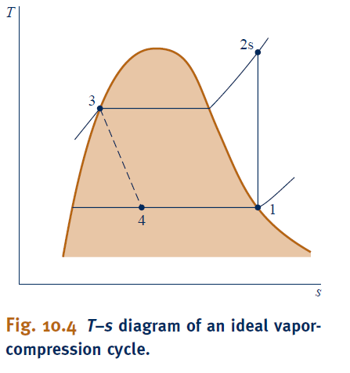
Performance of Ideal Vapor Compression Systems

Slide 6
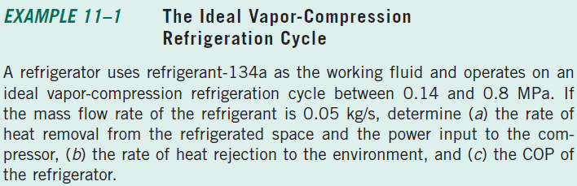
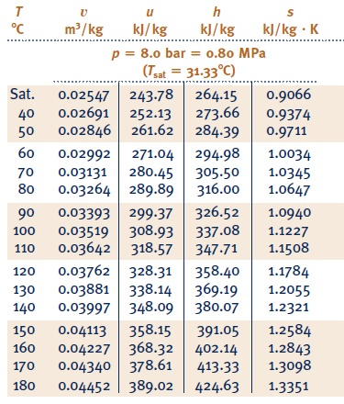

Slide 7
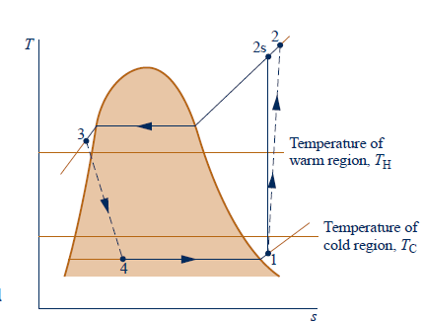
Performance of Actual Cycle

Slide 8
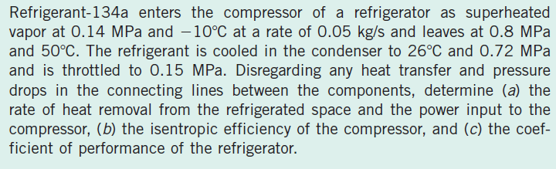
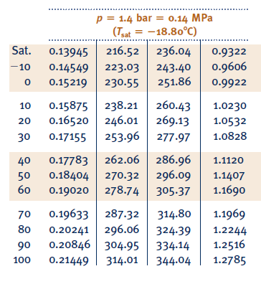
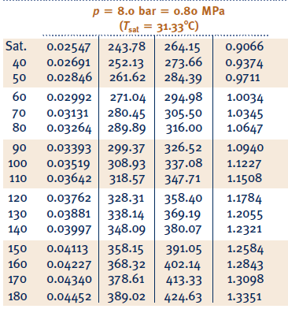

Slide 9
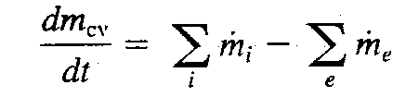

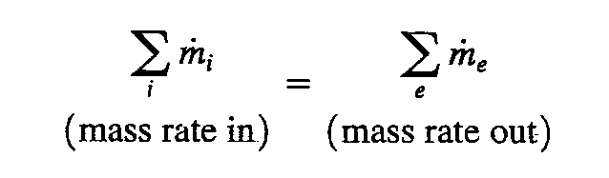

Control Volume Governing Equations (1)
Mass Conservation:
For Constant Property
And 1-D flow :
For steady state:
For closed System:

Slide 10


Control Volume Governing Equations (2)
Note:
For closed system,
2. Pay attention to the sign of Q and W, and other signs in the original equations.
3. Total energy includes internal, kinetic and potential energy.
4. Pay attention to the multiple inlets and exits (in=1, exit=2).
5. Pay attention to quazi-steady form (example:charging and filling process)
7. Pay attention to the units of enthalpy, Ke and Pe energy.

Slide 11
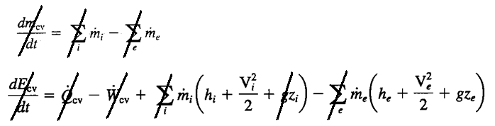
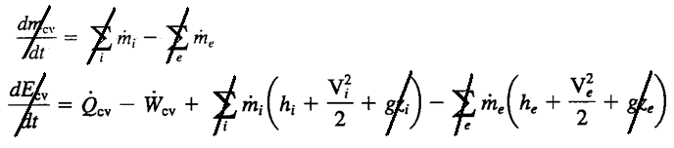
Typical Steady-State CV Analysis for Industrial Applications
Nozzle and Diffuser
Turbine, Pump and Compressor
May or may not neglect PE

Slide 12
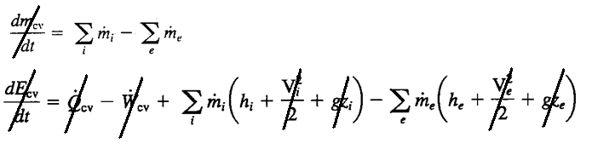
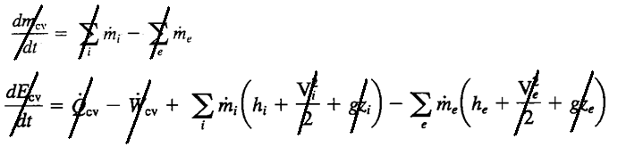
Heat Exchanger
Valve and Throttling Device

Slide 13
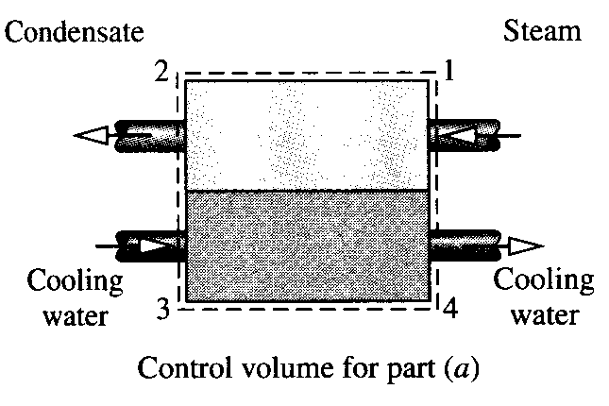
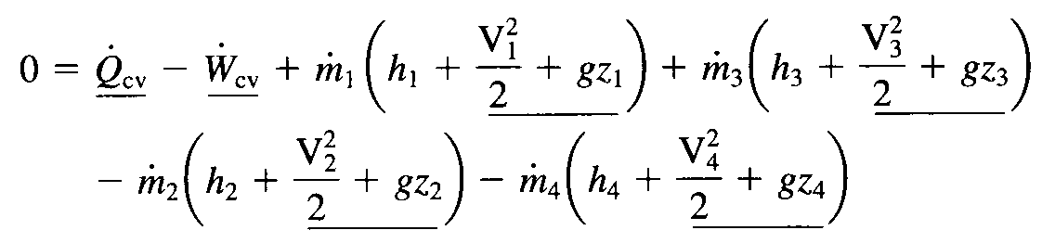

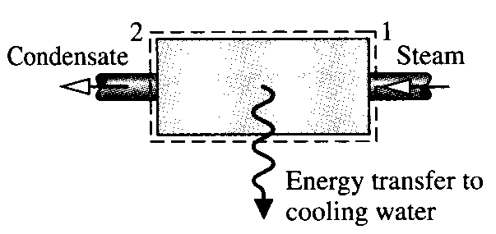
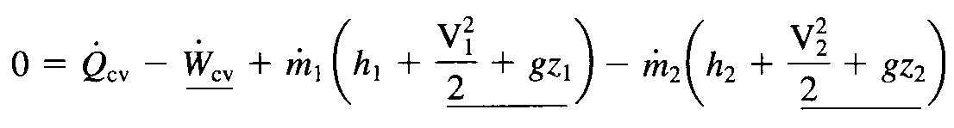

The types of governing equations depend on system selection:

Slide 14


Control Volume Governing Equations (3)
Note:
For closed system,
2. Steady state form.
3. Pay attention to the boundary temperature and sign of Q
4. Increasing in entropy principle

Slide 15
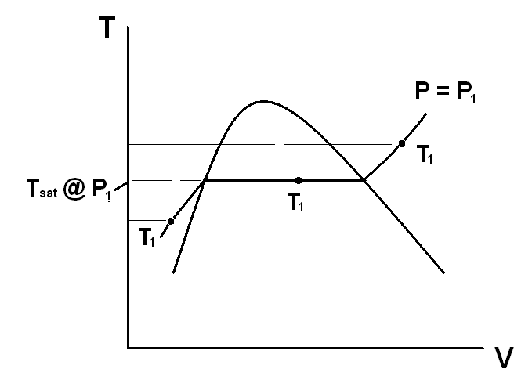
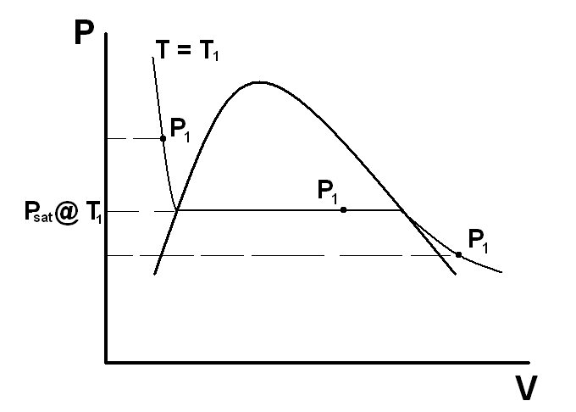
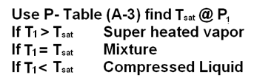
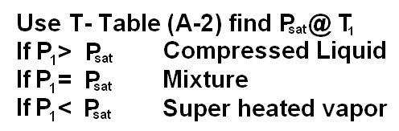
Retrieving Thermal Properties
Property tables at various states (saturation, superheated vapor and compressed liquid) can be used. We must determine the state of the working medium before using the corresponding tables. Typically, properties are given as:
1. Properties P and T are given:

Slide 16
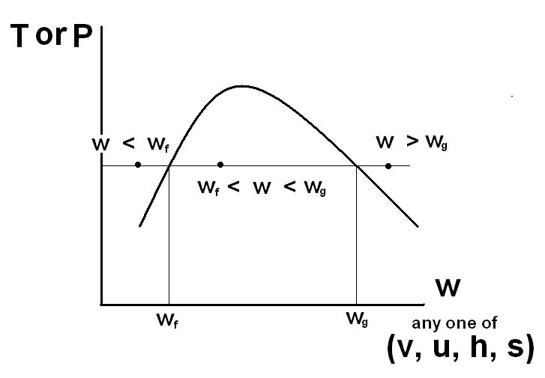
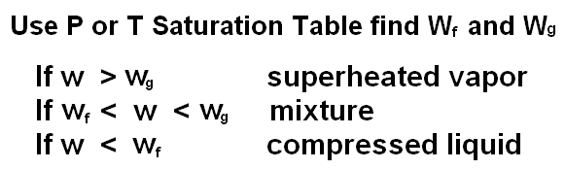
Retrieving Thermal Properties (2)
2. Property P or T and one of w (w represent any one of v, u, h, or s) are given

Slide 17


Retrieving Thermal Properties (3)
Evaluation of Property in S-L Mixture Region
The above equation also apply to properties of u, h, and s.
The above equation also apply to properties of u, h, and s Therefore, given any one of the properties (v,u,h,s) in the mixture region, the rest can be determined using this equation

Slide 18
Note:
T and P are not two independent parameters in mixture region.
Pay attention to unit of specific volume for liquid.
3. Approximation of liquid properties using the saturated liquid.
4. Properties of incompressible substances.
5. Using of generalized compressibility chart

Slide 19








Representation of Ideal Gas Model
(Unit: kJ/kmol)
is the universal constant
(Unit: kJ)
(Unit: kJ/kg)
(Unit: kJ)

Slide 20
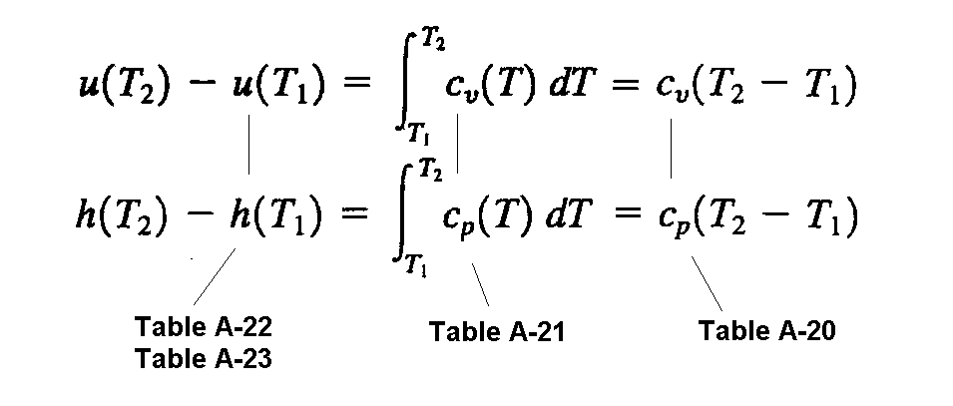

Use of Ideal Gas Tables

Slide 21


T dS Equations

Slide 22
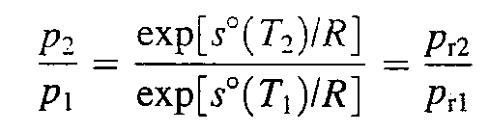
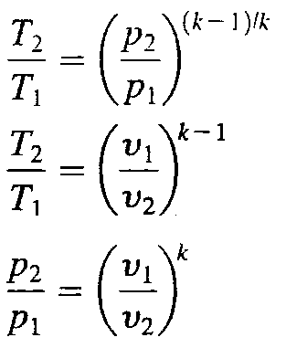
Isentropic Processes

Slide 23
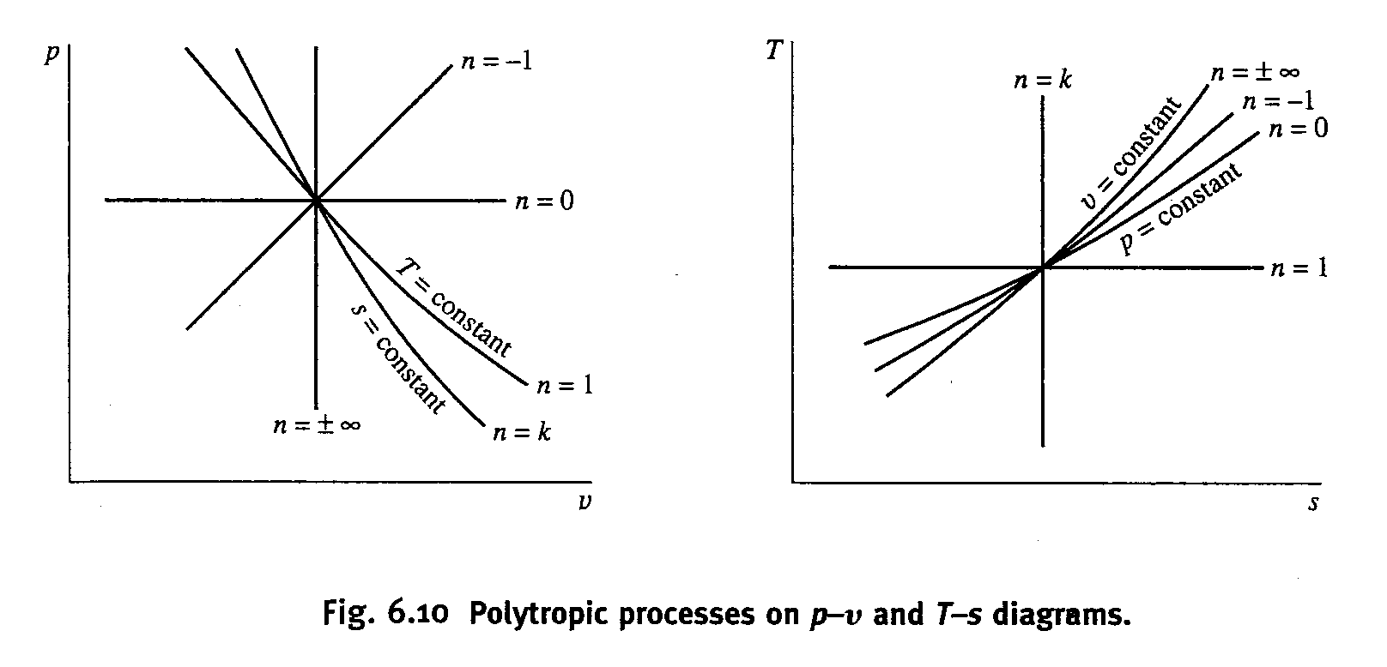

Slide 24
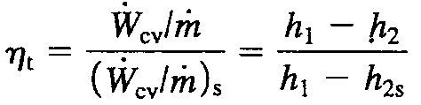
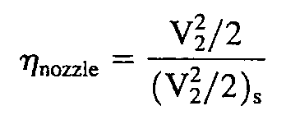

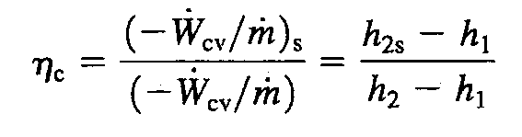
Isentropic Efficiencies of Industrial devices
1. Isentropic Efficiencies of Turbine
2. Isentropic Efficiencies of Nozzle
3. Isentropic Efficiencies of Compressors and pumps

Slide 25
Common Mistakes
∗ didn’t know how to start the problem
∗ didn’t write down what you know on the exam paper
∗ didn’t know how to find thermal properties
∗ didn’t know when to use ideal gas laws
∗ confused with the temperature scales
∗ made mistakes in units (ke/pe, liquid v)
∗ confused with different forms of governing equations
∗ confused with various definitions of COP and efficiencies
∗ didn’t know how to find work or heat
∗ made mistakes in signs (Q, W, property changes, and in/outlet)

