Slide 1
Not as the world gives…

Slide 2
Hear it every Christmas time
But hope and history won't rhyme
So what's it worth
This peace on earth
- U2 Peace on Earth

Slide 3
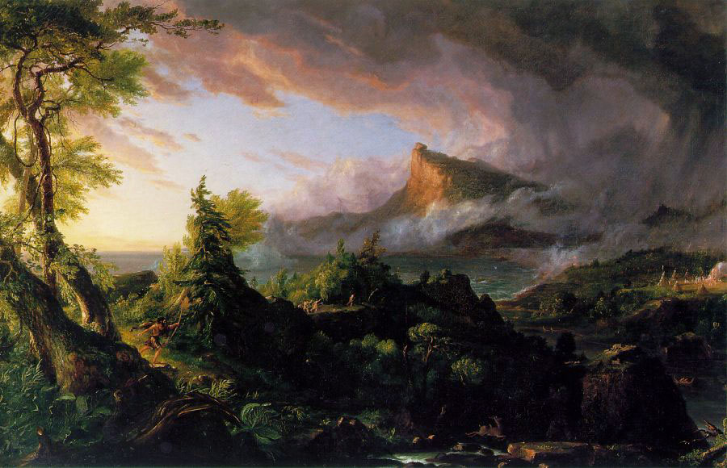
Notes:
The Savage State

Slide 4
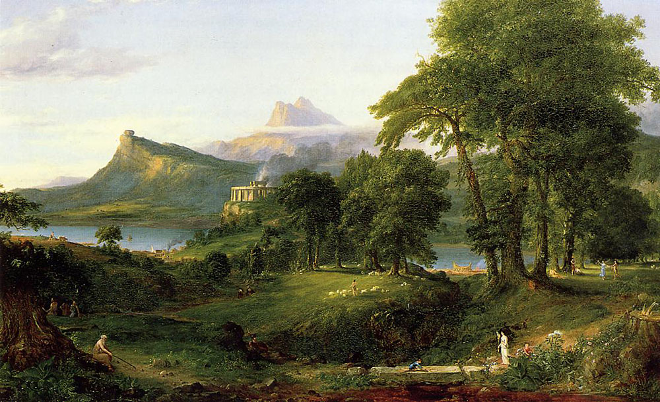
Notes:
The Pastoral, Agrarian State

Slide 5
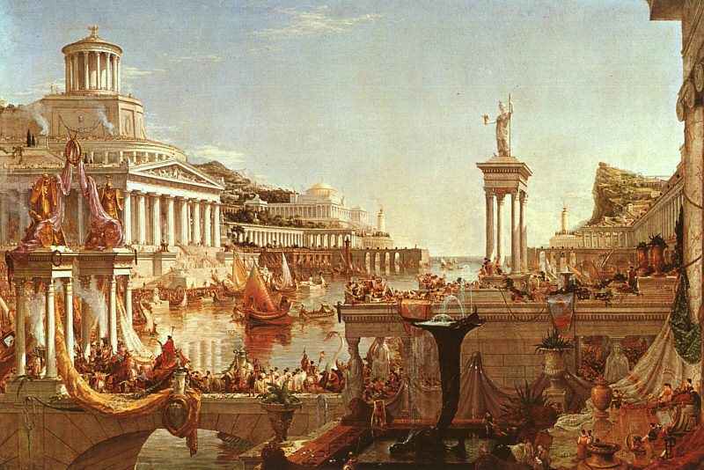
Notes:
The Consumption

Slide 6
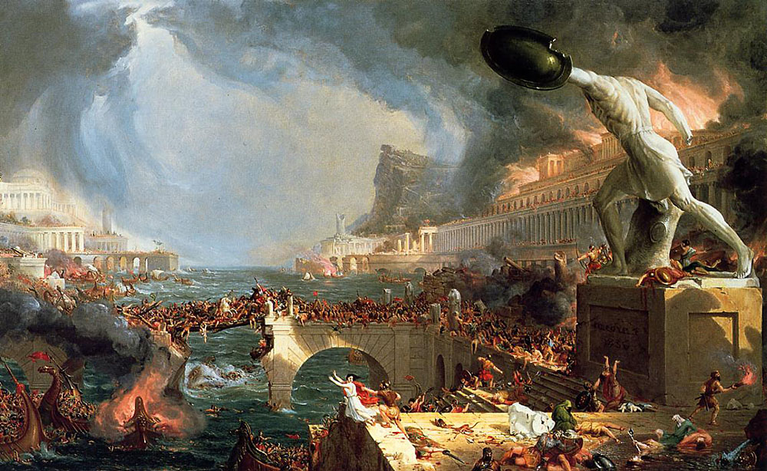
Notes:
The Destruction

Slide 7
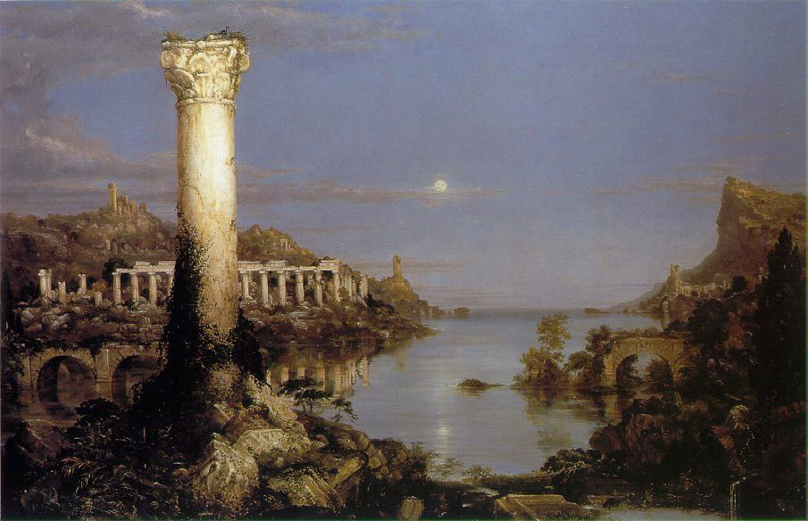
Notes:
The Desolation

Slide 8
…but, as men cannot engender new forces, but only unite and direct existing ones, they have no other means of preserving themselves than the formation, by aggregation, of a sum of forces great enough to overcome the resistance. These they have to bring into play by means of a single motive power, and cause to act in concert.
- Jean-Jacques Rousseau The Social Contract

Slide 9
“Come, let us build for ourselves a city, and a tower whose top will reach into heaven, and let us make for ourselves a name, otherwise we will be scattered abroad over the face of the whole earth.”
- Genesis 11:4 (NASB)

Slide 10
Sing, O goddess, the anger of Achilles…
- The Iliad

Slide 11
If chance be the Father of all flesh,
disaster is his rainbow in the sky,
and when you hear
State of Emergency!
Sniper Kills Ten!
Troops on Rampage!
Whites go Looting!
Bomb Blasts School!
It is but the sound of man worshiping his maker.
- Steve Turner The Collected Poems of Steve Turner

Slide 12
⁶ For a child will be born to us, a son will be given to us; and the government will rest on His shoulders; and His name will be called Wonderful Counselor, Mighty God, Eternal Father, Prince of Peace. ⁷ There will be no end to the increase of His government or of peace, on the throne of David and over his kingdom, to establish it and to uphold it with justice and righteousness from then on and forevermore. The zeal of the Lord of hosts will accomplish this.
- Isaiah 9:6-7 (NASB)

Slide 13
Rejoice greatly, O daughter of Zion!
Shout in triumph, O daughter of Jerusalem!
Behold, your king is coming to you;
He is just and endowed with salvation,
Humble, and mounted on a donkey,
Even on a colt, the foal of a donkey.
- Zechariah 9:9 (NASB)

Slide 14
These things I have spoken to you, so that in Me you may have peace. In the world you have tribulation, but take courage; I have overcome the world.”
- John 16:33 (NASB)

Slide 15
³God said, “Let there be light”; and there was light.
….
¹⁴“Let there be lights in the expanse of the heavens to separate the day from the night, and let them be for signs and for seasons and for days and years
- Genesis 1 (NASB)
²³And the city has no need of the sun or of the moon to shine on it, for the glory of God has illumined it, and its lamp is the Lamb.
- Revelation 21 (NASB)

Slide 16
Peace I leave with you; My peace I give to you; not as the world gives do I give to you. Do not let your heart be troubled, nor let it be fearful.
- John 14:27 (NASB)

Slide 17
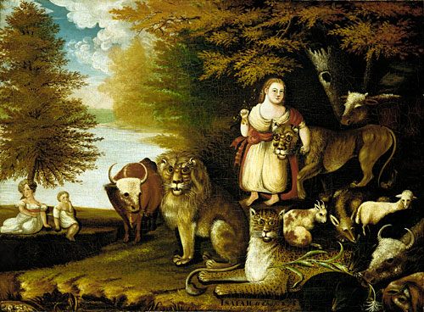

Slide 18
I am the voice of the past that will always be
Filled with my sorrow and blood in my fields
I am the voice of the future
Bring me your peace
Bring me your peace and my wounds, they will heal
- Eimear Quinn The Voice

Slide 19
Final Notice
All images courtesy of the Art Renewal Center©, (ARC) www.artrenewal.org

