Slide 1
Apologetics
with Nick

Slide 2
Hello, my name is:
Nick Robison
Notes:
I’m friendly, I do things. I’ve done things.

Slide 3
What we’re going to do today
Define our terms
Nicks’ Principles of Apologetics™
A few humble suggestions

Slide 4
Defining Terms
What we talk about when we talk about apologetics
Notes:
Whenever we start talking about something, we should probably define what we’re talking about. This will become of great importance later.

Slide 5
What is apologetics?
Notes:
What’s your definition.
Do this with your neighbor, ask and ye shall receive.

Slide 6
Apol•o•get•ics
systematic argumentative discourse in defense (as of a doctrine)
a branch of theology devoted to the defense of the divine origin and authority of Christianity
- Miriam Webster Dictionary

Slide 7
Apol•o•get•ics
The attempt to rationalize every single thing the Bible says, no matter how genocidal, homicidal, sexist, racist, or totally ridiculous those things might be.
- Urban Dictionary
Notes:
This is where we’re starting from; as much as we’d like it to be otherwise.

Slide 8
Why study apologetics?

Slide 9
What’s the end game?
Notes:
What are we trying to do here?
It’s important to figure out what we’re about, in order to figure out where we do next.

Slide 10
People need this.
Notes:
For me, I think the answer is simple. So let’s look at a few reasons that have come to my mind in the past couple of days.

Slide 11
It’s either quite a master plan.
Or just chemicals that help us understand.
That when our hearts stop ticking.
This is the end, there’s nothing past this.
St. Peter’s Cathedral
Death Cab for Cutie
(Codes and Keys, 2011)
Notes:
Why be such a dick?

Slide 12
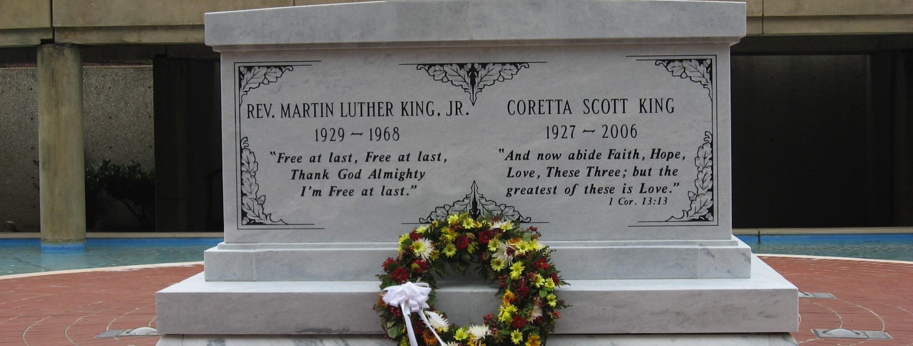
Notes:
Somebody forgot to tell the Reverend.

Slide 13
The only stars I see in the sky, they don’t move me.
Cause they’ve all been dead for millions of years, they’re just light diffusing.
Everything's a Ceiling
Death Cab for Cutie
(Kintsugi, 2015)
Notes:
Kintsugi is a Japanese word that means to knit broken pottery back together using gold.
Screw you Ben, screw you.

Slide 14
We take it equally for granted that a person who is not affected by the vision of earth and sky, who has no eyes to see the grandeur of nature and to sense the sublime, however vaguely, is not human.
Man is Not Alone: A Philosophy of Religion
Rabbi Abraham J. Heschel, 1951
Notes:
Young man. Sit down.
This is before Eichmann. Just after the I.G. Farben, High Command, and Judge’s trials at Nuremburg. Just after the state of Israel was founded, but before it was really a thing. The sounds of 7 million martyrs was still in his ears. And he still writes this.

Slide 15
I don’t believe in God, but I miss him.
Nothing to be Frightened Of
Julian Barnes, 2008
Notes:
Julian knows what’s up.

Slide 16
The world in its grandeur is full of a spiritual radiance, for which we have neither name nor concept.
Man is Not Alone: A Philosophy of Religion
Rabbi Abraham J. Heschel, 1951
Notes:
This. All of this.

Slide 17
A quick game
What would you say?
Notes:
These are some phrases that have come up in the last year.

Slide 18
I make my own morality.
Notes:
(3 minutes)

Slide 19
People don’t have souls.
Notes:
(3 minutes)

Slide 20
Most wars are caused by religion.
Notes:
(3 minutes)
Interesting.
So the question is, how do we actually do apologetics in the real world? How to we witness, minister and apologize to the people around us.
How do we do so in a way that’s relevant to the world we live in? How do we change cultures?

Slide 21
3 Principles of Apologetics™
According to Nick Robison
Notes:
Nothing fancy, just some things I’ve learned over the past few years, both from experience, and through divine inspiration.
I have my own life, my own world, my own call. You have you. You do you, and I’ll do me.

Slide 22
1. Language is tricky
People rarely say what they mean
Language is culturally dependent and in constant flux
People don’t speak Religion
Notes:
Their words belie a deeper reality
This freaks people out, because they can’t explain how they feel, or what they mean.
(Anyone read Flatland?) (Summary) It’s an analog to our world, people have no idea how to handle the divine.
This goes to the nature of language, it’s a mirror and interpreter of the world around us, thus it’s naturally deficient in the supernatural realm. [Heschel, Steiner]
Language is abstract creation, Adam made it, we get to build it. It’s beautiful, but it’s dangerous. This is why the Jewish people don’t speak the name of God. [Cowan]

Slide 23
2. It’s different when you’re alone
In the Midwest, we have the echoes of religion past
These cultural practices give normalcy to faith
When they disappear, it’s really hard
We are ‘citizens of another flag’
Notes:
In the Midwest, the structures and institutions of a culture of faith are still around. They may be decaying, but they're still there. If you leave here, you may not find that to be the case. That makes faith really hard, not because we're weak or unfaithful, but because our beliefs and ideas exist within a framework of community, and if that community suddenly vanishes, it's hard to know what to do next. Some places of this world are post-Christian (like Europe), other places are Post-Post-Christian (like the Northwest).
It’s easy to be a Christian here (sort of), it’s harder to be a Christian out there. It grinds on you (Sometimes a Great Notion)
Just like Chesterton said, that means we won’t every fully feel connected here, but that’s ok. ‘Further up and further in’.

Slide 24
3. Apologetics just happens
The LORD places us in situations where we can bear his image and witness
Don’t force it
You are each unique, you will have a unique witness
Notes:
Shh, shh, ssh. Just let it happen.
You have the image of the divine, God will use that.

Slide 25
Where do we go from here?
A few, humble suggestions….

Slide 26
1. Be Ready
Holistically ready
Read books
No on has ever been argued into the kingdom of God, but so many have been kept out by perceived inconsistencies and errors.
- Elton Trueblood The Company of the Committed
Listen to music, it gives a common language
Notes:
Emotionally, spiritually, mentally, etc.
The LORD has a plan, but if you're not prepared he'll have to find someone else. You have within you a unique image and fingerprint of Christ. Your own spark of divinity. Be ready to let that spark shine in whatever way, shape, or form that may be.
People don’t read anymore, they just don’t. They don’t have a coherent world view, let yours stand apart.
I like this quote, it shows the tension of knowledge, truth sets free, but arguments divide
Music is the emotional expression of our generation

Slide 27
2. Do life with people
This is the ‘real’ world
Seek the welfare of the city
Whatever your community does, do that.
Notes:
It’s pseudo-real, but it’s real enough. Anyone who tells you otherwise is doing you a disservice, and lying about how they feel. Also, our bodies are way too tuned to this ‘world’ for it to be just a myth.
This is your world, better it.
(Next slide, then come back)
Do what your people do, we may not be of the world, but we are in it. Do life with people. Love this World.
We are AngliCANS, not AnglicaCANTS
Everything emanates from community!!!!
The story of Genesis is a divine mic drop, a spiritual ‘come at me bro’, and its central theme (or one of) is Community. Man and Woman. God and Man. God and Community. Man and Community. That’s where it starts, and that’s where it ends. (Louise Cowen essay)

Slide 28
⁴“Thus says the Lord of hosts, the God of Israel, to all the exiles whom I have sent into exile from Jerusalem to Babylon: ⁵Build houses and live in them; plant gardens and eat their produce. ⁶Take wives and have sons and daughters; take wives for your sons, and give your daughters in marriage, that they may bear sons and daughters; multiply there, and do not decrease. ⁷But seek the welfare of the city where I have sent you into exile, and pray to the Lord on its behalf, for in its welfare you will find your welfare.
Jeremiah 29: 4-7
Notes:
This is a really powerful verse.
LOVE THIS WORLD!!!!

Slide 29
3. Find a Christian Community
You will drown without it.
Ask questions
Notes:
As faith has such a central role in our lives no matter how great of people our secular friends are, there will always be a part of you that is inaccessible to them. It's why we're not supposed to be 'un-equally yolked'. Find a community of believers, you'll need it.
God never says don’t ask, seek and ye shall find. You won’t have all the answers, you won’t have all the faith, be with people who do.
The Rabbi says that doubt is the auditor of the brain. You can’t doubt what you don’t already believe.

Slide 30
4. Be the image of Christ
You may be the closest thing they have to the image of Christ
The world gives them death, give them life
Be gentle, and respectful
Notes:
Trutjen(?) quote
(Next slide, then come back).
This is tricky, how do we balance judgment and mercy?
Very rarely do people have a problem with your logic. Unless they're wearing a fedora, then they're an internet atheist and think you might possibly be the bottom of the intellectual barrel. But then again, they're wearing a fedora. So….
You’re representing the person and temperament of Jesus Christ, carry that burden with honor and humility.

Slide 31
Always be prepared to give an answer to everyone who asks you to give the reason for the hope that you have. But do this with gentleness and respect, ¹⁶keeping a clear conscience, so that those who speak maliciously against your good behavior in Christ may be ashamed of their slander.
1 Peter 3:15b-16
Notes:
The classic verse

Slide 32
Shepherd the moments between the in-breaking of the Spirit.
Notes:
That’s my over arching principle, everything comes second to me preserving my witness until the Spirit of the Lord smashes into the moment.

Slide 33
That’s all folks.
nick@nickrobison.com
www.nickrobison.com
@nickrobison

Slide 34
References
Flatland: A Romance of Many Dimensions – Edwin Abbott
Formations of the Secular: Christianity, Islam, Modernity – Talal Asad
Nothing To Be Frightened Of – Julian Barnes
Orthodoxy – G.K. Chesterton
Jerusalem’s Claim Against Us. Louise Cowen Intercollegiate Review 2001;36:14–23.
The Brothers Karamazov – Fyodor Dostoevsky
Man Is Not Alone: A Philosophy of Religion – Abraham J. Heschel
God In Search of Man: A Philosophy of Judaism – Abraham J. Heschel
Sometimes a Great Notion – Ken Kesey
Death on a Friday Afternoon – Richard John Neuhaus
The Responsible Self: An Essay in Christian Moral Philosophy – H. Richard Niebuhr
Quantum Physics and Theology – John Polkinghorne

Slide 35
References
How (not) to be Secular – James K.A. Smith
Real Presences – George Steiner
A Secular Age – Charles Taylor
The Company of the Committed – Elton Trueblood
Seek the Welfare of the City: Christians as Benefactors and Citizens – Bruce W. Winter

