Slide 1

Reproducible Research: Moving From Excel to Scripting
source

Slide 2
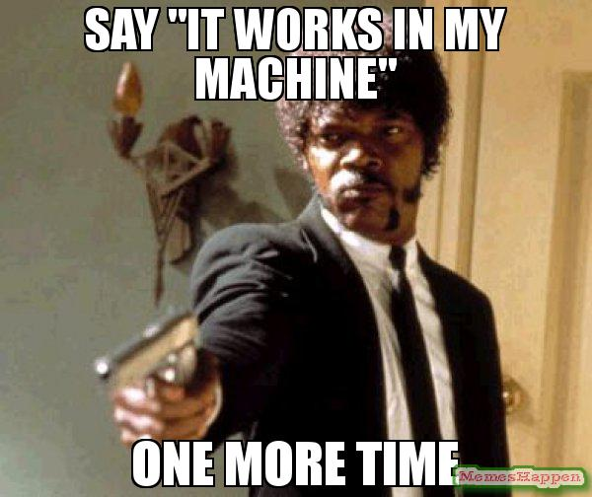
Reproducibility in Research
source

Slide 3
What is Reproducibility?

Slide 4
What is Reproducibility?
Reproducible
The existing data can be reanalyzed using the same research methods, and will yield the same results

Slide 5
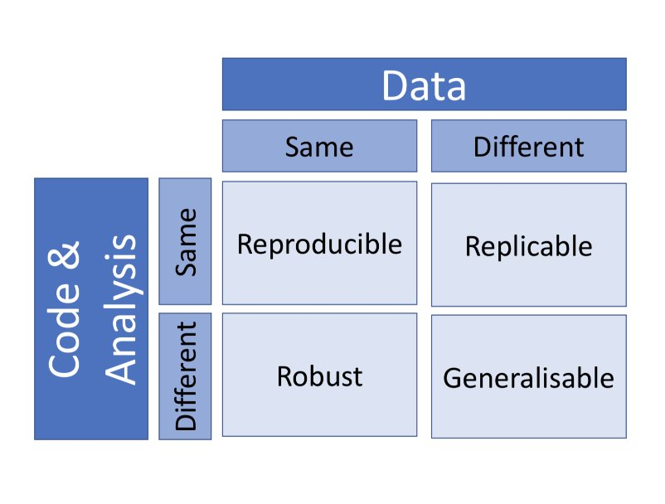
What is Reproducibility?
source

Slide 6

The Reproducibility Crisis
source

Slide 7
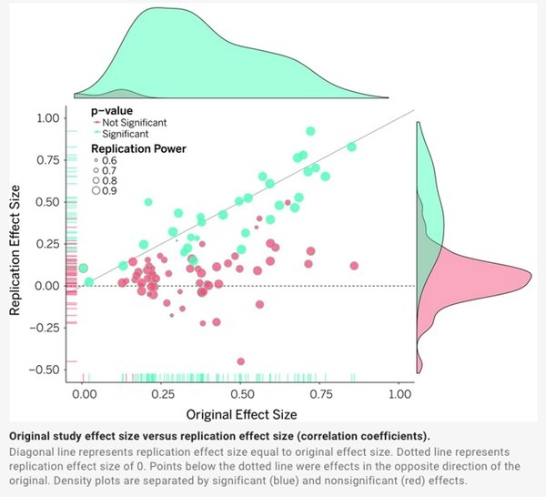
The Reproducibility Crisis
100 studies published in 3 psychology journals
36% of studies were able to be reproduced
source

Slide 8
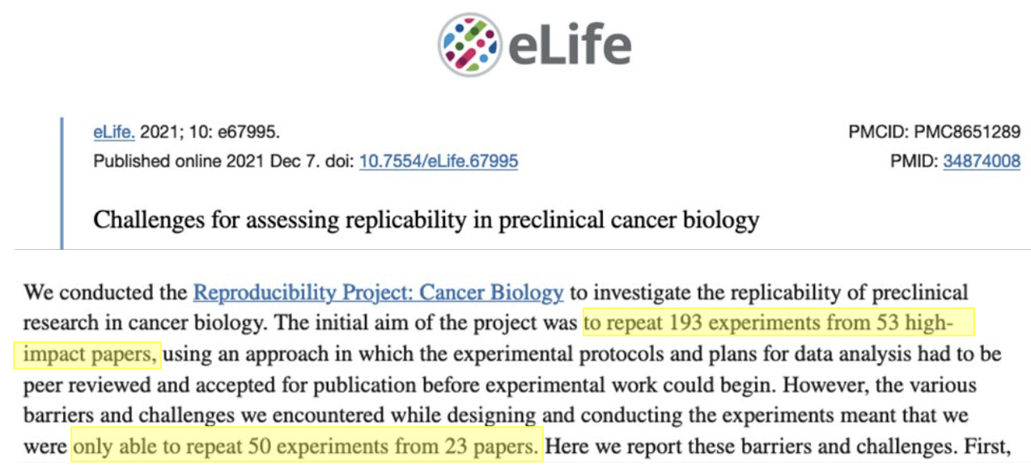
The Reproducibility Crisis
source

Slide 9
What Can We Do?
Libraries provide a lot of support around academic/scholarly integrity.
This largely consists of citation support and avoiding plagiarism, with the focus being students as consumers of research.
However, as graduate students step into their theses and dissertations, we should be thinking of academic integrity through the lens of students as producers of research.
Data integrity, open and reproducible research!

Slide 10
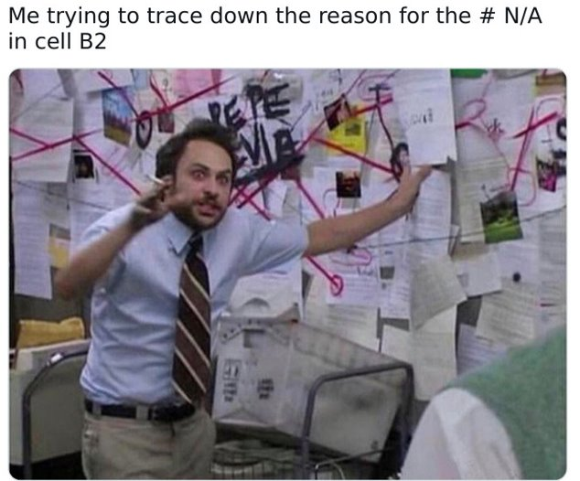
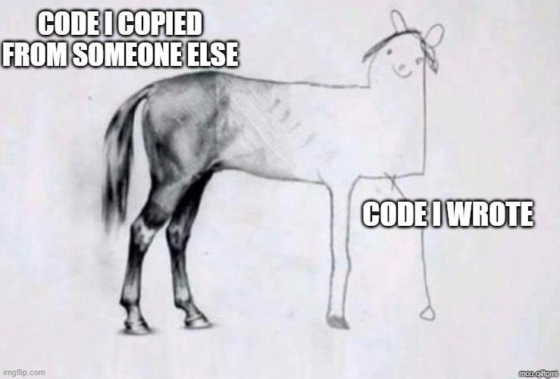
Nuances of Reproducibility
Computational vs. manual processes
source
source

Slide 11
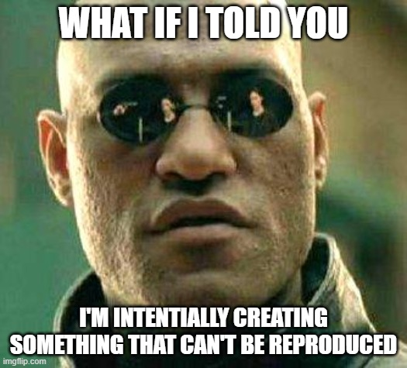
Nuances of Reproducibility
Arts, humanities, and creative outputs
source

Slide 12
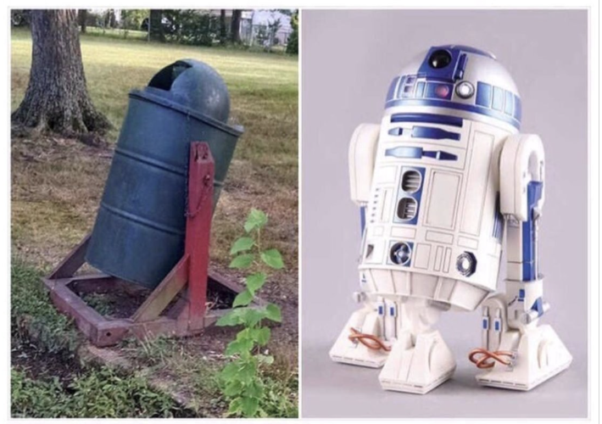
Overarching Best Practices
Your practices vs. the practices they told you not to worry about
source

Slide 13
Overarching Best Practices
FAIR Principles
Sharing/preserving research data in a data repository (Findable)
Ensuring materials are in open file formats (Accessible, Interoperable)
Supplementing data with documentation that facilitates interpretability and reuse (Reusable)
Notes:
Speak to preservation

Slide 14
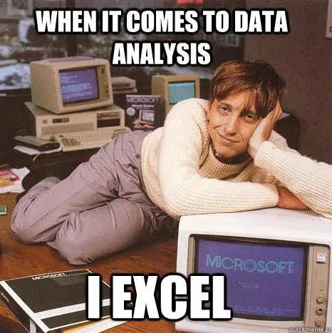
Let's Talk About Excel!
source

Slide 15
Have you ever used Excel?

Slide 16
Have you ever used Excel?
What did you use it for?
Did it do a good job? Why/why not?

Slide 17
Diving Into Excel: What it does well
Intuitive point-and-click graphical user interface (GUI)
Easily group and order datasets based on specific values
Easily calculate things like sum, mean, and other basic statistical methods
Create graphs and charts with a few clicks
TLDR: it's easy and convenient

Slide 18
Diving Into Excel: What it doesn't do so well
Any manual changes made to a document are subject to human errors, and tracking these changes and identifying errors can be challenging.
Formulaic changes are often hidden in cells and are subject to "breaking", making manipulations and analyses difficult to track and reproduce.
Manipulations require manual processes for every file.

Slide 19
Diving Into Excel: What it doesn't do so well
The auto-formatting of cells can be very annoying and cause issues.
Rows/columns can be hidden, causing issues with collaboration.
Changing variables will overwrite original data, causing issues with reproducibility and provenance.
TLDR: it's not very reproducible.

Slide 20
Questions?

Slide 21
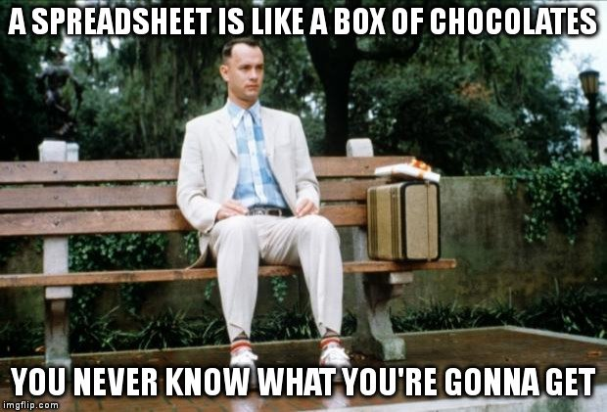
What's in a Spreasheat?: .xlsx vs .csv files
source

Slide 22
.xlxs Files
Excel files (.xlxs) are a proprietary file format, meaning that the ability to use them relies on a subscription to the Microsoft suite.

Slide 23
.xlxs Files
While it's natural to think of an Excel file as a single file, in reality these files are zipped archives containing multiple underlying files:
Worksheet data
Worksheet formatting
Charts and graphs
Pivot tables
Embedded objects
External links
Metadata

Slide 24
.csv Files

Slide 25
.csv Files
.csv files (Comma Separated Values) are tabular (spreadsheet) files, with each row representing a record and values within each row separated by commas (even though they can be presented in cells).

Slide 26
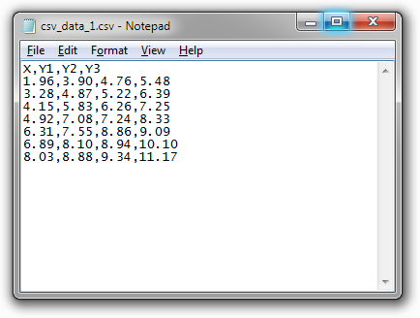
.csv Files

Slide 27
.csv Files
They are non-proprietary plain text files, meaning that they don't have any underlying structures like Excel files, and can be opened using any simple free text editor like Notepad, TextEdit, etc.
Because of their simplicity, they are an efficient way to store and transfer tabular data because they are smaller in size, but with this they have limited formatting options.
While it is possible to handle Excel files in coding languages like R and Python, .csv files are generally the preferred format due to their open and simple nature.
Notes:
Preservation***

Slide 28
Example: Genetic Data
In a survey looking at over 11,000 papers with Excel gene lists published between 2014 and 2020, more than 30% contained at least one gene name error caused by Excel's autoformatting.
This was due to gene names being converted to standard dates, internal data numbers (5 digits), and floating point numbers.
https://journals.plos.org/ploscompbiol/article?id=10.1371/journal.pcbi.1008984

Slide 29
Converting Excel Files to Other Formats
Original value/ format | What can happen | Example of change | Why it happens
01234 | Leading zero lost | 1234 | Treated as a whole number
Résumé | Characters corrupted | Rsum / RÃ©sumÃ© | Encoding issues
31/12/2024 | Date misread or changed | 12/31/2024 | Different regional settings for dates
=SUM(A1:A10) | Formula lost | 55 (only value) | Plain text only keeps values
Hello | Formatting lost | Hello | Plain text doesn’t store formatting
123456789012345 | Rounded or scientific notation | 1.23E+19 or rounded value | Precision limits

Slide 30
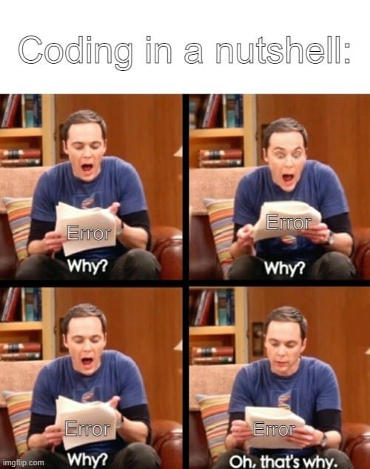
Moving to Scripting
source

Slide 31
Moving to Scripting: What is it?
Writing lines of code, or "scripts", is creating a set of instructions that a coding language can perform.
For the purpose of this program, these instructions are performed on a dataset (noting there can be broader usage).

Slide 32
Literate Programming
Scripting was just referenced as instructions for a coding language/computer to perform, which is true, but a big focus of this series is making our work reproducible, which needs to include a second element of instructions for humans to interpret.

Slide 33
Literate Programming
Literate programming is a framework that provides a human-language explanation of how a script works in combination with the script itself, so people can accurately interpret and reuse the script.
We've already discussed how to document our files and data, but as we move through the program we're also going to talk about documentating our code and literate coding principles.

Slide 34
Moving to Scripting: Why you wouldn't use it
Learning a coding language is like learning a human language, and can be a painful process.
Because the things we do with tabular data can seem like isolated and time-sensitive activities ("I need this chart now!"), the effort needed to learn how to perform a new task can take much longer than just doing it in Excel.

Slide 35
Moving to Scripting: Why you wouldn't use it
Even if you are familiar with a coding language, it can still be a struggle to figure out the exact way to do something.
TLDR: it can be a pain in the a**.

Slide 36
Moving to Scripting: Why you would use it
Other than the learning curve, scripting overcomes all of the downfalls of Excel:
There are no "manual" changes, and everything can be tracked and checked.
Scripts are kept in a document/documents and provide a clear and ordered list of everything that was done.
A single script can be performed across large amounts of similar files, and chunks can be taken from one script and altered slightly to perform the same task on different datasets.
No hidden rows or columns.
Can create new variables that are derived from existing variables, so the original data isn't overwritten.

Slide 37
Moving to Scripting: Why you would use it
The actions you can perform with scripts can also be far more precise and powerful than what Excel is capable of.
TLDR: it's powerful and reproducible.

Slide 38

An Experimental Activity
source

Slide 39
Tidy Data Principles
Each column is a variable.
Each row is an observation.
Each cell is a single value.
source
Notes:
Mention resourc

Slide 40
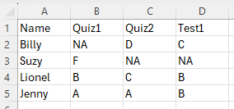
Tidy Data Principles
Each column is a variable.
Each row is an observation.
Each cell is a single value.
source

Slide 41
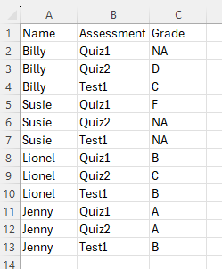
Tidy Data Principles
source

Slide 42
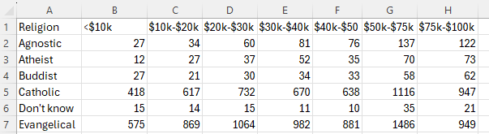
Tidy Data Principles
source

Slide 43
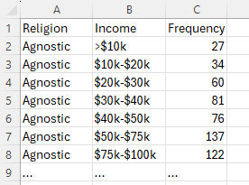
Tidy Data Principles
source

Slide 44
Questions?

Slide 45
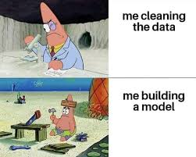
The Data Science Workflow
source

Slide 46
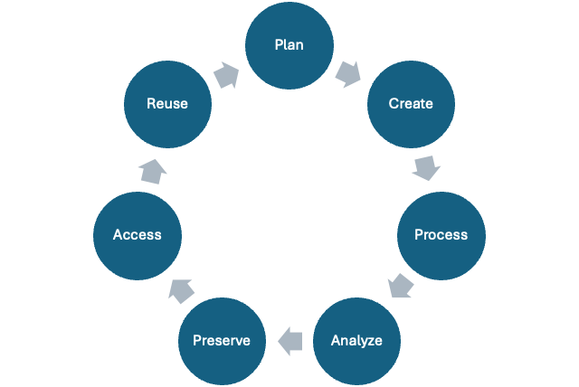
The Research Data Lifecycle

Slide 47
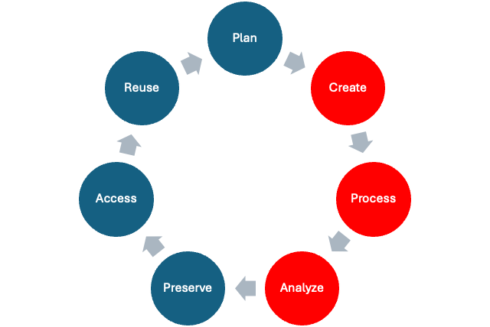
The Research Data Lifecycle

Slide 48
The Data Science Workflow
A framework to support transparent and open research processes throughout the active phases of the research data lifecycle.
While the research data lifecycle is focused on making research outputs FAIR, the data science workflow focses on asking questions from data in an open and reproducible way.

Slide 49
The R Coding Language
R is an open-source programming language designed for data manipulation, statistical analysis, and visualization in research.
Enables all of these activities to be easily reproducible, allowing for efficient work across data (many) data files, as well as sharing with others to reproduce and build off your work.
Promotes the transparency of research and academic integrity.

Slide 50
RStudio
While R is the programming language, RStudio is an Integrated Development Environment (IDE), which is a fancy term for a software application that makes working in R much more user-friendly.

Slide 51
RStudio
A (bad?) analogy could be:
You are writing a document in Microsoft Word. In this case, the plain human language that you are typing would be R, and Microsoft Word, which is the software that allows you to view, format, add visuals, and save your work, is RStudio.

Slide 52
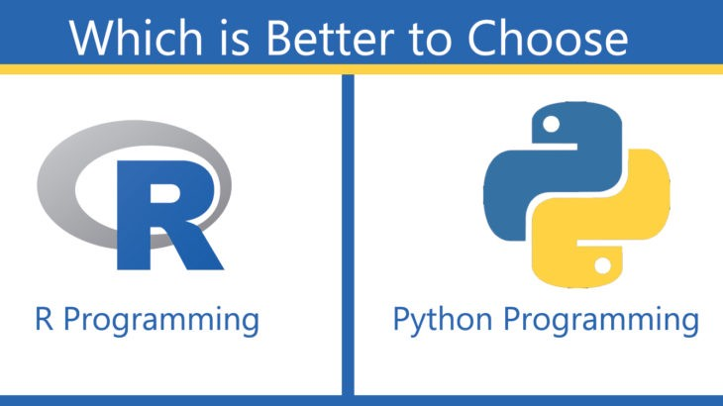
Choosing a Coding Language
source

Slide 53
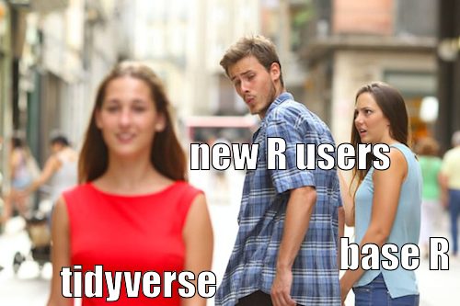
Across the Tidyverse
source

Slide 54
The Tidyverse
A group of R "packages" for data manipulation, exploration, and visualization.
Focused on the connections between the activities that make reproducible workflows possible.
Provides a good reference point for those new to coding to engage with computational processes.

Slide 55
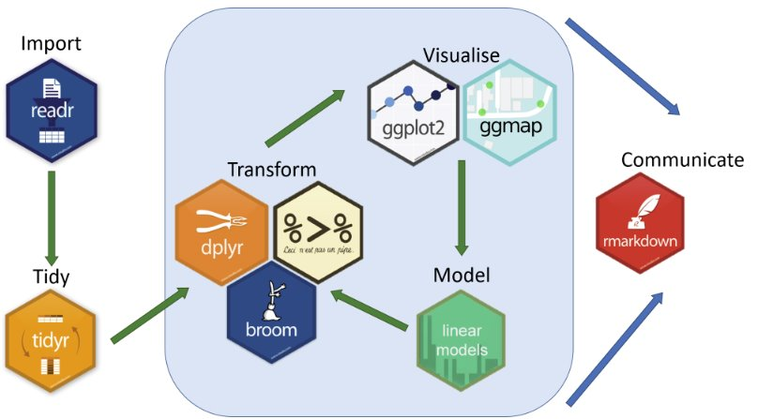
The Data Science Workflow with Tidyverse
source

Slide 56
Questions?

