Slide 1
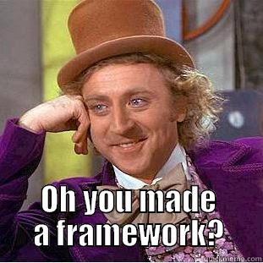
Open Science Framework (OSF)
source
Nick Rochlin, Data Science Librarian
UVic Libraries

Slide 2
Session Overview
Introduce OSF and its role in research as a storage, collaboration, and sharing platform
Walk-through of OSF functions
Discuss project files and how the workflow will work for this course
Discuss concepts of version control and how OSF will be used throughout this course
Fill in sections of DMP with DMP Assistant

Slide 3
What is OSF?

Slide 4
What is OSF?
An online data storage platform that supports good RDM practices and facilitates collaboration, transparency, and reproducibility in research.
Does this by provisioning descriptive metadata, version control, access restrictions, persistent identifiers, and regional cloud storage options.
Has built-in connections to various other research platforms to act as a centralized hub for research projects.
Notes:
Talk about other things it does:
Pre prints
Protocol registration
Sharing data and other materials
Teaching materials

Slide 5
Data Backup
3-2-1 Rule
3 copies of the data
2 different types of media
1 copy is stored offsit2
Notes:
Talk about other things it does:
Pre prints
Protocol registration
Sharing data and other materials
Teaching materials

Slide 6
Getting Started
You will hopefully have already set up an account with OSF, but if not, follow instructions on session webpage.
For this course there is a template set up for you to fork (copy), which can be found on the session webpage.

Slide 7
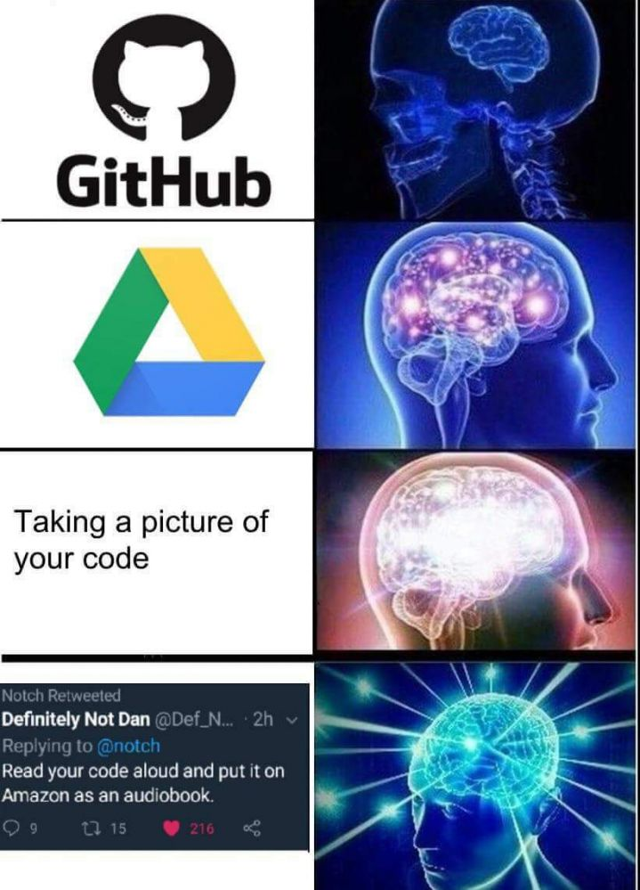
Version Control
source
Notes:
Importance of version control in a project
Especially in a collaborative project

Slide 8
What is Version Control?

Slide 9
What is Version Control?
A system to keep track of your files as they undergo transitions throughout collection, analysis, reporting, and storage.
The goal of version control is to provide a light audit trail to be able to discern:
What changed
When it changed
How it changed
Who changed it
Notes:
Why might his be valuable?

Slide 10
Types of Version Control
Manual version control
Accomplished using file naming conventions
Most common systems include:
Adding a version after a file name (ie. _v01, _v02, etc.)
Adding editor initials after a file name (ie. _NR, ie. _BN)
We will be covering file naming conventions more in the next block – stay tuned!

Slide 11
Types of Version Control
Automated version control
Computing applications that employ metadata to capture similar information to that of manual naming systems
Some systems can be quite complex and don’t lend themselves well to every type of project/workflow
For this course, well be using the automated version control system in OSF

Slide 12
Getting Started
The steps that we’ll be covering in this session include:
General introduction
Forking the project template
Setting storage preferences
Naming your project
Adding a description
Adding collaborators
Working with the wiki
Reviewing file organization
Downloading files
Uploading/version controlling files

Slide 13
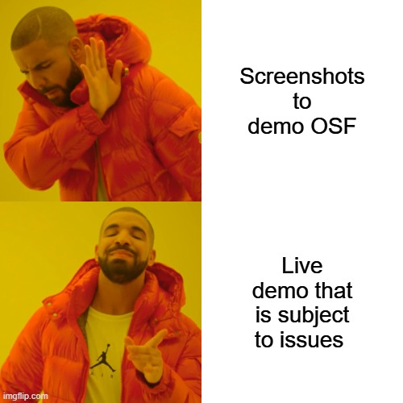
Let’s Go!
Notes:
Put on colleague hat
Talk about OSF limitations
Transition period and updates to software

Slide 14

Questions?
source

