Slide 1
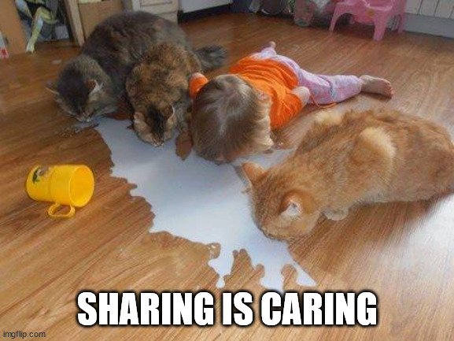
Data Deposit and Sharing
source
Nick Rochlin, Data Science Librarian
UVic Libraries

Slide 2
Why would you share data?
Discussion of data sharing considerations
Overview of data repositories
UVic Borealis
FRDR
Data licenses

Slide 3
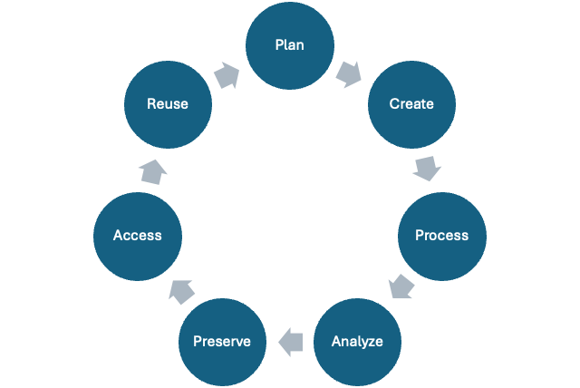
Research Data Lifecycle

Slide 4
Research Data Lifecycle

Slide 5
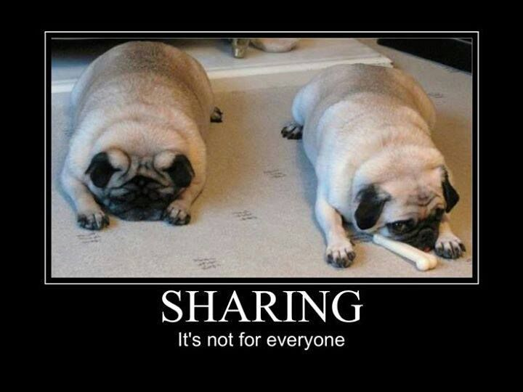
Sharing Data
source

Slide 6
Why would you share data?

Slide 7
Why would you share data?
Because someone told you to (publishers, funders, supervisors, etc.)

Slide 8
Why would you share data?
Because someone told you to (publishers, funders, supervisors, etc.)
Because it’s good research practice
Enables research to be reproduced
Allows others to do new work based on what you’ve done (with proper attribution)
Allows others to check for errors or bias
Supports the spirit of the FAIR principles

Slide 9
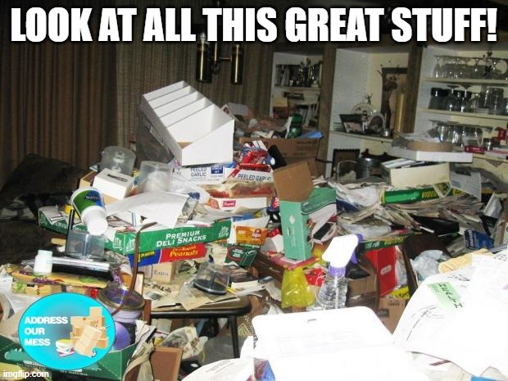
What to Share vs. What to Keep
source

Slide 10
What should you share?
**Data
Raw data (directly obtained from instruction, simulation, survey, etc.)
Processed data (cleaned or manipulated as a step prior to analysis)
Analyzed or summary data (results of analysis of the processed data)
Other?

Slide 11
What should you share?
**Data
Raw data (directly obtained from instruction, simulation, survey, etc.)
Processed data (cleaned or manipulated as a step prior to analysis)
Analyzed or summary data (results of analysis of the processed data)
Other?
Documentation that supports reuse of data
README
Data dictionary
Codebook
Code
Cleaning
Analysis
Visualization

Slide 12
What should you share?
Anything else?
Notes:
DMPs

Slide 13
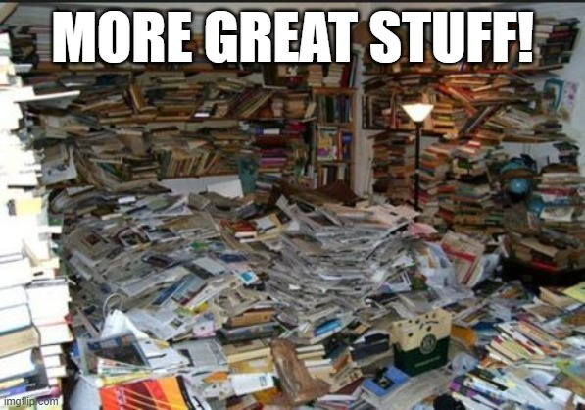
What to Keep for Yourself?
source

Slide 14
What to Keep for Yourself?
Project management records: internal communications, decision making documents, admin records, ethics information, etc.
Unused analyses, visualizations, code chunks…
Anything else?

Slide 15
Disclaimer
Just because you’re not sharing something doesn’t mean you should get rid of it
Most institutions have rules for how long you have to keep research records after a project is complete
REBs don’t always require you to destroy data, but if you tell participants their data will be destroyed, then you must do it
Consider all these things prior to starting a project (DMP plug!)

Slide 16
Disclaimer Part 2
Make sure that everybody involved in the projects agrees on what data are being shared (if any), and how/where that will happen
This can include:
Your supervisor
Partners/collaborators/communities you’re working with
Research participants

Slide 17
How to Share Data
On request
Via a website that you maintain
Via a data repository

Slide 18
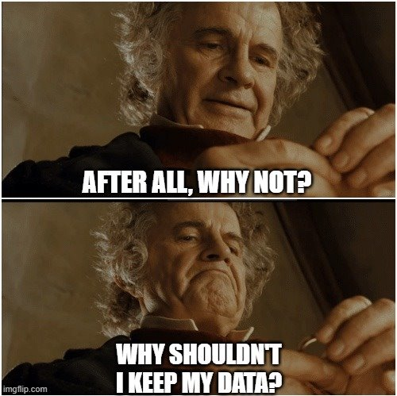
Reasons Data Isn’t Shared
source

Slide 19
Reasons Data Isn’t Shared
Sensitivities
Intellectual property
Community data
Too much data
Time, effort, and priorities

Slide 20
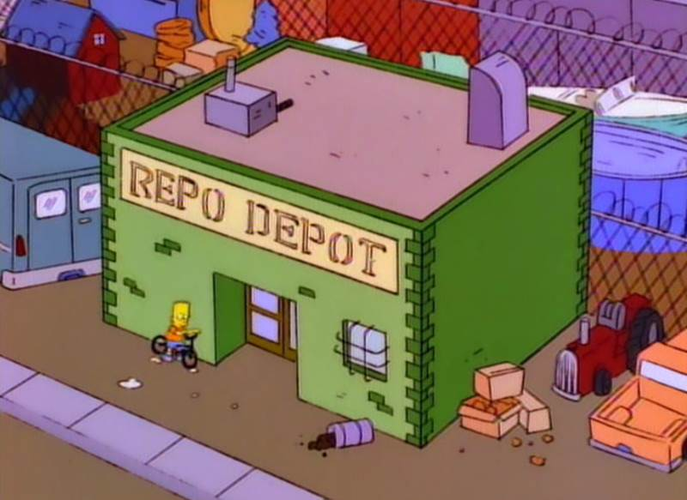
Data Repositories
source

Slide 21
What is a Data Repository?
Systems that facilitate the upload, long-term preservation, discovery, and access of research data and accompanying materials
Focus on housing data after a project’s completion, and that won’t be changing on a regular basis

Slide 22
Why Use a Data Repository?
You don’t have to handle all aspects of data sharing yourself, eg:
Responding to data requests
Maintaining a website
Data integrity checks over long periods of time
…
You can get help from repository support staff
You can get metrics about how often your dataset is viewed/downloaded

Slide 23

Things to Looks for in a Data Repository
Good data repositories will:
Have a mandate and plan for data preservation
Offer information about the data set that enables people to discover and learn about the data
Provide either direct access to the data or information on access conditions
Ensure that datasets have a persistent identifier that will provide perpetual access to the dataset (no broken links)
source

Slide 24
Types of Data Repositories
Generalist: Accept data from any discipline
Domain-specific: Limited to data from specific fields or disciplines (e.g. genomics, social sciences, etc.)
Institutional: Only accept data from people affiliated with a specific institution

Slide 25

Borealis
Shared service with Canadian regional library consortia, academic institutions, research organizations, and the Digital Research Alliance of Canada
Built on open-source software, The Dataverse Project (Harvard), hosted by Scholars Portal at the U of T Libraries
Data stores on the Ontario Library Research Cloud
source

Slide 26
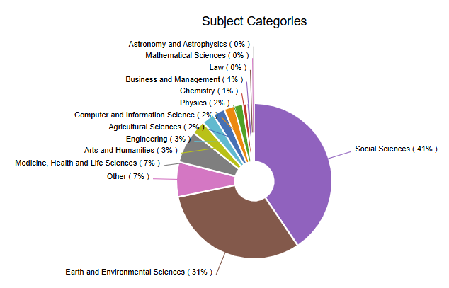
Borealis
70+ member institutions
Just under 23,000 datasets
Over 25M downloads

Slide 27
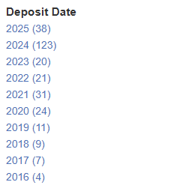
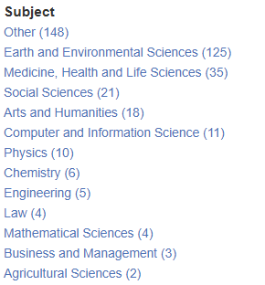
UVic Borealis
Deposits began in 2016
294 datasets
28 Dataverses
5,842 files

Slide 28
Semi-mediated curation workflow
Researchers initiate their dataset deposit
Submissions are reviewed by librarians following a modified CURATE(D) model to ensure that they align with our deposit guidelines
Librarian will contact the researcher for more information and work together to create/augment files
On publication, DOIs are minted and flagged for preservation processing
Uvic Borealis certified by CoreTrustSeal as a Trustworthy Repository

Slide 29

Federated Research Data Repository (FRDR)
National generalist repository hosted by the Digital Research Alliance of Canada
Focuses on housing large datasets
Works with Globus for seamless file transfer from national clusters, lab machines, and personal computers
Mints DOIs for each dataset
Default allocation of 1TB, with possibility to scale up
Curation services by FRDR team
Connected to Lunaris data discovery layer
source

Slide 30
Other Data Repositories
https://www.re3data.org/

Slide 31
Creative Commons (CC) Licenses
https://creativecommons.org/
Tells a re-user what they can do with a copyrighted work
Notes:
You must be the copyright holder to assign one of these licenses
Licenses can’t be revoked once assigned, so pick wisely!
(Ask for help if you need!)
Very commonly used by data repositories (including Borealis)

Slide 32
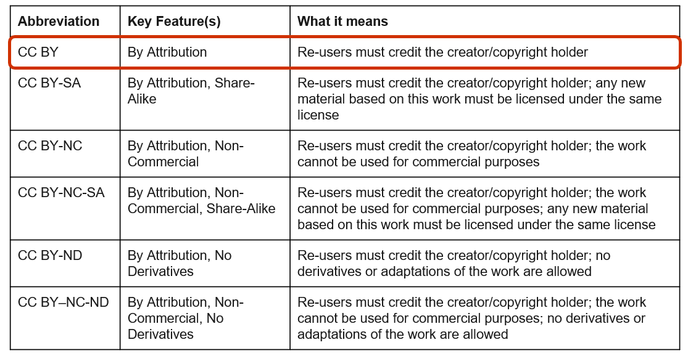
Creative Commons Licenses

Slide 33
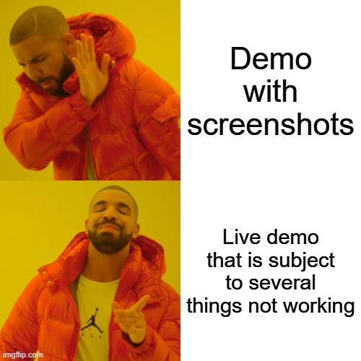
Borealis Demo Deposit
source

Slide 34
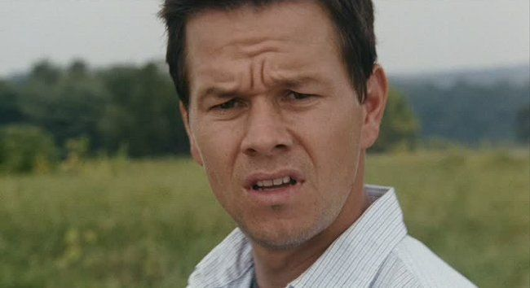
Questions?
source

