Slide 1
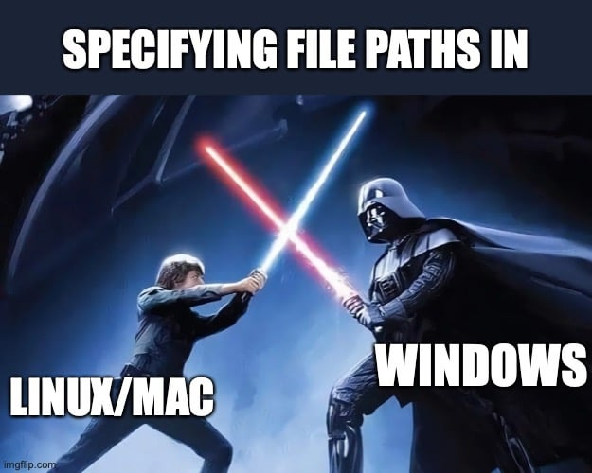
File & Directory Paths
source

Slide 2
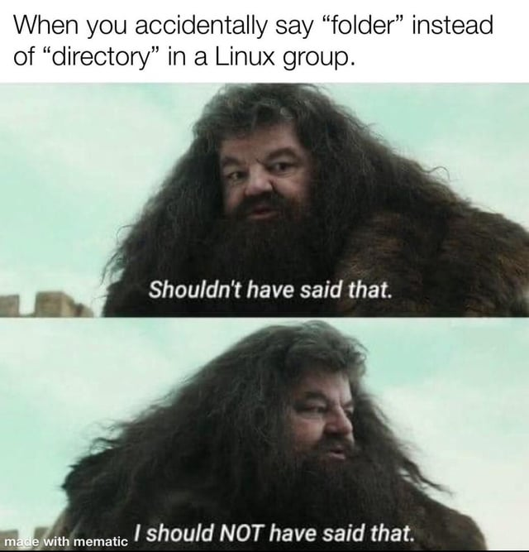
Navigating Files & Directories
source

Slide 3
Definitions
Files
Objects on a computer that store data, information, settings, or commands used with a computer program.
Directories
Also called "folders", are the units that hold files or other directories

Slide 4
Paths
A string of characters that specifies a unique location in a directory hierarchy.
A path specifies the location of a directory/file in a machine's file system structure.

Slide 5
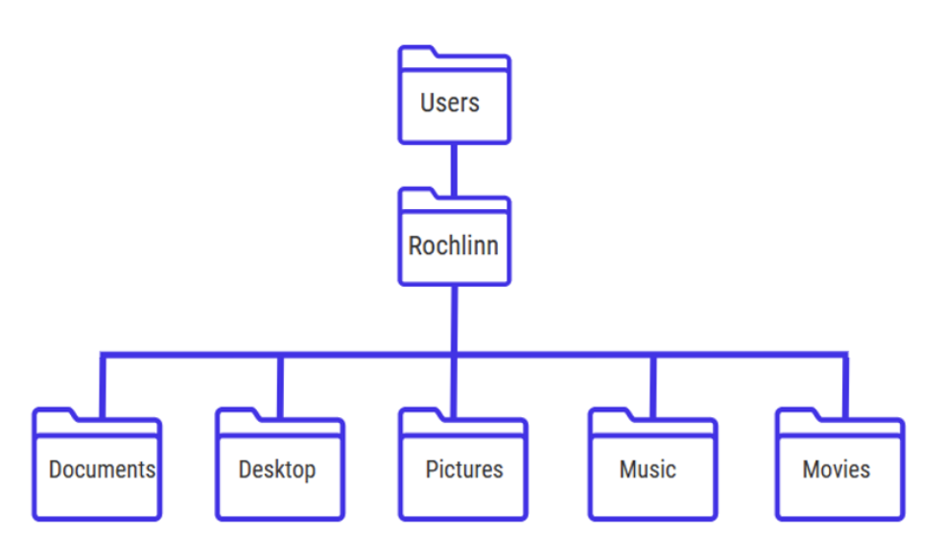
Paths
The picture below illustrates the directory structure of a typical computer.
Within this structure, the path to my Desktop would be:
/Users/Rochlinn/Desktop

Slide 6
Paths
When dealing with file paths, directories are denoted by a slash /, and each "layer" or the directory hiearchy is separated by a slash.
/Users/Rochlinn/Desktop

Slide 7
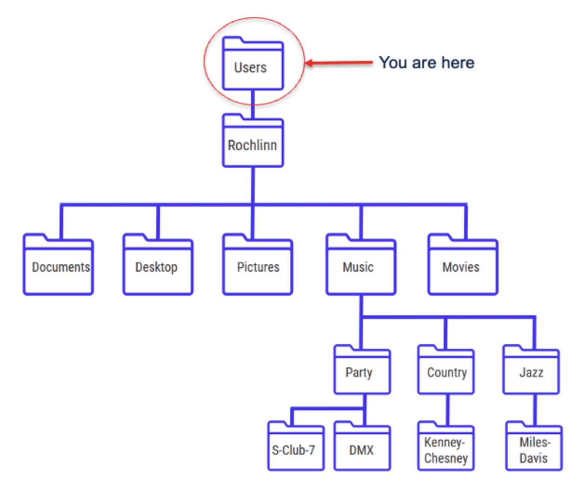
Exercise
What's the path to the Music directory?
What's the path to the S-Club-7 directory?

Slide 8
Answers
What's the path to the Music directory?
/Users/Rochlinn/Music
What's the path to the S-Club-7 directory?
/Users/Rochlinn/Music/Party/S-Club-7

Slide 9
Absolute vs. Relative Paths
When thinking about navigating through your files and directories, there are two paths that can be used:
Absolute paths: Includes the entire path from the root directory
Relative paths: Includes the path relative to where you are

Slide 10
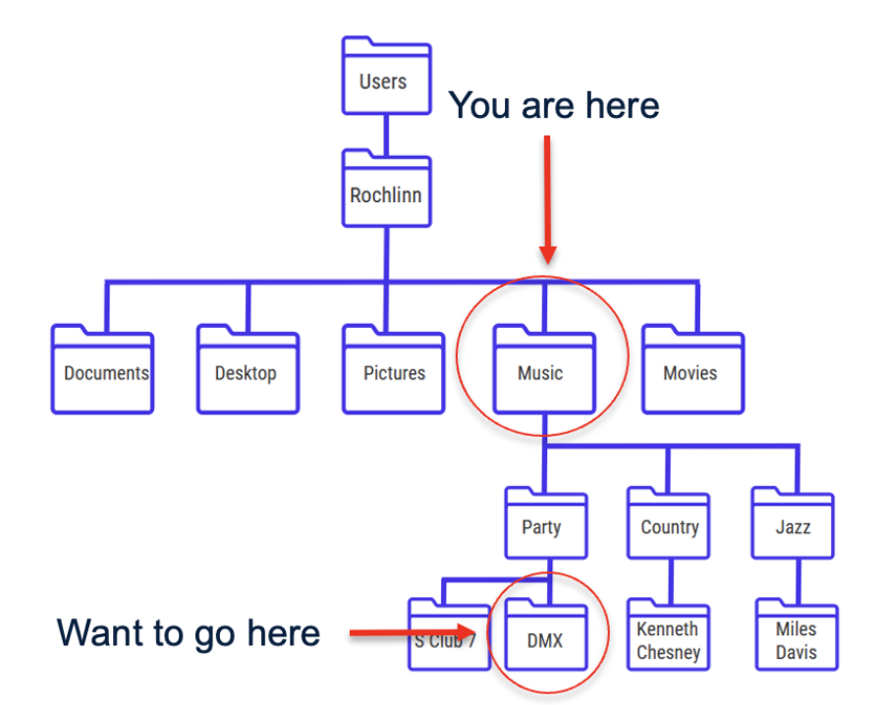
Absolute Paths
/Users/Rochlinn/Music/Party/DMX

Slide 11
Relative Paths
/Party/DMX
The path already assumes your location, so you don't need to write
/Users/Rochlinn/Music

Slide 12
Note
It should be noted that relative paths only work going down the hierarchy, and not upwards.

Slide 13

Why Should You Care?
source

Slide 14
Why Should You Care?
File paths tend to be a key point of struggle/issues for those learning coding languages.
To import a dataset into RStudio (or other IDEs), and to export/save derived datasets, images, etc., you need to specify the file path.
You don't need to be an expert in paths, but having a basic understanding of how this works is very helpful when approaching these tasks, and is something we'll start doing in the next block!

Slide 15
Questions?

