Slide 1
Workflow for the Week
Nick Rochlin, University of Victoria
RDM Jumpstart
May 12, 2025
Notes:
This is meant to provide a roadmap for what we’ll be doing this week, and the tools we’ll be using to support these activities. Because this is just an introduction, I’m not going to be speaking to things in a fulsome way, but rather giving a teaser of what you can expect to be covered during the week.

Slide 2
Key Tools & Concepts
Notes:
Introduce ourselves, make sure we mention being co-chairs of NTEG

Slide 3
Overview
Before collecting data
Data management planning
Open Science Framework (OSF)
After collecting data
OSF
R, RStudio, & Rmarkdown
At project completion
Borealis/Dataverse

Slide 4
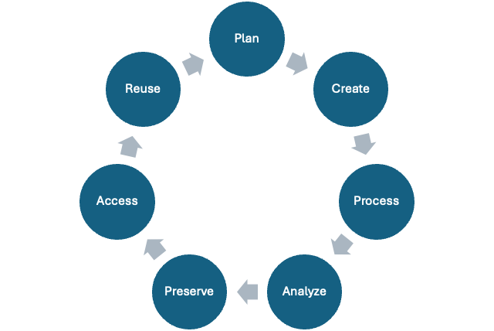
The Research Data Lifecycle

Slide 5
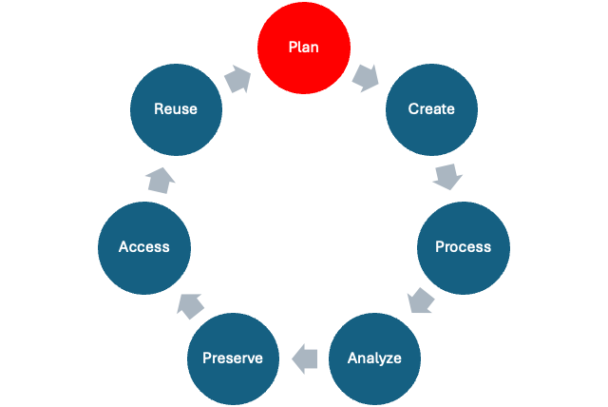
The Research Data Lifecycle

Slide 6
Data Management Plans – Covered in day 1
Questions and considerations about your research data prior to starting a project.
Will be covered in more detail this afternoon!

Slide 7
The Data Science Workflow
Notes:
Introduce ourselves, make sure we mention being co-chairs of NTEG

Slide 8
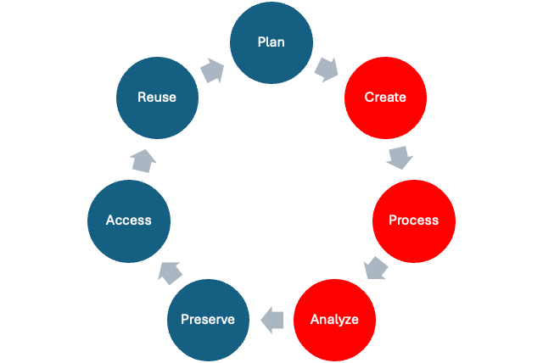
The Data Science Workflow

Slide 9
The Data Science Workflow
A framework to support transparent and open research processes.
A granular roadmap to support the “active” stages of the research data lifecycle.
While the research data lifecycle is focused on making research processes and outputs transparent and reproducible, the data science workflow focuses on manipulating and asking questions from data in an open and reproducible way.

Slide 10
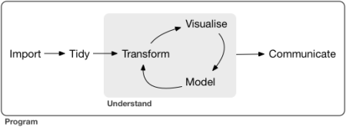
The Data Science Workflow
source

Slide 11
R
An open-source programming language designed for data manipulation, statistical analysis, and visualization.

Slide 12
RStudio
While R is the programming language, RStudio is an Integrated Development Environment (IDE), which is a fancy term for a software application that makes writing scripts R much more user-friendly.

Slide 13
RStudio
A analogy:
You are writing a document in Microsoft Word. In this case, the plain human language that you are typing would be R, and Microsoft Word, which is the software that allows you to view, format, add visuals, and save your work, is RStudio.
In the morning of day 2 we’ll do a session on using Excel vs. a coding language like R, and then we’ll jump into R and RStudio in the afternoon.

Slide 14
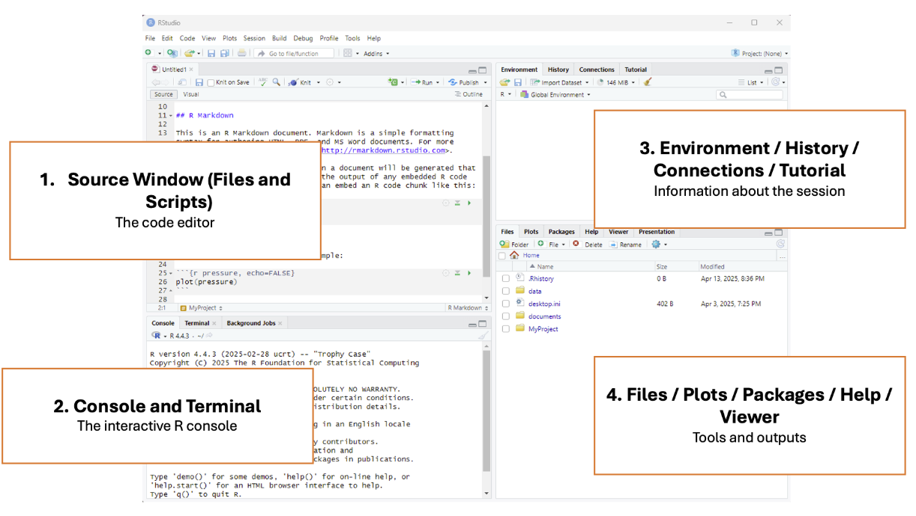
RStudio

Slide 15
Across the Tidyverse

Slide 16
The Tidyverse
A group of R “packages” for data manipulation, exploration, and visualization.
Focused on the connections between the activities of reproducible workflows.
Provides a good reference point for those new to coding to engage with coding.
Notes:
Cross-cutting policies: things like ethics, open access

Slide 17
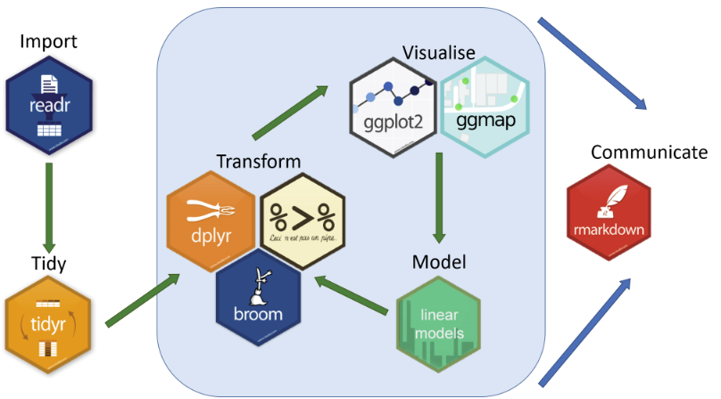
The Data Science Workflow with Tidyverse
source
Notes:
Cross-cutting policies: things like ethics, open access

Slide 18
Import – Covered in day 2
source
Notes:
Cross-cutting policies: things like ethics, open access

Slide 19
Import – Covered in day 2
Unlike Excel, which can immediately start working with spreadsheet data, for R to be able to work with data, the data first needs to be brought in, or imported, to the coding environment.

Slide 20
Tidy – Covered in day 3
source
Notes:
Cross-cutting policies: things like ethics, open access

Slide 21
Tidy – Covered in day 3
Most of the data we collect or retrieve is quite messy, and needs to be cleaned up, or tidied, before we can start asking questions from it.
This can include things like:
Changing the names of columns
Accounting for missing values / missing data
Re-formatting data
…

Slide 22
source
Notes:
Cross-cutting policies: things like ethics, open access

Slide 23
Transform – Covered in day 3
Once data has been tidied, we can start playing around!
Data transformations, such as:
Filtering rows and columns that meet certain criteria
Creating new columns based on the values of existing columns
Subsetting specific portions of the data
Transforming data can be a good way to set up data visualizations or modeling, but can also be conducted after visualization and modeling if you notice something interesting in the data.

Slide 24
Visualize – Covered in day 4
Excel can be pretty good at creating visualizations quickly, but it can also be frustrating due to rigid structures and it not doing what you want.
Visualizations in R require a bit more upfront work, but have much more flexibility and power in what you can create.
Visualizations can be used to communicate your findings, but can also be a valuable tool in exploring data and discovering interesting trends.

Slide 25
Model – Out of scope
Applying statistical models to data is the real “science” of data science, but is a bit beyond the scope of this series.
However, it’s worth mentioning here as a key part of the data science workflow, and we encourage you to use the skills developed throughout the week as a foundation to start entering this area.
It’s also possible that we may build out a more advanced level of the series, and if that’s of interest, please let us know!

Slide 26
Communicate – Covered in day 2-5
source
Notes:
Cross-cutting policies: things like ethics, open access

Slide 27
Communicate – Covered in day 2-5
Communicating your findings is the most fulfilling part of the data science workflow (it’s finally over!), but to do this in an open and transparent way, it needs to be considered throughout the entire research life cycle.

Slide 28
Communicate – Covered in day 2-5
Rmarkdown is a plain text format that combines R code, results, and explanatory text into a single, shareable, reproducible document.
Allows you to create various file formats like PDF, Word, HTML, and presentations.

Slide 29
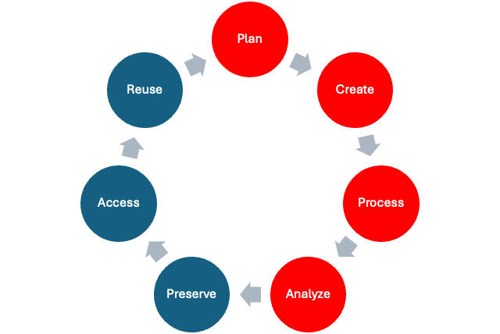
Storage & Backup

Slide 30
Open Science Framework (OSF) – Whole week
Cloud-based platform designed to promote transparency, collaboration, and reproducibility in research.
For the purpose of the Jumpstart, it will be used to:
Version control documents
Backup and share working documents
OSF will be introduced in further detail this afternoon and used throughout the week.

Slide 31
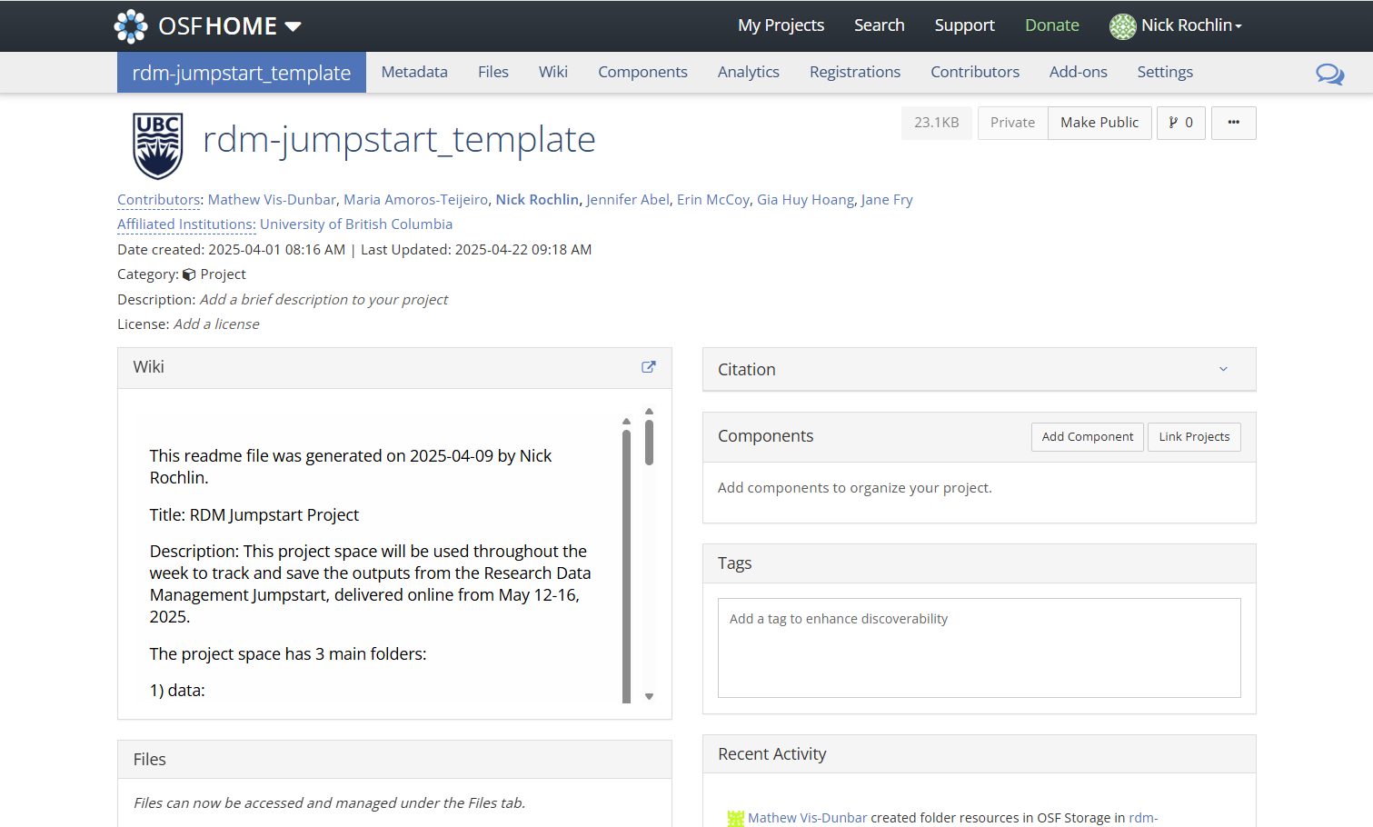

Slide 32
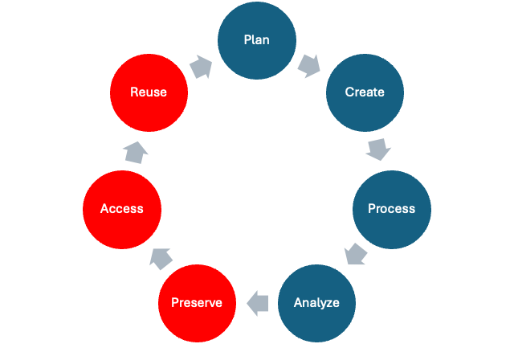
Data Preservation & Sharing

Slide 33
Borealis / Dataverse – Covered in day 5
A Canadian data repository supported by academic libraries and institutions across Canada.
Facilitates the sharing, preservation, and discovery of Canadian research data.
Throughout the week we’ll be discussing considerations for sharing and preserving data, and on day 5 we’ll cover Borealis and will deposit materials from the week into the repository.

Slide 34
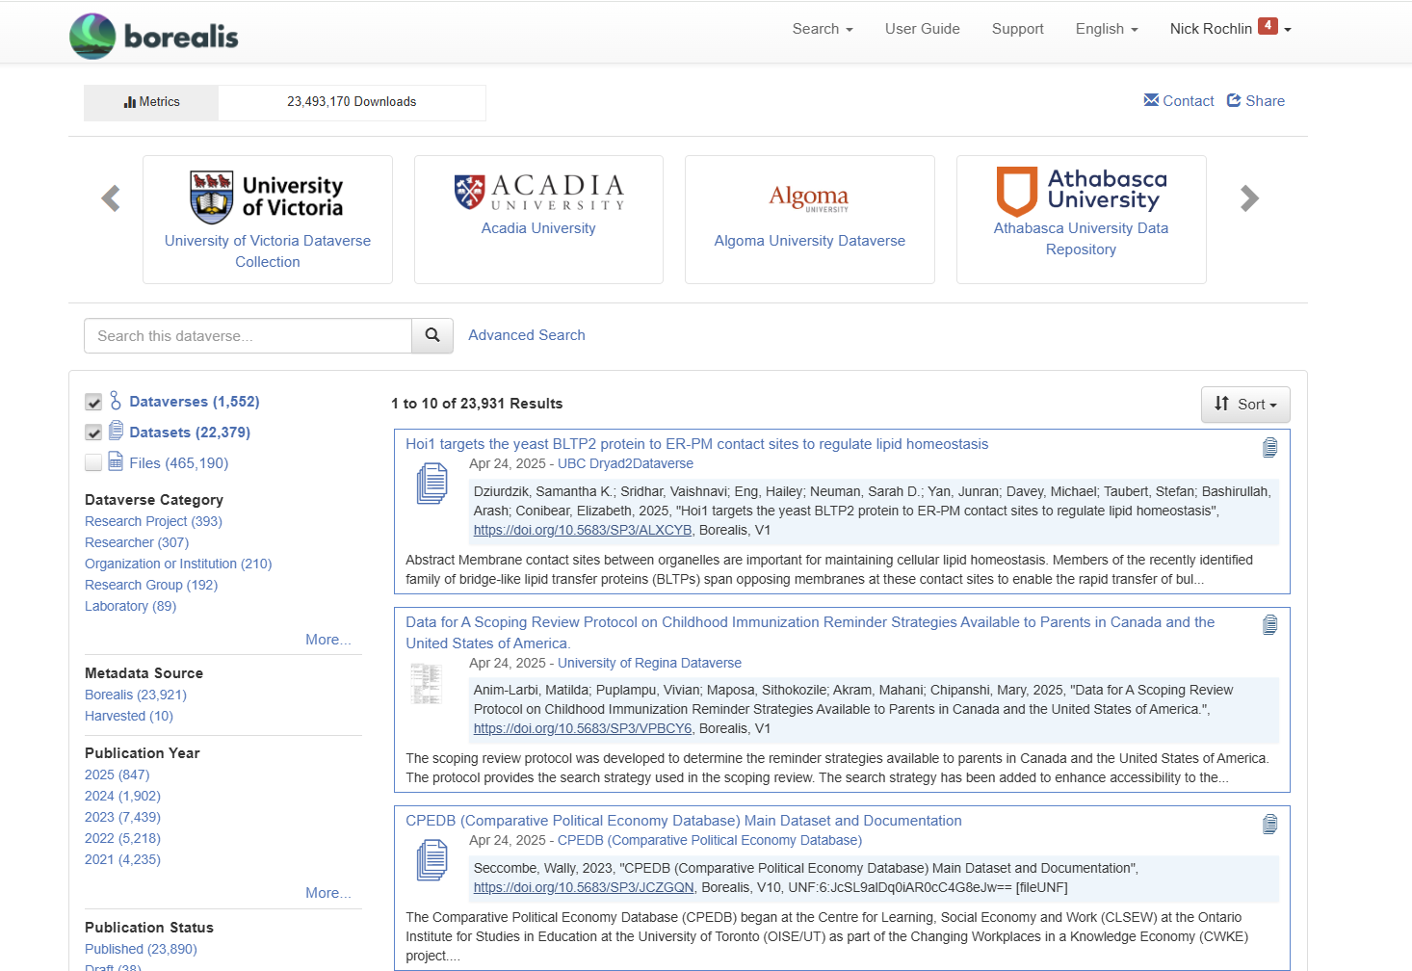

Slide 35
Questions?

