Slide 1
Sharing and Deposit The why, what, where and how
Jennifer Abel, University of Calgary
RDM Jumpstart
May 16, 2025

Slide 2
Sharing Data

Slide 3
Why do we share data?
Because someone tells us we have to (funders, publishers, supervisors)
Because it’s good research practice
Allows others to reproduce our results
Allows others to check our work for errors, bias, etc.
Allows others to do new work based on ours (with proper attribution)
In the spirit of the FAIR principles

Slide 4
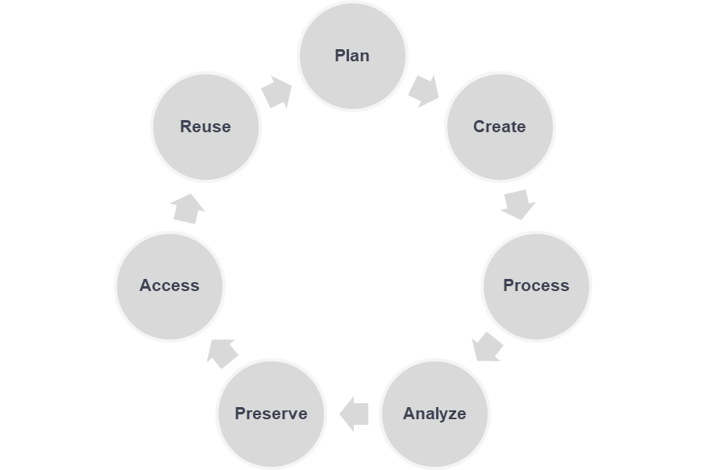
When do we share data?

Slide 5
What to share vs. what to keep internally
To share (ideally in non-proprietary formats)
Master/final data
Documentation that supports re-use of the data: readmes, data dictionaries, codebooks
Code used to analyze the data
To keep
Project management records: internal communications, decision making documents, admin records, ethics information (if appropriate), etc.
DMPs, standard operating procedures, methodologies
Analytic data (intermediate steps)
Analyzed data (graphs, charts, tables, etc.)
It depends
Raw data

Slide 6
IMPORTANT!
Just because you’re not sharing something doesn’t mean you should get rid of it
Most institutions will have rules for how long you have to keep research records for after a project is complete
Some funders will have these types of rules as well
Despite what you might have heard, REBs will not always require you to destroy data
However, if you tell participants that that’s what you’re going to do, then you have to do it
Make these plans/decisions at the beginning of your project!

Slide 7
ALSO IMPORTANT!!
Make sure that everyone involved in the project agrees on what data are being shared (if any), and how and where that will happen.
This includes your supervisor (if appropriate), any partners you might have at other institutions/in industry/at community organizations, Indigenous communities you may be working with.
Also includes getting consent from participants in your research.
If someone says no, you can’t share your data.
Make these plans/decisions at the beginning of your project and document them!

Slide 8
What we’re sharing from this project
Data:
The initial data file that you started with on day 2
The final data file that you finished with on day 4 (in .tsv and .Rdata)
Data dictionary
The .md and/or PDF for the data we worked with (not for the original dataset from Statistics Canada)
Readme
Code:
Your .Rmd file
Your .renv lockfile

Slide 9
Ways to share your data
On request
Via a website that you maintain
Via a data repository
This is often called ‘depositing’ your data
People sometimes use ‘sharing’ and ‘depositing’ interchangeably, but deposit is just one way of sharing data

Slide 10
Data Repositories

Slide 11
What are data repositories?
Online database services that provide long-term preservation for data and make them available for discovery and use
Unlike online storage services (e.g., Dropbox, Box, Google Drive), they’re designed to make your data findable by others
Unlike an institutional repository, they hold data, rather than theses/dissertations, publications, presentations, manuscripts, etc.
Used after a project is complete and data won’t be changing on a regular basis

Slide 12
What data repositories aren’t
Active storage for data during the course of a project
Either as your main storage or as your backup
‘Dark storage’ for data
Most repositories won’t take your data if it can’t be made findable/accessible in any way
Almost always an assumption that you’ll make your data findable at minimum
In most cases, metadata about the data will be accessible, even if the data themselves aren’t
Notes:
Note that OSF is more for the active phases of research

Slide 13
Why use a data repository?
You don’t have to handle all aspects of data sharing yourself
E.g., responding to every request for data, maintaining a website, ensuring that data are FAIR for a long period of time, ensuring that data are preserved for a long period of time…
You can get support from repository staff if you have particular needs/questions/issues
You can get metrics about how often your dataset is downloaded/viewed

Slide 14
What to look for in a data repository
Good data repositories will
Have a mandate and plan for data preservation
Offer information about the data set that enables people to discover and learn about the data
Provide potential data users with either direct access or information on access conditions
Ensure each data set has a persistent identifier (PID) that will always take people to information about the dataset and can be cited in publications
Do a little research before you start to make sure a repository is right for you
Notes:
Note what PIDs are: DOIs, handles, etc.

Slide 15
Types of data repositories
Generalist vs. domain-specific
Generalist repositories take data from any research discipline
Domain-specific repositories are limited to data from particular areas: e.g., genomics, health sciences, social sciences
Institutional vs. non-institutional
Institutional data repositories only accept data from people affiliated with a particular institution
Non-institutional data repositories aren’t limited to people at a particular institution, but may have other restrictions
Notes:
Go to OSF to show these

Slide 16
Canadian data repository options
Federated Research Data Repository (FRDR): https://www.frdr-dfdr.ca/repo/
A national generalist repository hosted by the Alliance
Custom-built for large datasets
Mainly targeted at faculty researchers (students get access through a faculty member)
Borealis: https://borealisdata.ca/
A network of 70 Canadian institutional repositories hosted by Scholars Portal/University of Toronto Libraries
Better for smaller datasets
Each institution decides who has access, what materials will be accepted, how data curation/review is handled, etc.

Slide 17
Borealis

Slide 18
Benefits of Borealis
Servers are hosted in Canada
Has a robust preservation plan (https://borealisdata.ca/preservationplan/)
Provides a persistent digital object identifier (DOI) for all datasets
Metadata are harvested by a number of aggregation services, e.g., Lunaris (https://www.lunaris.ca/en), Google Dataset Search (https://datasetsearch.research.google.com/)
Metrics available for how often datasets/files have been downloaded
If your institution uses Borealis, there’ll be local support available to you

Slide 19
Drawbacks of Borealis
Not all institutions use it
Maximum file size of 5GB, so it can’t handle all datasets
Terminology can be a little strange (e.g., the software/platform is called ‘Dataverse’ but collections are also called ‘Dataverses’)

Slide 20
An important thing to consider: Licensing
When you share data you create, you should carefully consider your license
What do you want other people to be able to do with it, and not do with it?
What kind of credit do you want to receive?
Most data repositories will require you to have some kind of license
Often you can select from already existing licenses (e.g., Creative Commons, Open Data Commons)
Sometimes you can create your own
If you’re working in a partnership, make sure you discuss this with your partners at the beginning of a project (put it in your DMP)

Slide 21
Creative Commons (CC) Licenses
https://creativecommons.org/
Tells a re-user what they can do with a copyrighted work
Notes:
You must be the copyright holder to assign one of these licenses
Licenses can’t be revoked once assigned, so pick wisely! Use the CC License Chooser if you’re not sure: https://chooser-beta.creativecommons.org/
Very commonly used by data repositories (including Borealis)

Slide 22
CC License Types
Abbreviation | Key Feature(s) | What it means
CC BY | By Attribution | Re-users must credit the creator/copyright holder
CC BY-SA | By Attribution, Share-Alike | Re-users must credit the creator/copyright holder; any new material based on this work must be licensed under the same license
CC BY-NC | By Attribution, Non-Commercial | Re-users must credit the creator/copyright holder; the work cannot be used for commercial purposes
CC BY-NC-SA | By Attribution, Non-Commercial, Share-Alike | Re-users must credit the creator/copyright holder; the work cannot be used for commercial purposes; any new material based on this work must be licensed under the same license
CC BY-ND | By Attribution, No Derivatives | Re-users must credit the creator/copyright holder; no derivatives or adaptations of the work are allowed
CC BY–NC-ND | By Attribution, Non-Commercial, No Derivatives | Re-users must credit the creator/copyright holder; the work cannot be used for commercial purposes; no derivatives or adaptations of the work are allowed

Slide 23
CC Public Domain Dedication (CC0)
Not actually a license: it’s a dedication of your work/data to the public domain
Anyone can use the work/data and do what they want with it without crediting you in any way
Unless you’re very altruistic, you probably want a different CC license type

Slide 24
More things to consider when depositing in Borealis
Whether you can make the deposit yourself, or whether someone else needs to be involved. This will depend on your institution’s policies
Mediated: you send the dataset to a staff member and they handle the deposit/publishing after review
Semi-mediated: you submit the dataset in Borealis and a staff member will review before publishing
Unmediated: you can submit and publish yourself
What your timeline is, in cases of mediated/semi-mediated deposit
Important if you need deposit for e.g., peer review, thesis/dissertation submission, grant submission, etc.
Leave yourself enough time for review!

Slide 25
More things to consider when depositing in Borealis
Whether there’s a specific collection (aka ‘Dataverse’) that you’re depositing in
We’ll be using a particular collection today to keep all our deposits together
If you think you need your own collection, contact your institutional support
Large files/datasets will take time to upload/publish
You can only upload 1000 files at a time
.csv and spreadsheet-type files will be converted into a tabular data format
The original files will still be available
Conversion can take a bit of time - don’t worry!

Slide 26
Hands-on: Depositing in the Borealis Demo site
After this session, you can find detailed guidance on how to deposit in the Borealis User Guide (https://learn.scholarsportal.info/all-guides/borealis/ )
Creating an account: https://learn.scholarsportal.info/all-guides/borealis/user-accounts/
Depositing data: https://learn.scholarsportal.info/all-guides/borealis/datasets/

Slide 27
Questions?

