Slide 1
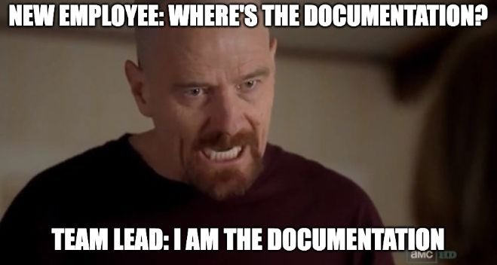
Documentation
source

Slide 2
Session Overview
Identify the importance of documentation as it relates to RDM and the FAIR Principles
Key concepts to cover in a README document
Data dictionaries as an alternative/additional form of documentation
Discuss general best practices of data licensing, and how it pertains to the project’s data

Slide 3
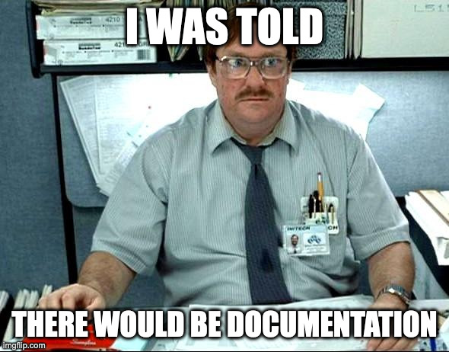
Why Document Your Files?
source

Slide 4
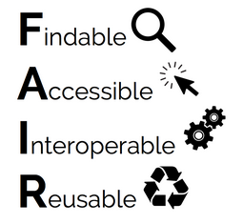
Documentation
A way to ensure that others (and your future selves) can navigate and correctly interpret that files and data of a project
Crucial in achieving FAIR data
source

Slide 5
Documentation
Questions to ask yourself:
Can you and your collaborators easily find and interpret files?
Could people outside of your group be able to find and interpret your files?

Slide 6
README Files
A file that sits in a project’s root directory (sometimes there can be multiple README files for a project), and provides information about the files and their content
During a project, keeping an updated README file will help you and your team having a source of truth regarding your project’s files
After a project’s completion, a README file can be used by those who might be accessing your data, as a sort of instruction manual on how to navigate and use the data

Slide 7
README Files
Things to include in a README file:
Contact information for the researcher(s)
Data collection methods (protocols, sampling, instruments, coverages, etc.)
File structures
Naming conventions of files, if applicable
Description of data cleaning, analysis, manipulations, or modifications
Descriptions of variables and explanations of codes and classifications
Data confidentiality and permissions, if applicable
Data use license

Slide 8
README Files
More considerations:
Create README files for logical clusters of related files/data
Write your README as a plain text document (.txt or .md)
Prepend the filename with an _ so that it shows up at the top of the file list
If using multiple README files, place them in sensical locations and format identically
Be sure to update!

Slide 9
Exercise
Take a look at the following datasets:
Kampen, Andrea; Pearson, Maggie; Smit, Michael, 2018, "Replication Data for: Digital Tools and Techniques in Scholarship and Pedagogy in the Social Sciences and Humanities", https://doi.org/10.23685/1H9TOV
Livingstone, D.W., 2021, "7 Replication Data for: 2017 CWKE Registered Nursing Dataset", https://doi.org/10.5683/SP2/I98O1W
Perron, Maxime, 2023, "Interindividual variability in the benefits of personal sound amplification products on speech perception in noise: a randomized cross-over clinical trial", https://doi.org/10.5683/SP3/HTMDLI

Slide 10
Exercise
What kind of documentation do you see?
Can you tell what each of the files is?
When looking at a data file, can you understand what you’re looking at?
Is there anything that sticks out to you as interesting? Good? Bad?

Slide 11
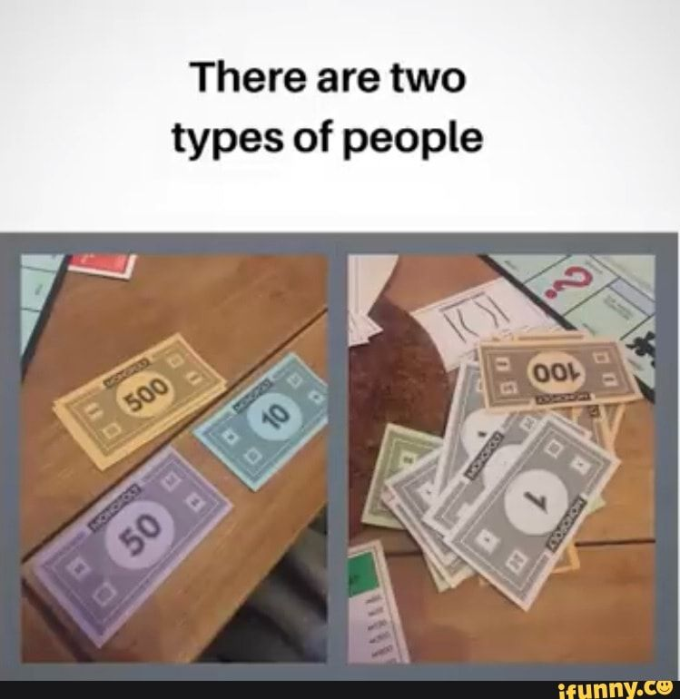
Caveat: 2 Types of READMEs
source

Slide 12
Caveat
Things to include in a DEPOSIT README file:
Contact information for the researcher(s)
Data collection methods (protocols, sampling, instruments, coverages, etc.)
File structures
Naming conventions of files, if applicable
Description of data cleaning, analysis, manipulations, or modifications
Descriptions of variables and explanations of codes and classifications
Data confidentiality and permissions, if applicable
Data use license

Slide 13
Caveat
Things to include in an ACTIVE README file:
Contact information for the researcher(s)
Data collection methods (protocols, sampling, instruments, coverages, etc.)
File structures
Naming conventions of files, if applicable
Description of data cleaning, analysis, manipulations, or modifications
Descriptions of variables and explanations of codes and classifications
Data confidentiality and permissions, if applicable
Data use license

Slide 14
Questions?

Slide 15
Data Dictionaries / Codebooks
A file that describes each element of tabular datasets
Details of variagble names, labels, units, and constraints such as acceptable range of values
Can enable software programs (R, Python, etc.) to read and process a data file, enhancing machine-readability, interoperability, and data reuse
Provides human-readable details to support interpretation and analysis

Slide 16
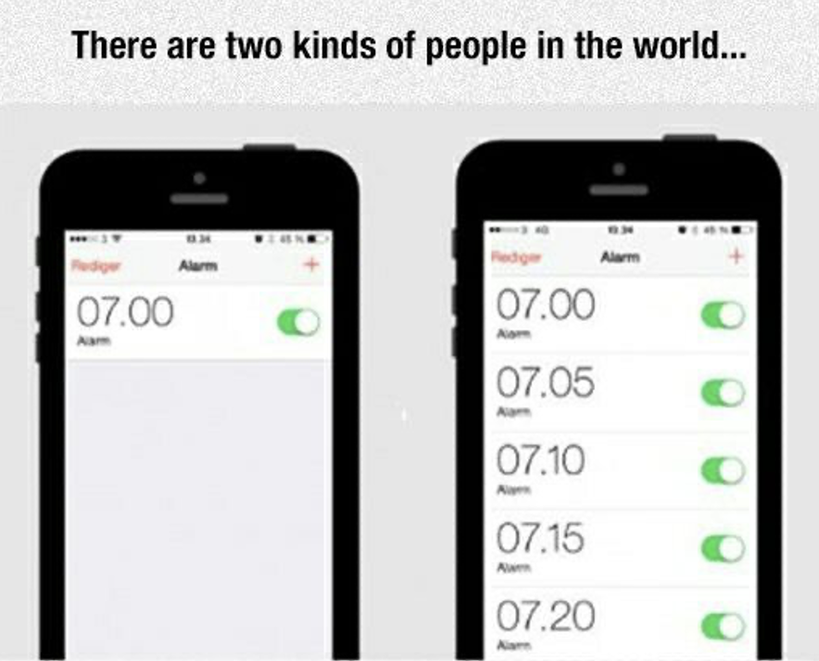
Caveat: 2 Types of Data Dictionaries
source

Slide 17
Our Data Dictionary (Stats Can)
https://osf.io/p7cv8

Slide 18
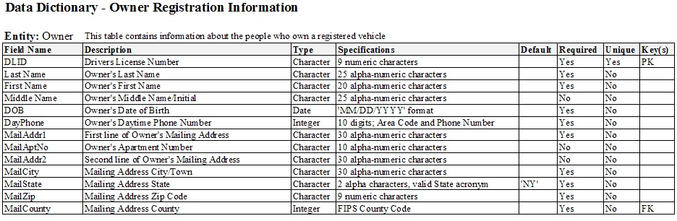
Machine Readable
source

Slide 19
Sneak Peak - README Template
In the next session we’ll begin filling out a README for our project. We’ll take a quick look at the temlate that we’re using, which can be found in the docs folder in OSF
https://data.research.cornell.edu/data-management/sharing/readme/

Slide 20
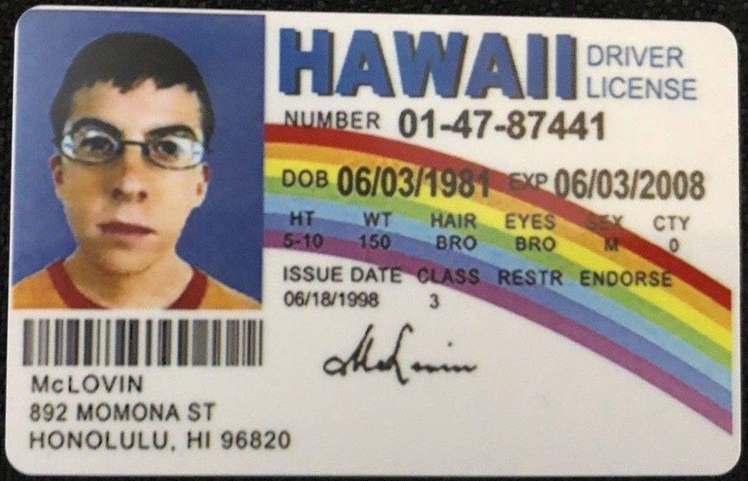
Licenses
source

Slide 21
Data Licenses
A data license is a legal arrangement between the creator of the data and the end-user, specifying what can be done with the data.
As a producer of data, this allows your work to be shared/used in the ways that you are comfortable with.
As a consumer of data, this provides boundaries of what you are able to do with data you encounter.

Slide 22
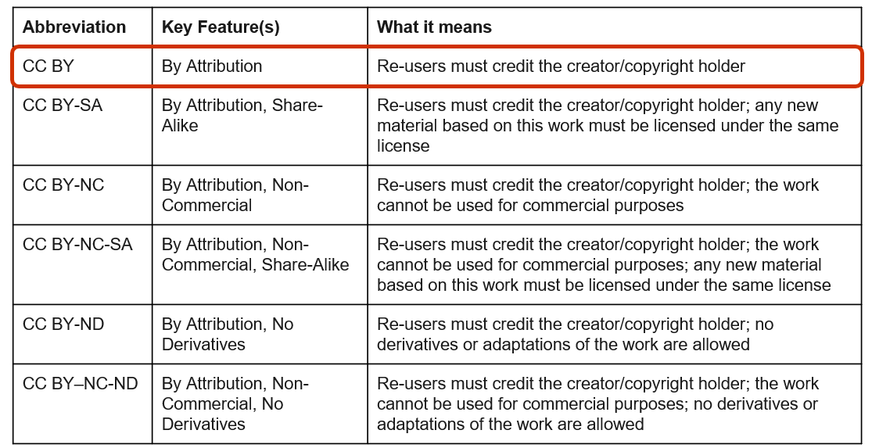
Creative Commons Licenses

Slide 23
Licenses – Our Dataset
At the end of the program, we’ll be looking at data repositories and depositing data, and we’ll be applying a license to our data set (stay tuned!).
However, because we’ll be working with an existing dataset, we need to make sure that we understand its license and what that entails.
Let’s take a look!
https://doi.org/10.5683/SP3/RDS0CK

Slide 24
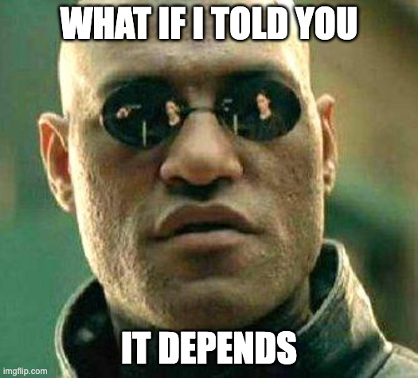
Ethical, legal, and commercial considerations
source

Slide 25
Ethical, legal, and commercial considerations
Research involving any of the following requires additional considerations:
Human participants / personal information
Animals
Collaborators at other institutions
Industry partners
Community organizations
Indigenous communities
Communities that have traditionally been marginalized or tokenized
Others?

Slide 26
Ethics and Consent Forms
Research involving human participants requires an ethics application and informed consent.
Consent/information letters to participants must describe how data are handled during active phases of research as well as post-project.
It can be quite difficult, or even impossible, to revise participant consent, so getting things right at the start of a project is very helpful!
UVic Ethics applications contain sections on Data Management and Informed Consent to help guide this process.
Opportunities for collaboration between ORS and the Library!

Slide 27
Partnerships and Contracts
Research involving industry partners, community organizations, or even researchers from different institutions, may require data sharing agreements and other contracts.
These can dictate where the data must reside, how it can be transferred, and what can be done with the data both during active research phases and after a project's completion.

Slide 28
Research Involving the First Nations, Inuit, and Métis Peoples of Canada
The Tri-Council Policy Statement: Ethical Conduct for Research Involving Humans – TCPS 2 (2022) provides a detailed framework for approaching this research and data/knowledge in respectful ways that are beneficial to the involved communities.
A large part of conducting this type of research involves relationship building and a slower timeline than other research projects.
No clear-cut paths or solutions, and each project generally requires a unique approach that reflects the values and desires of the communities.

Slide 29
Research involving communities that have traditionally been marginalized or tokenized
Should be approached in similar ways to research involving Indigenous communities, but there may be less formal guidance to support.
Integrated Knowledge Translation Guiding Principles

Slide 30

Questions?
source

