Slide 1
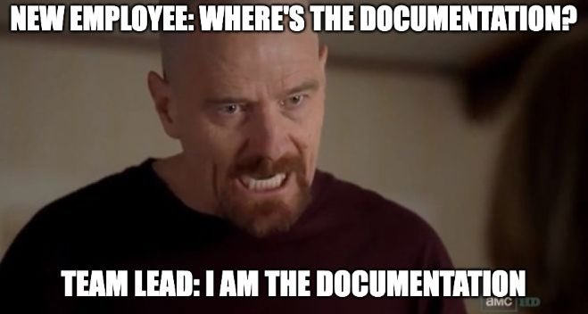
Documentation
source

Slide 2
Session Overview
Learning Objectives:
Discuss the importance of documentation as it relates to RDM and the FAIR Principles
Describe two documentation formats and their elements:
README files
Data dictionaries

Slide 3
Session Overview
Learning Outcomes – by the end of this session you’ll be able to:
Describe the importance of documentation
Explain the use of different documentation formats and their respective elements
Create a README file

Slide 4
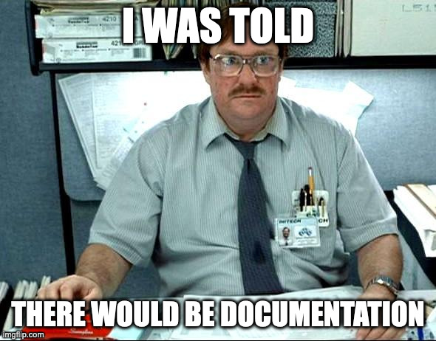
Why Document Your Files?
source

Slide 5
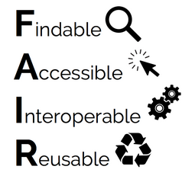
Documentation
A way to ensure that others (and your future selves) can navigate and correctly interpret that files and data of a project
Crucial in achieving FAIR data
source

Slide 6
Documentation
Questions to ask yourself:
Can you and your collaborators easily find and interpret files?
Could people outside of your group be able to find and interpret your files?

Slide 7
README Files
A file that sits in a project’s root directory (sometimes there can be multiple README files for a project), and provides information about the files and their content
During a project, keeping an updated README file will help you and your team having a source of truth regarding your project’s files
After a project’s completion, a README file can be used by those who might be accessing your data, as a sort of instruction manual on how to navigate and use the data

Slide 8
README Files
Things to include in a README file:
Contact information for the researcher(s)
Data collection methods (protocols, sampling, instruments, coverages, etc.)
File structures
Naming conventions of files, if applicable
Description of data cleaning, analysis, manipulations, or modifications
Descriptions of variables and explanations of codes and classifications
Data confidentiality and permissions, if applicable
Data use license

Slide 9
README Files
More considerations:
Create README files for logical clusters of related files/data
Write your README as a plain text document (.txt or .md)
Prepend the filename with an _ so that it shows up at the top of the file list
If using multiple README files, place them in sensical locations and format identically
Be sure to update!

Slide 10
Exercise
Take a look at the following datasets:
Kampen, Andrea; Pearson, Maggie; Smit, Michael, 2018, "Replication Data for: Digital Tools and Techniques in Scholarship and Pedagogy in the Social Sciences and Humanities", https://doi.org/10.23685/1H9TOV
Livingstone, D.W., 2021, "7 Replication Data for: 2017 CWKE Registered Nursing Dataset", https://doi.org/10.5683/SP2/I98O1W
Perron, Maxime, 2023, "Interindividual variability in the benefits of personal sound amplification products on speech perception in noise: a randomized cross-over clinical trial", https://doi.org/10.5683/SP3/HTMDLI

Slide 11
Exercise
What kind of documentation do you see?
Can you tell what each of the files is?
When looking at a data file, can you understand what you’re looking at?
Is there anything that sticks out to you as interesting? Good? Bad?

Slide 12
Data Dictionaries / Codebooks
A tabular (spreadsheet) file that describes each element of tabular datasets
Details of variagble names, labels, units, and constraints such as acceptable range of values
Enables software programs (R, Python, etc.) to read and process a data file, enhancing machine-readability, interoperability, and data reuse
Provides human-readable details to support interpretation and analysis

Slide 13
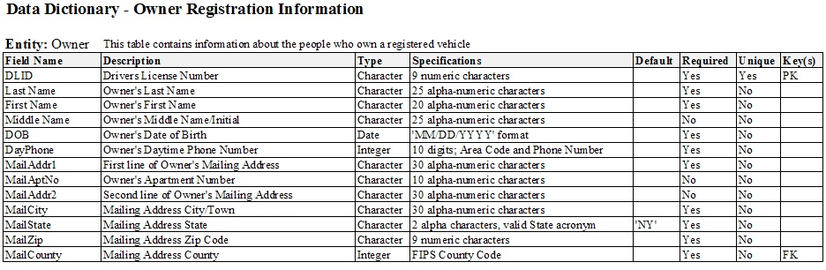
Data Dictionaries / Codebooks
source

Slide 14
Sneak Peak - README Template
In the next session we’ll begin filling out a README for our project. We’ll take a quick look at the temlate that we’re using, which can be found in the docs folder in OSF
https://data.research.cornell.edu/data-management/sharing/readme/

Slide 15
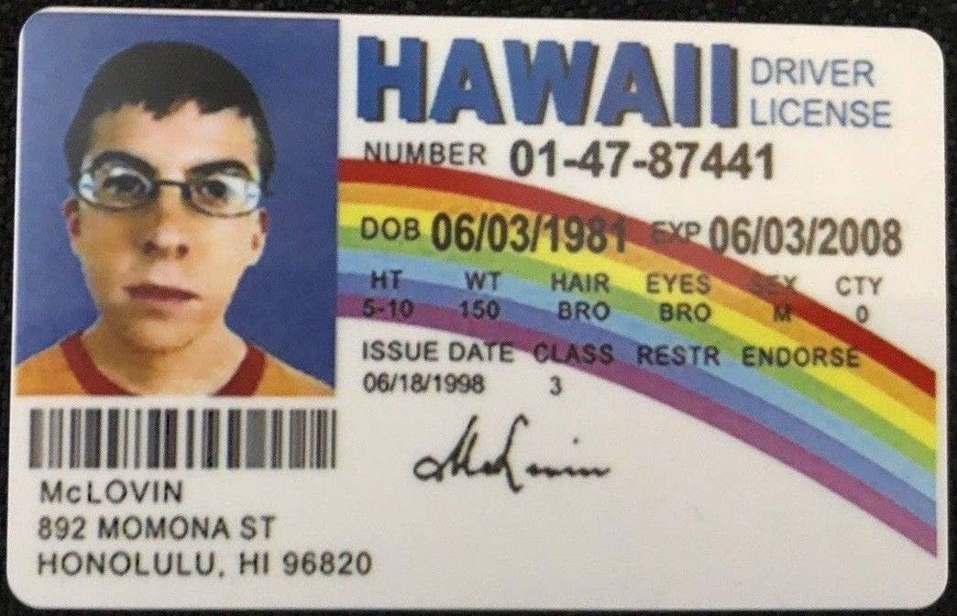
Licenses
source

Slide 16
Data Licenses
A data license is a legal arrangement between the creator of the data and the end-user, specifying what can be done with the data.
As a producer of data, this allows your work to be shared/used in the ways that you are comfortable with.
As a consumer of data, this provides boundaries of what you are able to do with data you encounter.

Slide 17
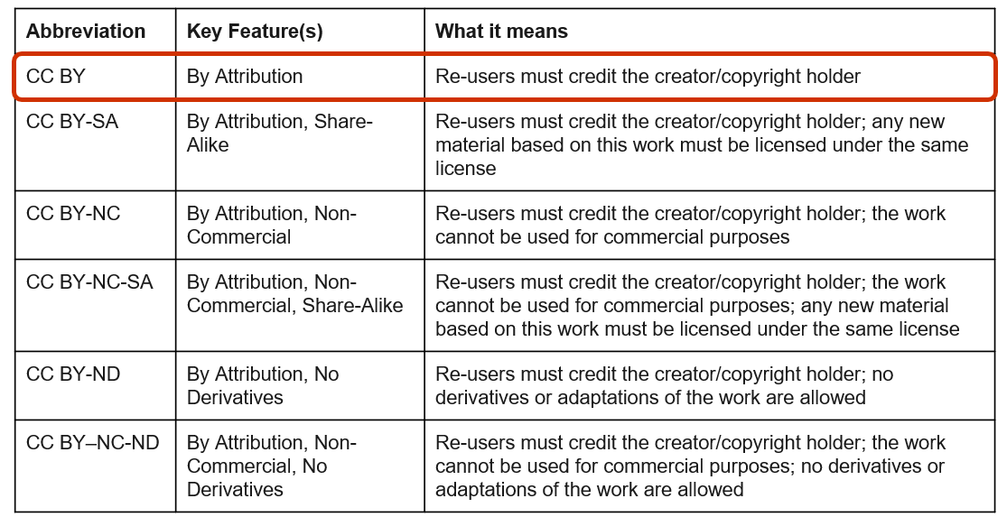
Creative Commons Licenses

Slide 18
Licenses – Our Dataset
At the end of the program, we’ll be looking at data repositories and depositing data, and we’ll be applying a license to our data set (stay tuned!).
However, because we’ll be working with an existing dataset, we need to make sure that we understand its license and what that entails.
Let’s take a look!
https://doi.org/10.5683/SP3/RDS0CK

Slide 19
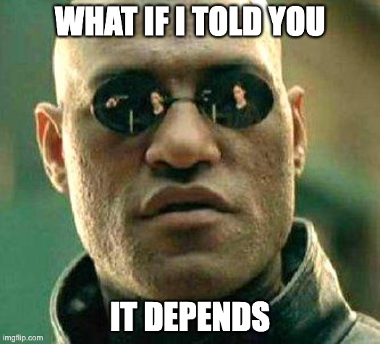
Ethical, legal, and commercial considerations
source

Slide 20
Ethical, legal, and commercial considerations
Research involving any of the following requires additional considerations:
Human participants / personal information
Animals
Collaborators at other institutions
Industry partners
Community organizations
Indigenous communities
Communities that have traditionally been marginalized or tokenized
Others?

Slide 21
Ethics and Consent Forms
Research involving human participants requires an ethics application and informed consent.
Consent/information letters to participants must describe how data are handled during active phases of research as well as post-project.
It can be quite difficult, or even impossible, to revise participant consent, so getting things right at the start of a project is very helpful!
UVic Ethics applications contain sections on Data Management and Informed Consent to help guide this process.
Opportunities for collaboration between ORS and the Library!

Slide 22
Partnerships and Contracts
Research involving industry partners, community organizations, or even researchers from different institutions, may require data sharing agreements and other contracts.
These can dictate where the data must reside, how it can be transferred, and what can be done with the data both during active research phases and after a project's completion.

Slide 23
Research Involving the First Nations, Inuit, and Métis Peoples of Canada
The Tri-Council Policy Statement: Ethical Conduct for Research Involving Humans – TCPS 2 (2022) provides a detailed framework for approaching this research and data/knowledge in respectful ways that are beneficial to the involved communities.
A large part of conducting this type of research involves relationship building and a slower timeline than other research projects.
No clear-cut paths or solutions, and each project generally requires a unique approach that reflects the values and desires of the communities.

Slide 24
Research involving communities that have traditionally been marginalized or tokenized
Should be approached in similar ways to research involving Indigenous communities, but there may be less formal guidance to support.
Integrated Knowledge Translation Guiding Principles

Slide 25

Questions?
source

