Slide 1
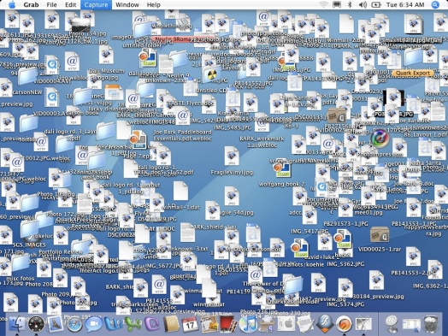
Me: “I’m very organized” Also me:
Organizing Files & Folders
Nick Rochlin, Data Science Librarian
source

Slide 2
Session Overview
Learning Objectives
Introduce concepts and best practices of file naming
Implement file naming best practices on example files
Introduce concepts and best practices of directory organization
Implement directory structure best practices on an example project

Slide 3
Session Overview
Learning Outcomes
By the end of this session, you’ll be able to…
Describe best practices for file naming and directory organization
Begin conceptualizing how to apply these practices to your own files and directories

Slide 4
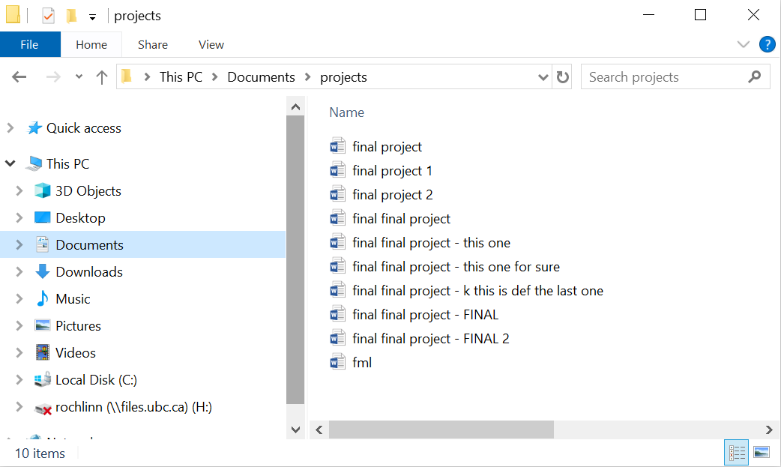
File Naming Best Practices

Slide 5
File Naming Best Practices
Human readable
Machine readable
Be consisent!

Slide 6
Human Readable
Can you look at a file name and know what it is? What about in a year from now?
Will others be able to look at your files and know what they are?
Will you/others be able to easily find a file you’re/they’re looking for?

Slide 7
Human Readable
Short but complete names
Ideally 3-5 conceptual elements
Write down your naming conventions and document in a README file
Define acronyms, abbreviations, codes, etc.

Slide 8
Human Readable
Short but complete names
Ideally 3-5 conceptual elements
Write down your naming conventions and document in a README file
Define acronyms, abbreviations, codes, etc.
Elements to consider in naming files:
Date of creation/collection
Short description
Group/affiliation
Activity
Location
Editor/creator
Other relevant information

Slide 9
Machine Readable
How will a computer sort your file names?
If files move from one computer / application / operating system to another, will they remain interpretable in the same way?

Slide 10
Machine Readable
How will a computer sort your file names?
If files move from one computer / application / operating system to another, will they remain interpretable in the same way?
Machine Readable Qualities:
Only contain letters in the English alphabet, numbers 0-9, dashes -, and underscores _
Do not use spaces or special characters such as: !@#$%^&*()+={}[]|
Separate naming elements with underscores and dashes
Use date format: YYYYMMDD or YYYY-MM-DD

Slide 11
Examples: Data
Example: lldr_mpp_20240723.csv
Documentation:
Convention: project_location_collection-date.file-type
lldr: Leaf Litter Decomposition rate
mpp: Monk Provincial Park

Slide 12
Examples: Manuscript
Example: lldr_manuscript_V01.docx
Documentation:
Convention: project_content_version.file-type
lldr: Leaf Litter Decomposition rate

Slide 13
Examples: Feedback
Example: lldr_manuscript_V01_NR.docx
Documentation:
Convention: project_content_version_editor.file-type
lldr: Leaf Litter Decomposition rate

Slide 14
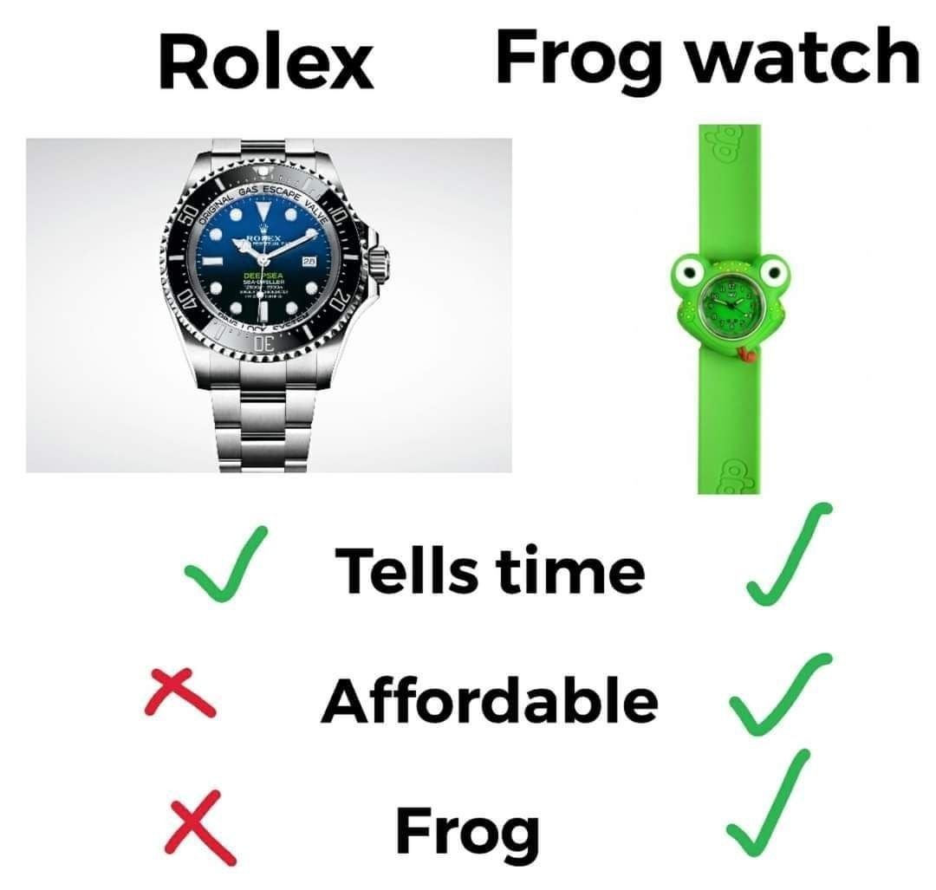
Likeness & Importance
source

Slide 15
Questions?

Slide 16
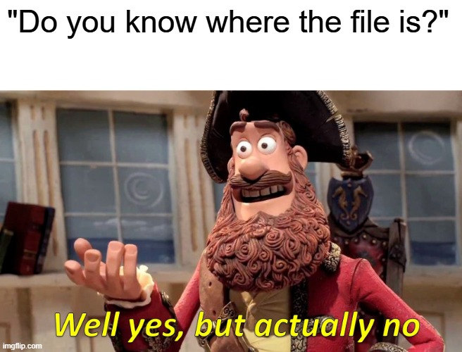
Managing Directories
source

Slide 17
Managing Directories
Directories, AKA folders, are a way of keeping your files organized and easy to find
Developing a directory structure before you begin a project can help with managing all the files that will be collected / generated
The same principles for file naming apply to directories
Directories are denoted by a “/” at the end in diagrams

Slide 18
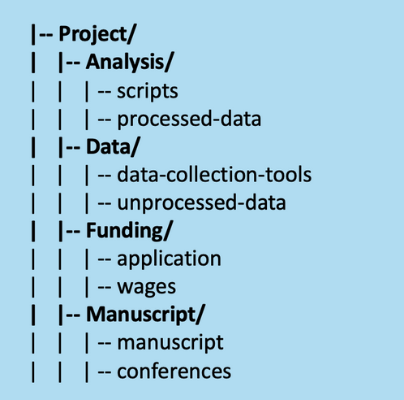
Directory Structures
Directory structures typically have:
A root directory (top-level folder)
Subdirectories (subfolders)
Relevant files

Slide 19
Hierarchy Depth
A “shallow” directory structure has minimal nesting of folders
A “deep” structure contains (potentially many) subdirectories
Choosing which type of structure you want will depend on:
How many files the project has
The types of files the project has
The size/nature of your research team
Personal preference

Slide 20
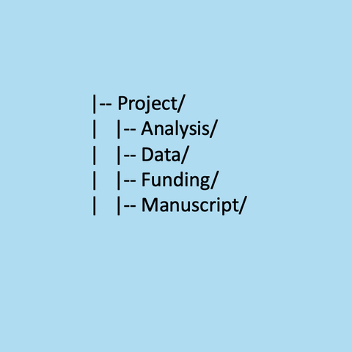
A Shallow Structure

Slide 21
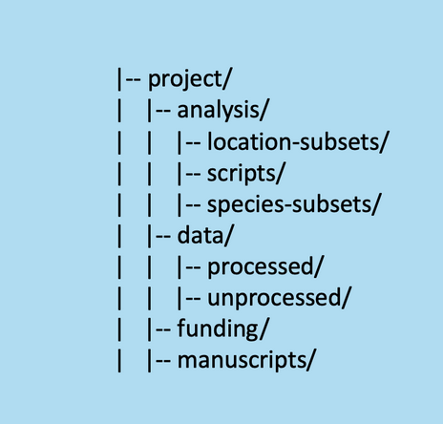
A Deep(er) Structure

Slide 22
Whiteboard a Plan
Before jumping into a project, it’s very useful to whiteboard a plan of directories
It can be helpful to think about natural and distinct groups of data and files that you’ll be working with
To start whiteboard, you can think about:
Directory names
Directory contents
Access permissions
Other relevant aspects of the project

Slide 23
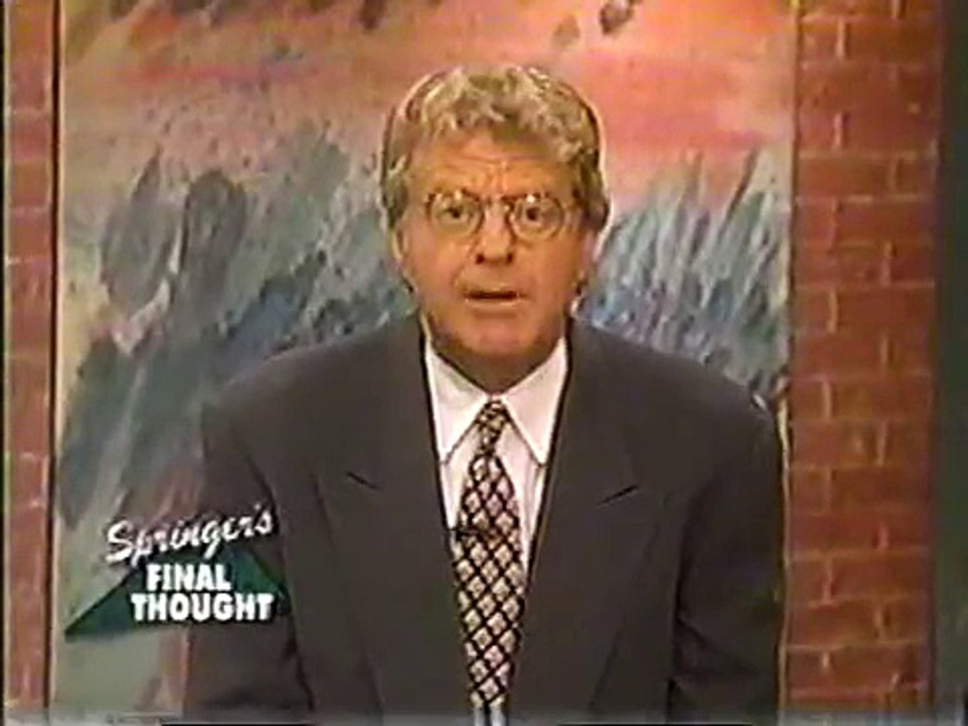
Final Thoughts
source

Slide 24
Versioning Data
Data files can change and evolve over the course of a project
Versioning is a way to keep “snapshots” of this progress
Promotes transparency
A good safeguard if things fall off the rails

Slide 25
Versioning Data – Best Practices
Keep an original copy of your data files, and DON’T TOUCH!
Consider various stages of data cleaning/analysis, and what versions might be valuable, and if these are best captured by naming or by directories:
Cleaning/cleaned
Subsets
Analysis/analyzed
Final

Slide 26
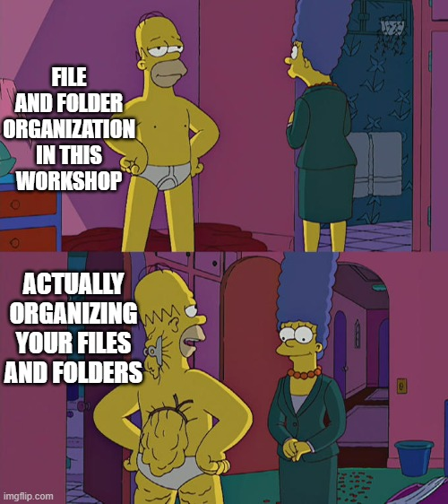
source

Slide 27

Questions?
source

