Slide 1
Planning for Data Management
With some best practice tips
Jennifer Abel, University of Calgary
RDM Jumpstart
May 12, 2025

Slide 2
Why you need to plan for data management
Research doesn’t happen in a vacuum!
There are many, many factors that will affect both a project overall and the data within a project
If you don’t plan for these factors before you start, you can run into big problems as you go along
Even without big problems, planning to manage your data will make your life a lot easier

Slide 3
The key areas you need to plan for
Ethical, legal and commercial issues
Data collection
Data documentation
Storing, accessing and working with data
Specifics of procedures/workflows
Long-term data management, discoverability and access

Slide 4
Ethical, legal and commercial issues

Slide 5
1. Ethical, Legal and Commercial Issues
It’s possible you’ll work on a project where none of these are relevant to your work. However, if you do research with any of the following, they can be crucial:
Human participants in research (e.g., health research, behavioural research, surveys, user testing…) or personal information/personal health information
Animals
Researchers at other institutions, inside or outside of Canada
Industry partners or community organizations (e.g., using a product that a company developed; surveying community service users)
Data that someone else collected
Indigenous communities and/or Traditional Knowledge
Areas of research that a government has said are sensitive

Slide 6
1. Ethical, Legal and Commercial Issues
What you need to consider:
Laws (e.g., privacy laws, copyright laws, laws around access to health data)
Legal agreements and frameworks (e.g., contracts with partners, licenses for products or data, copyright)
Ethical frameworks (for working with humans or animals)
Federal or provincial policies (e.g., around research security)
Funder policies (e.g., around sharing data)
Institutional policies, procedures and standards (e.g., around privacy, intellectual property, cybersecurity, submitting theses/dissertations)
Any specific guidelines around the student/supervisor relationship at your institution

Slide 7
1. Ethical, Legal and Commercial Issues
You need to plan to meet whatever obligations you’re under. E.g.,
How you’ll ensure that data are safely and securely stored during the active phases of the project
Who’ll have access to the data
What will happen to the data after the project is complete
Will you share any of it? If so, how and where, and what permissions/licenses will you apply?
Do you have to keep any of it for a particular period of time?
Will any of it have to be destroyed?

Slide 8
Sidebar: Assessing the Risk Level of Data
When you’re planning, it’s useful (and often essential) to assess the risk level of your data.
Ask yourself, “What would happen if someone other than a member of the research team had access to the data?”
Will release of any or all of the data:
harm my data sources?
make me or my institution liable?
adversely impact my collaborators?
adversely impact by ability to share my findings?
pose a security threat?

Slide 9
Example: Risk Categories for Human Participant Data
 | Low Risk | Medium Risk | High Risk | Extreme Risk
Risk Level Definitions | Publicly available data where there is no reasonable expectation of privacy, regardless of sensitivity or identifiability. | All identifiers collected have been stripped so that data to be deposited has no information that could reasonably identify individuals or groups. | Identifiers remain and/or (re)-identification is possible or probable. Data subjects may be vulnerable in the context of the research and may be harmed if a breach were to occur. | Data acquired through an agreement (formal or informal) with a custodian, barring further use or retention.
Abbreviated form of:
Sensitive Data Expert Group. (2020). Sensitive Data Toolkit for Researchers Part 2: Human Participant Research Data Risk Matrix. Zenodo. https://doi.org/10.5281/zenodo.4060449

Slide 10
Example: Federal Research Security Guidelines
Certain categories of research are deemed sensitive by the Canadian government, e.g.,
Critical minerals or infrastructure
Large datasets that could be sensitive
Dual-use research with civilian and military potential
If your research falls into one of these categories, you need to fill out a risk assessment form before you can get federal funding:
https://science.gc.ca/site/science/en/safeguarding-your-research/guidelines-and-tools-implement-research-security/national-security-guidelines-research-partnerships/national-security-guidelines-research-partnerships-risk-assessment-form

Slide 11
Data Collection

Slide 12
2. Data collection
This concerns all the data you’ll collect, observe, generate, and/or acquire.
Consider:
How you’ll get it (i.e., how you’ll collect, observe, generate and/or acquire it)
What kind(s) of data will be involved (e.g., textual, numeric, images, video, audio…)
What format(s) the data will be in (e.g., .docx, .txt, .xlsx, .csv…)
How much data will be involved (Kilobytes? Megabytes? Gigabytes? Terabytes?)
Whether any of it is subject to any of the concerns in the previous area

Slide 13
A note on file formats: Proprietary vs. non-proprietary
Proprietary
Require specialized software/hardware to open/read
Might not be openable/readable if the software/hardware ceases to exist
May be industry standard
Examples: Microsoft Word files (.docx), Microsoft Excel files (.xlsx)
Non-proprietary
Readable by various kinds of software/hardware, including open source software
Generally good for making data FAIR
May be industry standard
Examples: Plain text files (.txt), comma-separated values files (.csv)

Slide 14
A note on versions of data
Important when you’re thinking about how much storage you need
Raw: what you obtained directly from your research
Master (sometimes called processed data): have been manipulated to remove errors/outliers, prepare data for analysis, derive new variables, de-identify participants, etc.
Analytic: the files you do the analysis work on
Analyzed: the results of qualitative or quantitative analysis (often presented as charts, tables, graphs, etc.)
Final: master/processed data in a preservation-friendly format

Slide 15
Data Documentation

Slide 16
3. Data Documentation
Think about the procedures/documents you’ll use to make sure that your data are easily read and interpreted correctly throughout the research process, including after project completion.
Some examples of documentation:
Research methodologies
Code (used in conducting analyses)
Standard operating procedures
Data dictionaries
Codebooks
Readme files

Slide 17
Data dictionaries, codebooks and readmes
“Data dictionary” and “codebook” are often used interchangeably: they’re both documents that outline the layout, structure, content, and meaning of the variables in a dataset. (see https://www.nnlm.gov/guides/data-glossary/data-dictionary ; https://guides.library.upenn.edu/c.php?g=564157&p=9554907 )
Readmes provide information about a data file/dataset and are intended to help ensure that the data can be correctly interpreted by yourself or others (see e.g., https://data.research.cornell.edu/data-management/sharing/readme/ )

Slide 18
Storing, Accessing and Working with Data

Slide 19
4. Storing, accessing and working with data
You need to think about both where and how this will happen, during the
active phases of the project.
Consider:
The versions of data that will be worked with (raw, master, analytic)
The activities involved (collection, processing, analysis, dissemination)
The software and platforms you’ll be using to work with the data
Who needs access, and any necessary security measures
How data will be backed up to prevent data loss

Slide 20
Notes on storage and backup
Your institution may have rules/guidelines on where you can store research data during a project
Check with IT
If you can, follow the 3-2-1 rule:
3 copies of your data, on 2 different storage media, with 1 copy in a physically different location from the others

Slide 21
Specifics of Procedures/ Workflows

Slide 22
5. Specifics of procedures/workflows
Consider things like
How you’re naming your files
What your folder hierarchy will be
How you’ll clean your data
How often things are backed up
Who can change/edit documentation
Also consider who’s responsible for doing these things, and what resources will be needed

Slide 23
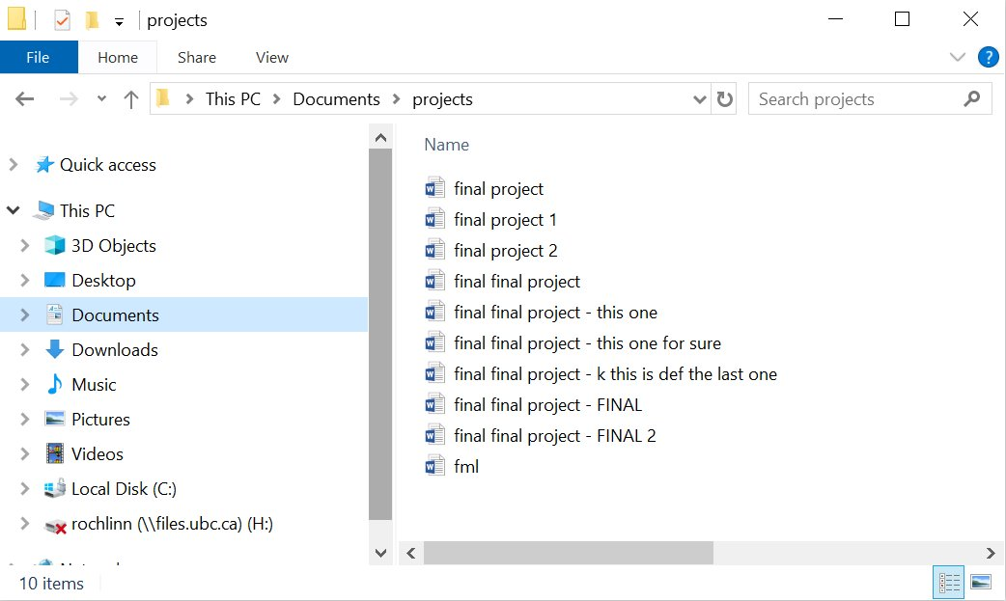
A Specific Specific: File Naming Best Practices

Slide 24
File Naming Best Practices
Human readable
Machine readable
Consistency!

Slide 25
Human Readable
Can you look at a file name and know what it is? What about in a year from now?
Will others be able to look at your files and know what they are?
Will you/others be able to easily find a file that you/they are looking for?

Slide 26
Human Readable
Short but complete names
Ideally 3-5 conceptual elements
Write down your naming conventions in a README file
Define acronyms, abbreviations, codes, etc.

Slide 27

Human Readable
Short but complete names
Ideally 3-5 conceptual elements
Write down your naming conventions in a README file
Define acronyms, abbreviations, codes, etc.
Elements to consider in file naming:
Date of creation/collection
Group/affiliation
Activity
Location
Editor/creator
Version
Other relevant information

Slide 28
Example: Data Files
Example: lldr_mpp_2025-04-22.csv
Documentation:
Convention: description_location_collection-date.file-type
lldr: leaf litter decomposition rate
mpp: Monk Provincial Park

Slide 29
Machine Readable
How will a computer parse your file names?
If a file moves from one computer / application / operating system to another, will they remain interpretable in the same way?

Slide 30
Machine Readable - Best Practices
Only contain letters in the English alphabet, numbers 0-9, dashes -, and underscores _
Do not use spaces or special characters such as ~!@#$%^&*()_+{}|
Separate naming elements with underscores and dashes
Use date format: YYYYMMDD or YYYY-MM-DD

Slide 31
Machine Readable - Best Practices
Only contain letters in the English alphabet, numbers 0-9, dashes -, and underscores _
Do not use spaces or special characters such as ~!@#$%^&*()+{}|
Separate naming elements with underscores and dashes
Use date format: YYYYMMDD or YYYY-MM-DD
Does anybody know why these are considered best practices?

Slide 32
Machine Readable - Ordering
A big part of organizing files has to do with how machines order characters.
There can be subtle differences across operating systems and applications that can be quite complicated as is beyond this series, but the following can be good general guidelines to follow for interoperable ordering:
Ordering begins with the first character of a file name, and works its way from left to right.
Numbers are ordered ahead of alphabetical characters.
Dashes - are ordered ahead of underscores _, and both are ordered ahead of numbers.
While some systems will position capital letters ahead of lowercase, it is not recommended to use letter casing as a way to order names.

Slide 33
Machine Ordering - Test Yourself!
How would the following file names be ordered?
session-10_file-naming.pptx
session-1_intro-to-rdm.pptx
-README.txt
session-10_file-naming.docx

Slide 34
Machine Ordering - Test Yourself!
How would the following file names be ordered?
-README.txt
*session-9_intro-to-osf.pptx
session-10_file-naming.docx
session-10_file-naming.pptx
*May not always happen! Some systems will prioritize the first number it sees, so 10 may appear higher than 9 because the system is looking at 1 vs. 9. To avoid this, you may want to consider giving numbers in file names a numerical system like 01, 02… or 001, 002…

Slide 35
Likeness and Importance
When choosing file names, consider which elements are the most important, and how likeness/differences with play into how the names are sorted.
Which element should come first? Second? Third? …
Elements to consider in file naming:
Date of creation/collection
Group/affiliation
Activity
Location
Editor/creator
Version
Other relevant information

Slide 36
Version Control
Version control refers to the systematic tracking of the various versions and growth of your files.
There are 3 main ways this can be handled:
Manual systems
Automated systems
Scripting

Slide 37
Version Control - Manual Systems
Manual version control is a way to track files via file naming, and lends itself well to administrative documents and manuscripts, but in the right context can be appropriate for data as well.
Examples of manual version control:
Version number: manuscript_v01.docx, manuscript_v02.docx, …
Editor initials: manuscript_v01_NR.docx
Stage/process of data: data_raw.csv, data_clean.csv
For the purpose of the Jumpstart, we will not be using manual version control, but it’s worth knowing it exists as it may be valuable in your own research.
Please ask if you’re interested in knowing more!

Slide 38
Version Control - Automated Systems
Automated version control systems are computer applications that employ metadata, similar to manual systems, that don’t require manual input.
There are many different systems that can handle automated version control, and they vary widely in their abilities and complexity.
For the purpose of the Jumpstart, we will be using OSF to handle some level of automated version control, but if you are interested in other systems, please ask!

Slide 39
Version Control - Scripting
Scripting, which will be covered in detail over days 2-4, is a way to handle version control by providing a systematic list of all activities that were performed on a data file or files.
It allows both you and others to be able to review and re-perform any changes or actions, and can be used to save files periodically (with file naming to denote different stages of the data).
For the purposes of the Jumpstart, this will be our primary means of version control, but as you may see, there is generally crossover across version control systems.

Slide 40
Directory Structures
Directories, AKA folders, are a way of keeping your files organized and easy to find.
The same principles for file naming apply to directories.
Developing a directory structure before you begin a project can help with managing all the files that will be collected or generated.

Slide 41
An Example
Mountain Legacy Project, 2024, "MountainScape Segmentation Dataset", https://doi.org/10.5683/SP3/CEYU10, Borealis, V2

Slide 42
File Naming for the Week
For the purpose of this workshop series, you will be working with 2 directories to save your files:
Scripts → a place to save your code files
Data → a place to save your data files
You won’t be working with too many files this week, so you’re not at risk of making a huge mess, and you are free to name your files how you see fit.
With that said, you can use this as an opportunity to play around with file naming conventions and to think about how things might work if there were many more files to deal with.

Slide 43
Questions on file naming?

Slide 44
Long-term data management, discoverability and access

Slide 45
6. Long-term data management, discoverability and access
What happens to your data after the project is complete
Consider:
What data you’ll keep, what you’ll destroy, and what you’ll share
What you’ll need to do to allow you to keep/destroy/share the data
All the software and platforms you’ll need to allow you to do this (e.g., long-term storage options, data repositories)

Slide 46
6. Long-term data management, discoverability and access
Also consider:
What do your funders/publishers/regulators/partners/supervisors require you to do with the data? (see part 1)
What scripts/software/code/metadata are necessary to allow continued access to/usability of the data? (see part 3)
If you’re sharing data, how will you do that? What do you need to put in place at the beginning of your project so you can do that? (e.g., ethics approval, agreement with your supervisor, contracts, deciding on a data repository)

Slide 47
A preliminary note on data repositories
Data repositories are one way that you can share your data.
Online database services that provide long-term preservation for data and make them available for discovery and use
Used after a project is complete and data won’t be changing on a regular basis
Intended for sharing data, rather than just keeping it but having it inaccessible
We’ll go into more detail on repositories on Day 5.
Make sure you sign up for a Borealis Demo account!

Slide 48
Questions?

