Slide 1
SIMULATED ANNEALING for tsp
Nasser Alghamdi, Anjal Doshi, Nick Rohde
CSS 534: Parallel Programming in Grid and Cloud
Computing and Software System
University of Washington, Bothell

Slide 2
Application Overview
Consists of two nested loops:
while heat > min_heat
for i in range(0, max_iterations)
Parallelization applied in the inner loop
Source: https://en.wikipedia.org/wiki/File:Travelling_salesman_problem_solved_with_simulated_annealing.gif

Slide 3
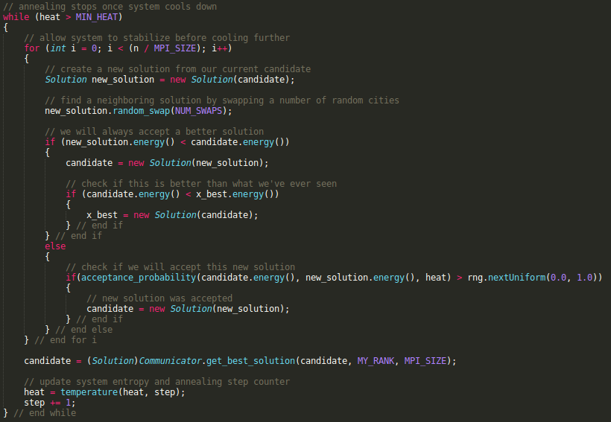
Mpi-java

Slide 4


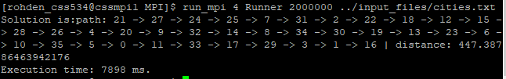
Mpi-java Execution
Improvement:
31070/7898 = 3.93 times

Slide 5
MapReduce
public void reduce(Text key, Iterator<Text> values, OutputCollector<Text, Text> output, Reporter reporter) throws IOException {
//select the first reducer input and set it as the best solution
String found_best = values.next().toString();
Matcher dist_match = p.matcher(found_best);
boolean found = dist_match.find();
float min = Float.parseFloat(dist_match.group(0));
String temp = found_best;
//iterate through all the outputs and select the one with minimum distance
while(values.hasNext()){
temp = values.next().toString();
dist_match = p.matcher(temp);
found = dist_match.find();
if(Float.parseFloat(dist_match.group(0)) < min){
min = Float.parseFloat(dist_match.group(0));
found_best = temp;
}
}
//collect the best solution
output.collect(new Text("Best Solution Found:"), new Text(found_best));
}
public void map(LongWritable key, Text value, OutputCollector<Text, Text> output, Reporter reporter) throws IOException {
//get the number of iterations to ber performed for SA
int n = Integer.parseInt(conf.get("iterations"));
//create a graph of all city coordinate pairs from the input file
Graph g = new Graph(value.toString());
//run simmulated annealing on the input graph on each mapper and generate the best solution
Solution x = simulated_annealing(g, n, rng);
//assign the same key to each map output and collect the <key, value> output
output.collect(new Text(one.toString()), new Text(x.toString()));
}

Slide 6
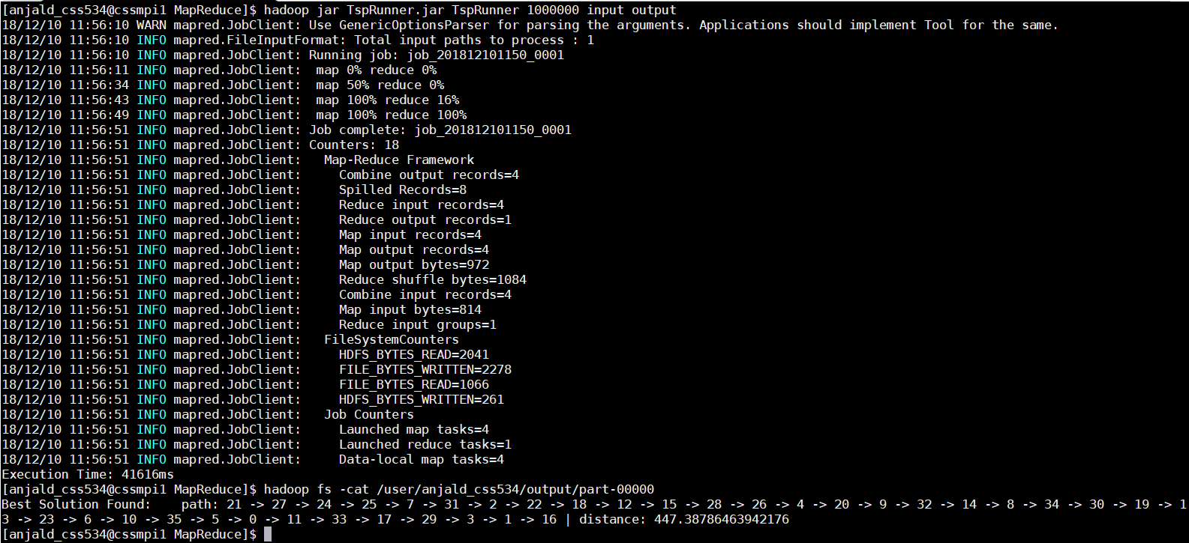
MapReduce Execution

Slide 7
SPARK
public static Solution simulated_annealing(Graph g, int iterations, RandomDataGenerator rng) {
... Generate initial solution
Broadcast<Solution> best_broadcast = jsc.broadcast(best); // for broadcasting best found solution
Broadcast<RandomDataGenerator[]> rng_broadcast = jsc.broadcast(rngs); // broadcast random generator once
... Initialize RDD contains initial solution ad many as the number of intended partitions List<Solution> candidatesList = Collections.nCopies(NUM_PARTITIONS, candidate);
JavaRDD<Solution> candidates = jsc.parallelize(candidatesList, NUM_PARTITIONS);
Annealing annealingProcess = new Annealing(heat, iterations / NUM_PARTITIONS, NUM_SWAPS, best_broadcast, rng_broadcast);
do { // start annealing process -> see Annealing.java
candidates = candidates.map(annealingProcess).repartition(NUM_PARTITIONS);
// reduce to best solution
Solution a_best = candidates.reduce((acc, next) -> acc.Reduce(next));
if(best.GetDistance() > a_best.GetDistance()){
annealingProcess.UpdateBroadcast(jsc.broadcast(a_best));
best = a_best;
}
heat = temperature(heat, step);
step += 1;
annealingProcess.UpdateHeat(heat);
} while (heat > MIN_HEAT);
return best; } // end method simulated_annealing

Slide 8
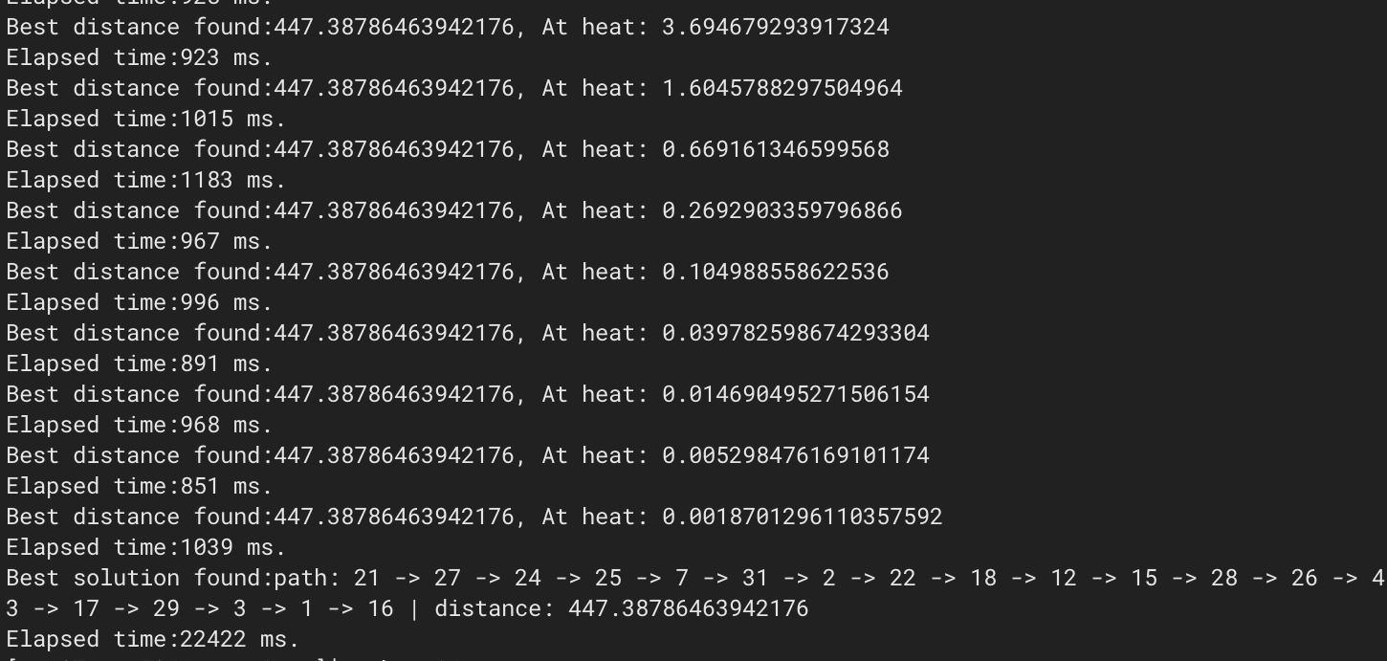
SPARK Execution

Slide 9
MASS
Places places = new Places( 1, Annealing.class.getName(), (Object) new Integer(n/num_nodes), num_places); // creating places
double heat = INITIAL_HEAT;
int step = 2;
//initalize the best solution
Solution best = new Solution();
best.init(g);
while (heat > MIN_HEAT){ //Run and store the output of the annealing method for each place
Object[] calledPlacesResults = (Object[]) places.callAll(Annealing.START_ANNEALING, arguements);
//From all the places select the solution with the minimum distance
for(int j=1; j<calledPlacesResults.length ; j++){
. . .
}
//set the best solution obtained from above as the new best solution
best = new Solution( (Solution)calledPlacesResults[best_index] );
// update system entropy and annealing step counter
heat = temperature(heat, step);
step += 1;
} // end while

Slide 10
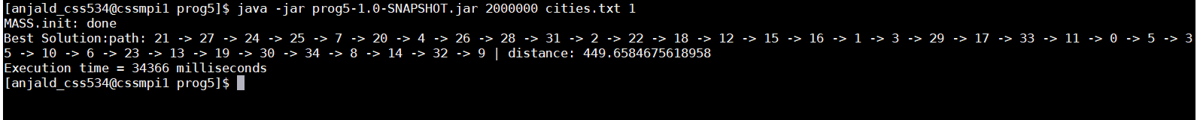
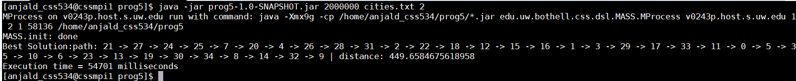
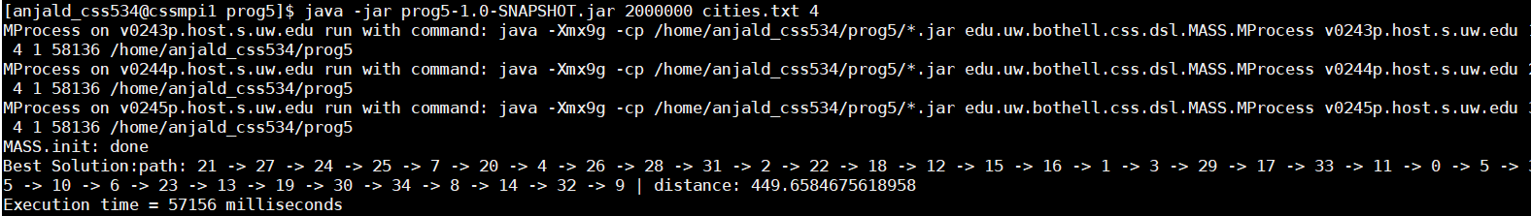
MASS Execution

Slide 11
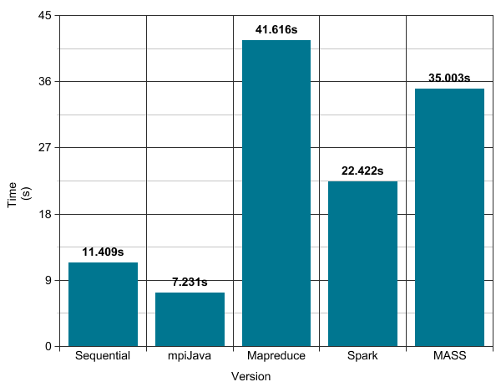
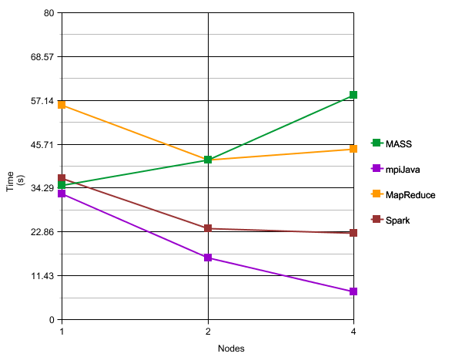
Performance

Slide 12
Programmability
Version | # of Classes | # Boilerplate Calls | TLOC | Boilerplate %
Sequential | 4 | N/A | 104 | N/A
MPI JAVA | 6 | 18 | 137 | 13.14
MapReduce | 6 | 19 | 141 | 13.48
Spark | 5 | 4 | 128 | 3.13
MASS | 6 | 47 | 135 | 34.81

Slide 13
Questions?

