Slide 1
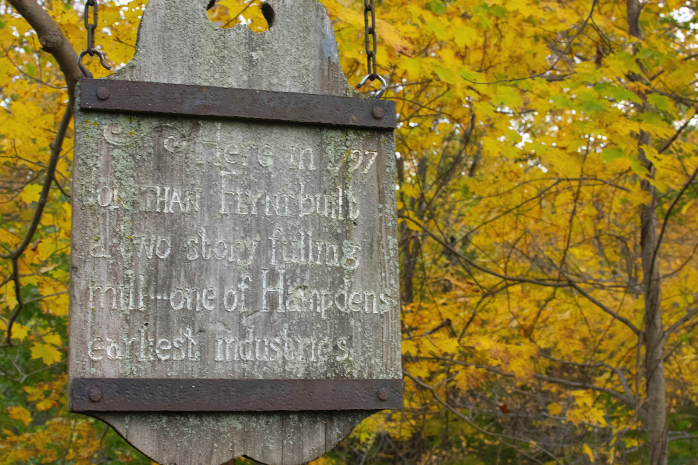
Fifty Pieces of Gold
An Engineer’s Musings
on Business and Life
Nick Russo

