Slide 1

Comprehensive Analysis of Global Video Game Sales Data
SMRUTI PANDA

Slide 2
Analysis of Video Game Sales Data
The primary goal of this project is to analyze global video game sales data to identify key trends, patterns, and insights
01
This analysis will help in understanding the factors that drive video game sales, popular genres and platforms, and regional preferences.
02
Scope= Data cleaning, descriptive statistics, trend analysis, comparative analysis, and predictive analysis
03

Slide 3
Data Cleaning and Preparation
Tasks:
Imported and inspected the dataset for inconsistencies.
Cleaned and preprocessed the data to handle missing values and format dates.

Slide 4
Descriptive Statistics
Summary Statistics: Provided key insights into the basic characteristics of the data.
Genre and Console Distribution: Displayed the count of different genres and consoles

Slide 5
Data Visualization
Sales by Region: Bar chart showing total sales in different regions.
Sales Distribution: Box plot of sales across various regions

Slide 6
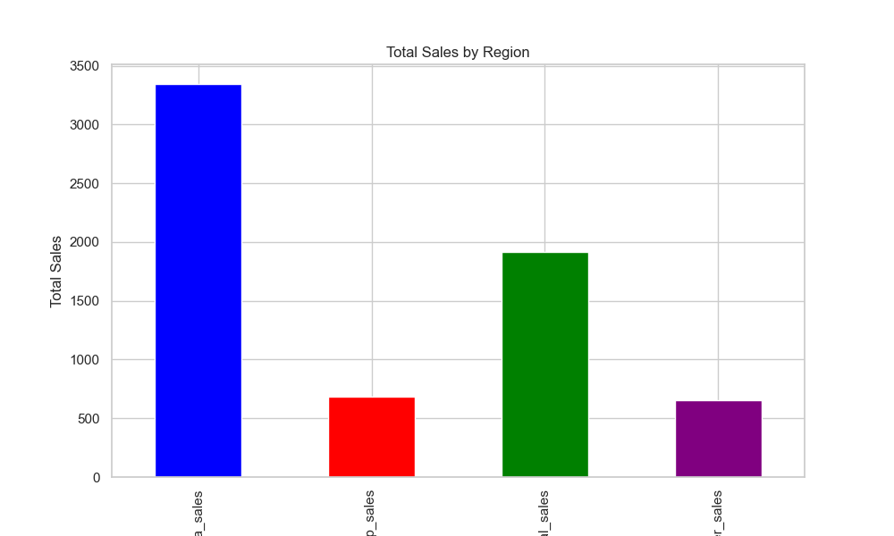
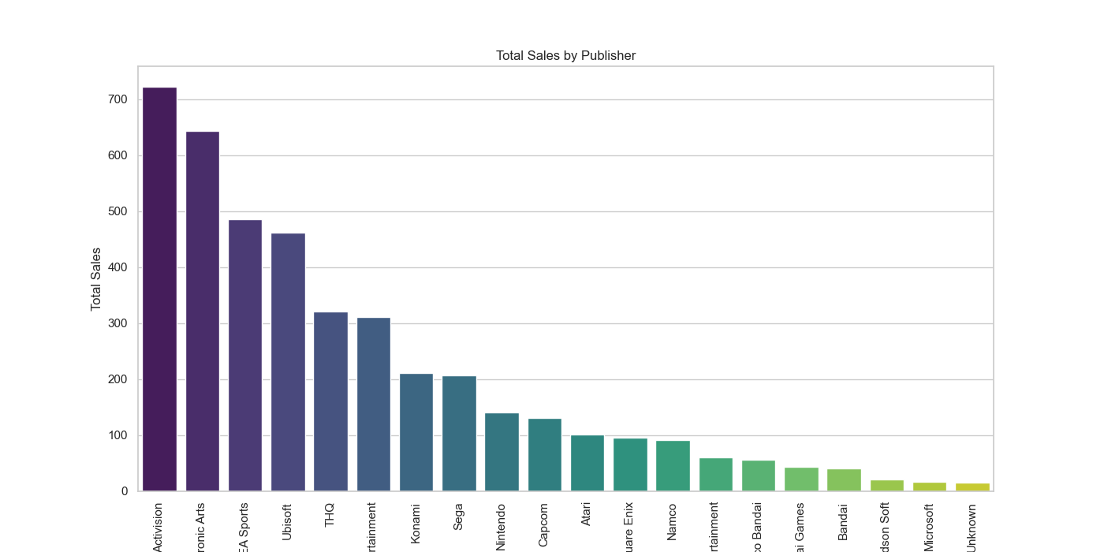

Slide 7
Trend Analysis
Sales Trends Over Years: Line graph showing sales trends over the years.
Platform Performance: Bar chart showing performance of different gaming platforms.
Genre Performance: Bar chart showing performance of different game genres

Slide 8
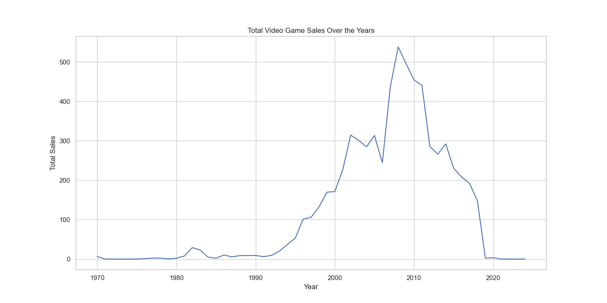
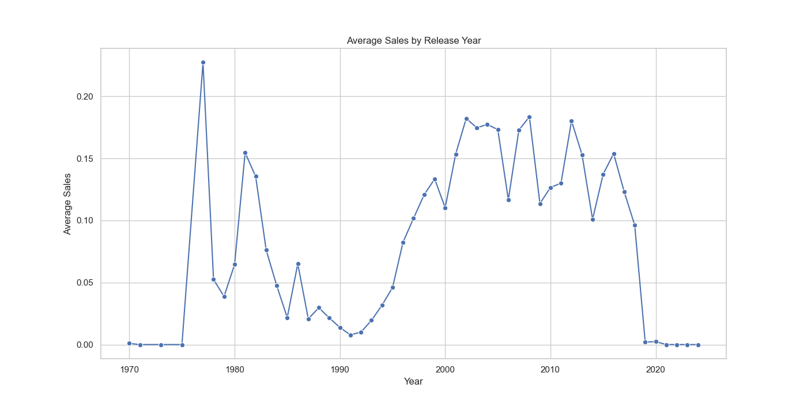

Slide 9
Comparative Analysis
Regional Sales Performance: Bar chart comparing sales across regions.
Top-Selling Games: Bar chart of the top 10 best-selling games.
Genre Distribution: Count plot of genres in top 10 games.
Platform Distribution: Count plot of platforms in top 10 games.
Publisher Distribution: Count plot of publishers of top 10 games.
Release Year Distribution: Count plot of release years of top 10 game

Slide 10
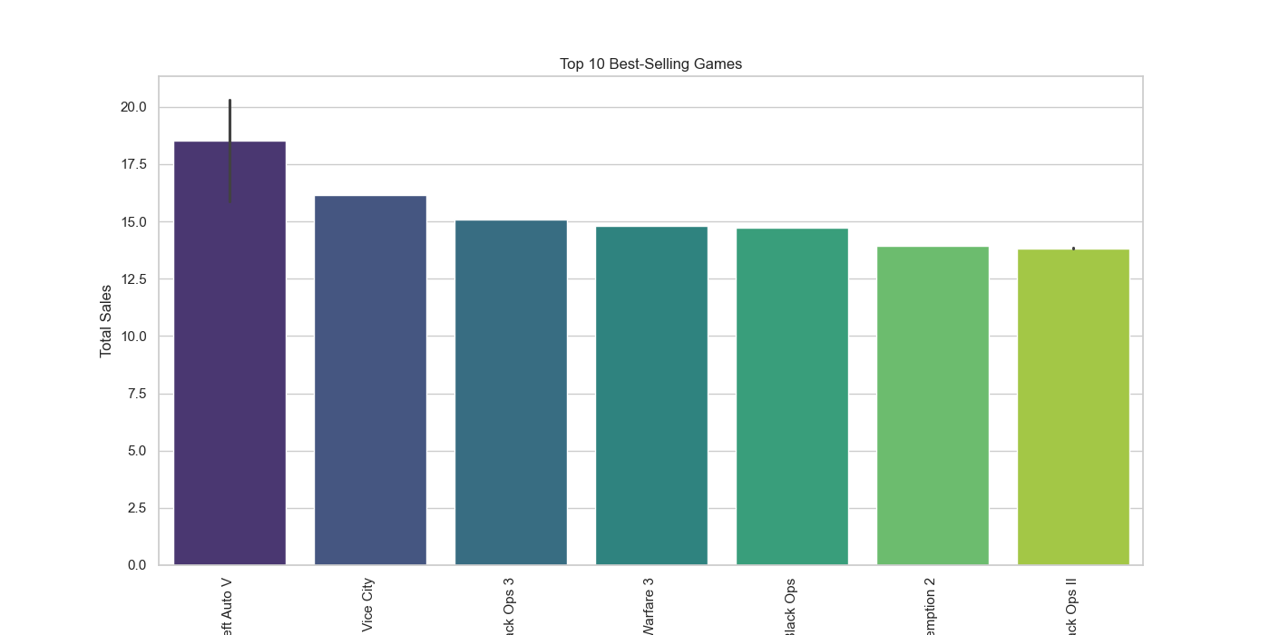
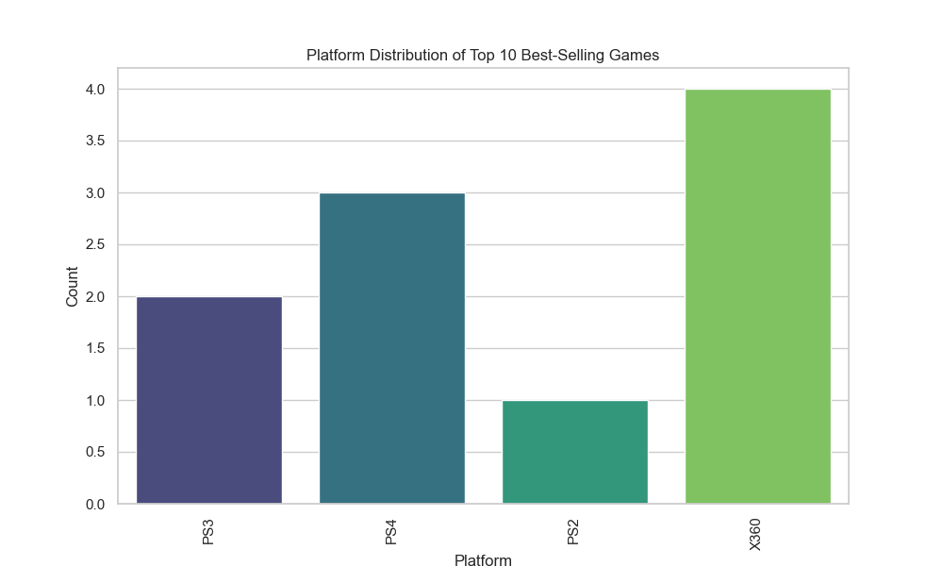
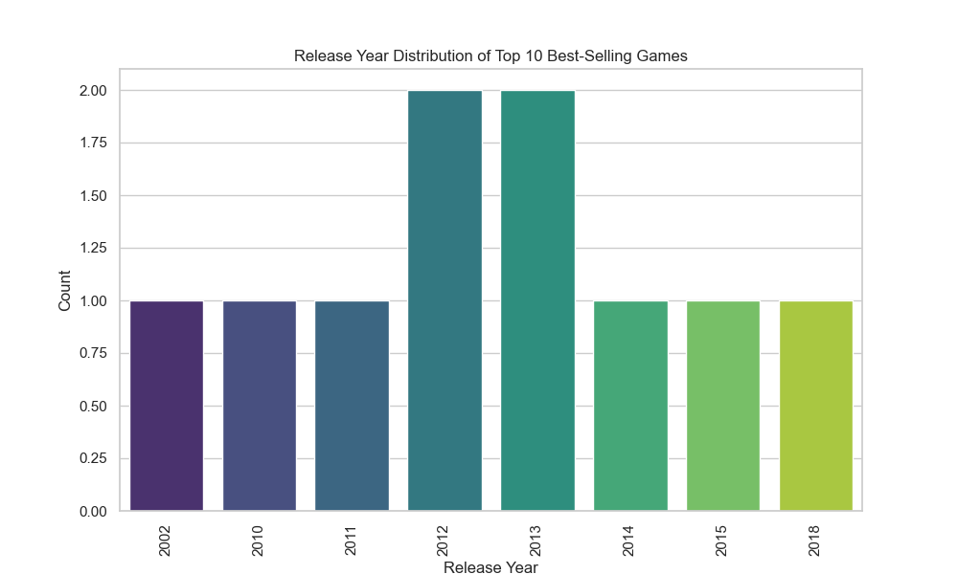
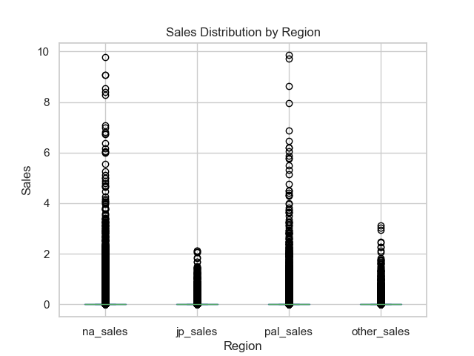

Slide 11
Predictive Analysis
Model Used: Random Forest Regressor
Model Evaluation: Mean Squared Error and prediction results.
Future Predictions: Line graph showing historical sales and future predictions.

Slide 12
Data Preparation:
Aggregates sales data by year.
Splits the data into training and testing sets.
Random Forest Regressor Model:
Fits a Random Forest Regressor model to the training data.
Evaluates the model using Mean Squared Error (MSE) and plots the predictions against actual sales.
Future Prediction:
Uses the trained Random Forest Regressor model to predict future sales for the next 10 years.
Plots the historical sales along with the future predictions.

Slide 13
