Slide 1

A-TEAM
Github link:
https://github.com/nicks258/apptite/
Sumit Mehra
Suvojit Kar
(from SRM UNIVERSITY)

Slide 2
YouTube Links
Live Demonstration Available At:
1.)Beacon implementation : https://youtu.be/XCMhSdcvds4
2.)Chat System : https://youtu.be/N4Vb_0PdwNA
3.)Negotiating with the dealer through gmail : https://youtu.be/ixBC2fvovlk
4.)View price & Order : https://youtu.be/d_EULxq32Qg
5.)App Tour : https://youtu.be/JifG3LuMZTw
6.)View Retailer location and share product with your friends : https://youtu.be/oj9e9ZOr7H8

Slide 3
PROBLEM STATEMENT
E-Commerce is growing faster than any other retail sector in India. We are in the 21st century where customers today prefers
to buy products online rather than going to a retailer shop. Online stores provides a large number of benefits such as
Delivery status, timely notification .That is order anything and anywhere etc. Hence Retailers is facing a tough competition.
If we are in a shopping mall, we find a large number of employees standing in different part of the mall to guide the customer
to a particular section( eg: clothes section, electronics section).The owner needs to pay all the employees in a shopping mall.
Now question comes
When someone is inside a store :
i) What if most of the employees are absent on a single day?
ii) What if an employee behaves rudely with a customer?
iii) what if the customer have a language problem and is unable to ask an employee about
a particular section ( eg: clothes section, electronics section) in a store?
iv)What if the same product is available in some other retailer shop at a lower price?
Problem faced
When someone buys from e-commerce website/application :
i)Around 60% of the local market are at loss due to e-commerce portals.
ii)The price mentioned on the e-commerce websites/apps are fixed and cannot be negotiated.
iii)Customers have no idea about the actual seller.
iv)Customers cannot check the genuinity of the product(If the product is new or an old modified product).
v)Cannot ask friend if a particular product is good or not. They generally have to depend on users review.
vi)Some products do not have cash on delivery and hence customers have to think twice before paying the money.
.

Slide 4
SOLUTION
Both the problems as mentioned in the problem status can be solved by the following ways:
When someone is inside a store :
What if the retailer does not have employees but have beacons instead.
How can Beacon be helpful to solve the problem?
Beacon helps smartphones determine their approximate location or context. With the help of an Beacon,
a smartphone's software can approximately find its relative location to a Beacon in a store.
Brick and mortar retail stores use the beacons for mobile e-commerce, offering customers special deals through
Mobile marketing and can enable mobile payments through point of sale systems.
When someone is shopping online:
What if you can negotiate about the price of a particular product with the retailer/dealer.
What if you can view the price of the same product available on different stores around and near you.
What if you can trace out the location of the seller.
What if you don’t need to pay before you actually see the product
What if you can share the product with your friend before buying and take suggestion from him.

Slide 5
ABOUT OUR APPLICATION
Our application(Funshoppers) can be used in distributing messages at a specific point of interest using Beacon, for example a store, a bus stop, a room or a more specific location like a piece of furniture or a vending machine. This is similar to previously used geopush technology based on GPS, but with a much reduced impact on battery life and better precision.
Funshoppers is a Online Shopping Mall of Trusted Local Retailers. Find nearby stores pricing of electronics,
mobiles & tablets, computers & laptops and Home & Kitchen products anywhere in India and around you.
Our map directions will make you get to exact shop location and our contact form, can get you better negotiations
from your nearby shop.
Funshopper is an application that works as a Service platform, exclusively for local brick and mortar store and small business owners. Opening an Online platform for each brick and mortar store, needs huge initial investment with additional operational and maintenance cost. Also, consumers don't get time to visit all sites for each of the products they need to buy. Funshoppers goal is to increase sales for retailers, locally owned business through Funshopper platform and amazing shopping experience for buyers.
Funshopper is a win-win situation portal for both customers and retailers. On one hand, customers can contact directly with their nearby stores using Funshopper portal and utilize it for negotiating the price of required products with the retailer. And receive cash back on delivery. While on the other retailers would never miss their nearby customers by making their local presence strong.
There are lot of new features like share button to share the pricing and product to your near and dear ones and chat with them as well, searching with exact location and current location for nearby shops. Our search will help you get anything anywhere soon.

Slide 6
UNIQUENESS
We have designed an overall smart application( currently supporting android) with the following features:
ROBO Concept(Research online buy Offline).
Using beacon technology locate various products and its details in a store.
Scan and locate various beacons to reach to your destination
Negotiate with the dealer about the price of an item being online.
Know your retailer.
Buy from retailer to receive cashback after each delivery.
Using share option, share products to various friends.
View same products around you at a cheaper rate.
View location of shops near you.
Chat with your friends while shopping.
Get variety of products.
Light-weight app.
For Faster approach:
Caching and histories are saved to a particular limit.
Works in:
Online and offline mode(beacon).

Slide 7
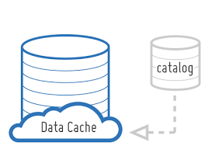
ONLINE AND OFFLINE MODE
Online mode: In online mode the user can view products, buy products etc.
Offline mode: In offline mode , User can turn on Bluetooth to buy and search things using beacon technology.
Data caching:
This is very important for the app to work offline.
Whenever an user is online, all the data are loaded and stored in cache
, data are fetched fro

Slide 8
AUTHENTICATION AND SECURITY
Input validation.
Encrypted Password.
Handle user data.
No Login without Internet.
Crone job.

Slide 9
WHY OUR APPLICATION
User friendly. Easy to use
No paid sms API used.
App size is less than 3 mb.
Visual design and user Interaction
App request only the absolute minimum permission that it needs to support core functionality
App does not request permissions or services that can cost the user money.
Optimize layout for small as well as large screen
Works fine from and above android version 4.3(jellybean).
Online and offline mode
No services left when the app is in the background(correctly preserves and restore user or app state)
Performance
Scalability

Slide 10
Working
Beacon:
Beacon uses Bluetooth low energy proximity sensing to transmit a universal unique identifier picked up by a
compatible app or operating system. The identifier and several bytes sent with it can be used to determine the
device's physical location track customers, or trigger a location based action on the device such as a
Check in on social media or a push notification.
One application is distributing messages at a specific point of interest, for example a store, a bus stop, a room or a more
specific location like a piece of furniture or a vending machine. This is similar to previously used geopush technology
based on GPS, but with a much reduced impact on battery life and better precision.
Location:
Using google maps to show location of the retailer shop around you.
Chat and share:
This messaging service uses POST type XMLHttpRequest (implemented through asynchronous JavaScript and XML).
Every 2 mille-seconds the XMLHttpRequest is sent to the server, where it checks for any updation in the database.
Any updation to the database is reflected to the user. This is the push technology.
If we perform the same from server side. We can run a daemon script, which checks for updates on the server side and
pushes the message automatically to the required user. This is the push technology. It uses Reverse concepts.
You can share image of a particular product you wish to buy through whatsapp.

Slide 11
Target Audience
All online buyers, retailers, and distributors are the targeted audience, which includes
Almost every one of us.
Funshopper is a win-win situation portal for both customers and retailers. On one hand, customers can contact
directly with their nearby stores using Funshopper portal and utilize it for negotiating the price of required products
with the retailer. And receive cash back on delivery. While on the other retailers would never miss their nearby customers
by making their local presence strong.

Slide 12
HARDWARE AND SOFTWARE REQUIREMENT
.
Minimum requirements are :
Android devices starting from API Level:18 Android 4.3 (jelly bean).
Beacon is not supportable below API Level 18 as Bluetooth low energy does not exist below that.
512 mb ram.
Internet connectivity(Though it can work offline, internet is required during signup and login).
Location access.

Slide 13
DIAGRAM
.
LOGIN/SIGNUP
Customer In store
Customer not In store
Use beacon
View Retailer shops online in location around you

Slide 14
DIAGRAM
.
Beacon
Scan
(Search beacon)
Radar
(Detect beacon in your range)
Manage
(Manage tracked beacons)
Settings
(change beacon settings)

Slide 15
DIAGRAM
.
Retailer shops
Home
Electronics
Lifestyle
Brands
Automotive
Offerzone
My order
My account
i)Track Retailers location. Find the shortest route between you and the retailer shop.
ii)Negotiate with Retailer about the price of a particular item.
iii)View prices of a particular product offered by all possible dealers around you.
iv)Get cashback when the product is delivered.

Slide 16
LOGIN/SIGNUP
LOGIN
<<include>>Phonenumber and password
<<include>>Phonenumber and password
<<include>> Email id and username
SIGNUP

Slide 17




LANGUAGE AND TECHNOLOGY USED
Front end :
Backend:

Slide 18

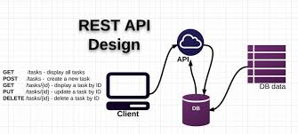

LANGUAGE AND TECHNOLOGY USED
Database:
Hosting:
Apis:
Hostinger

Slide 19
SCREENSHOTS

Slide 20
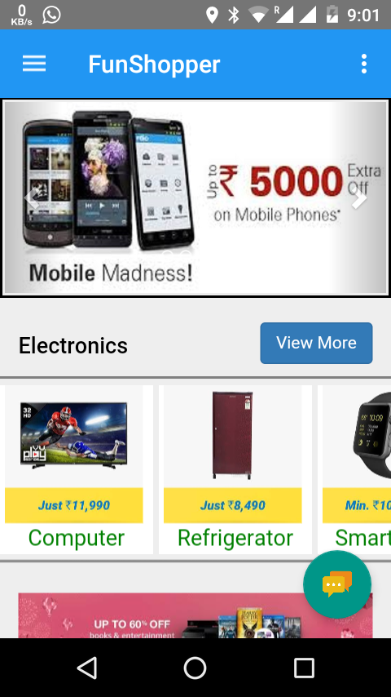
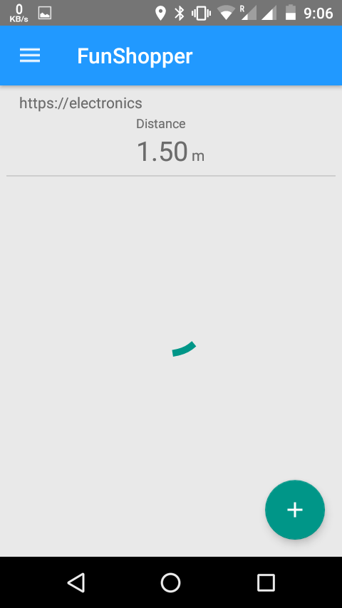
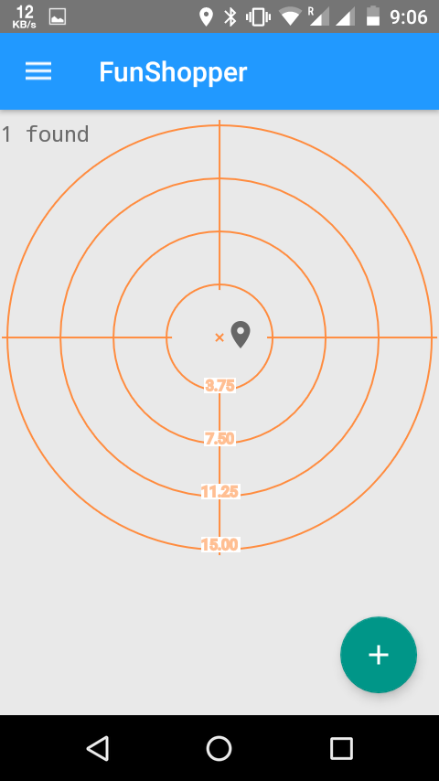

Slide 21
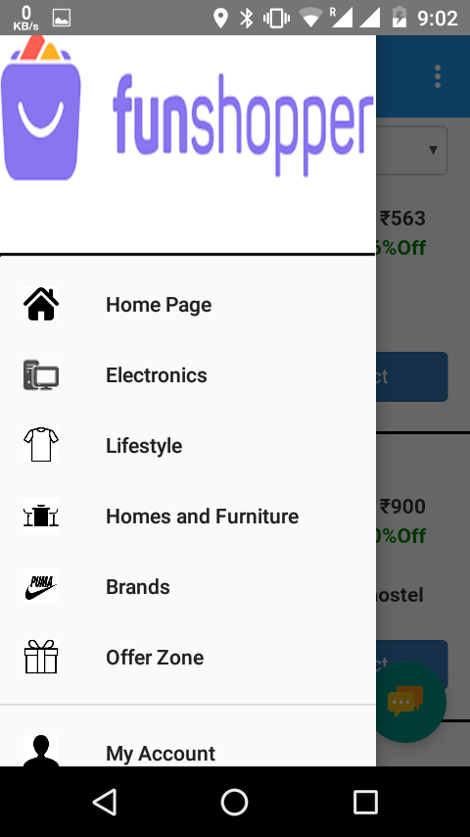
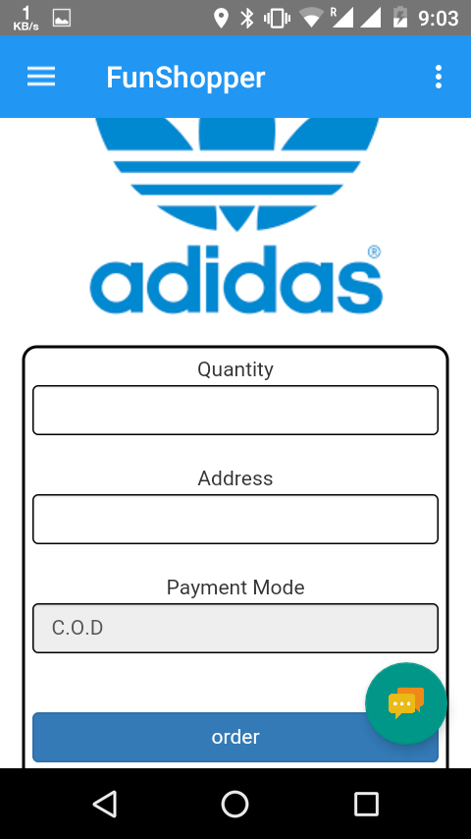
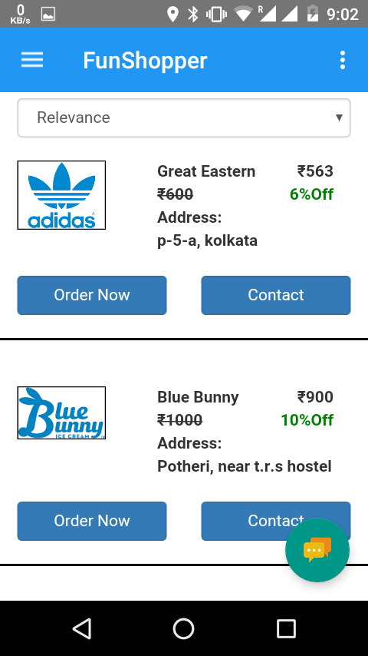

Slide 22
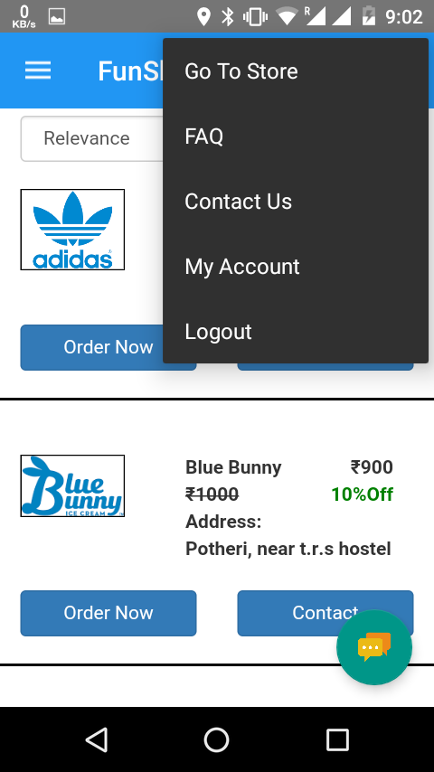
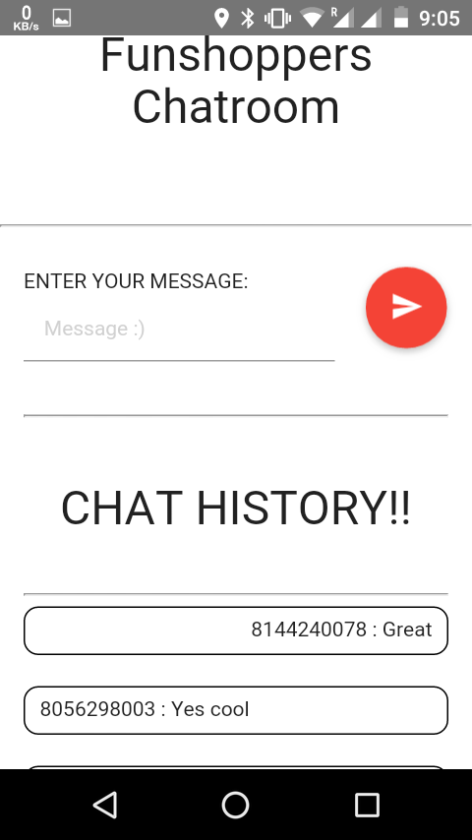
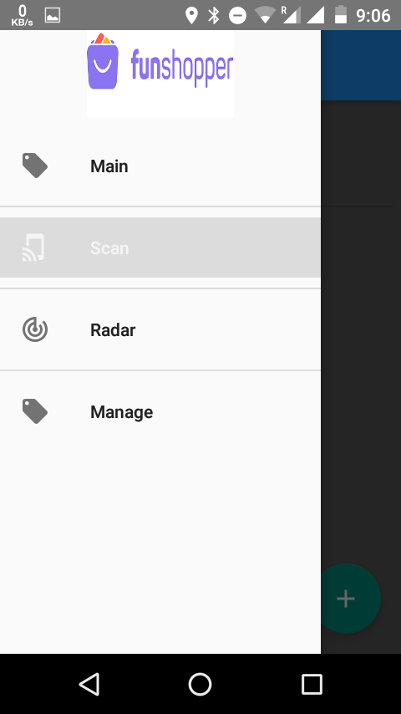

Slide 23
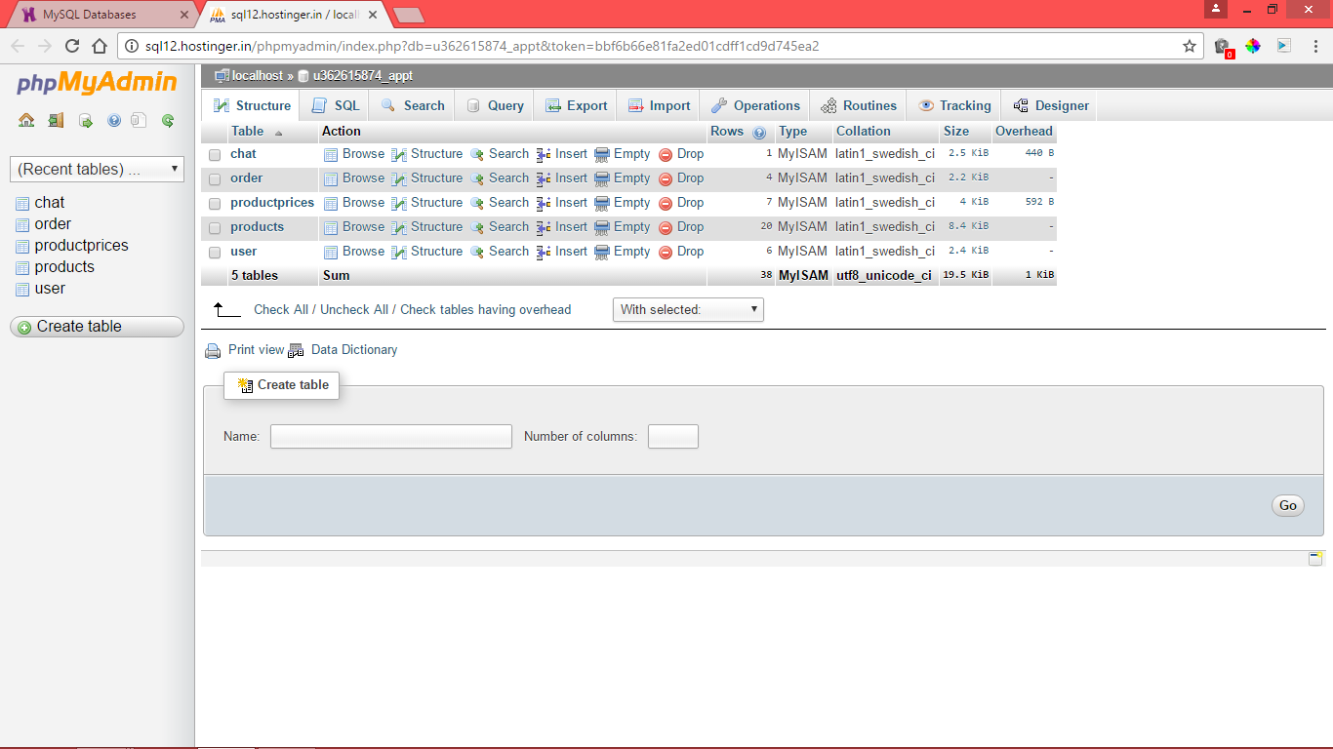

Slide 24
THANK YOU

