Slide 1
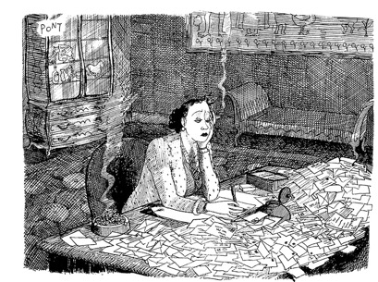
Tidy Data
"Tidy data" is a standardised format for dataframes which makes them easy to manage with standard approaches, and reduces the need to wrangle data into a new form for each new analysis/graph.
Wickham, Hadley. (August, 2014). “Tidy Data.” Journal of Statistical Software, 10(59). https://vita.had.co.nz/papers/tidy-data.pdf
“Tidy datasets are all alike, but every messy dataset is messy in its own way.” –– Hadley Wickham

Slide 2
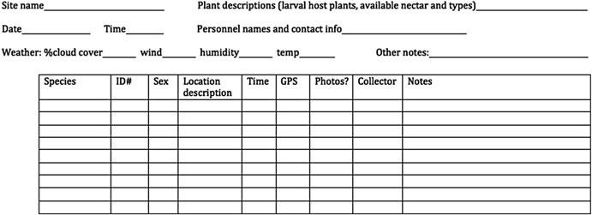
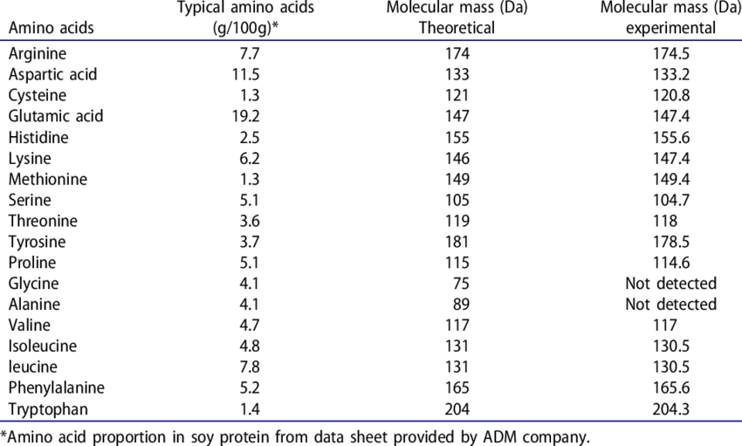
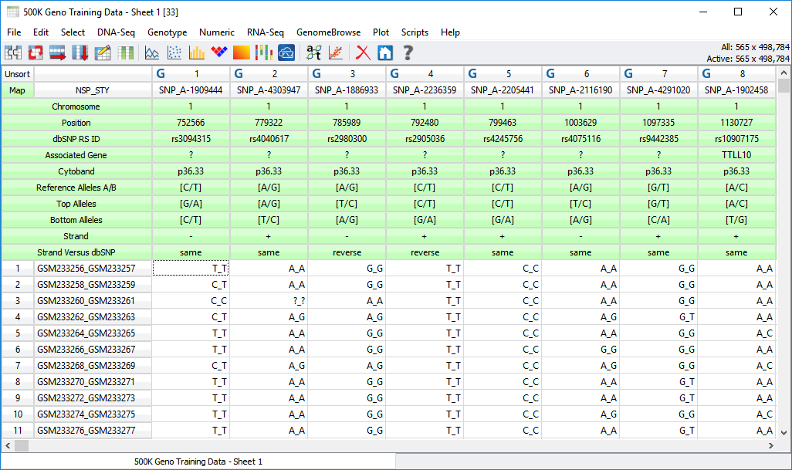

Slide 3
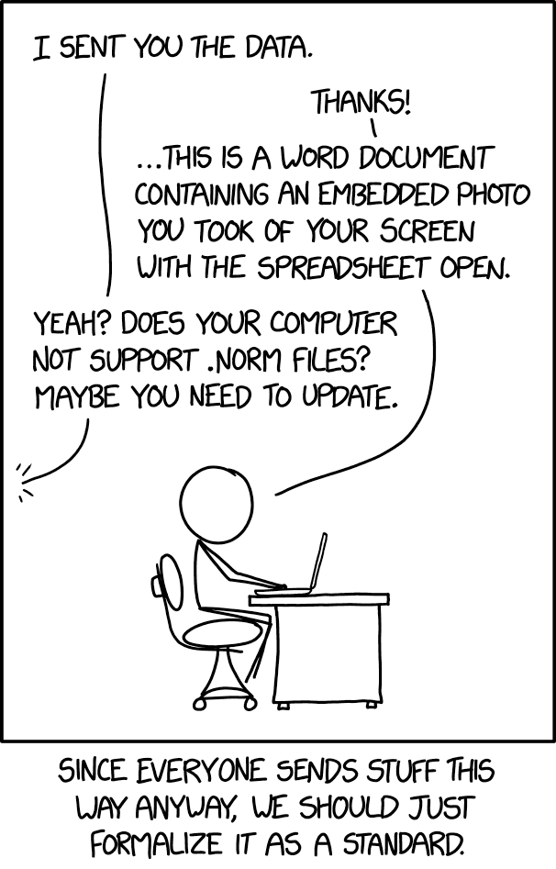
A dataset is a collection of values.
Values are organised in two ways.
Every value belongs to a variable and an observation.
A value is a single piece of data:
A measure of daytime temperature
The expression level of a gene
Barnacle counts at a specific location
A variable contains all values that measure the same underlying attribute:
List of daytime temperatures across Scandinavia
RNASeq values in replicate 1
Species counts along a single transect
An observation contains all values measured on the same unit:
Oslo metrological station temperature data
The phantastica gene
Semibalanus balanoides

Slide 4
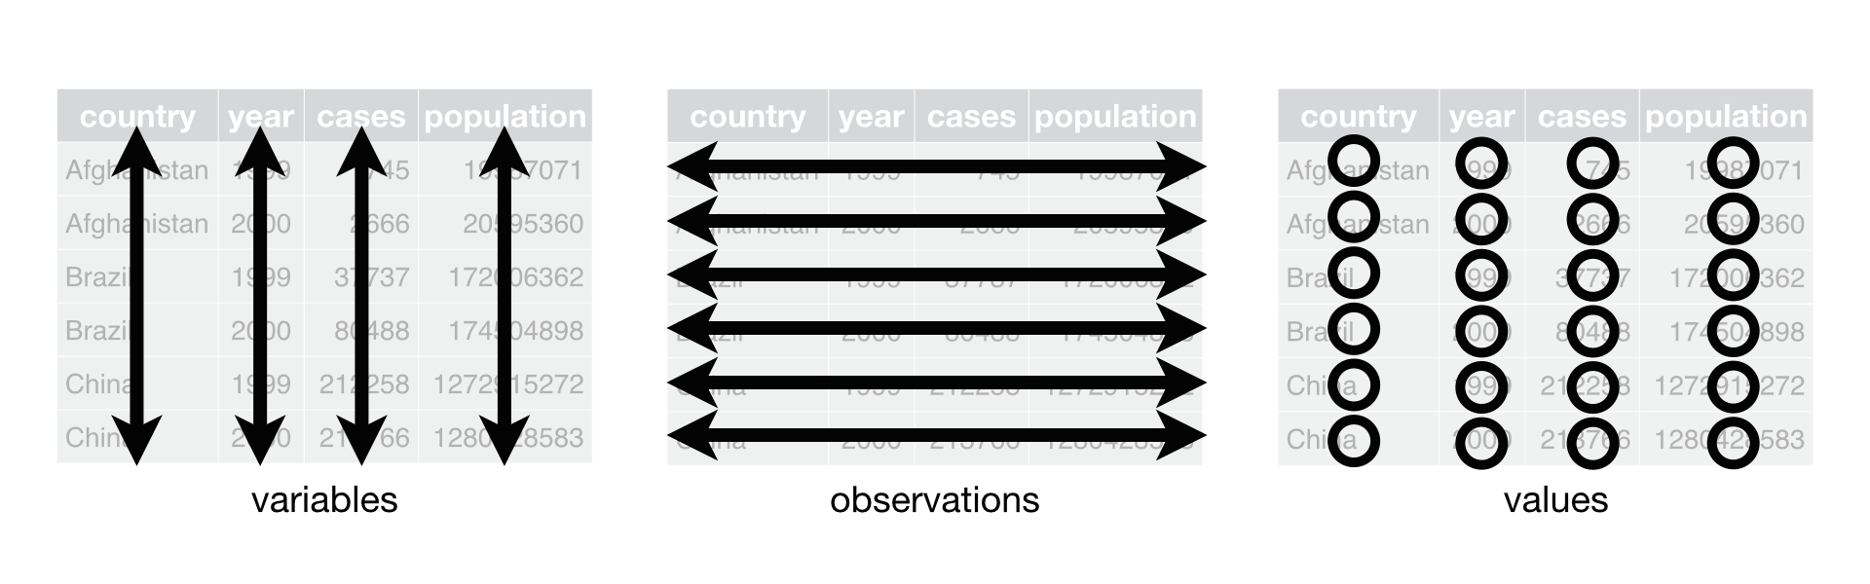
Each variable must have its own column.
Each observation must have its own row.
Each value must have its own cell.

Slide 5
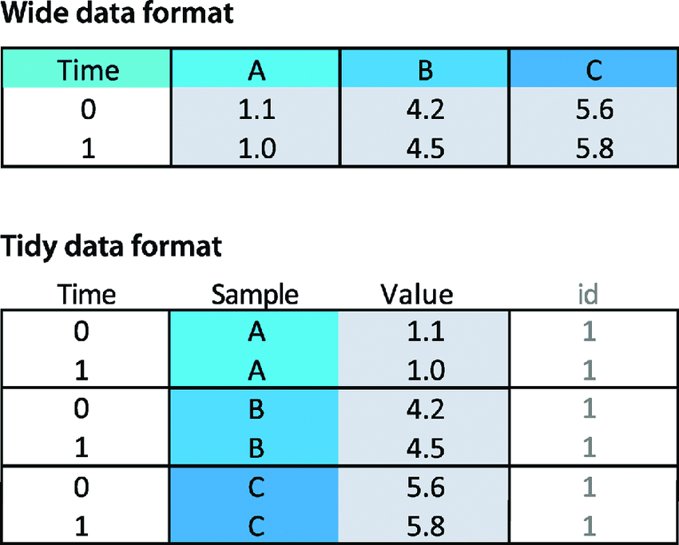
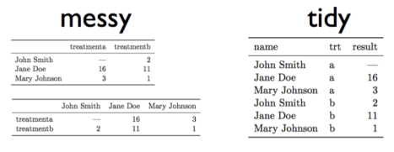
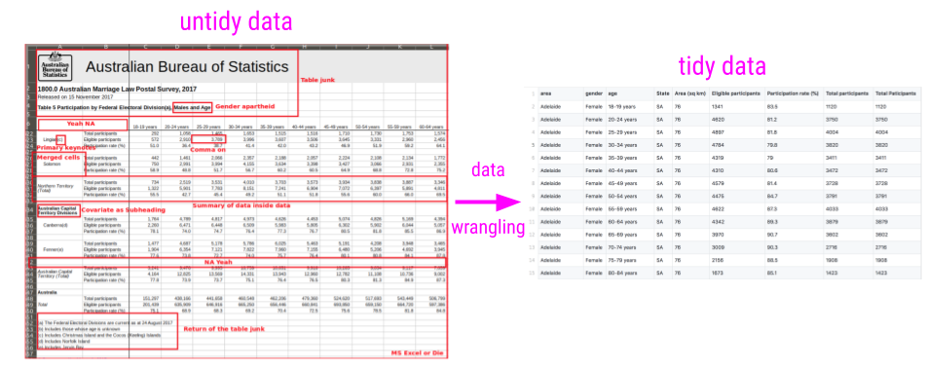
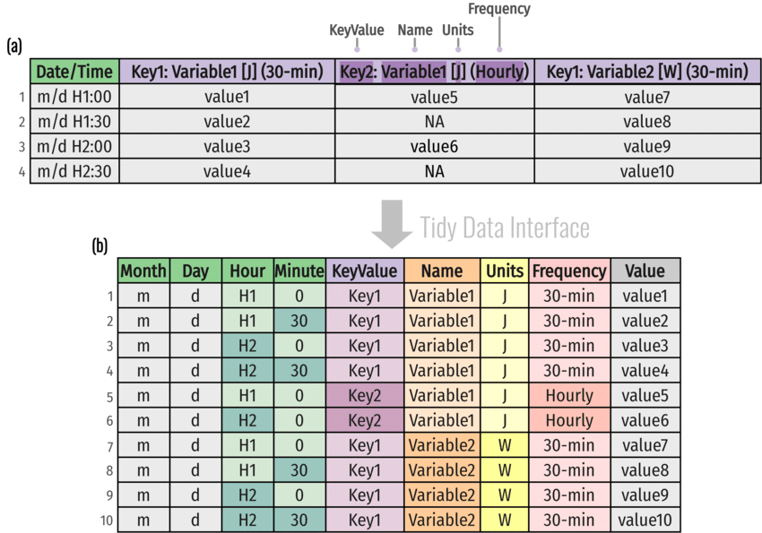

Slide 6
”It is surprisingly difficult to precisely define variables and observations in general.” Wickham 2014
One way of organizing variables is by their role in the analysis: are values fixed by the design of the data collection, or are they measured during the course of the experiment?
Measured variables are what we actually measure in the study.
Fixed variables should come first, followed by measured variables, each ordered so that related variables are contiguous
Tidy data is only worthwhile if it makes analysis easier

Slide 7
What do you need to do with your data?
Transform: adding or modifying variables. These modifications can involve either a single variable (e.g., log-transformation), or multiple variables (e.g., computing density from weight and volume).
Sort: changing the order of observations
Filter: subsetting or removing observations based on some condition.
(week 5)
Aggregate: collapsing multiple values into a single value (e.g., by summing or taking means).
(week 5)
Tidy data (usually) makes all these operation easier

Slide 8
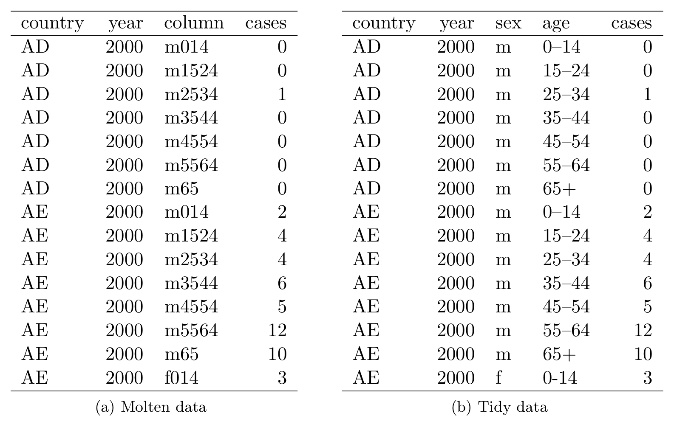
Splitting
Series.str.split()

Slide 9
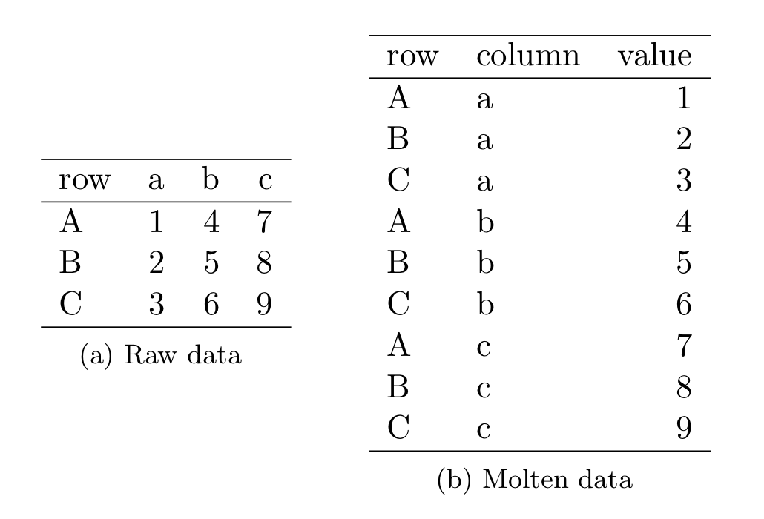
Melting
df.melt()
pd.melt(df, id_vars=[Row'], value_vars= [‘a’, ‘b’, ‘c’], var_name=‘column', value_name=‘value')

Slide 10
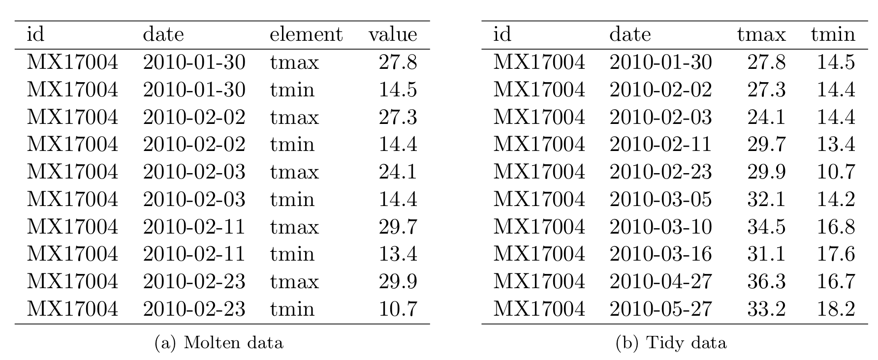
Casting (Opposite of melting) – use pivot
df.pivot()
df2 = pd.pivot(df, index=[‘id’, ‘date’], columns=‘element', values=‘value')

Slide 11
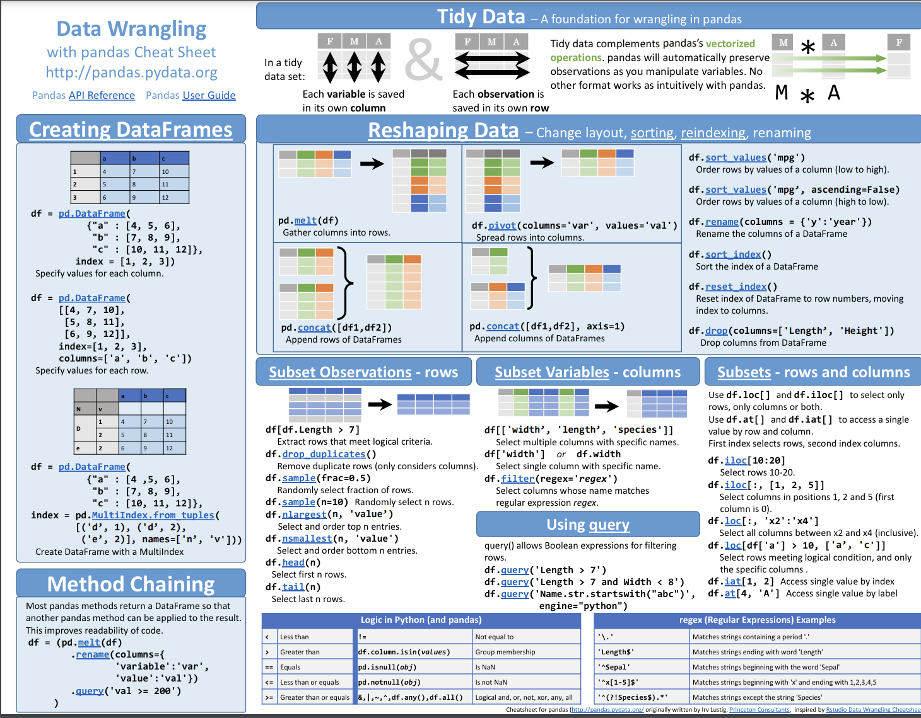
https://pandas.pydata.org/docs/user_guide/10min.html#min
https://pandas.pydata.org/Pandas_Cheat_Sheet.pdf

