Slide 1
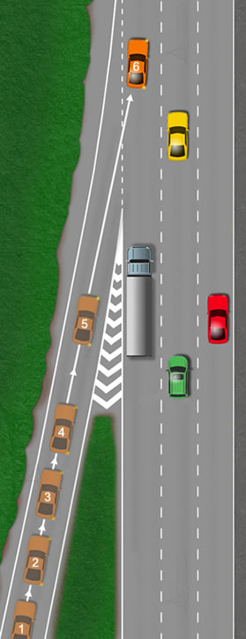
Joining dataframes together
concat
merge
join

Slide 2

family | population | country | germinatedtotal | viable | germinatedviable
A111 | arniston | SA | 1 | 1 | 1
A111 | arniston | SA | 1 | 1 | 1
A111 | arniston | SA | 1 | 1 | 1
A131 | arniston | SA | 1 | 1 | 1
A131 | arniston | SA | 1 | 1 | 1
A131 | arniston | SA | 1 | 1 | 1
A131 | arniston | SA | 1 | 1 | 1
A131 | arniston | SA | 1 | 1 | 1
Lots of files for each different measure…
family | country | population | flowernumber
A14 | SA | arniston | 0
A14 | SA | arniston | 4
A14 | SA | arniston | 0
A14 | SA | arniston | 0
A15 | SA | arniston | 2
population | country | seedweight
arniston | SA | 6.24
arniston | SA | 5.34
arniston | SA | 4.82
arniston | SA | 11.71
arniston | SA | 7.5
arniston | SA | 8.38
arniston | SA | 6.63
arniston | SA | 8.38
family | population | country | survival
A11 | arniston | SA | 1
A11 | arniston | SA | 0
A13 | arniston | SA | 1
A13 | arniston | SA | 1
A13 | arniston | SA | 1
A13 | arniston | SA | 1
family | population | country | flowering
A14 | arniston | SA | 0
A14 | arniston | SA | 1
A14 | arniston | SA | 0
A14 | arniston | SA | 0
A15 | arniston | SA | 1
A15 | arniston | SA | 1
A15 | arniston | SA | 0
A15 | arniston | SA | 1
A15 | arniston | SA | 1
https://doi.org/10.1093/aobpla/plac038
Brandenburger, Claire; Moles, Angela; Maslen, Ben; Sherwin, William (2022), Data from: Weedy and seedy: The rapid evolution of life-history characteristics in an introduced daisy, Dryad, Dataset, https://doi.org/10.5061/dryad.wh70rxwqx

Slide 3
Making a new dataset from two or more sources

Slide 4
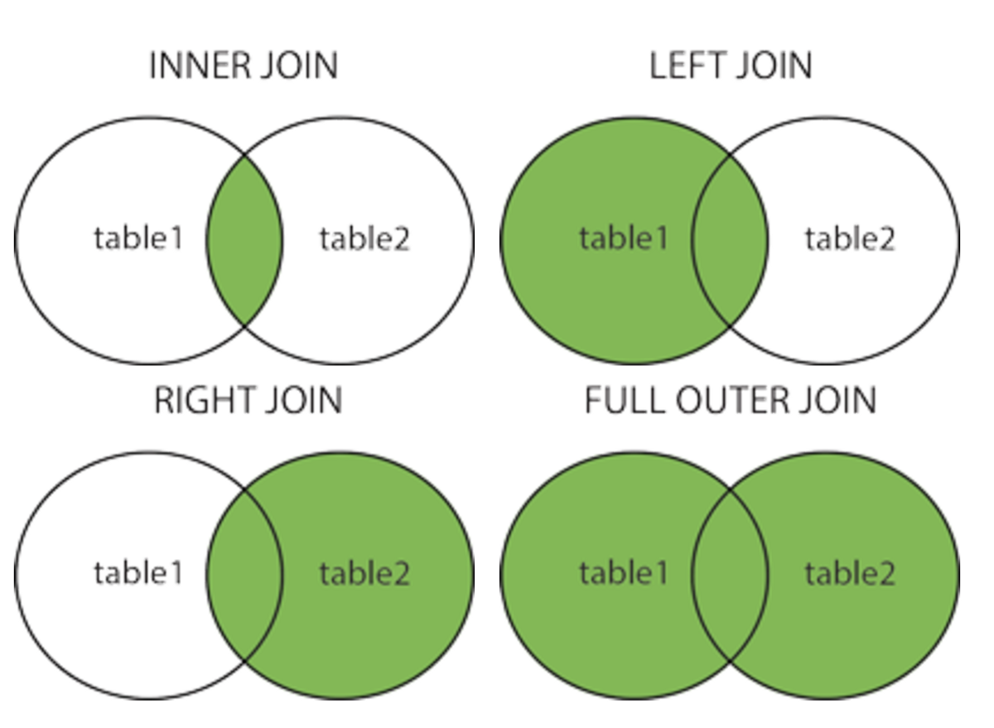

Slide 5
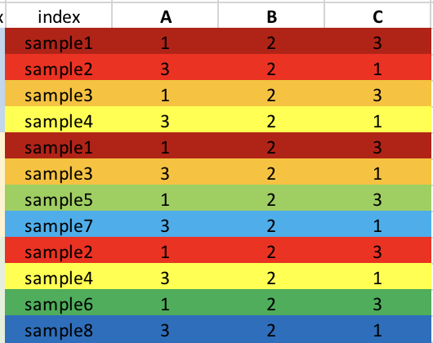
Concatenating dataframes
frames = [df1, df2, df3]
result = pd.concat(frames, axis = 0)
Pasting them together top to bottom

Slide 6
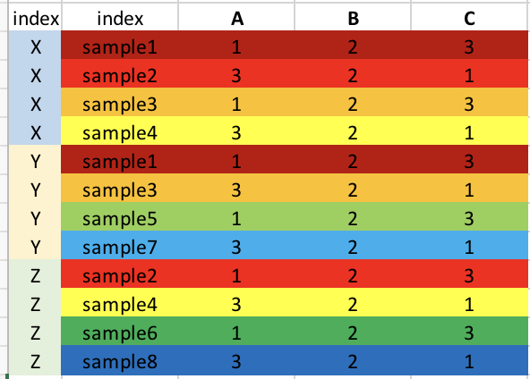
Adding an index to show which bits of the dataframe came from where
result = pd.concat(frames, keys=[”X", ”Y", ”Z"], axis = 0)

Slide 7
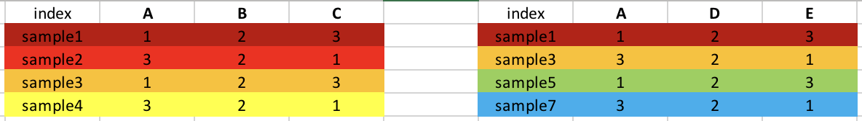
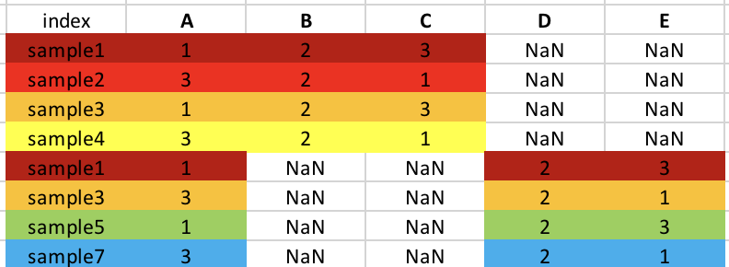
Outer join (Default)
result = pd.concat([df1, df4])
Everything in.
NaN added where values missing

Slide 8
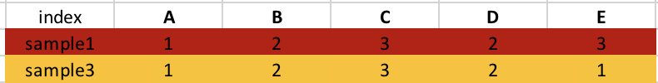
Inner join
result = pd.concat([df1, df4], axis=1, join="inner")
Including all the columns (axis =1) from both dataframes, but only rows where there are values in BOTH dataframes.

Slide 9
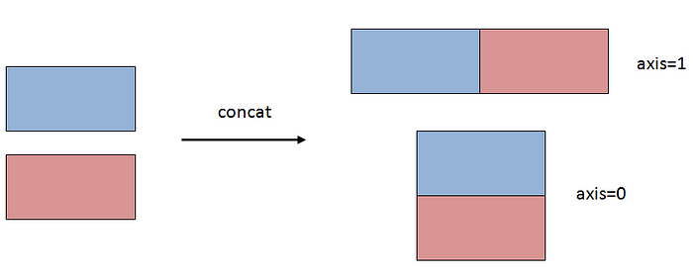
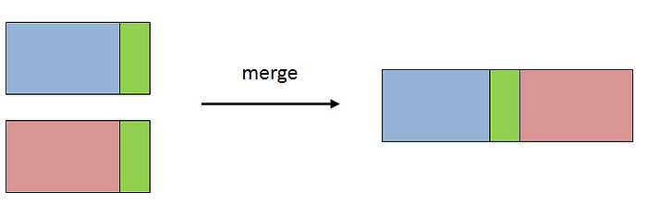
concat stacks, merging uses a shared key

Slide 10
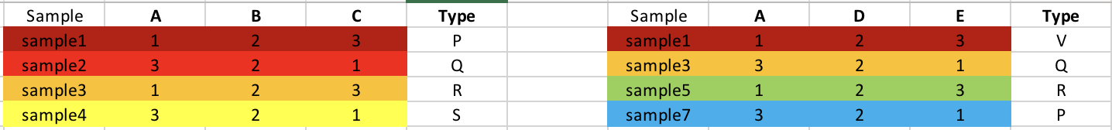
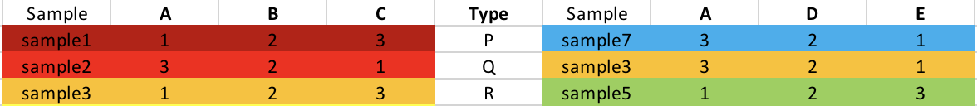
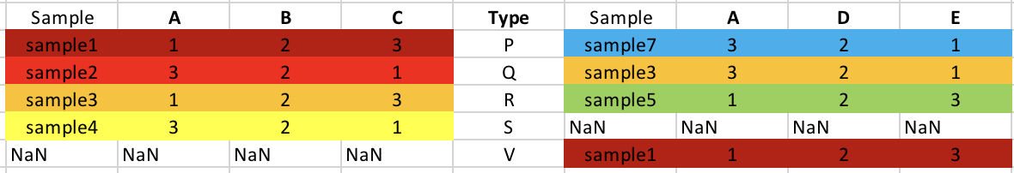
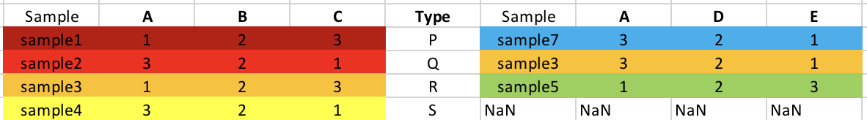
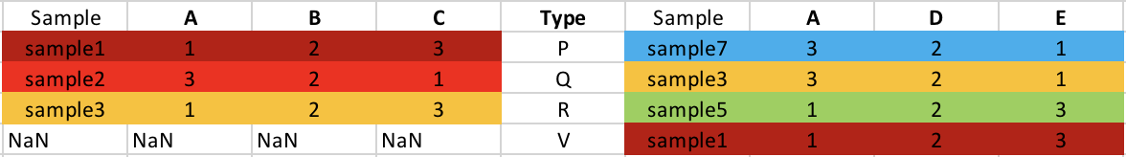
Merging dataframes
df1
df2
result = df1.merge(df2, on =‘Type’, how = ‘inner’)
result = df1.merge(df2, on =‘Type’, how = ‘outer’)
result = df1.merge(df2, on =‘Type’, how = ‘left’)
result = df1.merge(df2, on =‘Type’, how = ‘right’)

Slide 11
Joining dataframes
df.merge joins on common columns by default and gives an inner join
df.join joins on indexes by default and gives an outer join

Slide 12
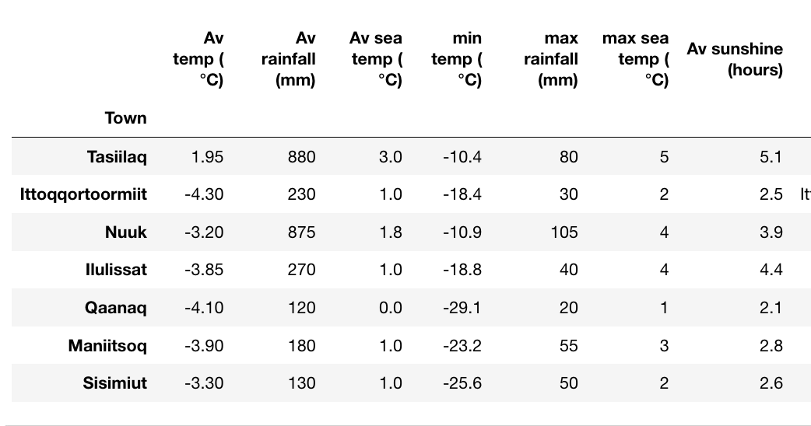
Breaking up dataframes
df.loc[‘Av sea temp (°C)’]
df.iloc[2]
Dataframes have columns and rows,
These are labeled with column names and indexes
Can define a position by:
Column name and row name: df.loc
By postion: df.iloc
df.iloc[-5]
df.loc[:, ‘Nuuk’
df.iloc[:, 2]
df.iloc[: -5]
df.loc[‘Av sea temp (°C)’, ‘Nuuk’
df.iloc[2, 2]
df.iloc[2, -5]

Slide 13
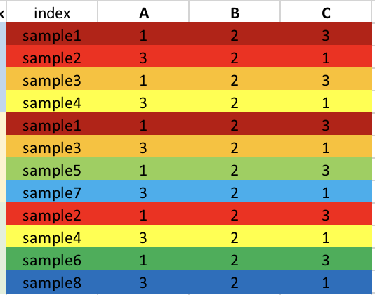
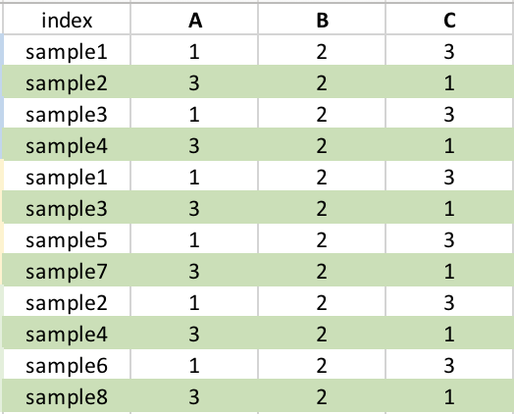
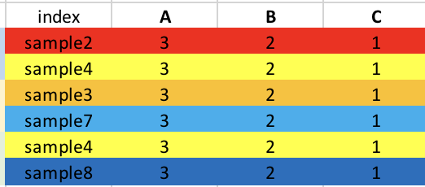
Filtering with conditional masks
Original dataframe
Mask of A > 2
Mask applied
df[df[‘A'] > 2]

Slide 14
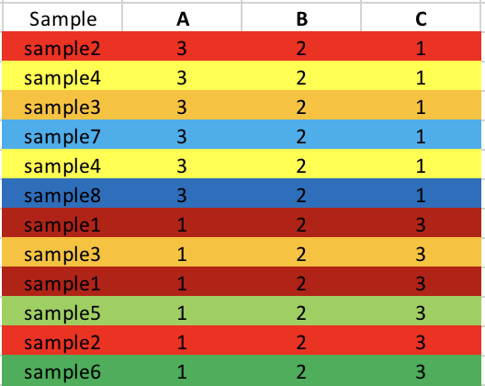
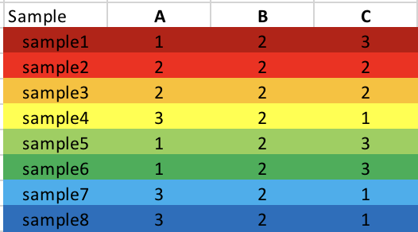
Grouping and summarising
df.group_by(‘Sample’).mean()

Slide 15
Pivot tables for aggregating data
df.pivot_table(index=['Sample'])

Slide 16
Indexes – the simple and the heirarchical
https://towardsdatascience.com/pandas-index-explained-b131beaf6f7b

