Slide 1


Clustering
How do we know if things are similar?

Slide 2
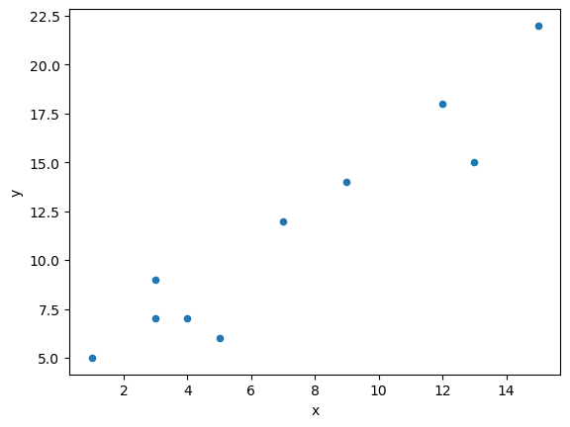
Simple Question
How close are these points?

Slide 3
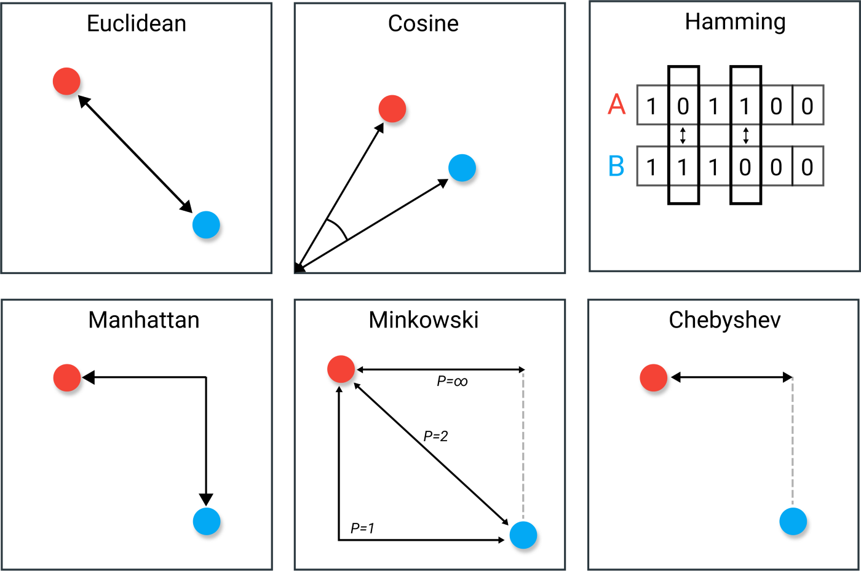
Some distance measures……
Just direction,
disregards magnitude
The number of values that are different between two vectors – like genetic distance
Euclidean distance is not scale in-variant. Need to normalize the data
The greatest of difference between two vectors along any coordinate dimension
Good with discrete and/or binary attributes
Complicated!

Slide 4
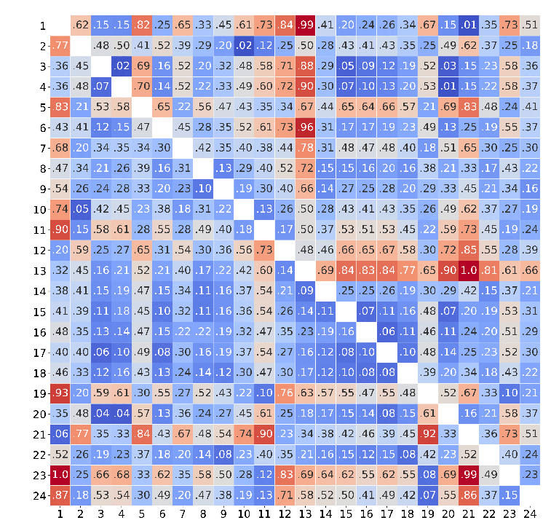
Calculate all pairwise distances using the metric of your choice…
Scipy has an integrated function "pdist" that can work with 22 different similarity measures
euclidean
minkowski
cityblock
seuclidean
sqeuclidean
cosine
correlation
hamming
jaccard
chebyshev
canberra
braycurtis
mahalanobis
yule
matching
dice
kulsinski
rogerstanimoto
russellrao
sokalmichener
sokalsneath
wminkowski

Slide 5
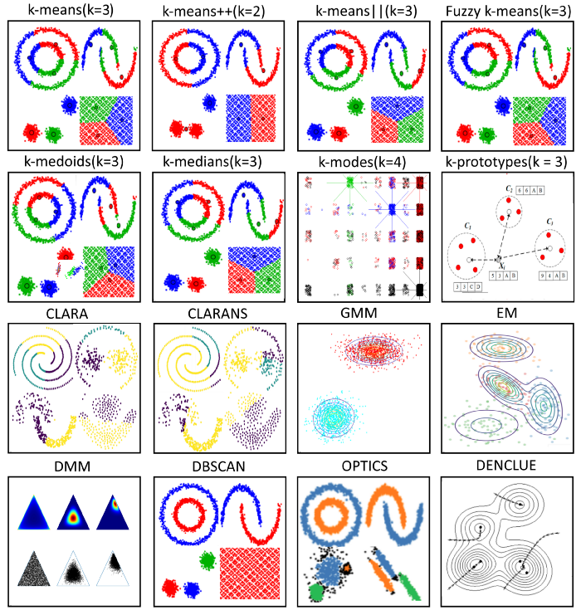
Use the grid of pairwise values to cluster.
Centroid-based k-means
mini-Batch k-means (sample rather than whole dataset)
Hierarchy-based
Agglomerative (bottom up - grouping)
Divisive (top down - spliting)
BIRCH (Balanced Iterative Reducing and Clustering using Hierarchies)
UPGMA
Distribution-based GMM – Gaussian
DMM
EM
Density-based
Use density drop to detect cluster borders
DBSCAN (Density-Based Spatial Clustering of Applications with Noise)
OPTICS
MiMean Shift

Slide 6
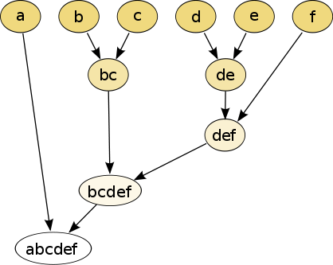
Hierarchical clustering - dendrograms
Finding the ‘tree’ of relationships
Different methods possible here too.
Joining together
Usually start with two closest. How to add in third?
Could add the next closest to that pair,
or pair up the 3rd and fourth closest?
Keep going til you have k groups
How do you join groups?
Re-calculate distances from center?
Re-calculate distances from nearest edge?
Re-calculate distances from furthest edge?
Dividing
Which are the outlier points?
Keep splitting the the least similar cluster until you’ve
divided up the set into as many groups as you like (k groups)
Computationally expensive
Sensitive to outliers

Slide 7
Partition clustering - kmeans
Find k non-overlapping groups in the data set.
Best with spherical groups of data points.
K means exploring how to divide up the data points
Expectation
Assigns each data point to its nearest centroid (k centroids)
Maximization
Calculate a new centroid as the the mean of all the points for each cluster and sets the new centroid.
Minimise SSE
Sum of the Squared Error (Euclidean distances of each point to its closest centroid)
Computationally cheap, but you have to set k yourself

