Slide 1
PCA analysis
Reducing dimensions

Slide 2
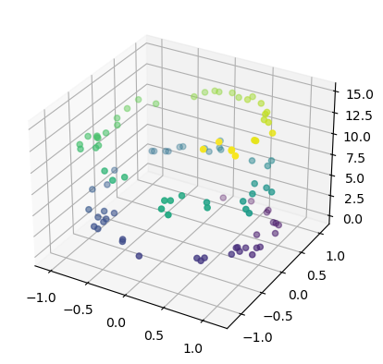
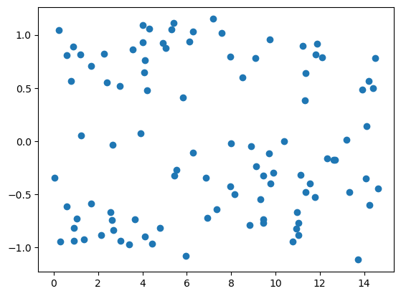
2D Data
3D Data
Distances between these points can be calculated
Distances between these points can be calculated
Please imagine 4D data

Slide 3
Please imagine 200D data
Distances between these points can be calculated using exactly the same distance measures as discussed last week.

Slide 4
Reducing dimensions
Losing the least data

Slide 5
PCA2
Standardise the data so the average for each dimension is 0
PCA1
Fit a best-fit line through the cloud of points
This is the first PCA.
It describes the direction with most variation
Rotate the cloud until this line become the new axis
Fit a new line orthogonal to the first
This is the second PCA
It describes the direction of second most variation
Rotate the cloud until this line become the new axis
Fit a new line orthogonal to the second
This is the third PCA
It describes the direction of third most variation

Slide 6
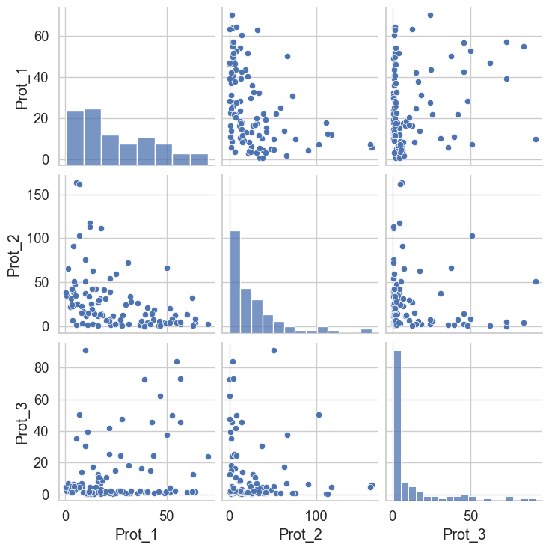
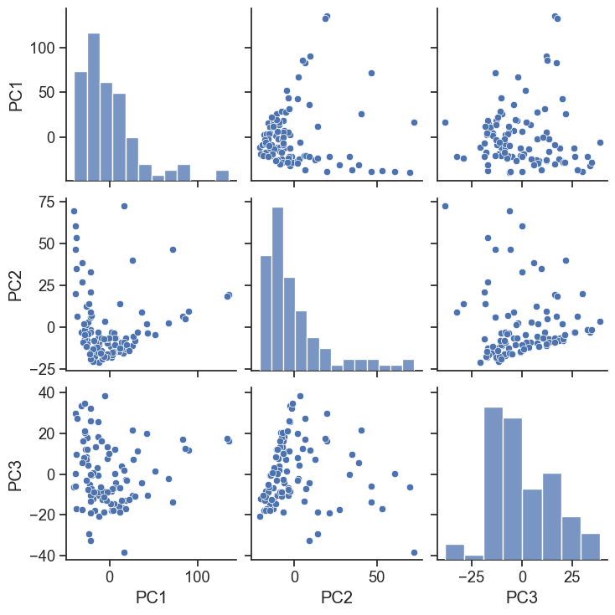
Original Data
Projected onto new PC axes

