Slide 1
Masters of MongoDB
Notes:
<number>

Slide 2
Project Recap
Notes:
<number>

Slide 3
Project Recap
Awesome Job
(Y’all don’t need memes anymore. You are professionals now.)
Notes:
<number>

Slide 4

Just Kidding.
Notes:
<number>

Slide 5
MongoDB
Notes:
<number>

Slide 6

What’s MongoDB?
MongoDB is a very popular noSQL Database
It uses a document-oriented model as opposed to a table-based relational model (SQL)
MongoDB stores data in BSON Format (effectively compressed JSONs)
MongoDB has tons of drivers and packages for connecting to Node, C++, Java, etc.
Notes:
<number>

Slide 7
Relational Databases (SQL)
ID | Title | Author | Published
1 | The History of Blah | Blah Matic | 2010
2 | The Chronicles of Blahrnia | Sir Blahston | 2011
3 | Love in the Time of Blah | Gabriel Garcia Blah | 2013
SQL relies on Joins to combine relevant data
Author | Email | Phone Number
Blah Matic | blahston@gmail.com | 911-546-5454
Sir Blahston | blahby@gmail.com | 911-544-5112
Gabriel Garcia Blah | blahby231@gmail.com | 125-215-5645
Notes:
<number>

Slide 8
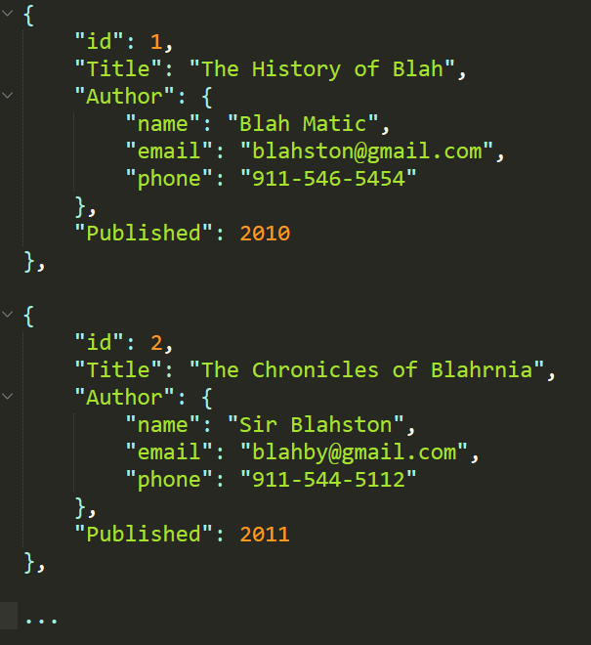
Document Database (noSQL)
noSQL Databases on the other hand are effectively JSONs.
They excel at heterogeneous data formats and are easy to implement.
Notes:
<number>

Slide 9
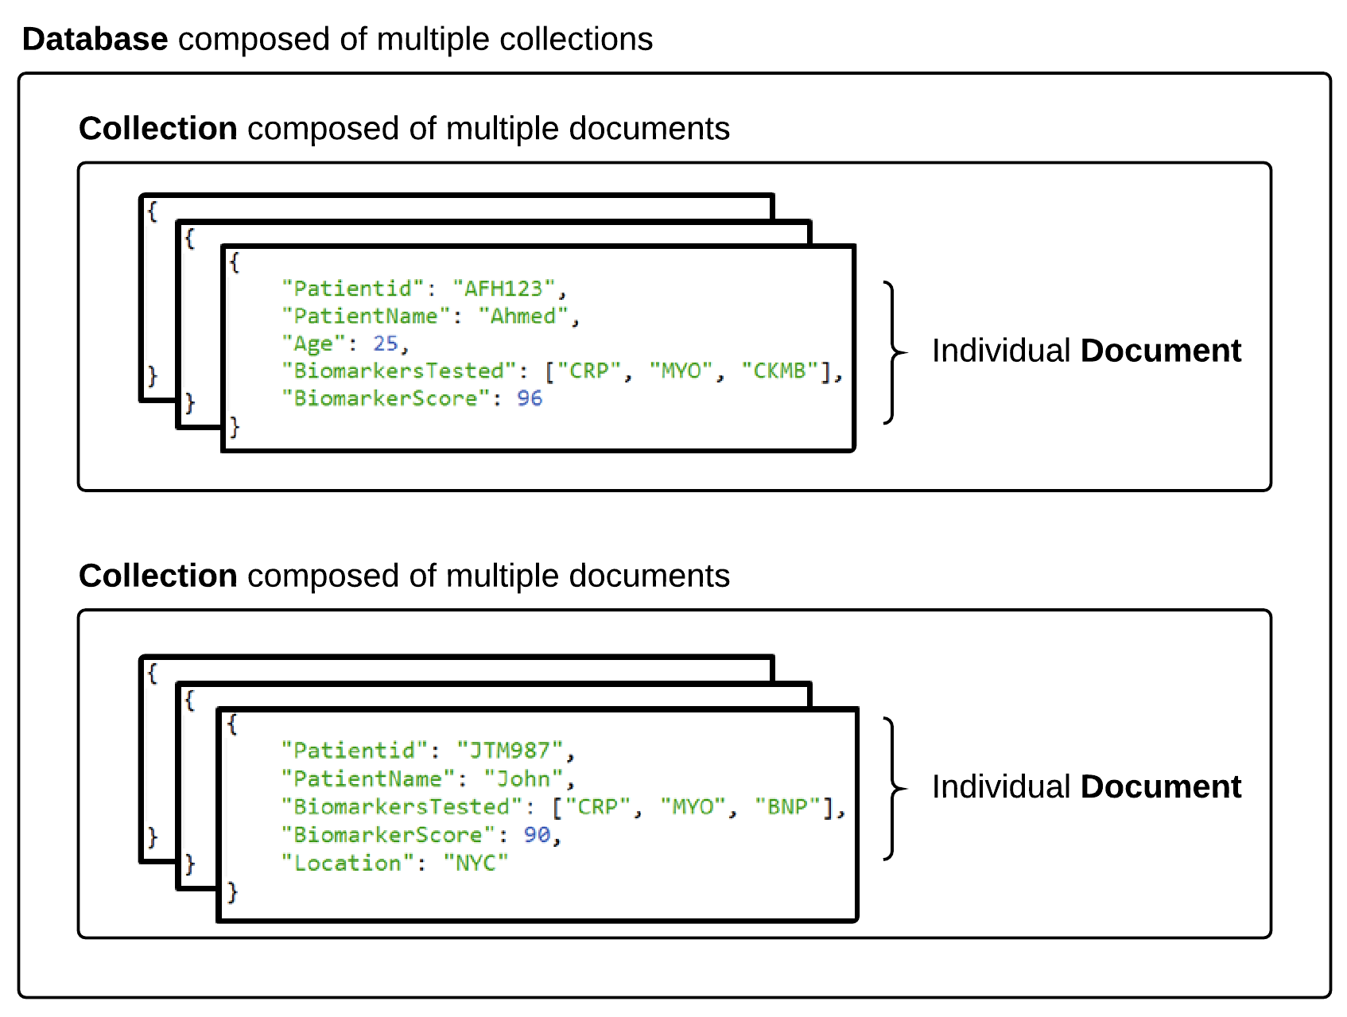

MongoDB Storage
Notes:
<number>

Slide 10
MongoDB Storage
SQL Term | noSQL Term
Database | Database
Table | Collection
Row | Document
Column | Field
Terms are slightly different in the noSQL context.
Take note!
Notes:
<number>

Slide 11
> YOUR TURN!!
Quick Activity:
Work with your neighbors to research the following
What are the advantages of using a noSQL database like MongoDB according to the MongoDB Website?
What are the advantages of using a noSQL database like MongoDB according to the web?
What are the disadvantages of using a noSQL database like MongoDB according to the web?
Notes:
<number>

Slide 12
Code Time!
Notes:
<number>

