Slide 1
Ecological regression in health policy evaluation: A guilt-free dessert?
Society for epidemiologic research annual meeting
Nicholas J. Seewald, Ph.D.
Assistant Professor of Biostatistics
June 13, 2025

Slide 2

Motivating Example: Medical Cannabis Laws and Opioid Prescribing in the U.S.
Scan for slides
Cannabis is a potentially effective treatment for chronic non-cancer pain, but evidence is limited and mixed.
Patients with chronic non-cancer pain are eligible to use medical cannabis under all existing U.S. state medical cannabis laws
There is some evidence of substitution among adults with chronic non-cancer pain.
Question: What are the effects of state medical cannabis laws on receipt of opioid pain treatment among patients with chronic non-cancer pain?
McGinty EE, Tormohlen KN, Seewald NJ, et al. Effects of U.S. State Medical Cannabis Laws on Treatment of Chronic Noncancer Pain. Ann Intern Med. 2023;176(7):904-912.
Notes:
ADD CITES

Slide 3

Data for Health Policy Evaluation
Scan for slides
Many health policy evaluations start with “disaggregated” individual-level data (e.g., insurance claims, EHR, etc.)
Intuitively, we like this!
Allows more choices about the population of interest
Continuous enrollment, samples with certain diagnoses, etc.
Allows outcome / covariate construction
BUT! Data becomes large, computational constraints kick in, and aren’t policies inherently cluster-level interventions?

Slide 4
Motivating Example: Medical Cannabis Laws and Opioid Prescribing in the U.S.
Scan for slides
Data are individual-level commercial health insurance claims.
Individuals included if they have a chronic non-cancer pain diagnosis pre-law and are continuously present in data for full study period
Monthly data on diagnoses, opioid Rx, non-opioid Rx, pain procedures, etc.
7-year study periods → 84 measurement occasions per person
Computation is extremely expensive. Can we aggregate to state-month without losing information?
McGinty EE, Tormohlen KN, Seewald NJ, et al. Effects of U.S. State Medical Cannabis Laws on Treatment of Chronic Noncancer Pain. Ann Intern Med. 2023;176(7):904-912.

Slide 5
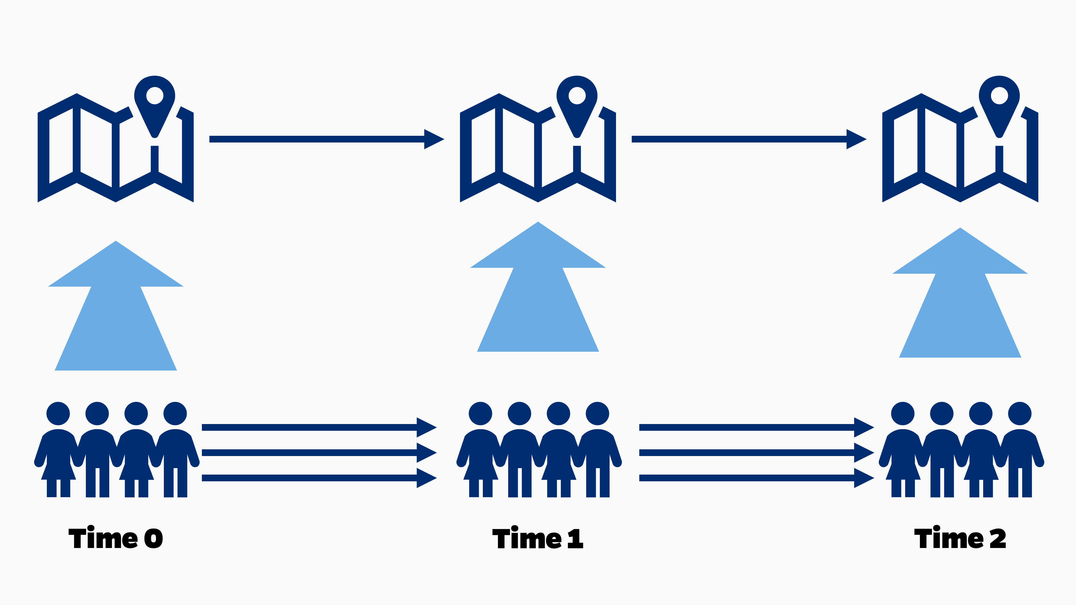
Unit-Time Aggregation
stats::aggregate(Y ∼ state + time, data, mean)

Slide 6
The Ecological Fallacy
Data aggregation might introduce worries about ecological bias.
I argue it should not:
Policies are inherently cluster-level
Policy scholars think about cluster-level effects
Policymakers think about cluster-level effects
So, can we just do ecological regression and be done with it?

Slide 7
Two Big Questions
Are difference-in-difference analyses using individual-level data more statistically efficient than those using aggregate-level data?
Does individual-level data allow for better control of confounding?

Slide 8
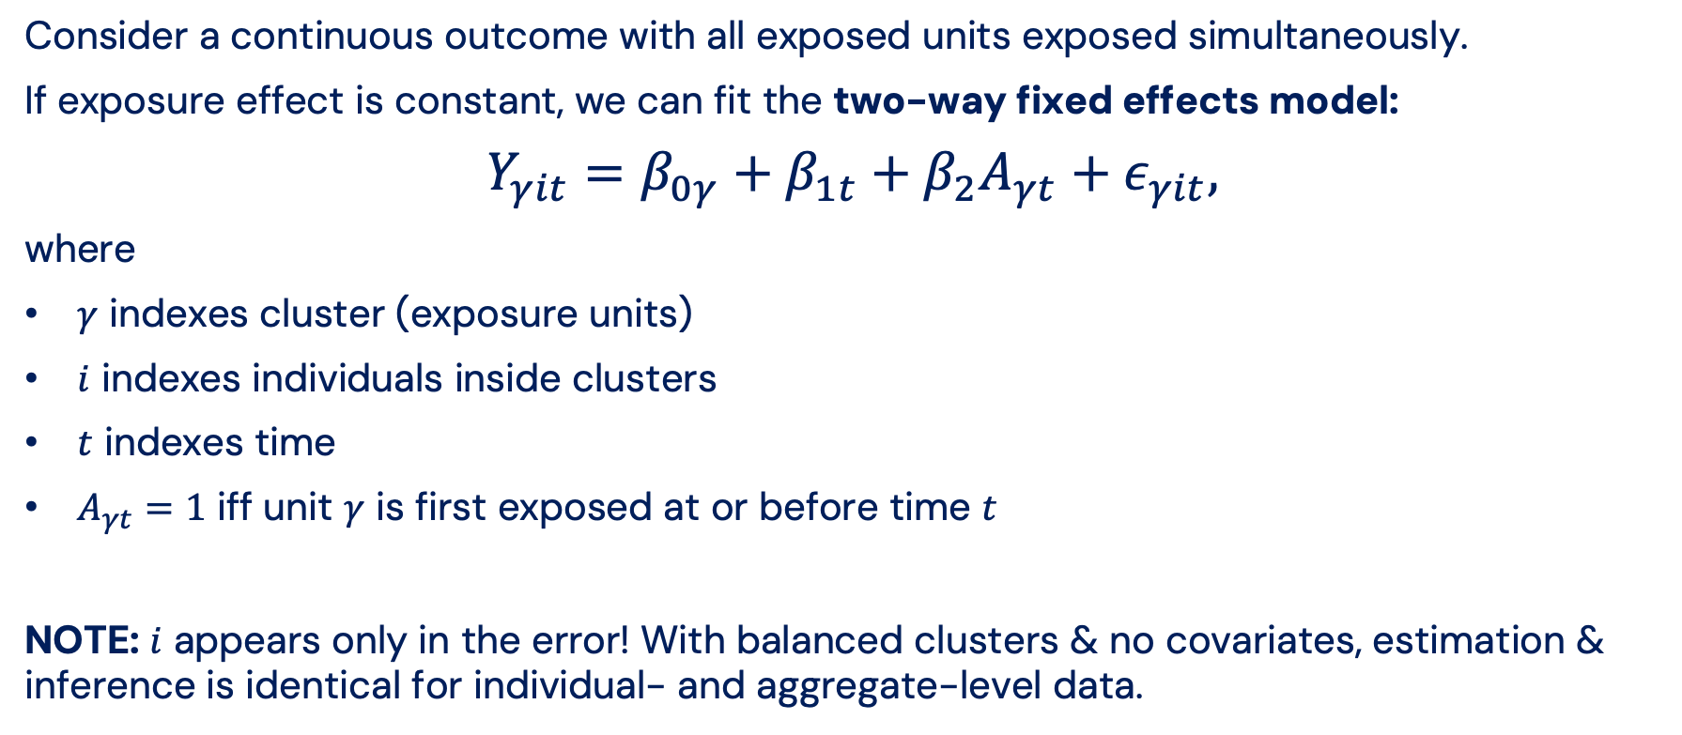
Difference-in-Differences
Consider a continuous outcome with all exposed units exposed simultaneously.
If exposure effect is constant, we can fit the two-way fixed effects model:
$$Y_{γit}=β_{0γ}+β_{1t}+β_{2}A_{γt}+ε_{γit},$$
where
$γ$ indexes cluster (exposure units)
$i$ indexes individuals inside clusters
$t$ indexes time
$A_{γt}=1$ iff unit $γ$ is first exposed at or before time $t$
NOTE: $i$ appears only in the error! With balanced clusters & no covariates, estimation & inference is identical for individual- and aggregate-level data.

Slide 9
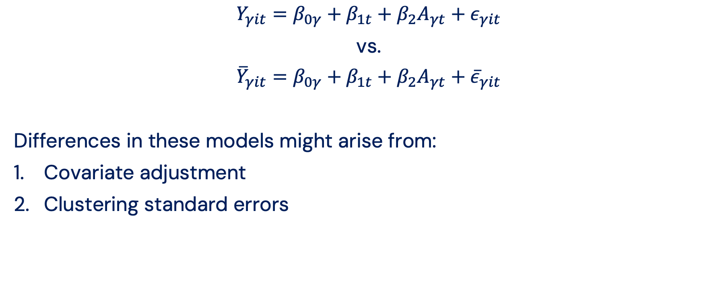
Ecological Regression?
$$Y_{γit}=β_{0γ}+β_{1t}+β_{2}A_{γt}+ε_{γit}$$
vs.
$${\overline{Y}}_{γit}=β_{0γ}+β_{1t}+β_{2}A_{γt}+{\overline{ε}}_{γit}$$
Differences in these models might arise from:
Covariate adjustment
Clustering standard errors

Slide 10
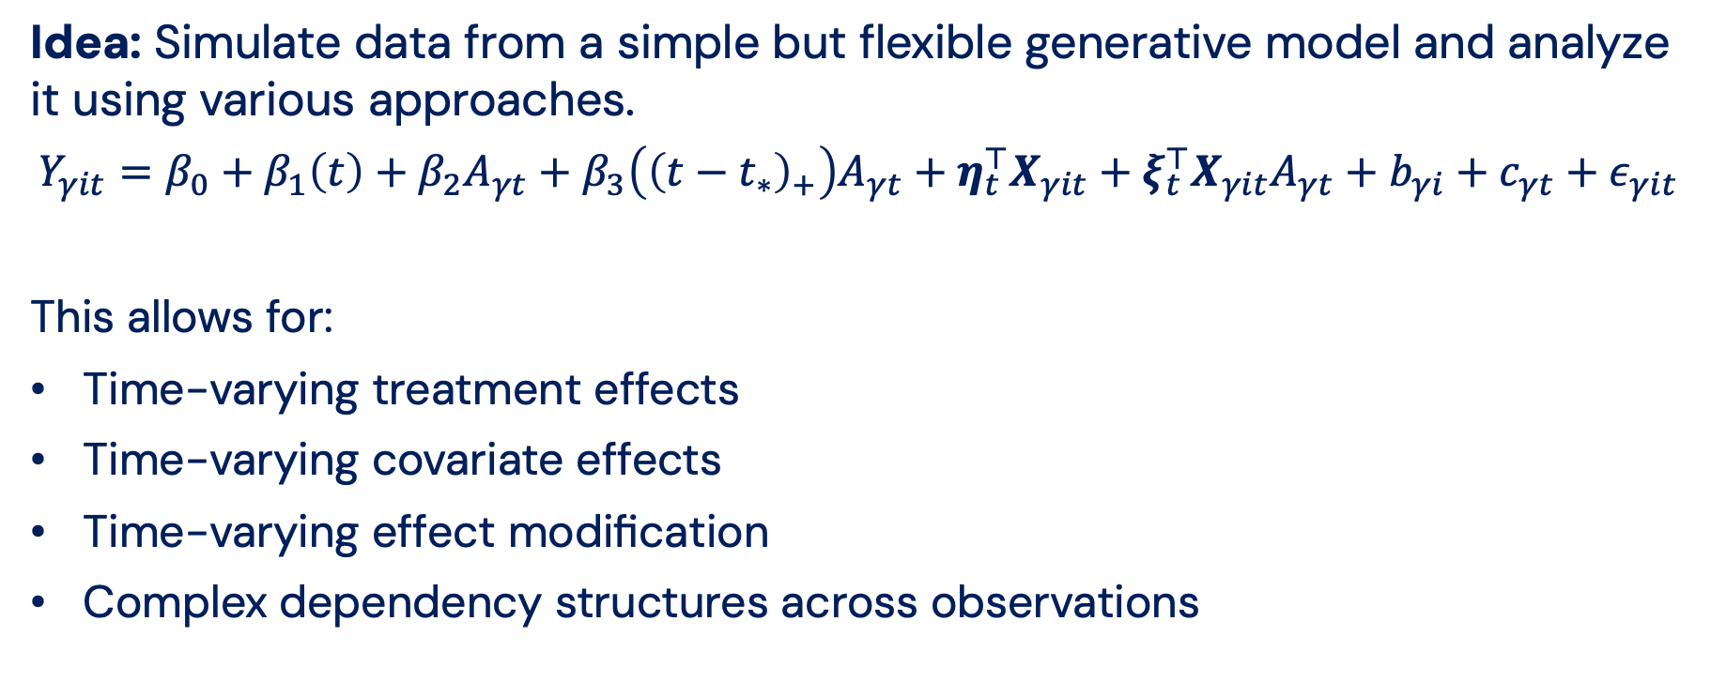
Simulation Study: Generative Model
Idea: Simulate data from a simple but flexible generative model and analyze it using various approaches.
$$Y_{γit}=β_{0}+β_{1}\left(t\right)+β_{2}A_{γt}+β_{3}\left({\left(t−t_{∗}\right)}_{+}\right)A_{γt}+η_{t}^{⊤}X_{γit}+ξ_{t}^{⊤}X_{γit}A_{γt}+b_{γi}+c_{γt}+ε_{γit}$$
This allows for:
Time-varying treatment effects
Time-varying covariate effects
Time-varying effect modification
Complex dependency structures across observations

Slide 11
Simulation Study: Setting
Limited, but common settings:
Continuously-enrolled sample (i.e., closed cohorts)
Balanced panels
Simultaneous exposure
Similar number of treated and control states (Rokicki et al. 2018)
Analytic approaches are extremely mechanical: fit two-way fixed effects model and cluster SEs
Rokicki S, Cohen J, Fink G, Salomon JA, Landrum MB. Inference With Difference-in-Differences With a Small Number of Groups: A Review, Simulation Study, and Empirical Application Using SHARE Data. Medical Care. 2018;56(1):97-105.

Slide 12
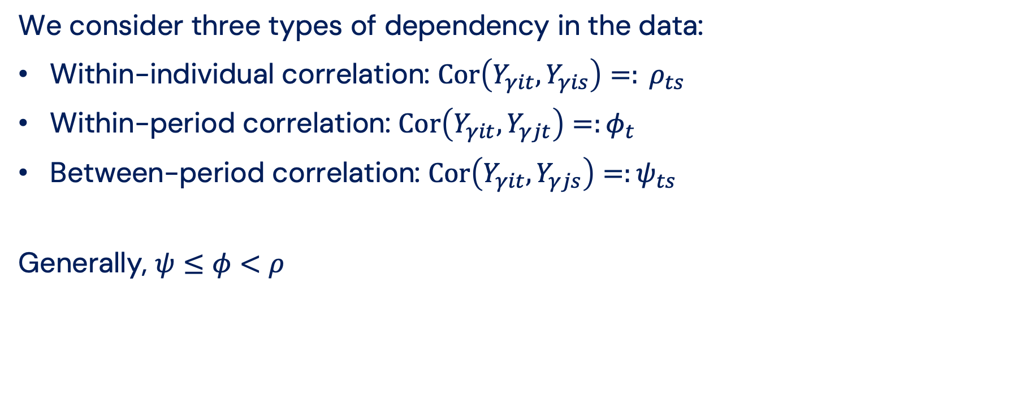
Correlation Structures
We consider three types of dependency in the data:
Within-individual correlation: ${\text{Cor}\left(Y_{γit},Y_{γis}\right)=: ρ}_{ts}$
Within-period correlation: ${\text{Cor}\left(Y_{γit},Y_{γjt}\right)=:φ}_{t}$
Between-period correlation: ${\text{Cor}\left(Y_{γit},Y_{γjs}\right)=:ψ}_{ts}$
Generally, $ψ≤φ<ρ$

Slide 13
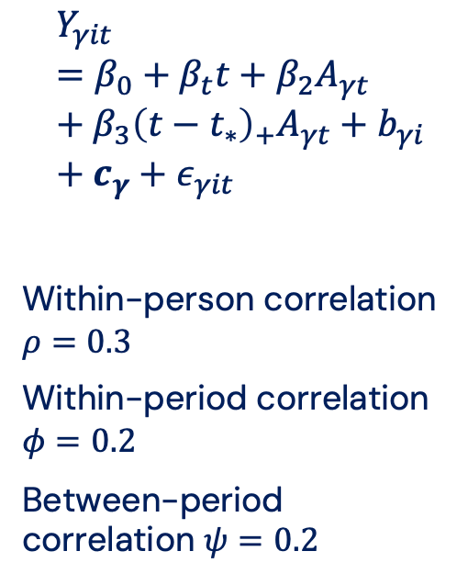
“Block Exchangeable” Correlation, No Covariates
$$Y_{γit}=β_{0}+β_{t}t+β_{2}A_{γt}+β_{3}{\left(t−t_{∗}\right)}_{+}A_{γt}+b_{γi}+c_{γ}+ε_{γit}$$
Within-person correlation $ρ=0.3$
Within-period correlation $φ=0.2$
Between-period correlation $ψ=0.2$
 | % Bias | Std. Err. | 95% CI Covg.
Aggregated Data (ecological models)
OLS SE | 0.0 | 0.019 | 0.948
SE clustered by state | 0.0 | 0.019 | 0.948
Individual-Level Data
OLS SE | 0.0 | 0.020 | 0.964
SE clustered by individual | 0.0 | 0.019 | 0.942
SE clustered by state | 0.0 | 0.019 | 0.940
SE clustered by individual and state | 0.0 | 0.019 | 0.940
SE clustered by state and time | 0.0 | 0.019 | 0.924
True mixed model | 0.0 | 0.019 | 0.944
Just use the aggregated data!

Slide 14
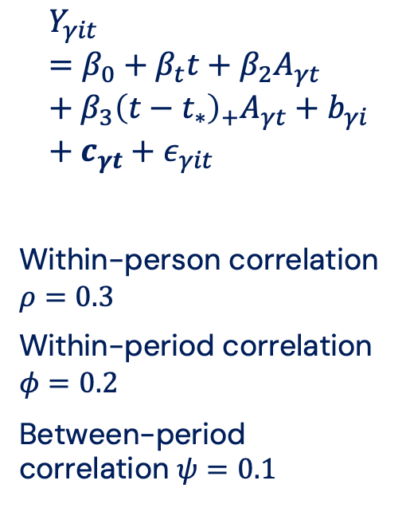
“Nested Exchangeable” Correlation, No Covariates
$$Y_{γit}=β_{0}+β_{t}t+β_{2}A_{γt}+β_{3}{\left(t−t_{∗}\right)}_{+}A_{γt}+b_{γi}+c_{γt}+ε_{γit}$$
Within-person correlation $ρ=0.3$
Within-period correlation $φ=0.2$
Between-period correlation $ψ=0.1$
 | % Bias | Std. Err. | 95% CI Covg.
Aggregated Data (ecological models)
OLS SE | 0.1 | 0.124 | 0.938
SE clustered by state | 0.1 | 0.125 | 0.936
Individual-Level Data
OLS SE | 0.1 | 0.023 | 0.302
SE clustered by individual | 0.1 | 0.020 | 0.266
SE clustered by state | 0.1 | 0.122 | 0.926
SE clustered by individual and state | 0.1 | 0.122 | 0.926
SE clustered by state and time | 0.1 | 0.122 | 0.916
True mixed model | 0.1 | 0.124 | 0.944
Individual-level analysis must correctly cluster SEs.

Slide 15
Confounding in Diff-in-Diff
“Only covariates that differ by treatment group and are associated with outcome trends are confounders in diff‑in‑diff.”
Time‑invariant covariates are confounders if they have time‑varying effects on the outcome
Time‑varying covariates are confounders if they have time‑varying effects on the outcome or evolve differently in treated and control groups.
Zeldow B, Hatfield LA. Confounding and regression adjustment in difference-in-differences studies. Health Services Research. 2021;56(5):932-941.

Slide 16
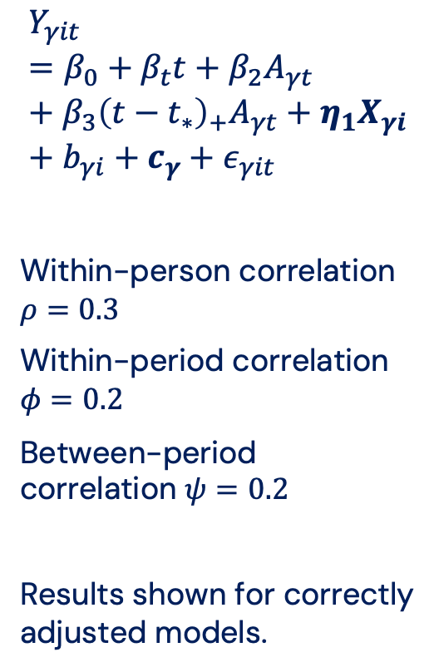
Block Exchangeable Correlation, Unconfounded
$$Y_{γit}=β_{0}+β_{t}t+β_{2}A_{γt}+β_{3}{\left(t−t_{∗}\right)}_{+}A_{γt}+η_{1}X_{γi}+b_{γi}+c_{γ}+ε_{γit}$$
Within-person correlation $ρ=0.3$
Within-period correlation $φ=0.2$
Between-period correlation $ψ=0.2$
Results shown for correctly adjusted models.
 | % Bias | Std. Err. | 95% CI Covg.
Aggregated Data (ecological models)
OLS SE | 0.1 | 0.030 | 0.950
SE clustered by state | 0.1 | 0.030 | 0.940
Individual-Level Data
OLS SE | 0.1 | 0.032 | 0.958
SE clustered by individual | 0.1 | 0.030 | 0.946
SE clustered by state | 0.1 | 0.029 | 0.928
SE clustered by individual and state | 0.1 | 0.029 | 0.929
SE clustered by state and time | 0.1 | 0.029 | 0.932
True mixed model | 0.1 | 0.030 | 0.948
Just use the aggregated data!

Slide 17
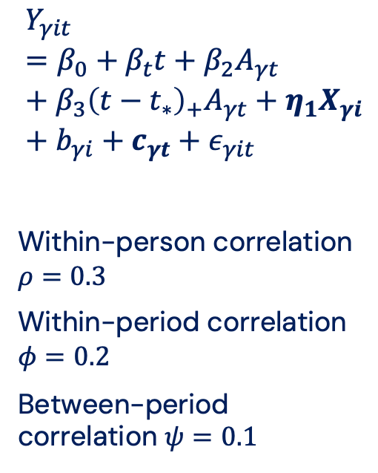
Nested Exchangeable Correlation, Unconfounded
$$Y_{γit}=β_{0}+β_{t}t+β_{2}A_{γt}+β_{3}{\left(t−t_{∗}\right)}_{+}A_{γt}+η_{1}X_{γi}+b_{γi}+c_{γt}+ε_{γit}$$
Within-person correlation $ρ=0.3$
Within-period correlation $φ=0.2$
Between-period correlation $ψ=0.1$
 | % Bias | Std. Err. | 95% CI Covg.
Aggregated Data (ecological models)
OLS SE | -0.1 | 0.195 | 0.938
SE clustered by state | -0.1 | 0.195 | 0.936
Individual-Level Data
OLS SE | -0.1 | 0.037 | 0.294
SE clustered by individual | -0.1 | 0.020 | 0.262
SE clustered by state | -0.1 | 0.187 | 0.924
SE clustered by individual and state | -0.1 | 0.187 | 0.924
SE clustered by state and time | -0.1 | 0.185 | 0.903
True mixed model | -0.1 | 0.195 | 0.946
Individual-level analysis must correctly cluster SEs and is still slightly inefficient. Weird!

Slide 18
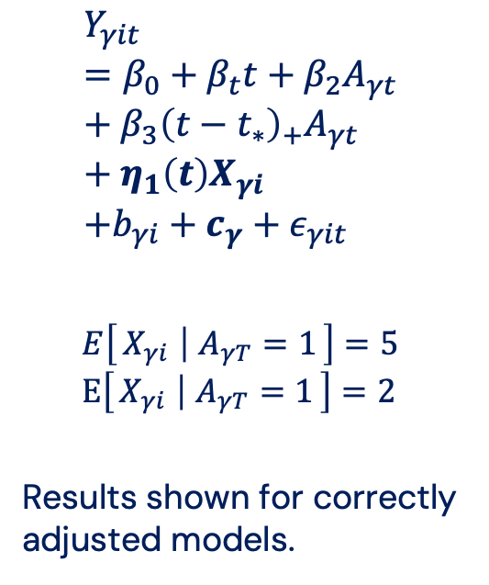
Block Exchangeable Correlation, Confounded
$$Y_{γit}=β_{0}+β_{t}t+β_{2}A_{γt}+β_{3}{\left(t−t_{∗}\right)}_{+}A_{γt}+η_{1}\left(t\right)X_{γi} \\ +b_{γi}+c_{γ}+ε_{γit}$$
$$E\left[X_{γi} ∣ A_{γT}=1\right]=5 \\ E\left[X_{γi} ∣ A_{γT}=1\right]=2$$
Results shown for correctly adjusted models.
 | % Bias | Std. Err. | 95% CI Covg.
Aggregated Data (ecological models)
OLS SE | 0.3 | 0.793 | 0.968
SE clustered by state | 0.3 | 0.732 | 0.910
Individual-Level Data
OLS SE | 0.0 | 0.058 | 0.972
SE clustered by individual | 0.0 | 0.054 | 0.958
SE clustered by state | 0.0 | 0.053 | 0.942
SE clustered by individual and state | 0.0 | 0.053 | 0.942
SE clustered by state and time | 0.0 | 0.050 | 0.906
True mixed model | 0.0 | 0.054 | 0.960

Slide 19
Block Exchangeable Correlation, Confounded
$$Y_{γit}=β_{0}+β_{t}t+β_{2}A_{γt}+β_{3}{\left(t−t_{∗}\right)}_{+}A_{γt}+η_{1}\left(t\right)X_{γi} \\ +b_{γi}+c_{γ}+ε_{γit}$$
$$E\left[X_{γi} ∣ A_{γT}=1\right]=5 \\ E\left[X_{γi} ∣ A_{γT}=1\right]=2$$
Results shown for correctly adjusted models.
 | % Bias | Std. Err. | 95% CI Covg.
Aggregated Data (ecological models)
OLS SE | 0.3 | 0.793 | 0.968
SE clustered by state | 0.3 | 0.732 | 0.910
Individual-Level Data
OLS SE | 0.0 | 0.058 | 0.972
SE clustered by individual | 0.0 | 0.054 | 0.958
SE clustered by state | 0.0 | 0.053 | 0.942
SE clustered by individual and state | 0.0 | 0.053 | 0.942
SE clustered by state and time | 0.0 | 0.050 | 0.906
True mixed model | 0.0 | 0.054 | 0.960
When time-invariant confounder is imbalanced at baseline, aggregation leads to efficiency loss

Slide 20
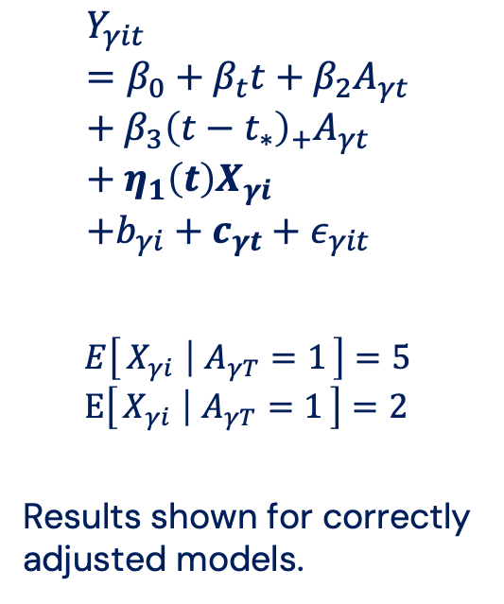
Nested Exchangeable Correlation, Confounded
$$Y_{γit}=β_{0}+β_{t}t+β_{2}A_{γt}+β_{3}{\left(t−t_{∗}\right)}_{+}A_{γt}+η_{1}\left(t\right)X_{γi} \\ +b_{γi}+c_{γt}+ε_{γit}$$
$$E\left[X_{γi} ∣ A_{γT}=1\right]=5 \\ E\left[X_{γi} ∣ A_{γT}=1\right]=2$$
Results shown for correctly adjusted models.
 | % Bias | Std. Err. | 95% CI Covg.
Aggregated Data (ecological models)
OLS SE | -3.7 | 5.124 | 0.958
SE clustered by state | -3.7 | 4.766 | 0.910
Individual-Level Data
OLS SE | 0.0 | 0.066 | 0.516
SE clustered by individual | 0.0 | 0.058 | 0.448
SE clustered by state | 0.0 | 0.195 | 0.936
SE clustered by individual and state | 0.0 | 0.195 | 0.936
SE clustered by state and time | 0.0 | 0.192 | 0.928
True mixed model | 0.0 | 0.201 | 0.964

Slide 21
Nested Exchangeable Correlation, Confounded
Individual-level CIs slightly under-cover, but are orders of magnitude more efficient unless you also adjust for state-level covariate means
 | % Bias | Std. Err. | 95% CI Covg.
Aggregated Data (ecological models)
OLS SE | -3.7 | 5.124 | 0.958
SE clustered by state | -3.7 | 4.766 | 0.910
Individual-Level Data
OLS SE | 0.0 | 0.066 | 0.516
SE clustered by individual | 0.0 | 0.058 | 0.448
SE clustered by state | 0.0 | 0.195 | 0.936
SE clustered by individual and state | 0.0 | 0.195 | 0.936
SE clustered by state and time | 0.0 | 0.192 | 0.928
True mixed model | 0.0 | 0.201 | 0.964
NOTE: Without adjusting for cluster-level means, individual-level analysis answers an individual-level question. (not what we want!)

Slide 22
Takeaways
This is a question of design vs. analysis.
Individual-level data is very useful in the design stage of policy evaluation
Better sample identification, feature construction, outcome construction, etc.
In the analysis stage (with DiD), aggregate-level data is more ergonomic and usually yields CIs with nominal coverage.
Analyses using individual-level might struggle to achieve nominal coverage and can suffer when complex correlations are modeled wrong.
It’s hard to distinguish what’s an issue with aggregation and what’s an issue with model misspecification.

Slide 23
seewaldn@pennmedicine.upenn.edu
www.nickseewald.com

