Slide 1
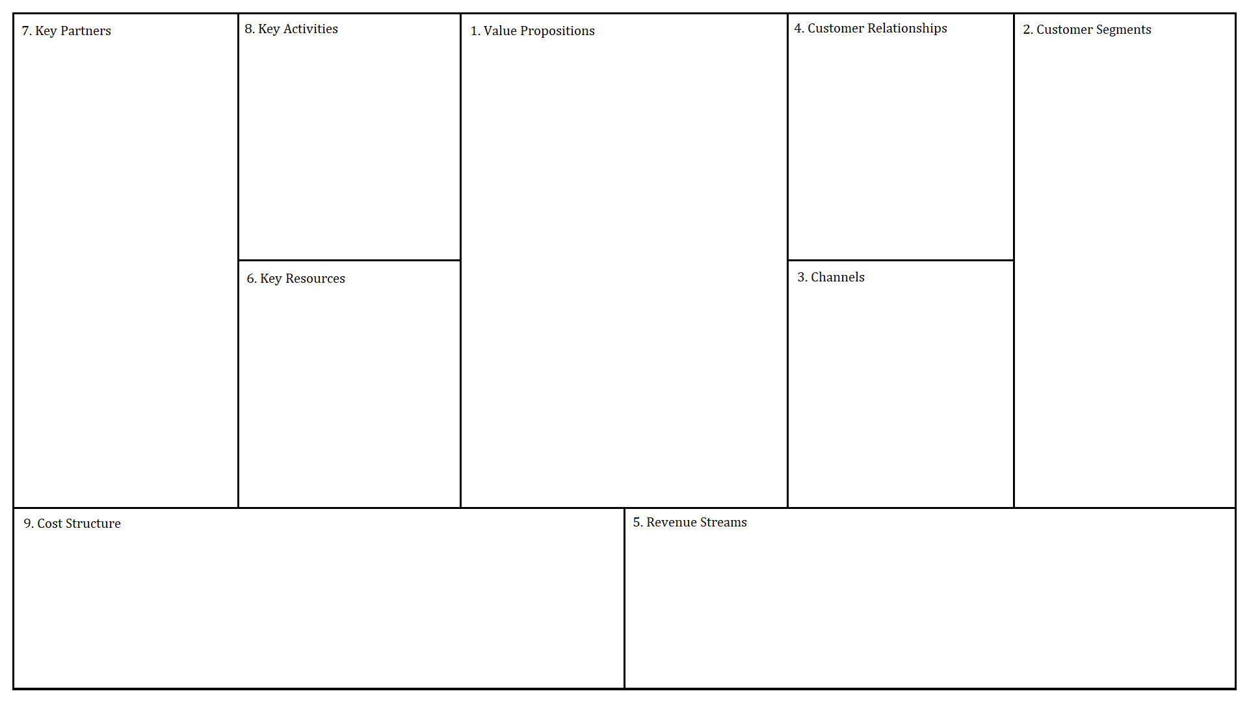
Names: Ferris DeHart, Seth Richard, Nicklaus Settoon
LSU
Scheduling
Showing Degree paths
Customizing degree paths
Degree planning
Products – A website used for course management/scheduling
Services – Course scheduling, Degree path management
Pain Killers – reduces the stress and confusion of scheduling and planning out a degree
Gain Creators – customizable degree plans that can be saved and edited in the future
We ourselves are part of the customers when we schedule and when we plan our degree.
Freshmen Students
Students Looking to change majors
Students looking for minors
Students during class registration
Faculty
LSU Course Database
Major Requirements /flowcharts
My LSU website would be used as a channel for customer access and getting the product out
Hosting the website on a server
Selling the product to LSU

