Slide 1


Smash Database
Group 5
Nick Settoon
Royden Lynch
Gerald Mouton
Seth Richard
Notes:
Seth

Slide 2
Overview of the Problem
Overview of the Problem
Project Objectives
To create an efficient, consistent, and scalable database to answer any user request regarding all of the Super Smash Bros. Ultimate data we collect.
Business Requirements
Be able to rank the players by the number of set wins they have in order to create a “standings” of the players.
Determine the fictional characters that give a player the biggest advantage and highest chance to win a set.
When two characters are paired up against each other who has the advantage, no matter who the esports players are.
What are the most popular regions for Ultimate, and what areas need more promotion and advertisement.
Notes:
Royden

Slide 3
Data
The data used to fill our database was collected with 2 main methods:
Manually importing our own discoveries off of the internet into CSV files.
Importing CSV files we found with relevant data.
Our database is 536kb.
The data is parsed out into multiple different CSV files for easy importing.
We divided tournaments into sets, which are usually 2-5 fights. Each fight is an individual fight that takes place at a tournament between two players. We store professional players and each character in the game. We also store each matchup between two characters for statistics purposes.
Notes:
Seth

Slide 4
Assumptions and Constraints
Assumptions
Each tournament should have one, and only one, winner.
Player names are unique
Character names are unique
Tournament names are unique
There are a finite number of possible matchups
Constraints
Based on how tournaments are usually structured.
We determined that a fight is the smallest unit of data.
Sets have one winner and contain 2-5 fights.
Tournaments have many sets
Fights are between 2 players that each use a character on a single stage.
Notes:
Royden

Slide 5
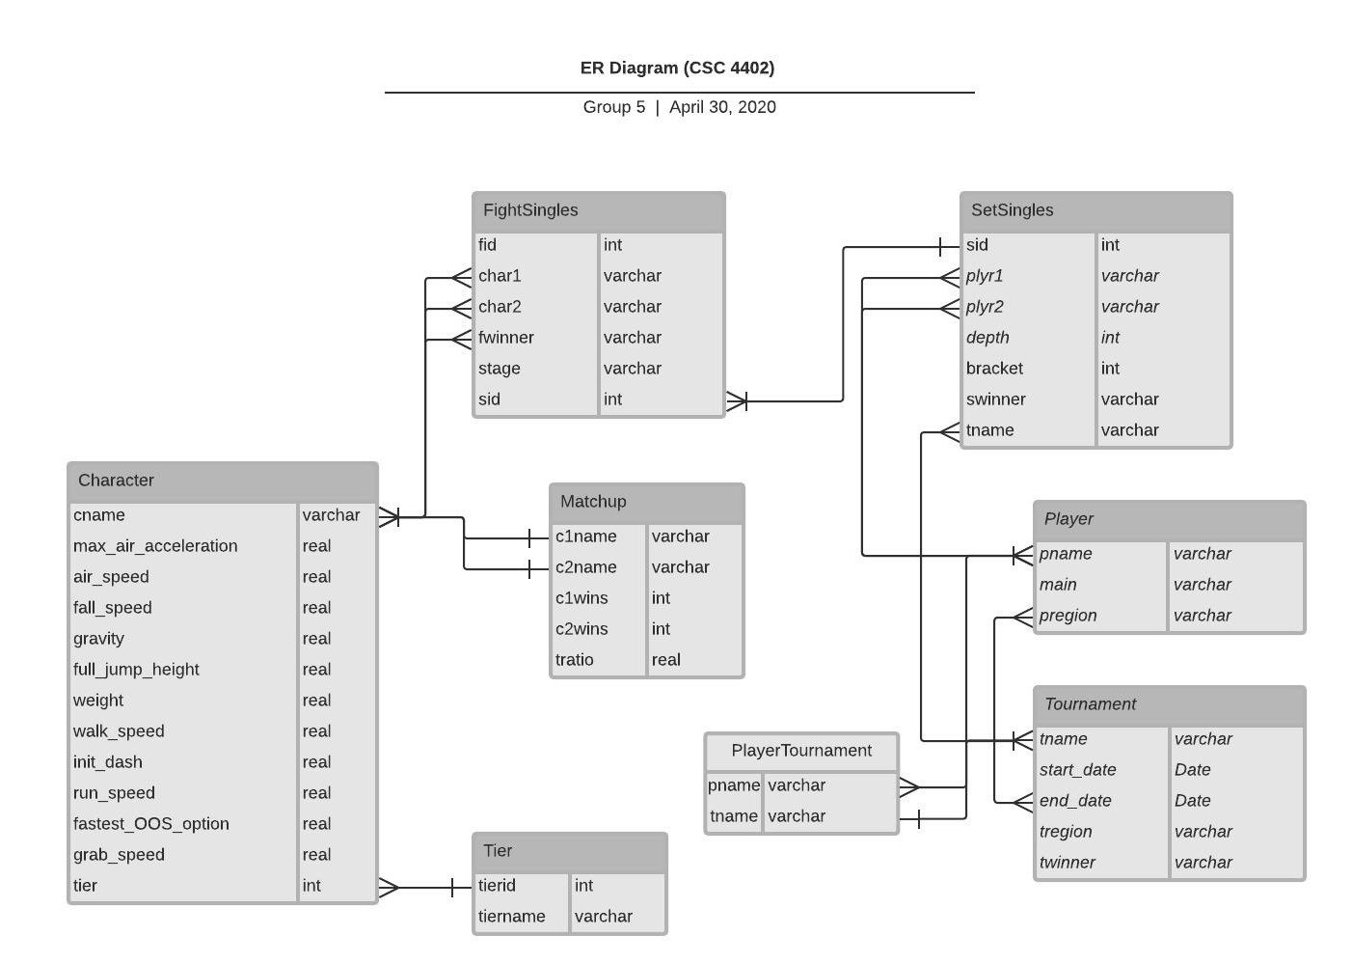
ER Diagram
Notes:
Royden

Slide 6
Normalization
We designed our relational database through the process of normalization to achieve greater data integrity and attempt to avoid data redundancy.
We took measures to avoid redundant information by creating multiple smaller tables to make our database more efficient.
Each of our tables achieves BCNF.
Notes:
Jay

Slide 7
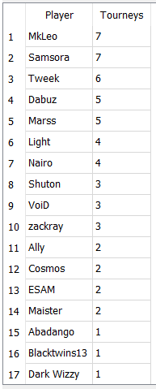
Querying and Data Statistics(1)
This query ranks players by the number of tournaments, in our data set, that they went to.
SELECT pname as Player, COUNT(*) as Tourneys
FROM PlayerTournament NATURAL JOIN Player
GROUP BY pname
ORDER BY Tourneys DESC;
Notes:
Jay

Slide 8
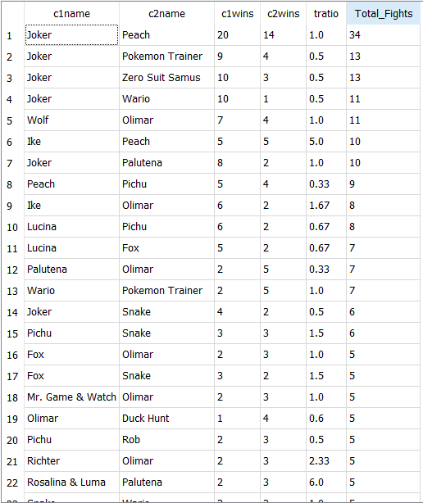
Querying and Data Statistics(2)
This query ranks matchups, a fight between two character independant of players, by the number of occurrences of that matchup.
SELECT *, c1wins + c2wins as Total_Fights
FROM Matchup
WHERE Total_Fights >= 1;
Notes:
Seth

Slide 9
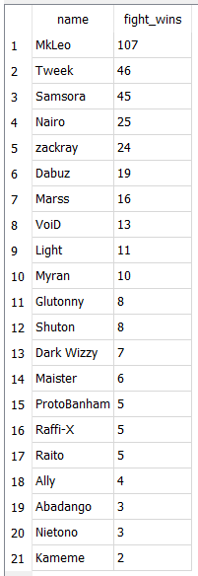
Querying and Data Statistics(3)
This query lists players by the number of fights they have won.
SELECT swinner AS name, COUNT(fid) AS fight_wins
FROM FightSingles NATURAL INNER JOIN SetSingles
GROUP BY swinner
ORDER BY fight_wins DESC;
Notes:
Jay

Slide 10
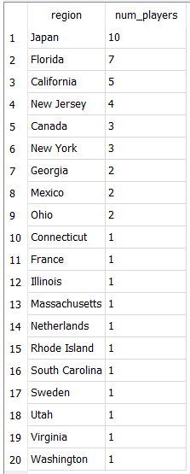
Querying and Data Statistics(4)
This query ranks the regions in our data set by the number of players that are based in that region.
SELECT pregion AS region, COUNT(pname) AS num_players
FROM Player
GROUP BY pregion
ORDER BY num_players DESC;
Notes:
Royden

Slide 11
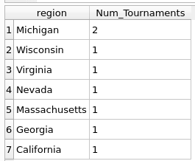
Querying and Data Statistics(5)
This query ranks regions by the number of tournaments that were held there.
SELECT tregion AS region, COUNT(tname) AS Num_Tournaments
FROM Tournament
GROUP BY tregion
ORDER BY Num_Tournaments DESC;
Notes:
Royden

Slide 12
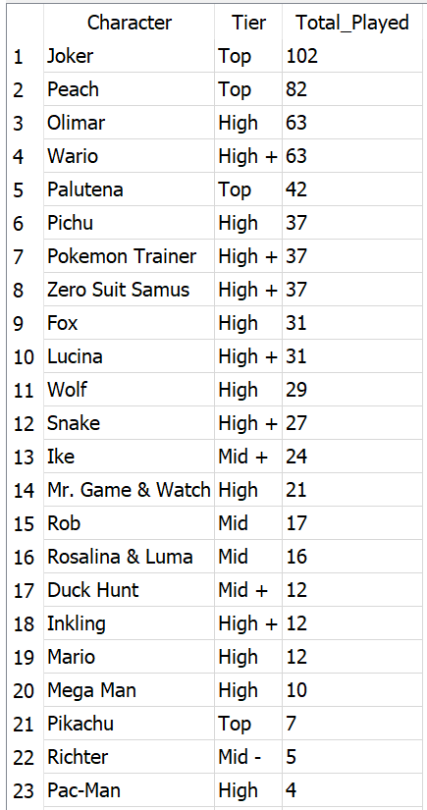
Querying and Data Statistics(6)
This query ranks which characters are most popularly used in Super Smash Bros. Ultimate.
SELECT cname AS Character, tiername AS Tier, Total_Played
FROM (SELECT Character AS cname, sum(Play_rate) as Total_Played
FROM (SELECT char1 as Character, COUNT() as Play_rate
FROM FightSingles NATURAL JOIN SetSingles NATURAL JOIN Tournament
GROUP BY char1
UNION
SELECT char2 as Character, COUNT() as Play_rate
FROM FightSingles NATURAL JOIN SetSingles NATURAL JOIN Tournament
GROUP BY char2)
GROUP BY Character
ORDER BY Total_Played DESC) NATURAL JOIN Character NATURAL JOIN Tier;
Notes:
Nick

Slide 13
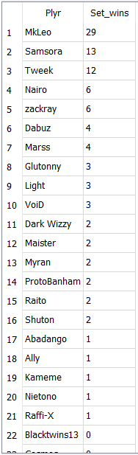
Querying and Data Statistics(7)
This query ranks players by the number of sets they have won in all of the tournaments in our data set.
SELECT Plyr, IFNULL(Set_wins,0) as Set_wins
FROM (SELECT Plyr
FROM (SELECT plyr1 as Plyr
FROM SetSingles
GROUP BY plyr1
UNION
SELECT plyr2 as Plyr
FROM SetSingles
GROUP BY plyr2))
LEFT JOIN
(SELECT swinner, COUNT(*) as Set_wins
FROM SetSingles
GROUP BY swinner) on Plyr = swinner
ORDER BY Set_wins DESC, Plyr ASC;
Notes:
Nick

Slide 14
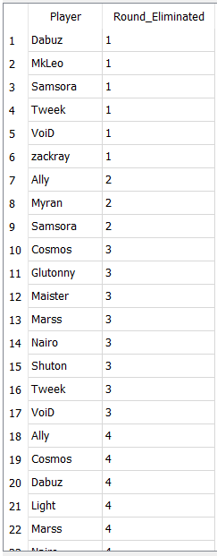
Querying and Data Statistics(8)
Tournaments are structured like trees only horizontal. With this in mind, we gave sets in tournaments different depths. Meaning that as you go from Grand Finals down the depth increases.
This query ranks the players by how early they were eliminated from the tournament. With 1 meaning they made it to Grand Finals.
SELECT plyr1 as Player, MIN(depth) as Round_Eliminated
FROM SetSingles NATURAL JOIN Tournament
GROUP BY Player
UNION
Select plyr2 as Player, MIN(depth) as Round_Eliminated
FROM SetSingles NATURAL JOIN Tournament
GROUP BY Player
ORDER BY Round_Eliminated;
Notes:
Nick

Slide 15
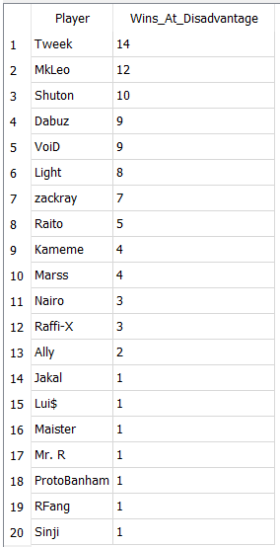
Querying and Data Statistics(9)
In Super Smash Bros, some character are better than others. Therefore, not all fights take the same level of skill.
This query ranks each player by the number of fights that they have won when the character that they are playing has a lower tier than the opponent's character.
This essentially means how many fights has a player won when their character was at a disadvantage.
SELECT Player,SUM(Wins_At_Disadvantage) as Wins_At_Disadvantage
FROM (SELECT plyr1 as Player, COUNT() as Wins_At_Disadvantage
FROM(SELECT char1,char2,fwinner,plyr1,plyr2
FROM FightSingles NATURAL JOIN SetSingles)
WHERE (SELECT tratio
FROM Matchup
WHERE c1name = char1 AND c2name = char2) > 1
AND char1 = fwinner
GROUP BY plyr1
UNION
SELECT plyr2 as Player, COUNT() as Wins_At_Disadvantage
FROM(SELECT char1,char2,fwinner,plyr1,plyr2
FROM FightSingles NATURAL JOIN SetSingles)
WHERE (SELECT tratio
FROM Matchup
WHERE c1name = char2 AND c2name = char1) > 1
AND char2 = fwinner
GROUP BY plyr2)
GROUP BY Player
ORDER BY Wins_At_Disadvantage DESC;
Notes:
Seth

Slide 16
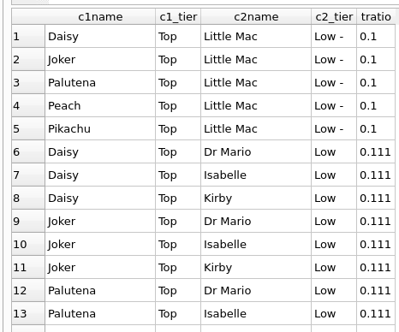
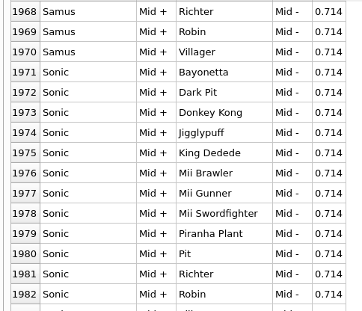
Querying and Data Statistics(10)
Ranks each matchup by how favorable it is to the first player based on their tier rating. Includes the tier names of the characters in the matchup next to each character.
SELECT c1name, adv_tier as c1_tier, c2name, t2.tiername as c2_tier, tratio
FROM (SELECT c1name, c2name, tratio, t1.tiername as adv_tier
FROM Matchup as mu INNER JOIN Character as char on mu.c1name = char.cname NATURAL JOIN Tier as t1) as view1 INNER JOIN Character as char2 on view1.c2name = char2.cname NATURAL JOIN Tier as t2
WHERE tratio < 1
ORDER BY tratio;
Notes:
Nick

Slide 17
Outcomes
Brainstorming and business requirements of building a database.
Deeper and more practical understanding of SQLite.
Knowledge of DBMS tools such as DB Browser for SQLite.
Developed better data preprocessing skills and better knowledge of importing data from CSV files.
Determining and utilizing foreign keys.
How to develop an ER diagram for a database.
How to handle different aspects of of designing a relational data model.
Developing complex queries to answer questions using the data.
Effectively work as a group on a database project.
Notes:
Jay

