Slide 1
Skyline Pivot Editor
Available in Skyline-Daily November, 2017

Slide 2
Scenario: Want to compare average CV of Total Area, and Total Area normalized to global standards.
Using “Rat_plasma.sky.zip” from the Grouped Studies tutorial: https://skyline.gs.washington.edu/tutorials/GroupedStudies1.zip
The data file has a replicate annotation called “BioReplicate” which represents the individual rats that the samples were taken from.
If we group by precursor and BioReplicate, whatever normalization method produces the lower CV is probably more precise and accurate.
In the next slides, we will look at how the CV of the precursor result “Total Area” compares to “TotalAreaRatioToGlobalStandards”.

Slide 3
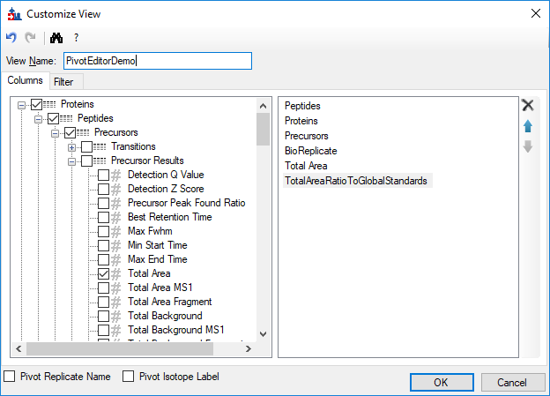
Create a view that has all of the columns that you are going to want to group and summarize

Slide 4
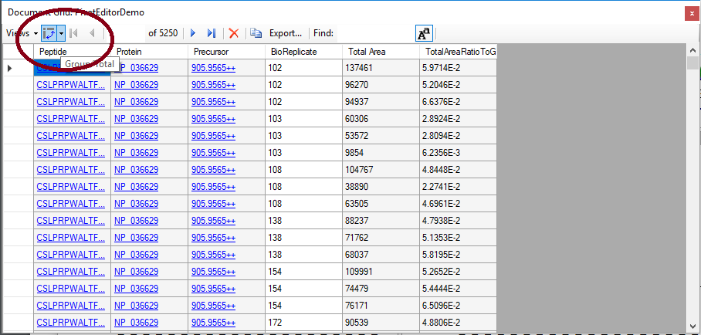
Push the Group/Total button to launch the pivot editor

Slide 5
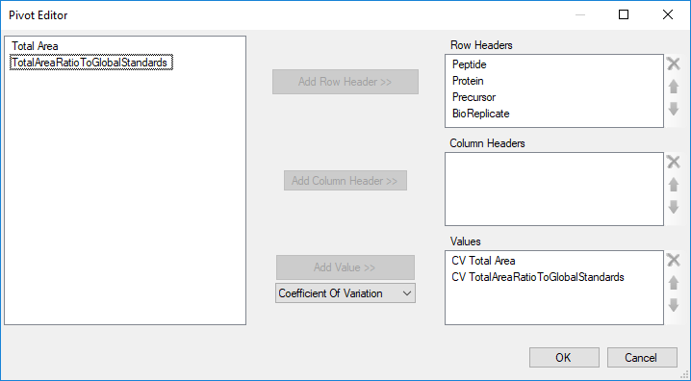
Choose which columns you want to group on, and what aggregate operations you want to apply to the other columns.
For each precursor, we want to calculate the CV within each BioReplicate

Slide 6
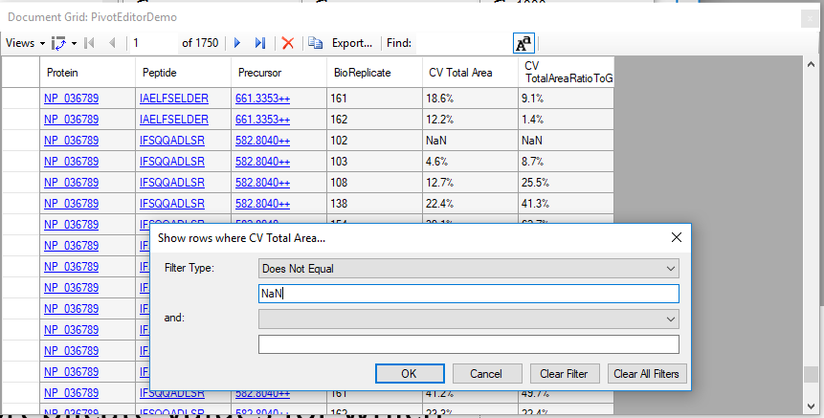
Filter out NaN (not a number)
Some precursors were only detected in one of the replicates for a given subject. The CV of one value is NaN. We need to filter these values out now so that they do not cause problems when we try to take the average later.

Slide 7
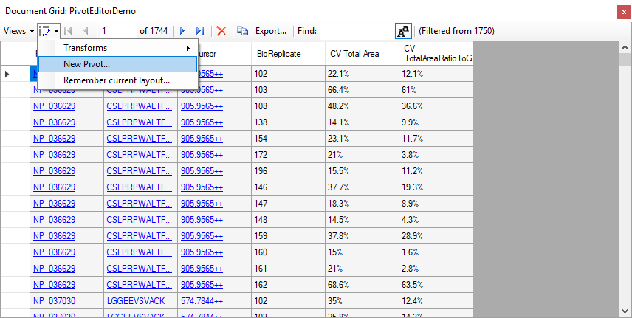
Use the New Pivot button to add another level of grouping/totalling

Slide 8
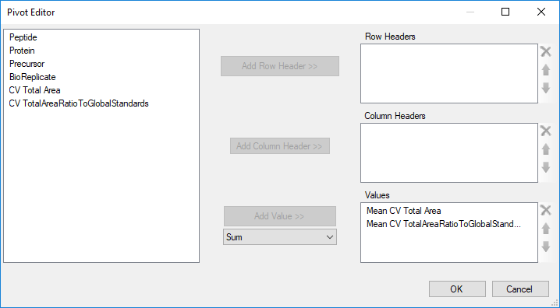
For the next level of pivoting, just get one with the mean of each of the CV columns.

Slide 9
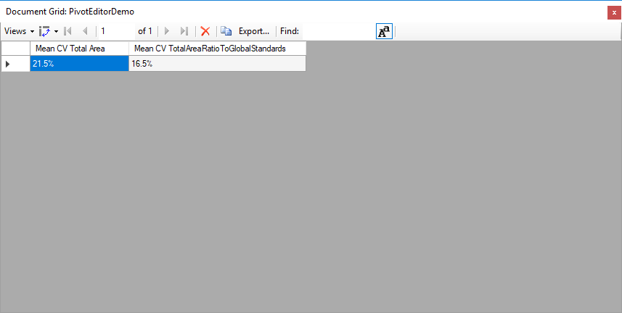
The result is a single row with the mean CVs

Slide 10
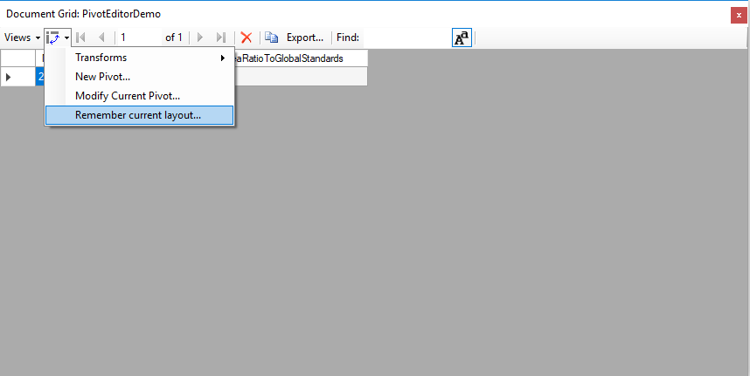
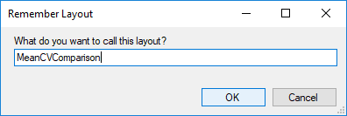
The “Remember Layout” menu item allows us to save the set of transforms that we have applied.
The Layout consists of the set of pivots, filters, sorts, and column width and formats that have been applied.

Slide 11
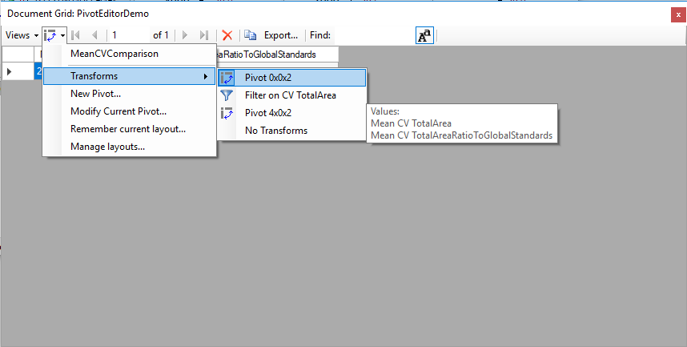
The Transforms sub-menu shows you the set of pivots and filters that have been applied.
Reading from bottom to top, we started with the plain view “PivotEditorDemo”, and then did a pivot with 4 row headers and 2 values, and then applied a filter, and then applied a pivot with 0 row headers and 2 values.
The tooltip shows you a more detailed explanation of what the pivot was.

Slide 12
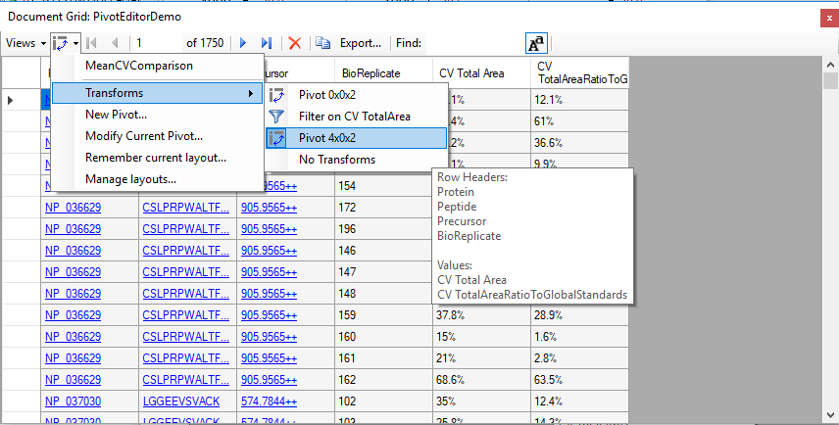
You can use the Transforms sub-menu to go back before some of the transforms were applied.

Slide 13
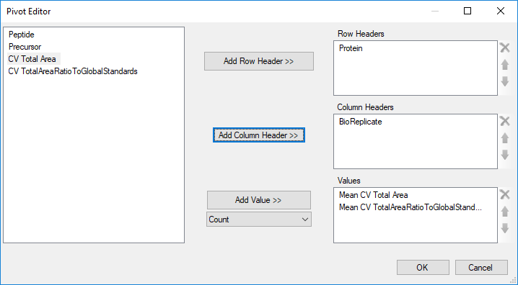
We can then add a new pivot to this earlier step, and demonstrate column headers.
In this case, we want one row per protein, and we want separate columns for each BioReplicate.

Slide 14
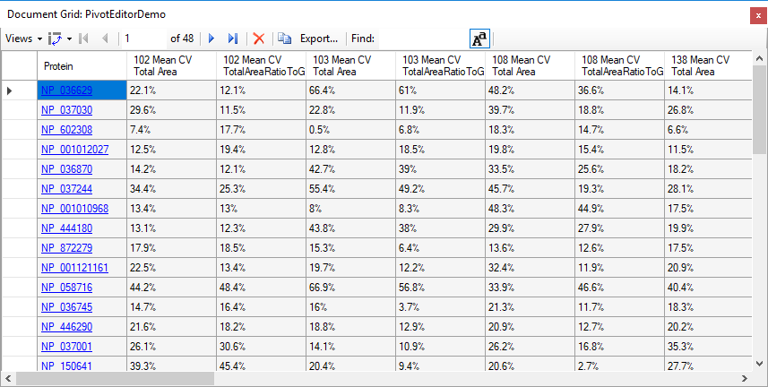
One row per protein, and separate columns for the BioReplicates.

