Slide 1
Buddhism and Christianity
Confluences

Slide 2
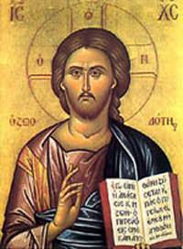
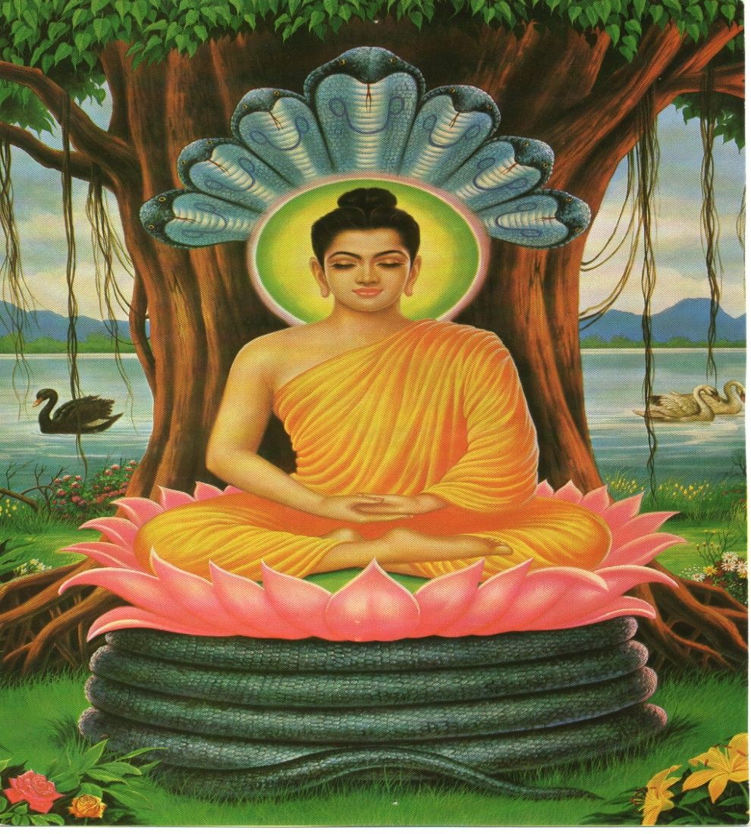
Jesus and Buddha
c. 0-33 A.D.
c. 646 -566 B.C.

Slide 3
Jesus or Buddha?
Do to others as you would have them to do you.
Love your enemies, do good to those who hate you, bless those who curse you, pray for those who abuse you.
Consider others as yourself
Hatreds do not ever cease in this world by hating, but by love; this is an eternal truth. Overcome anger by love, overcome evil by good. Over come the miser by giving, overcome the liar by truth.

Slide 4
Love
This is my commandment, that you love one another as I have loved you. No one has greater love than this, to lay down one’s life for one’s friends.
Just as a mother would protect her only child at the risk of her own life, even so, cultivate a boundless heart towards all beings. Let your thoughts of boundless love pervade the whole world.

Slide 5
Wisdom
Your father in heaven makes his sun rise on the evil and on the good, and sends rain on the righteous and on the unrighteous.
That great cloud rains down on all whether their nature is superior or inferior. The light of the sun and the moon illuminates the whole world, both him who does well and him who does ill, both him who stands high and him who stands low.

Slide 6
Wisdom
_____knew all people and needed no one to testify about anyone; for he himself knew what was in everyone.
He was expert in knowing the thoughts and actions of living beings.

Slide 7
Materialism
Blessed are you who are poor, for yours is the kingdom of God.
If you would be perfect, go sell your possessions, and give the money to the poor, and you will have treasure in heaven.
Let us live most happily, possessing nothing; let us feed on joy like the radiant gods.
The avaricious do not go to heaven, the foolish do not extol charity. The wise one, however, rejoicing in charity, becomes thereby in the beyond.

Slide 8
Inner Life
Those who want to save their life will lose it, and those who lose their life for my sake will save it.
Those who want to save their life will lose it, and those who lose their life for my sake will save it.
Those who want to save their life will lose it, and those who lose their life for my sake will save it.
Everyone who commits sin is a slave to sin.
With the relinquishing of all thought and egotism, the enlightened one is liberated through not clinging.
People compelled by craving crawl like snared rabbits.

Slide 9
Salvation
You will know the truth and the truth will set you free.
Blessed are the pure of heart, for they will see God.
One who acts on truth is happy in this world and beyond.
Anyone who withdraws into meditation on compassion can see Brahma with his own eyes, talk to him face to face and consult with him.

Slide 10
The End
Heaven and earth will pass away.
The good news of the kingdom will be proclaimed throughout the world, as a testimony to all the nations, and then the end will come.
This great earth will be burnt up, will utterly perish and be no more.
I will not experience final nirvana until I have disciples who are knowers of the dharma . . . And teach the dharma of wondrous effect.

Slide 11
Miracles
When he saw that they were straining at the oars against an adverse wind, he came towards them early in the morning, walking on the sea.
He walks upon the water without parting it, as if on solid ground.

Slide 12
Extra Ecclesiam nulla salus est
Outside the Church there is no salvation.
Scriptural basis?
Must one have explicit faith in Jesus?
Must one be baptized in order to be saved?
Will everyone else go to hell?

Slide 13
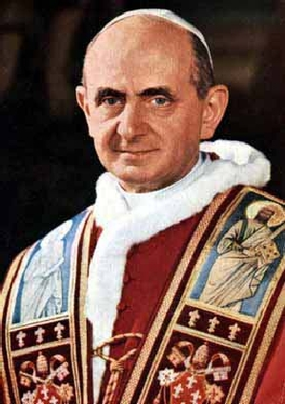
Nostra Aetate
Declaration on the Relation of the Church to Non-Christian religions
Pope Paul VI
October 28, 1965

Slide 14
Nostra Aetate
In our time, when day by day mankind is being drawn closer together, and the ties between different peoples are becoming stronger, the Church examines more closely the relationship to non-Christian religions. In her task of promoting unity and love among men, indeed among nations, she considers above all in this declaration what men have in common and what draws them to fellowship.

Slide 15
Nostra Aetate
What do all people have in common?
One is the community of all peoples, one their origin, for God made the whole human race to live over the face of the earth. One also is their final goal, God. His providence, His manifestations of goodness, His saving design extend to all men, until that time when the elect will be united in the Holy City, the city ablaze with the glory of God. Where the nations will walk in His light.

Slide 16
How do the religions respond to the unsolved riddles of human the condition?
What is man?
What is the meaning , the aim of life?
What is moral good, what is sin?
Whence suffering and what purpose does it serve?
Which is the road to true happiness?
What are death, judgment and retribution?
Where do we come from and where are we going?

Slide 17
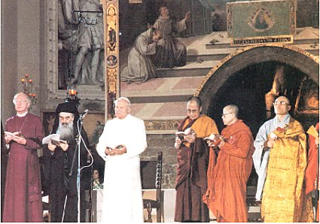
Miracle at Assisi

Slide 18
Nostra Aetate
Again, Buddhism, in its various forms, realizes the radical insufficiency of this changeable world; it teaches a way by which men, in a devout and confident spirit, may be able to acquire the state of perfect liberation, or attain, by their own efforts or through higher help, supreme illumination.

Slide 19
Nostra Aetate
The Catholic Church rejects nothing that is true and holy in these religions. She regards with sincere reverence those ways of conduct and life, those precepts and teachings which, though differing in many aspects from the ones she holds and sets forth, nonetheless often reflect a ray of that Truth which enlightens all men. Indeed she proclaims, and ever must proclaim Christ “the way, the truth and the life “(John 14:6) in whom men may find the fullness of religious life, in whom God has reconciled all things to Himself (2 Cor. 5:18-19).

Slide 20
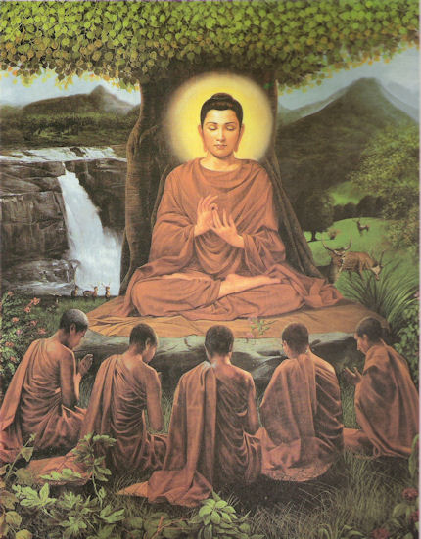
The Life of the Buddha
A prince, pampered and protected
Escape from the palace
An old man
A sick man
A dead man
An ascetic

Slide 21

Enlightenment or Awakening
The Four Noble Truths
  All life is suffering
  The cause of suffering is desire
  Suffering can end
  The way to end suffering: The Eightfold path

Slide 22
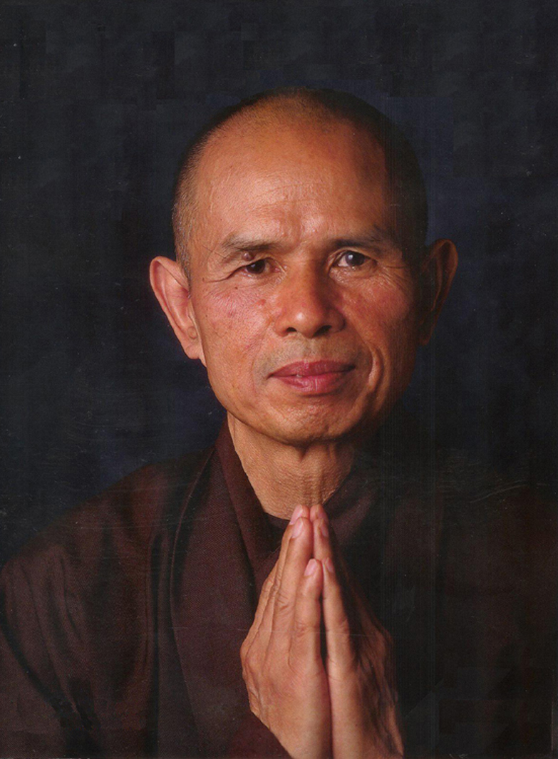
The Eightfold Path
Right understanding
Right thought
Right speech
Right action
Right livelihood
Right effort
Right mindfulness
Right concentration

Slide 23
If Buddhism is so good, why be a Christian?

