Slide 1


Residential Property Prices in Australia
Analysing and Visualising Factors and Trends

Slide 2


Project Inspiration
In which Australian capital cities is property most expensive? In which is it the least?
What factors influence property prices – and how much impact do they have?

Slide 3
Project Outline
Collect, analyse and visualize data on residential property prices in Australia
Identify trends and factors that influence prices
Interest rates
Migration
Household income
Unemployment
Make visualisations digestible and interactive

Slide 4
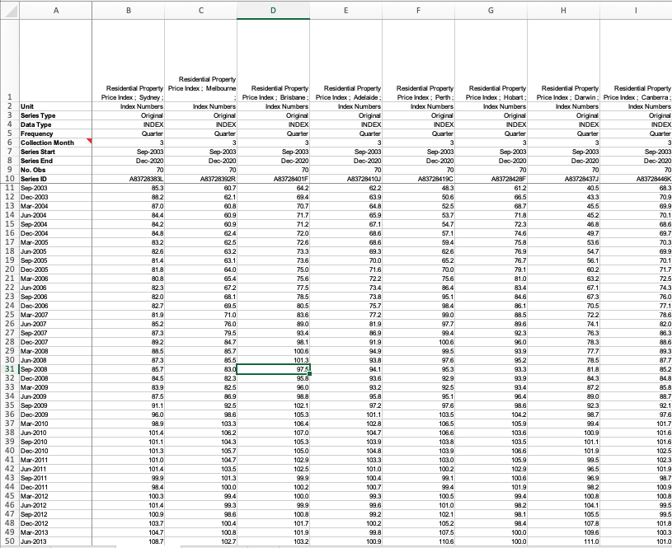
Step 1: ETL & Data Exploration
Data sources:
Property Price Index – ABS
Interest Rates – RBA/Quandl
Migration Data – ABS
Unemployment Data – ABS
Household Income Data – ABS
Extensive data for all variables but all in different formats

Slide 5

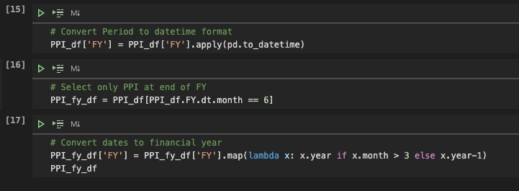
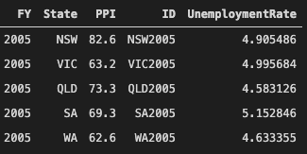
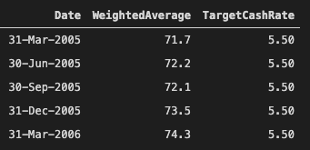
Step 1: ETL & Data Exploration
Datasets had to be reformatted to ensure all had same dates and number of records
Created primary key by combining financial year and state columns into a new ‘ID’ column, allowing DataFrames to be merged
Ultimately created csv files in the format that would make visualising the data easiest

Slide 6

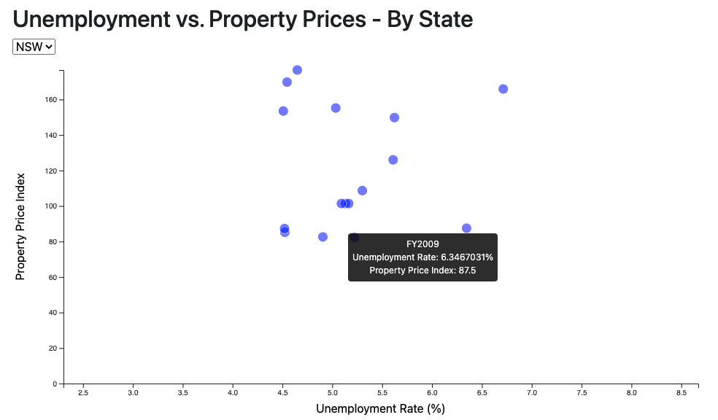
Step 2: Visualising the Data
Tools used:
Plot.ly
d3
MapBox API
Three visualisations:
Interactive scatter plot comparing a state’s residential property price index to its unemployment rate
Line chart with dual y-axes (PPI and the RBA’s Target Cash Rate)
Interactive map of Australia with markers on capital cities proportionate to their PPI at the end of the 2020 financial year

Slide 7


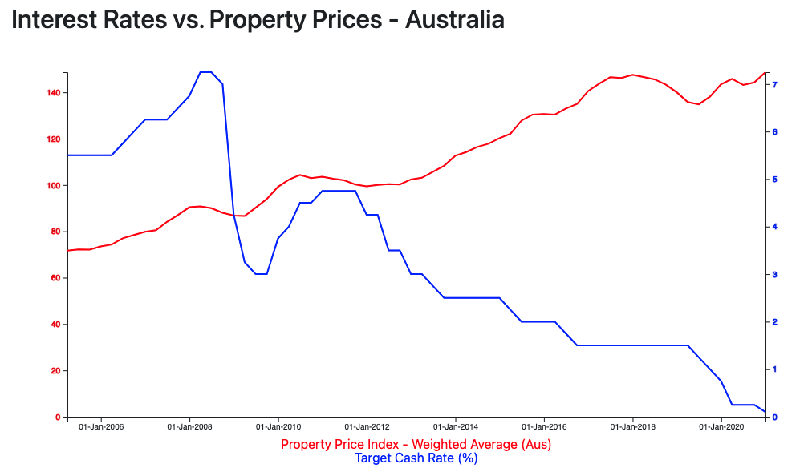
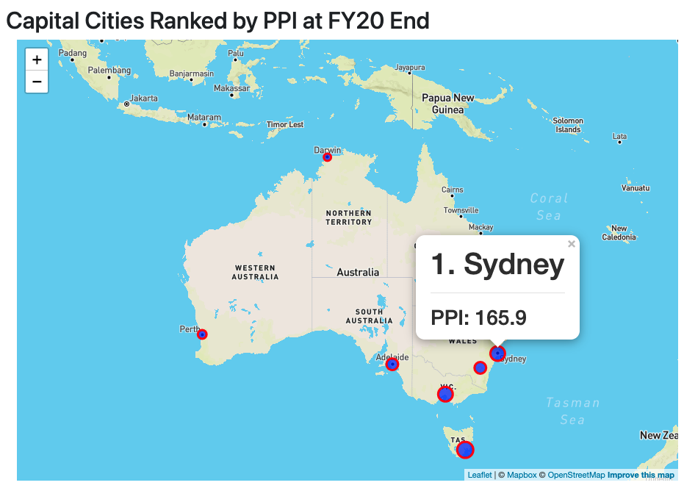
Step 2: Visualising the Data

Slide 8
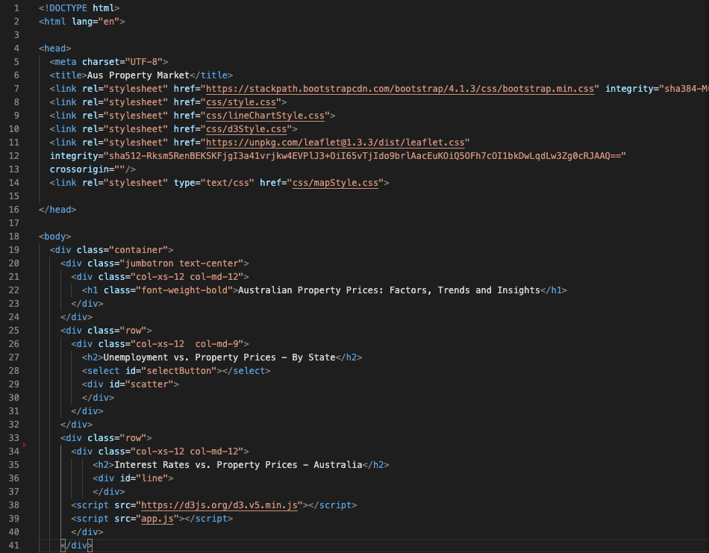
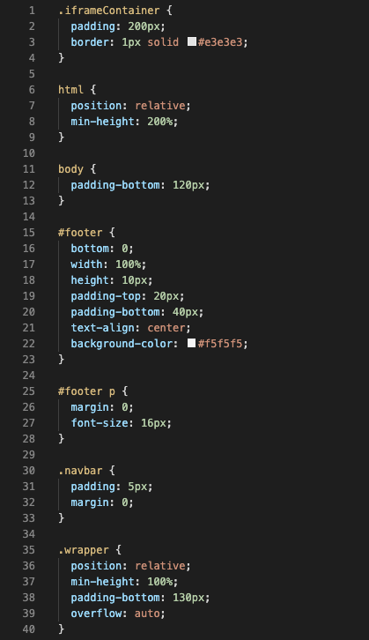
Step 3: Create HTML and CSS to Hold Visualisations
Used HTML to hold the three visualisations
Used CSS to edit the look of the visualisations
Published to GitHub pages
Ultimately did not leave enough time for this step

Slide 9



Insights from the Visualisations
The level of unemployment in a state does not appear to have much influence on property prices
There seems to be a relatively strong negative correlation between interest rates and property prices
Capital cities, ranked by PPI at end of FY20:
Sydney
Hobart
Melbourne
Canberra
Brisbane
Adelaide
Perth
Darwin

Slide 10
Conclusion
If I had more time:
Assess more potential factors (e.g. household income, migration)
Spend much more time on web design
Look at different ways to visualize data

