Slide 1
EXTRACTING ECHO DATA

Slide 2
The problem
['IMAGE QUALITY: Technically challenging exam; poor patient compliance. Poor/average image quality. Large respiratory swing. ECHO MACHINE: GE E95 ECG: ?underlying rhythm OPERATOR: Marie Meader No clinical question specified therefore standard echo performed. LEFT VENTRICLE: No left ventricular hypertrophy. No left ventricular cavity dilatation. The basal to mid inferior septum, inferior wall and inferior lateral wall. Anterior and anterior lateral wall poorly seen. Unable to complete exclude other RWMA. Global reduction to longitudinal function. Mild left ventricular systolic impairment. Unable assess diastolic function. LV MEASUREMENTS: IVSd 1.2cm, LVIDd 4.4cm, PWd 1.1cm TDI S waves: Septal 0.05m/s, Lateral 0.05m/s MITRAL VALVE: Leaflets are mobile. No mitral stenosis. Mild mitral regurgitation. LEFT ATRIUM: Dilated left atrial size. Volume 65mls, area 21.0cm2 AORTIC VALVE: Unable to determine aortic valve morphology. Cusps are mobile. No aortic stenosis. V max 1.4 m/s. No aortic regurgitation. AORTA: Aortic root dimensions; normal Sinuses 3.4cm, ST junction 2.8cm, No suprasternal views. RIGHT HEART: RA, 15.8cm2. Normal size RV, RVD1: 3.3cm. Normal size Normal long axis function. TAPSE 1.7cm Normal size IVC, cm with greater than 50% inspiratory collapse. IVC not seen, no subcostal views. TRICUSPID VALVE: No tricuspid stenosis. Mild tricuspid regurgitation, unable to measure. PULMONARY VALVE: No pulmonary stenosis. Trivial pulmonary regurgitation. Vmax 0.74 m/s PERICARDIUM: No obvious effusion noted SUMMARY: Technically challenging exam. Mild left ventricular systolic impairment. Unable assess diastolic function. No left ventricular hypertrophy. No left ventricular cavity dilatation. Dilated left atrium. Mild mitral regurgitation. Mild tricuspid regurgitation Normal RV size with normal long axis function.’]
LV MEASUREMENTS: IVSd 1.2cm, LVIDd 4.4cm, PWd 1.1cm TDI S waves: Septal 0.05m/s, Lateral 0.05m/s

Slide 3
Solutions
NS Solution:
Python
User interface
Slower
Less customisable
TD Solution:
Java
Database facing
Fast
Customisable
Ideal solution:
Java
Optional: GUI or Database facing
Fast
Customisable

Slide 4
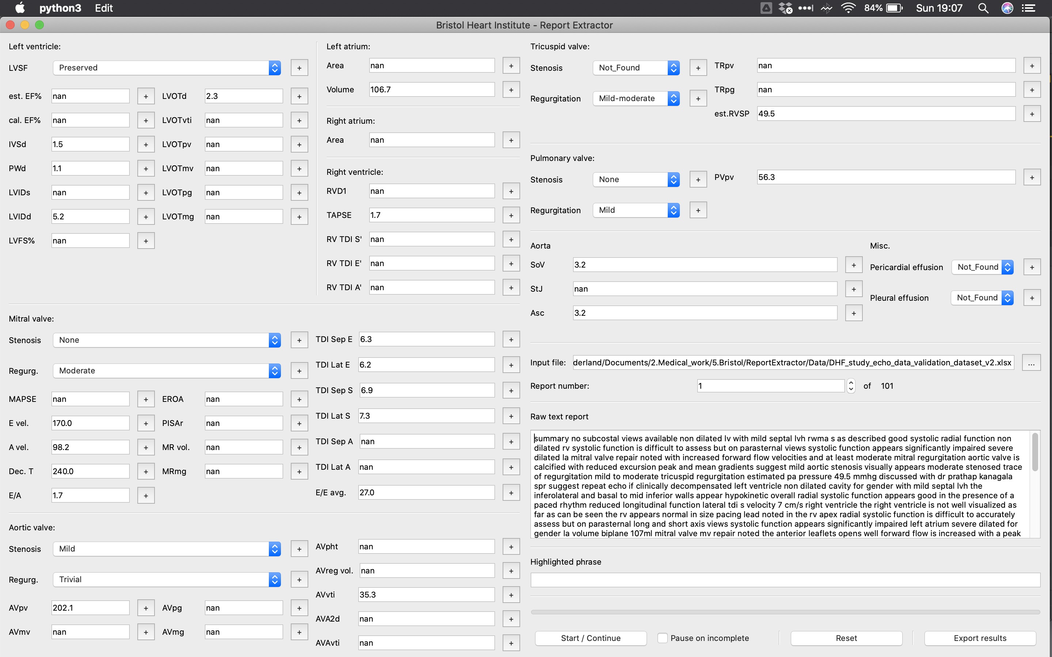
PYTHON GUI

Slide 5
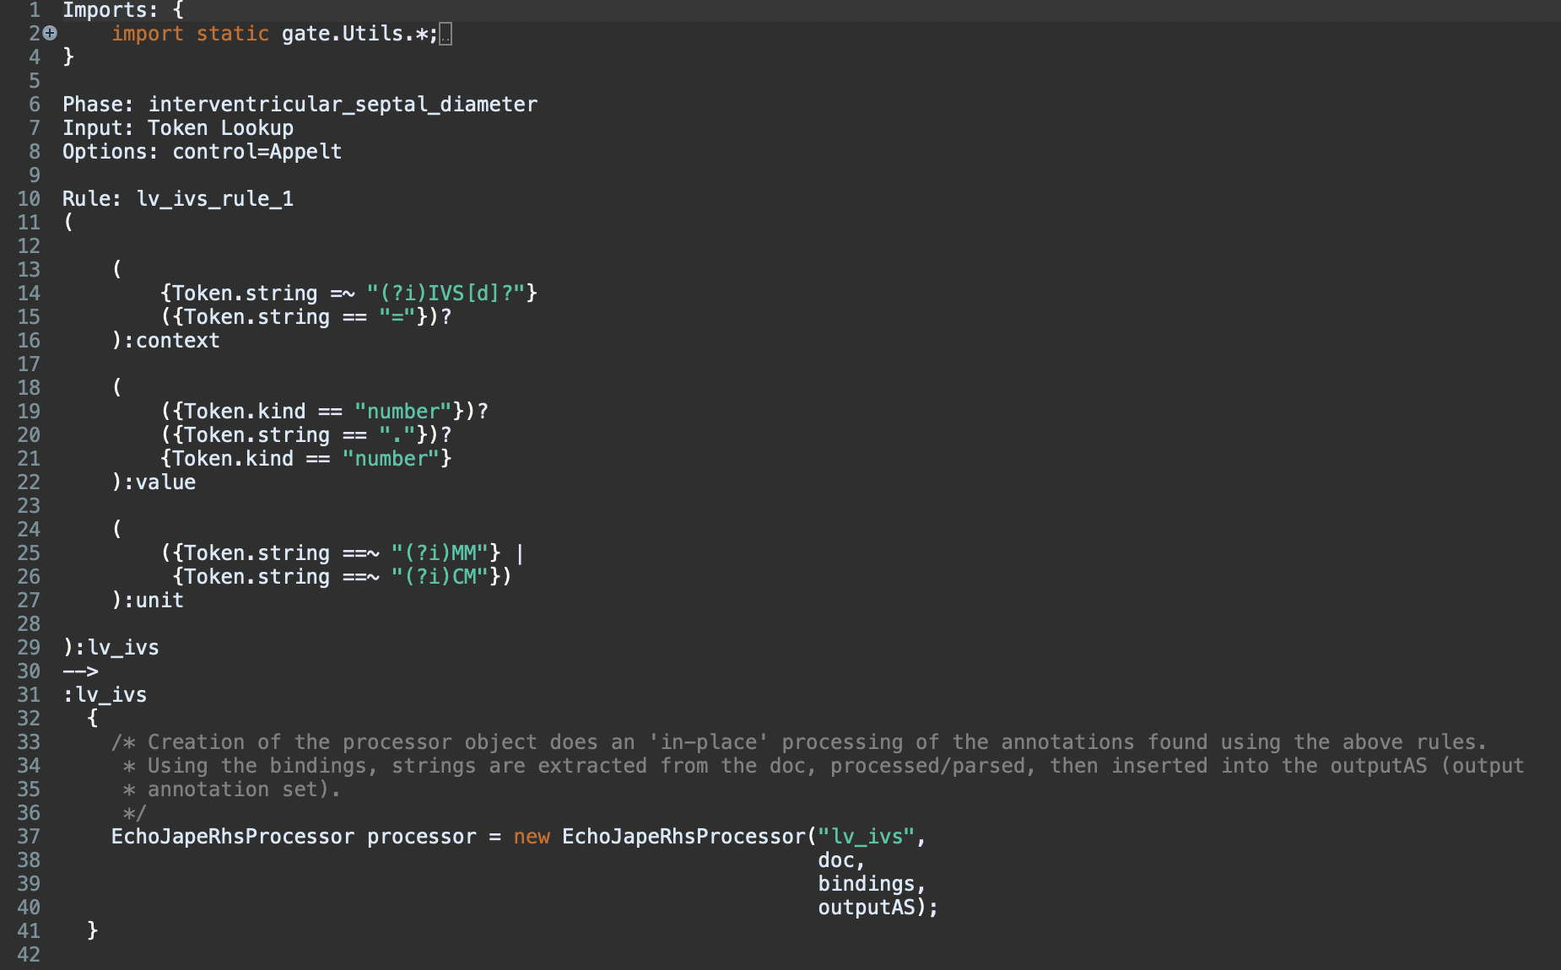
JAVA PROGRAMME GATE transducer

Slide 6
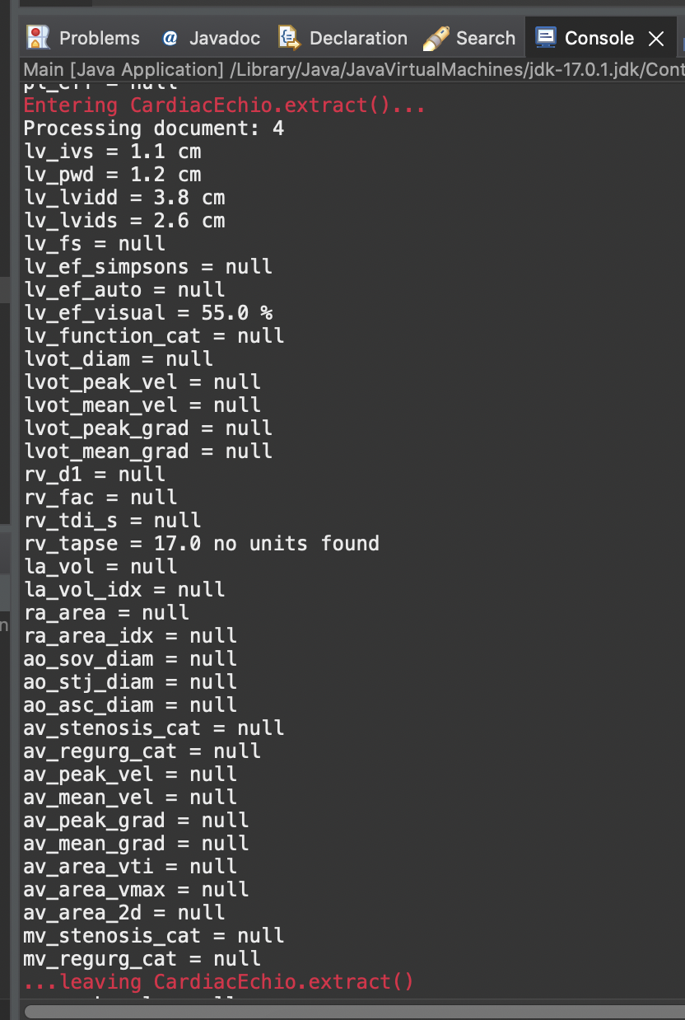
IMAGE QUALITY: Sub optimal apical imaging
ECHO MACHINE: GE Vivid 7 ECG: Sinus rhythm (average rate 75bpm)
Echocardiographer
LEFT VENTRICLE: Normal LV cavity size with normal wall thickness Preserved post op systolic function, hypokinesis of the septum, other walls appear to contract well No significant diastolic dysfunction
LV MEASUREMENTS:
IVSd 1.1cm
PWd 1.2cm
LVIDd 3.8cm
LVIDs 2.6cm
LVEF estimated visually at 55%
RIGHT SIDED STRUCTURES: Normal RV size with reduced radial and long axis function consistent with previous cardiac surgery TAPSE 17,
SUMMARY: Normal LV cavity size with preserved post op systolic function, septum is hypokinetic, LVEF estimated at 55% No significant diastolic dysfunction Normal RV size with reduced systolic function consistent with recent cardiac surgery Atria are of normal size No significant valvular abnormalities noted No significant pericardial effusion

Slide 7
END

