Slide 1
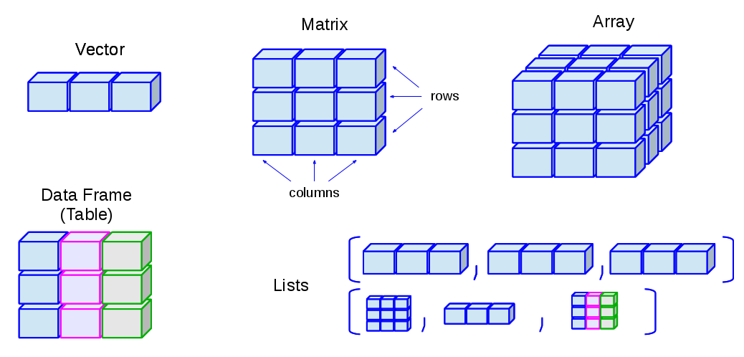
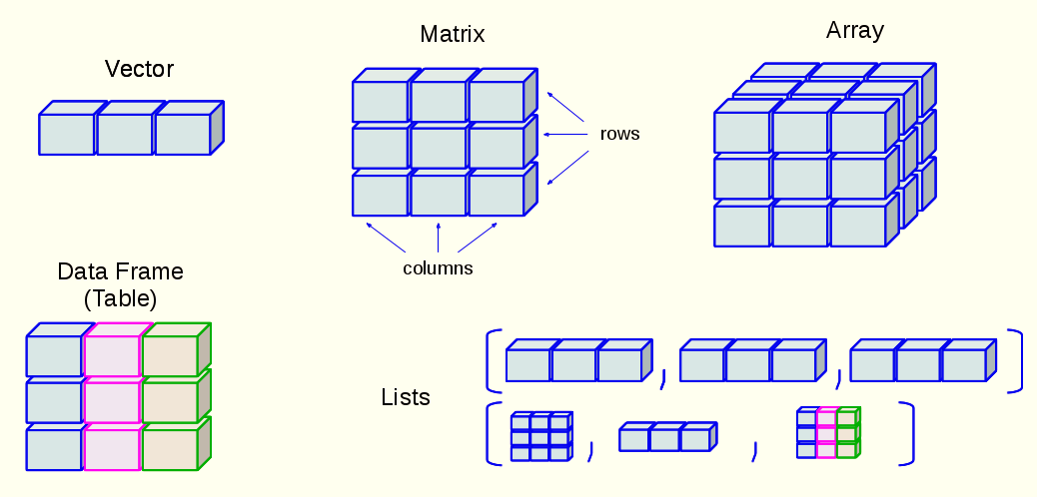
genepi.utils::MR
eaf_{exp}
beta_{exp}
se_{exp}
p_{exp}
n_{exp}
ncase_{exp}
id_{exp}
rsid
chr
bp
ea
oa
clump
eaf_{out}
beta_{out}
se_{out}
p_{out}
n_{out}
ncase_{out}
id_{out}
numeric
integer
character
logical
correlation

Slide 2


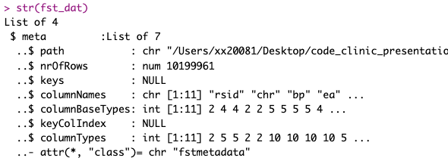
genepi.utils::chrpos_to_rsid
future::plan(future::multisession, workers = cores)
furrr::future_map( Chr1 : Chr23 , …
fst_dat <- fst(“Chr1.fst”)
Chr1.fst
rsid
chr
bp
ea
oa
Chr2.fst
pos <- fst[“bp”]
…
idxs <- which(pos %in% gwas$bp)
~1 billion variants total
rsids <- fst_dat[idxs, ]
… join to data
Chr23.fst

