Slide 1


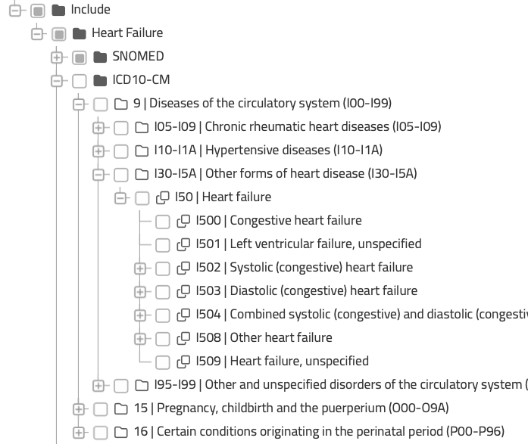
EHR
dictionaries
Base concept definitions
Concept name … e.g. heart failure
Concept description …
EHR terminologies …
Regular expression search terms …
Code review & consensus
Expert review of the EHR code trees
Review of previously published codes
Iterative refinement of search terms
Consensus meetings
Exploration of codes and validation in representative datasets
Final consensus agreement
CONCEPT VALUE-SET
ICD10
Regex
search
ICD9
Derived phenotype consensus
Consensus meeting discussion
Refinement of base concepts if required
OPCS
CPT4
Non-ischaemic heart failure
Heart failure
AND
ICD11
NOT
MI
NOT
CABG/PCI
SNOMED
Finalised phenotype

