Slide 1
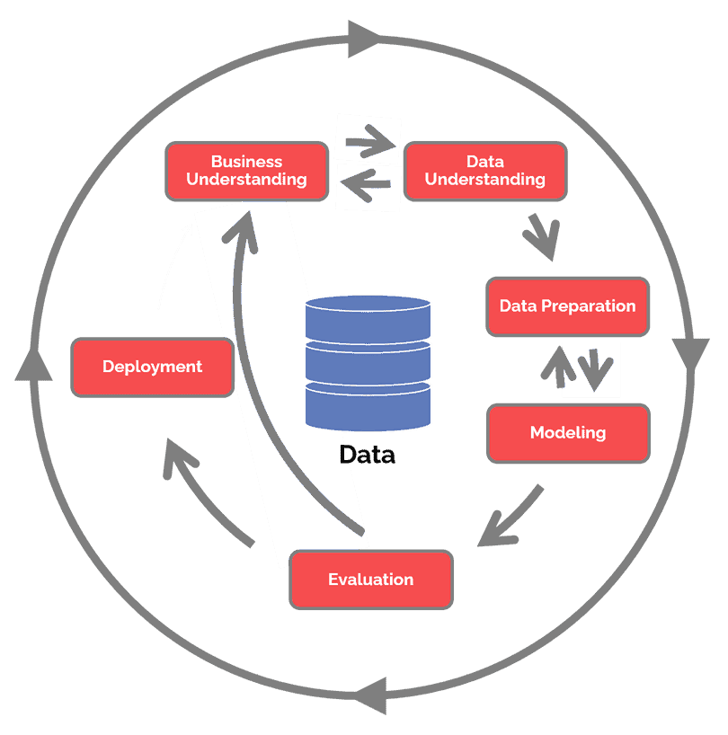
Swiss Re Interview Case Study
Nick Park
https://www.datascience-pm.com/crisp-dm-2/

Slide 2
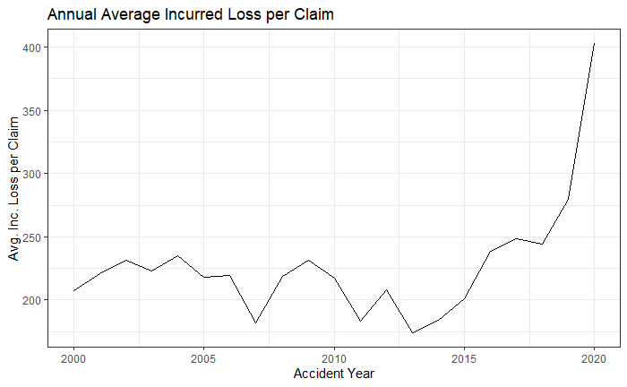
Average incurred loss per claim increased by +131% from 2013 to 2020, with statistically significant increases in 2016, 2019 and 2020.

Slide 3
Agenda
Assumptions
Analysis
Conclusion
Next Steps

Slide 4
Assumptions
Incurred Loss = Claim Paid + Loss Reserve
Rolled up to claim id level & Absolute value (mix of +/-)
Empty Claim Paid/Loss Reserves
Treated as 0 (exclusion, before loss assessment)
Incurred Loss per Claim
Zero loss claims are excluded

Slide 5
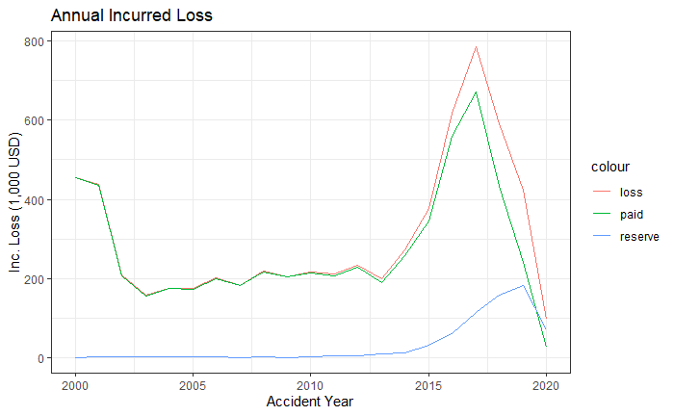
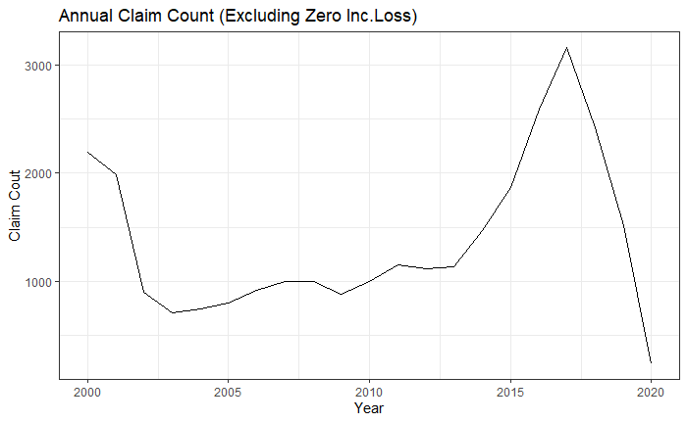
Analysis – Loss & claim count
2013 ~ 2020

Slide 6
Analysis – Loss per claim
Increased by +131% from 2013 to 2020
Statistically significant increases in ‘16, ’19 and ‘20

Slide 7
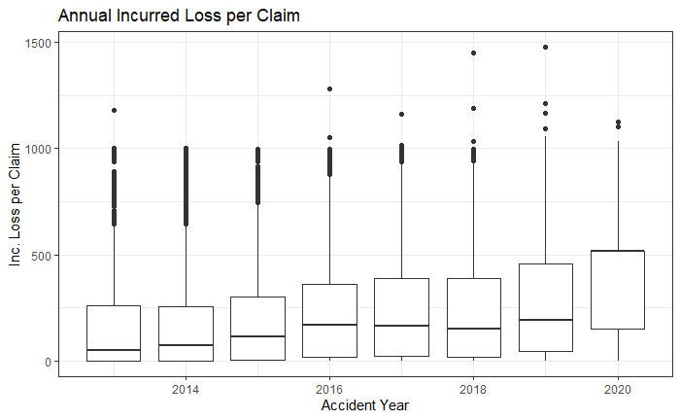
Analysis – Loss per claim (box plot)
More severe large losses
Increased volatility
in attritional losses

Slide 8
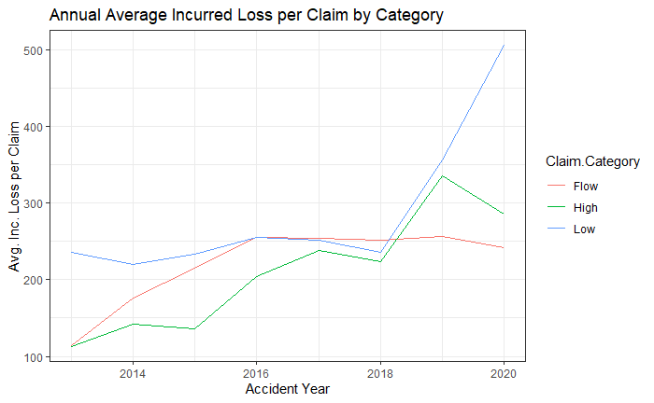
Analysis – Loss per claim (by category)
↑ 2016 ‘Flow’ Category
↑ 2016 & 2019 ‘High’ Category
↑ 2019 & 2020 ‘Low’ Category

Slide 9
Conclusion
[ Findings ]
↑ Large loss severity
↑ Att. loss volatility
Low & High categories drive recent loss per claim ↑
[ Caveat ]
Reserve effect (AY 2019 - 2020)
Only 4 months in 2020
Lack of information on
Claim frequency
Premium trend
Portfolio/UW strategy change
Catastrophic events
➔ Consult with internal clients (UW, actuarial) to better understand the business problem and the data

Slide 10
Next Steps
Consult with internal clients to understand:
How this trend is being addressed
Pain points / demand for analytical solution
Available data/resources
CRISP-DM
Develop analytical solution
Feature engineer for existing model
Develop new model
Develop/upgrade dashboard
Evaluate and monitor
Evaluate on validation data for honest assessment
Understand strength/weakness
Determine key metrics and monitor
Collect new data to improve features
Monitor data quality
Notes:
Cross-Industry Standard Process for Data Mining

Slide 11
Thank You

Slide 12
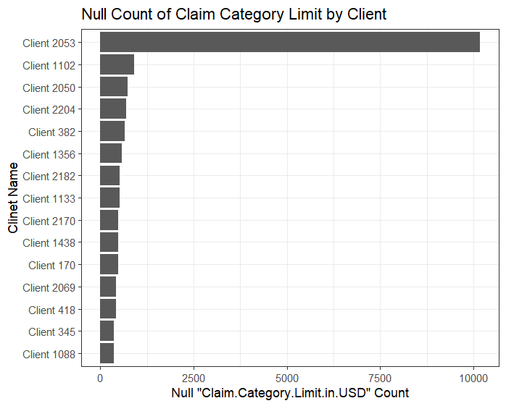
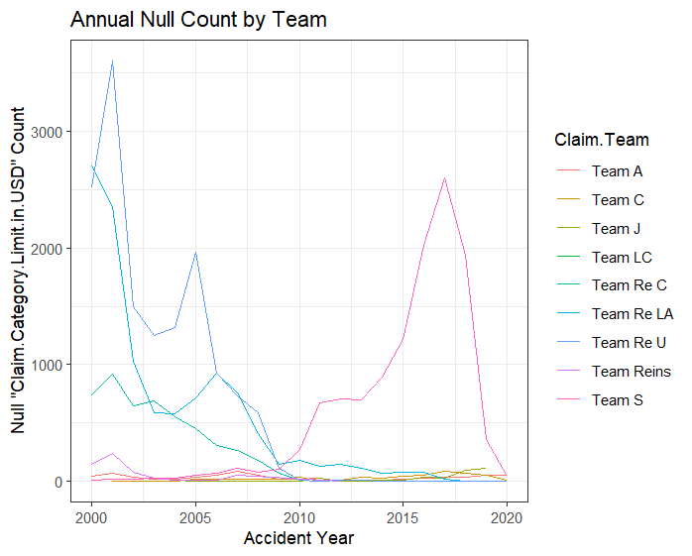
Data Concerns – Null Values
Client 2053, Team S

Slide 13
Next Steps
 | Consult | Strategize | Model | Monitor
Data & Analytics | New features (risk score using ML) New model (clustering, ML pricing) New tool (dashboard) | Improve data quality & data pipeline New data to collect for new feature/model/tool | Develop new feature/model/tool | Monitor data quality & pipeline Monitor model/tool performance
Underwriting & Actuarial | Opinion on analysis Opinion on new feature/model/tool Market cycle & trend | Renewal & new account Calibrate model based on UW strategy | Support business plan & KPI development Finalize model | Collect data for future model/feature/tools
Risk Management |  | Risk appetite & tolerance Capital allocation | Have business plans, KPI, models and strategy approved | Monitor KPI

