Slide 1
US Housing Price Analysis
IAA interview challenge – business deliverables
Nick Park

Slide 2
Driving Factors of Housing Price
Positive | Negative
Household Income Gross Rent by Bedrooms | Recently moved residents with less than Bachelor’s degree

Slide 3
Market Recommendations
Invest | Stay Clear
Expected to see rise in Household Income Gross Rent by Bedrooms | Trend of increasing residents with less than Bachelor’s degree

Slide 4
Market Cluster
1. Average population + higher income + higher education
2. Large population + average income + lower education
3. Low population + low income

Slide 5
Next Steps
More Data
Forecast of census data for ARIMAX
Economic data (interest rate, CPI)
Information of non-residential buildings (# of coffee shops)
Clearer Interpretation of the census data
‘Sex by Age’ features had the highest importance
Explore Delayed Effect
Some features may have delayed effect on the housing price

Slide 6
Backup Slides
Outlier Detection
Clustering
Feature Engineering
Nick Park

Slide 7
Significant Outliers
Top 5 zip codes based on Cook’s Distance
98571 (2021) - Grays Harbor County, Washington (Pacific Beach)
94129 (2021) - San Francisco, California (Presidio of San Francisco)
02199 (2013) - Boston, Massachusetts (Prudential Center)
02199 (2018)
02199 (2014)

Slide 8
 |  | Cluster 1 | Cluster 2 | Cluster 3
Characteristic |  | Average population + higher income + higher education | Large population + average income + lower education | Low population + low income
Avg. Population |  | 13,852 (Compared to Cluster 1) | 19,086 (+38%) | 5,277 (-72%)
Avg. Median Income |  | 77,138 | 68,965 (-11%) | 55,110 (-29%)
Geographical Mobility | Less than High School | 844 | 1,705 (+102%) | 558
Avg. Geo Mobility – High School | High School | 2,428 | 3,335 (+37%) | 1,302
Avg. Geo Mobility – Some Degree | Some Degree | 2,641 | 3,853 (+46%) | 1,065
 | Bachelor | 2,147 | 2,589 (+21%) | 434
 | Graduate | 1,456 | 1,522 (+5%) | 245

Slide 9
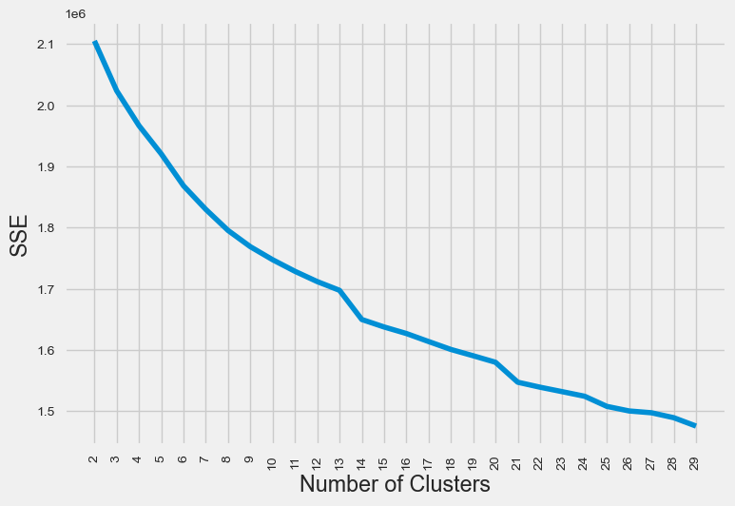
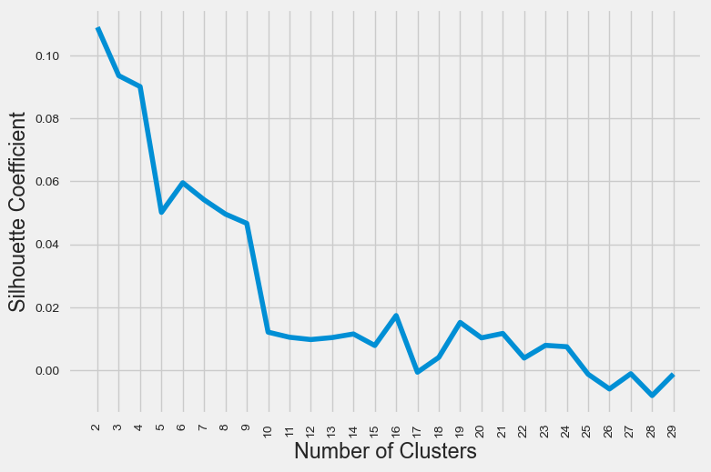
Clustering
Sum of Squared Error (SSE)
Silhouette Coefficient

Slide 10
Clustering
Used data from 02/2015 ~01/2023
Too many missing values prior to 02/2015 (more than 17%)
Monthly percent change in price was used
Log(x+1) and standardization were applied
Used K-means
Computationally inexpensive compared to hierarchical clustering

Slide 11
Feature Engineering
Imputed missing/negative values with each year’s median value for:
Median Age by Sex (All/Male/Female)
Median Household Income
Median Gross Rent by Bedrooms
All null values from 2011- 2014
Linear interpolation from later years
Log(X+1) transformation prior to standardization
Improved MAE by $30,769 (95,487 → 64,718)

Slide 12
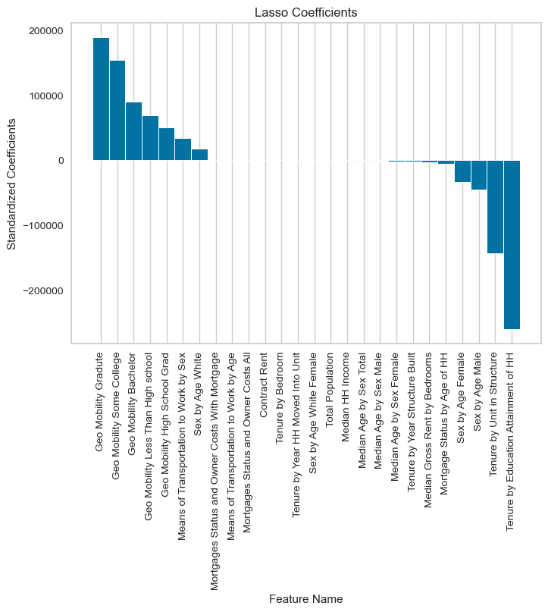
Before Feature Engineering
MAE = 95,487

Slide 13
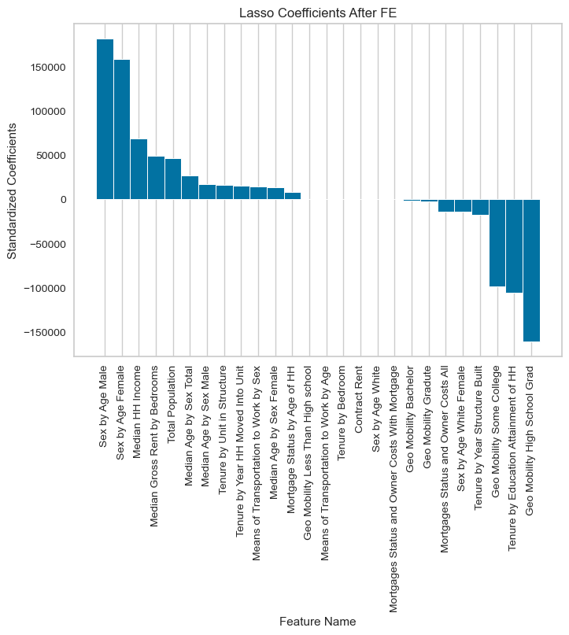
After Feature Engineering
MAE = 64,718
30,769 less than the first model

Slide 14
Others
Used January of each year from 2011 to 2021 for modeling
Census data was available only from 2011 to 2021
For missing values, performed linear interpolation
Used LASSO regression model
Feature selection to identify the driving/ factors

