Slide 1
Feature Engineering
Imputed missing/negative values with each year’s median value for:
Median Age by Sex (All/Male/Female)
Median Household Income
Median Gross Rent by Bedrooms
All null values from 2011- 2014
Linear interpolation from later years
Log(X+1) transformation prior to standardization
Improved MAE by $30,769 (95,487 → 64,718)

Slide 2
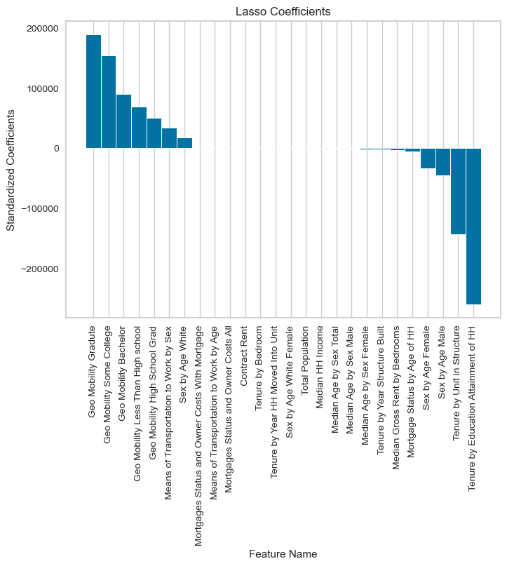
Before Feature Engineering
MAE = 95,487

Slide 3
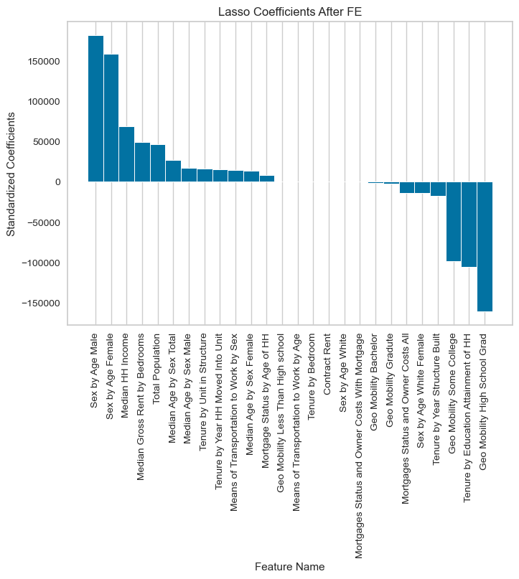
After Feature Engineering
MAE = 64,718
30,769 less than the first model

Slide 4
Significant Outliers
Top 5 zip codes based on Cook’s Distance
98571 (2021) - Grays Harbor County, Washington (Pacific Beach)
94129 (2021) - San Francisco, California (Presidio of San Francisco)
02199 (2013) - Boston, Massachusetts (Prudential Center)
02199 (2018)
02199 (2014)

Slide 5
Clustering
Used data from 02/2015 ~01/2023
Too many missing values prior to 02/2015 (more than 17%)
Monthly percent change in price was used
Log(x+1) and standardization were applied
Used K-means
Computationally inexpensive compared to hierarchical clustering

Slide 6
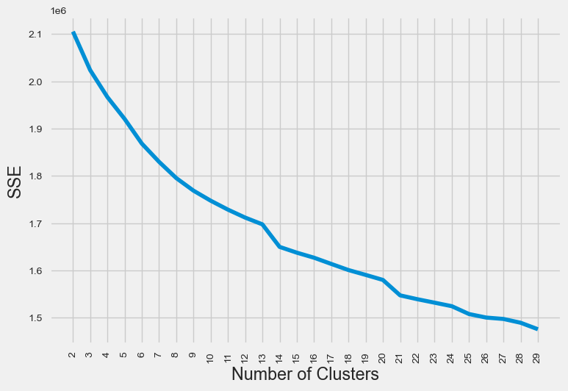
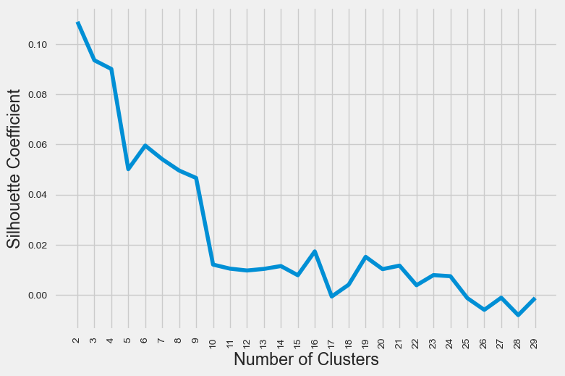
Clustering
Sum of Squared Error (SSE)
Silhouette Coefficient

Slide 7
 |  | Cluster 1 | Cluster 2 | Cluster 3
Characteristic |  | Average population + higher income + higher education | Large population + average income + lower education | Low population + low income
Avg. Population |  | 13,852 (Compared to Cluster 1) | 19,086 (+38%) | 5,277 (-72%)
Avg. Median Income |  | 77,138 | 68,965 (-11%) | 55,110 (-29%)
Geographical Mobility | Less than High School | 844 | 1,705 (+102%) | 558
Avg. Geo Mobility – High School | High School | 2,428 | 3,335 (+37%) | 1,302
Avg. Geo Mobility – Some Degree | Some Degree | 2,641 | 3,853 (+46%) | 1,065
 | Bachelor | 2,147 | 2,589 (+21%) | 434
 | Graduate | 1,456 | 1,522 (+5%) | 245

Slide 8
Others
Used January of each year from 2011 to 2021 for modeling
Census data was available only from 2011 to 2021
For missing values, performed linear interpolation
Used LASSO regression model
Feature selection to identify the driving/ factors

