Slide 1
BCS350 Web Database Development
Week #5
phpMyAdmin and MySQL, continued

Slide 2
Homework – Week 04
Write a PHP script that has a dropdown of all the phonebook entries
When a name is selected it opens the update program, bcs350_week04_12.php, with the person’s data

Slide 3
TODAY IS ALL LAB DAY !!!
Start WAMPServer
Start NotePad++

Slide 4
Using phpMyAdmin to Create a Database and Table
Start phpMyAdmin from WAMPServer
If needed, create a Database called: bcs350
Download classes.sql from Blackboard, Lectures, Week06
Import classes.sql into the bcs350 database to create the classes table
Browse the classes table to make sure it is correct

Slide 5
phpMyAdmin

Slide 6
Farmingdale State College Classes
Create an Excel spreadsheet called classes.csv (MS-DOS CSV format) with this data from at least 10 classes from the FSC Fall 2022 Class Schedule:
Rowid integer, start with 1 and add 1 for each row
Department 3 letter abbreviation, ie. BCS
Class number 3 digit code, ie. 350
Title ie. Web Database Development
Credits ie. 3
Days ie. T
Times ie. 5:55pm
Building ie. Whitman
Room ie. 209
Prof ie. Charles Kaplan

Slide 7
The classes Table
Use PHPMyAdmin to create the “classes” table:
rowid integer, unsigned, primary key, AI
dept char(5)
nbr char(5)
title varchar(50)
credits tinyint
days char(5)
times char(8)
building char(20)
room char(5)
prof varchar(25)

Slide 8
IMPORT the classes Table
Open the “bcs350” database on PHPMyAdmin
Go to the IMPORT tab
Browse for the classes.csv file on your PC
Format should default to CSV
Click on “GO”
Browse the table by going to the BROWSE tab

Slide 9
Code “classes.php”
Starting from scratch, or you can use phonebook.php from last week, code “classes.php” that will:
Connect to MySQL, check for errors
Create a query to return all columns and rows from the classes table
Execute the query, check for errors
Print (echo) out the results of the query

Slide 10
Accessing MySQL from PHP – 4 Steps
Connect (Login) to MySQL
Create a Query
Execute the Query
Process Query Results

Slide 11
Connect to MySQL
$host = ‘localhost’;
$userid = ‘root’;
$password = NULL;
$database = ‘bcs350’;
$mysqli = mysqli_connect($host, $userid, $password, $database);
if (!$mysqli) echo “MySQL Connect Error: “ . mysqli_connect_error();
$mysqli is the database handler or connection

Slide 12
Create a Query
SELECT columns
FROM table
ORDER BY columns
$query = “SELECT rowid, dept, nbr, … , prof
FROM classes
ORDER BY dept, nbr”;

Slide 13
Execute the Query
$result = mysqli_query($mysqli, $query);
If (!$result)
echo “Query Failed [$query]: “ . mysqli_error($mysqli);
$result is the QUERY RESULT SET
A multidimensional array

Slide 14
Process Query Results
while(list($rowed, $dept, $nbr, … , $prof) =
mysqli_fetch_row($result)) {
Do something with the query results
}

Slide 15
BREAK

Slide 16
table_viewer.php
Code (together) a general-purpose MySQL table viewer program:
1) Select a database, dropdown
2) Select a table from the database, dropdown
3) Show the table structure (columns and attributes)
4) Show the table contents (all columns, all rows)
5) Allow the table be sorted from a column, dropdown
One step at a time, check results after each step.

Slide 17
Database Selection
1) Connect to MySQL, but not to a database
2) $query = “SHOW DATABASES”
3) Put results of the query into a dropdown

Slide 18
Table Selection
1) If a database has been selected, connect to MySQL and the database
2) $query = “SHOW TABLES”
3) Present results of the query into a dropdown

Slide 19
Table Structure
1) If a table has been selected:
A) $query = “DESCRIBE $table”;
B) Query results will have these columns:
1) column name
2) type
3) null
4) key
5) default
6) extras

Slide 20
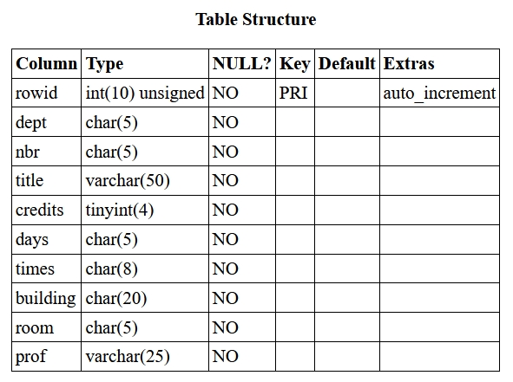
Table Structure

Slide 21
Table Structure
Put the query results into an HTML table
While going through the query results, create an array, called $cols, with the names of all the columns. We will need it for later.

Slide 22
Table Contents
1) Construct a query to select all rows and all columns from the table.
2) Execute the query
3) Process the query results by putting each row into an HTML table
4) On the top line of the HTML table, put the names of all the columns in BOLD

Slide 23
Column Sorting
Put a dropdown with the names of all the columns between the Table Structure and Table Contents
Use the selection from the dropdown to modify the query used for the Table Contents ORDER BY clause.

Slide 24
Homework
1) Review the programs we wrote today.
2) If you need help understanding them, email me and we can set up a Zoom meeting.
October 18th - Midterm Exam
Coding example like we did today (but simpler)
First half of class is a review, then break, then exam.

Slide 25
Week 5 - Summary
Dynamic websites create on demand webpages using data from databases.
PHP and MySQL provide a coding environment to easily manipulate database tables.
PHP arrays provide powerful function to PHP scripts.
You can create databases, tables and import data with phpMyAdmin.

