Slide 1

<Coding>
Best Practices & Tips
Nick Thesing
Matthijs Molhoek

Slide 2
What to expect
Javascript
HTML / CSS
Why you don’t need jQuery! (its slow)
Nick Thesing
Matthijs Molhoek

Slide 3
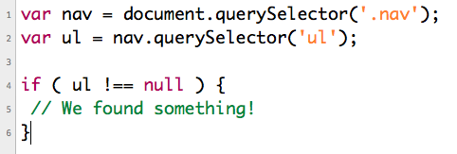


Javascript & jQuery
jQuery .find() vs …
#1:
#2:
Nick Thesing
Matthijs Molhoek

Slide 4
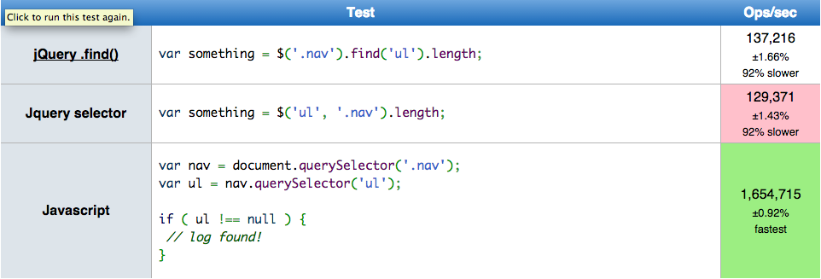
Javascript
jQuery .find() vs …
http://jsperf.com
Nick Thesing
Matthijs Molhoek

Slide 5
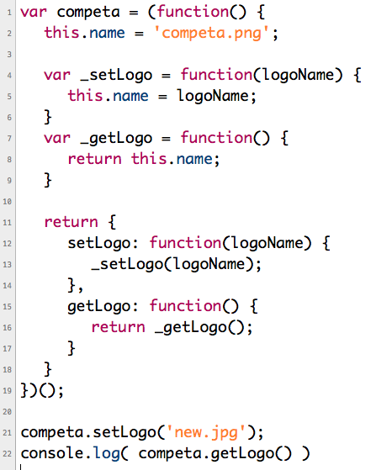
Javascript private & public
Nick Thesing
Matthijs Molhoek

Slide 6
2015!!!!!!!
Lot of new scripts/plugins/libraries coming in 2015
AngularJS 2.0?
MeteorJS
http://jsperf.com
Nick Thesing
Matthijs Molhoek

